Slide 1
QUALITY INFRASTRUCTURE & QUALITY POLICY DEVELOPMENT
EVENT: BRAZIL'S STRATEGY FOR QUALITY INFRASTRUCTURE:A POLICY UNDER DEVELOPMENT
Mr. Alejandro Rivera Rojas, Industrial Development Officer
10 August 2023

Slide 2
Outline
UNIDO’s Approach to Quality Infrastructure
  Expertise and work on standards and quality
  Enabling functions of QI
  Quality along the Value Chain
  Strategic partnerships
  UNIDO tools supporting policy implementation
UNIDO’s Approach to Quality Policy Development
  Quality Policy trilogy
  QP development
Quality Policy Action Plans
  Elements of the QP and implementation plan and strategy
  UNIDO’s action for NQIP implementation

Slide 3
1. UNIDO’s APPROACH TO QUALITY INFRASTRUCTURE

Slide 4
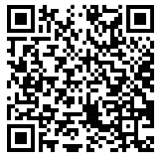
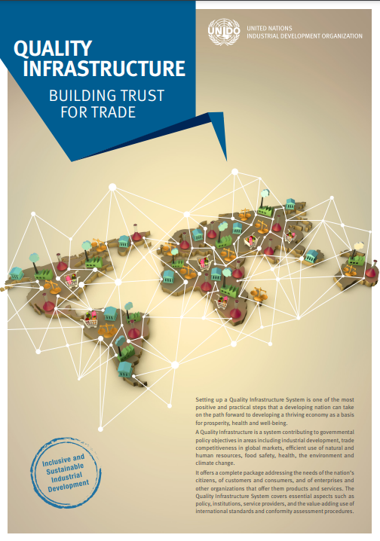



UNIDO’s work on Standards & Quality
UNIDO’s systemic approach to standards & quality
UNIDO’s service module on standards & quality
UNIDO’s unique value added
UNIDO tools & methodologies

Slide 5
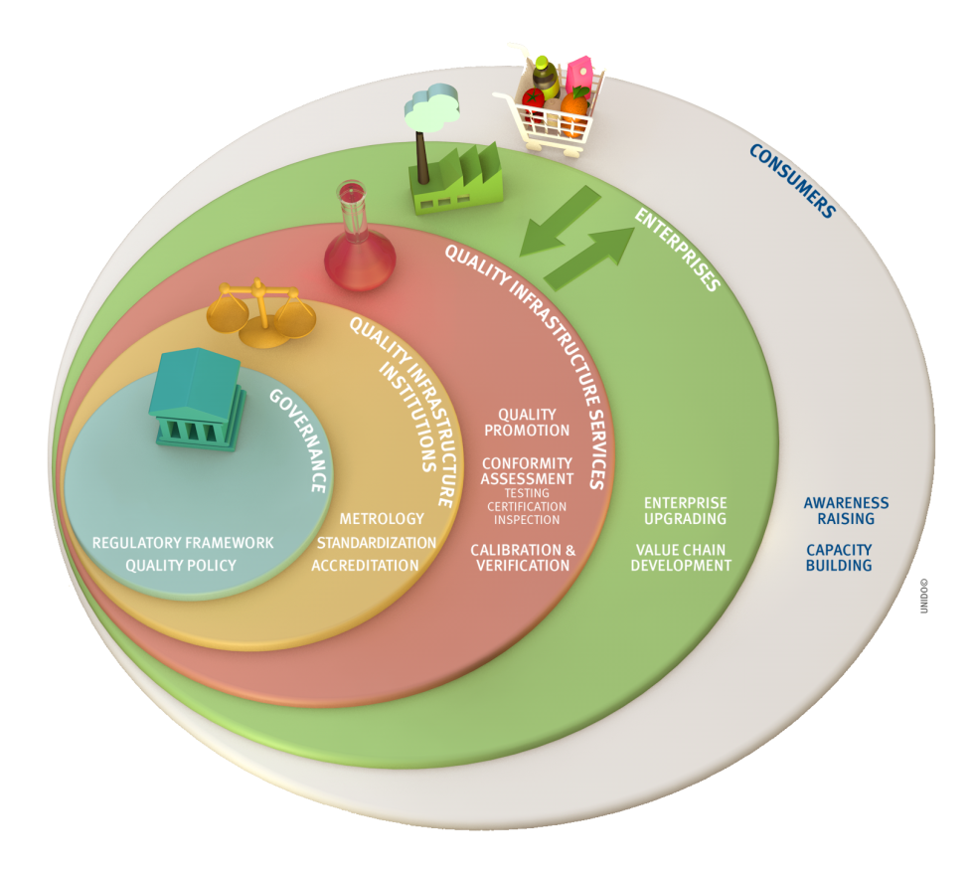

UNIDO QI approach
STANDARDS AND QUALITY FOR MARKET ACCESS
FOLLOWING A SYSTEMIC APPROACH TO QI DEVELOPMENT
DRIVEN BY PRIVATE SECTOR NEEDS

Slide 6


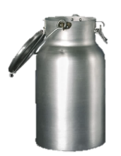
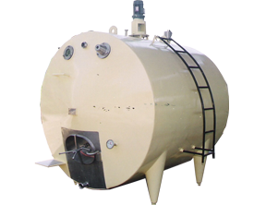


Quality along the Value Chain
Inputs
Production
Transport
Processing
Packaging
Market
Standardization
Supply-side
The quality infrastructure system is strengthened to provide globally recognized conformity assessment services (standardization, inspection, certification and testing)
  Targeted value-chain interventions improve the quality and export competitiveness of enterprises by complying with international standards.
Inspection & Certification
Testing (Laboratories)
Demand-side

Slide 7
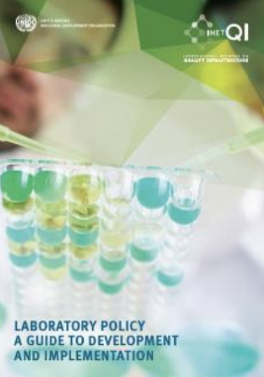


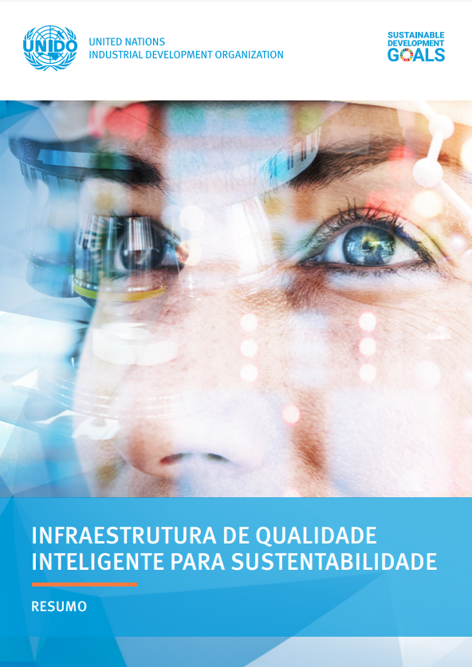

UNIDO tools supporting policy implementation
Category | Target Audience | Tools & Methodologies
QI Observatory (macro- level) | Policy makers | Quality Infrastructure Development Index
 |  | Standards Compliance Analytics
 |  | Quality Policy Programme
 |  | Trade Capacity Building Resource Guide (who is who in providing QI-related TC)
 |  | Laboratory Policy guidelines for development and Implementation
QI Assessment (meso-level) | QI Institutions and CABs | Laboratory Network
 |  | Quality Infrastructure for Trade Facilitation Toolkit
Quality Roadmap (micro –level) | Enterprises and consumers | Quality along the Value Chain Methodology
 |  | Quality Management (A Roadmap to Quality)
 |  | SME upgrading
 |  | Culture for Quality
CAPACITY BUILDING
PT version

Slide 8

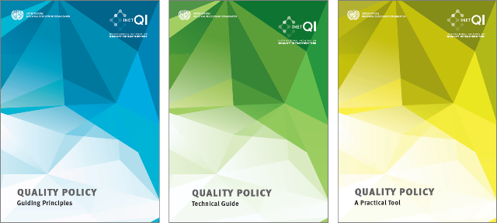

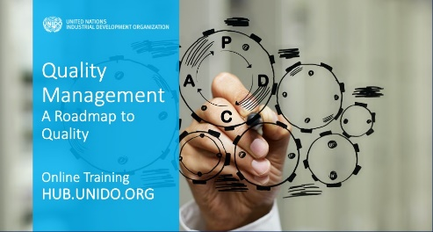


UNIDO tools supporting policy implementation
Online Trainings
Quality Infrastructure and Trade
Quality Policy
Quality Management
Good Governance in QI
Innovation Management
392
Good Standardization Practice (ISO)
ONLINE RESOURCES (PUBLICATIONS)

Slide 9



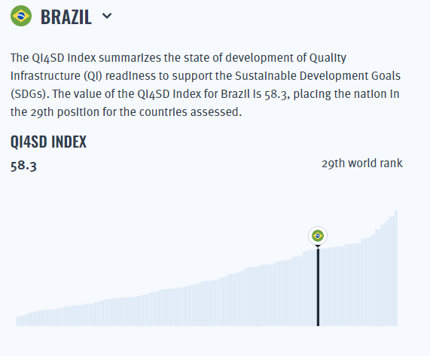
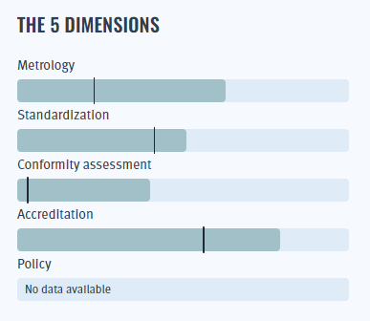
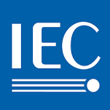



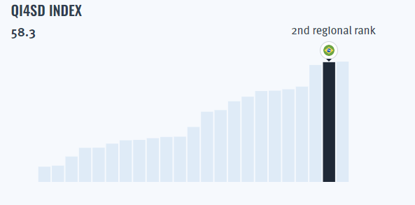
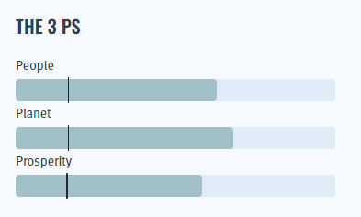



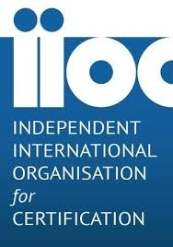
QI for Sustainable Development Index (QI4SD)
QI4SD INDEX website
Summarizes the overall state of development of a country’s and/or region’s QI readiness to support the SDGs.
Index composed by 36 indicators and made out of 5 dimensions: metrology, standardization, conformity assessment, accreditation and policy.
Related to the 3Ps of the SDGs: People, Planet and Prosperity
Data and composite results available for 137 countries worldwide.
Data that supports policy processes and national implementation plans for achieving the SDGs
Available here

Slide 10
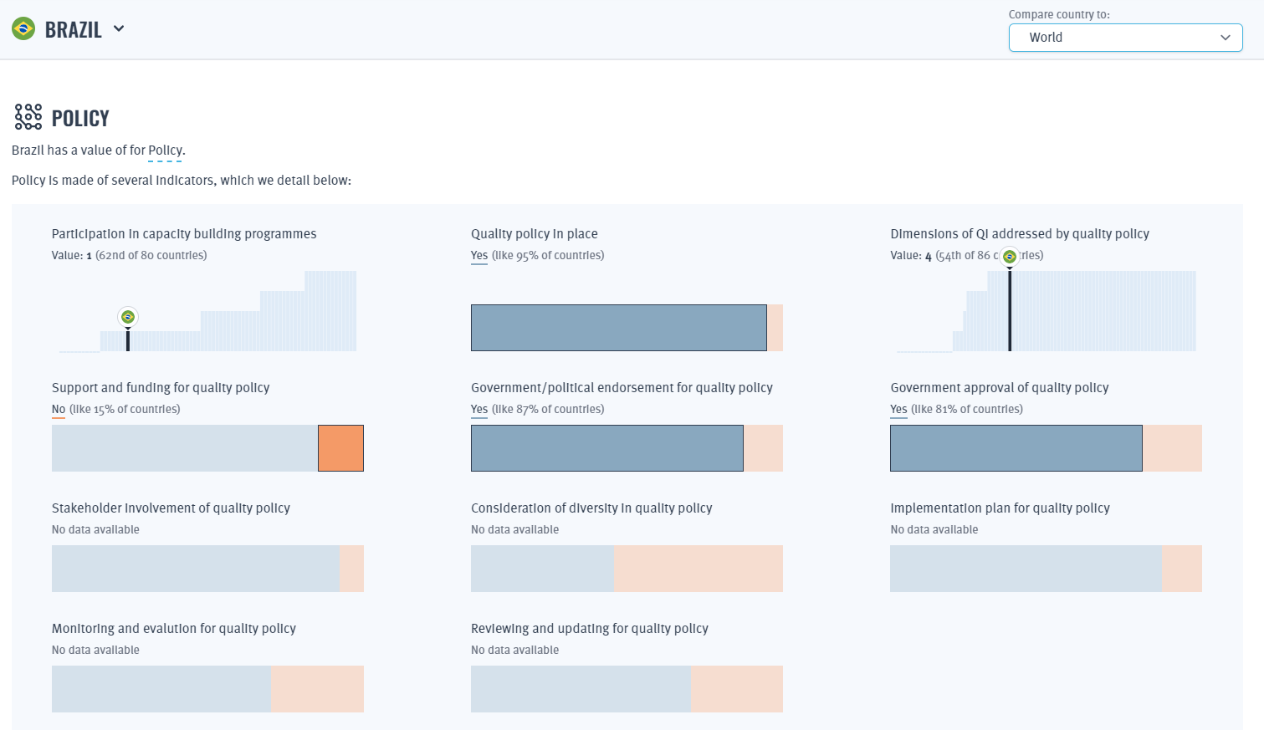
QI for Sustainable Development Index (QI4SD)

Slide 11

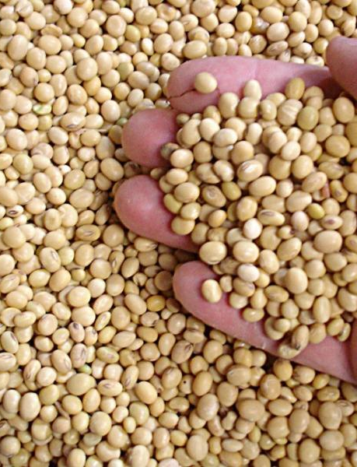
Standards Compliance Analytics
Country profile: Brazil
Frequency of Reasons for Rejections (%) for Food & Feed HS1-23 Brazilian exports by market in 2020
EXPLORE global trends in standards compliance, challenges and exporting countries’ global performance​
COMPARE neighbours, rivals or partners’ performance in different markets, products, specific compliance challenges
ASSESS exporting countries performance in specific markets, their compliance challenges in specific products
Informs policy development and technical assistance to navigate and focus efforts in addressing compliance issues.
STANDARDS COMPLIANCE ANALYTICS
BRAZIL
Website available here

Slide 12

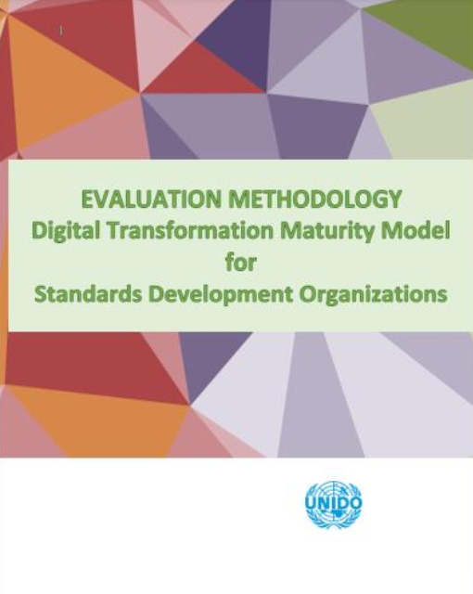


SMART QI
What is Smart QI and how will it affect the future of industrialization? A collaborative effort is required to ensure that the digital transformation of QI serves a bigger cause, thereby contributing to the sustainability paradigm.
Available online
Summary available in Portuguese
Global discussion on Smart QI
UNIDO, ISO, IAF, and TIC Council
Video recording
ES (coming up)
EN

Slide 13
2. UNIDO’S APPROACH TO QUALITY POLICY DEVELOPMENT

Slide 14
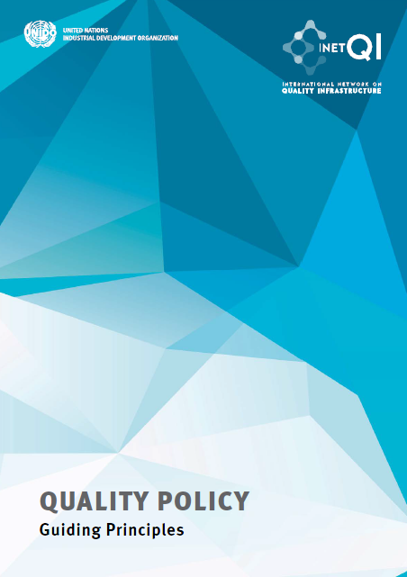
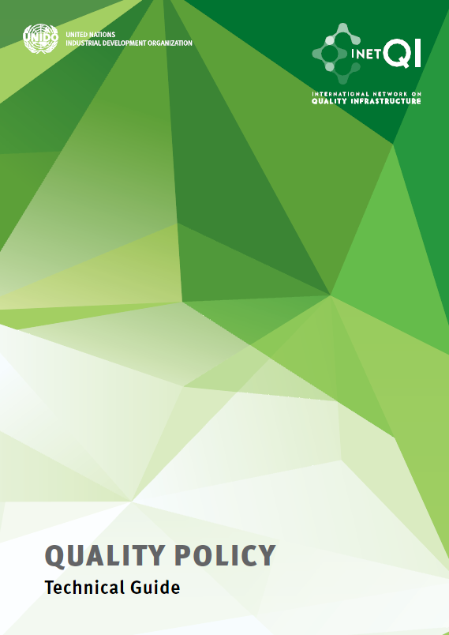
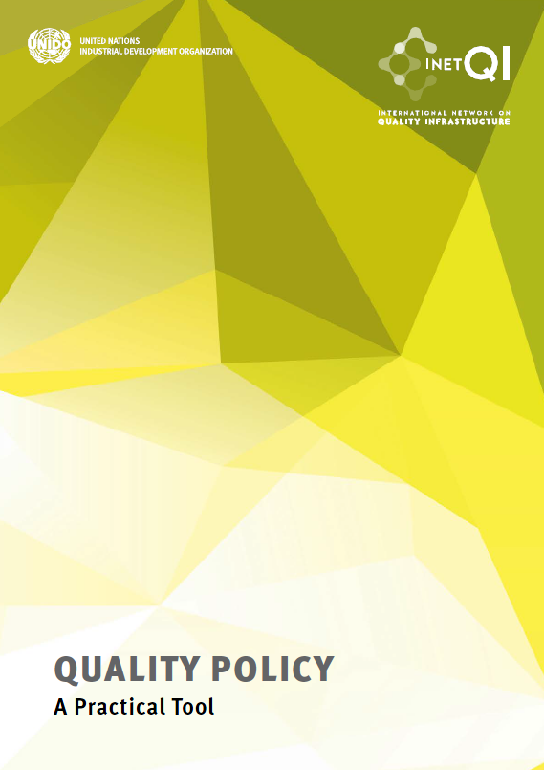
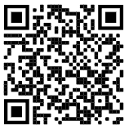

Quality Policy Trilogy
OBJECTIVE
To help stakeholders to develop a quality policy and a robust quality infrastructure to promote national,
regional and international trade, environmental sustainability and societal wellbeing.
Normative
Principles
Guide to
TC
Based on
Research
Convening
Partners

Slide 15
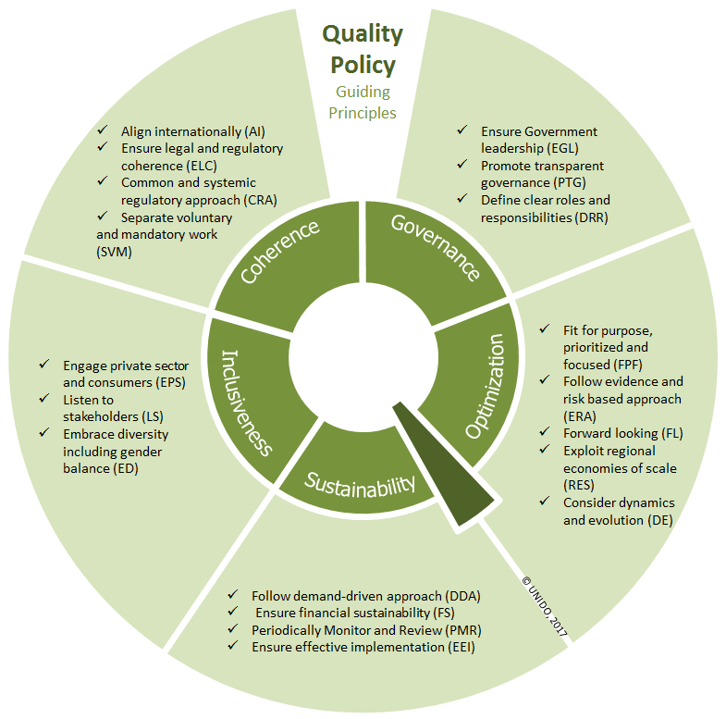
Quality Policy: Guiding principles
Coherence
Governance
Inclusiveness
Sustainability
Optimization

Slide 16
Quality Policy: Technical Guide
WHY? The guide explains how quality policy and quality infrastructure support effective trade.
WHAT? It lists all the main elements of a quality policy: vision, goals, objectives, outcomes and measures; and stresses government’s commitment as a prerequisite for success.
WHERE? The guide highlights the need for national, regional and international contextualization and can be used for the development of national and regional quality policies.
WHO? All stakeholders, including government, private sector, non-governmental organizations, civil society, international development partners and media should participate in quality policy development.
HOW? By presenting various elements of a quality policy, the Guide offers policymakers “building blocks” and clarifies the available options for quality policy and quality infrastructure development.

Slide 17

Quality Policy: Practical Tool
Detailed Guidance in every Step
Intended Outcome​
Why?​
Who?​
What and How?​
Challenges and mitigation measures
Case Stories
Best practices from around the world
+
Glossary of Terms
+
Examples
+
Templates

Slide 18
Step-by-step Tool for NQP Development
1 Do the groundwork
2 Conduct Strategic Planning
3 Prepare draft NQP and build consensus
4 Obtain approval
5 Deploy the NQP
Make sure there is a clear sense of ownership and coordination from top levels of government
Define priorities and allocate resources
Provide for transparent consensus building and assure coherence
Incorporate as part of national policy
Ensure effective and sustainable implementation

Slide 19
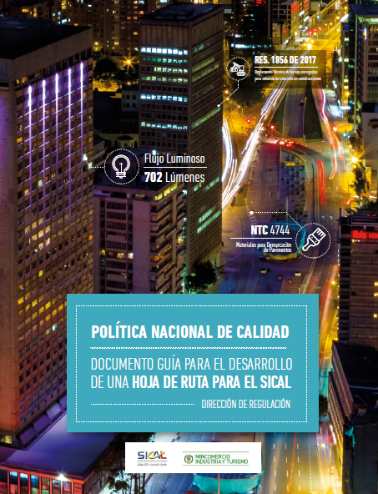
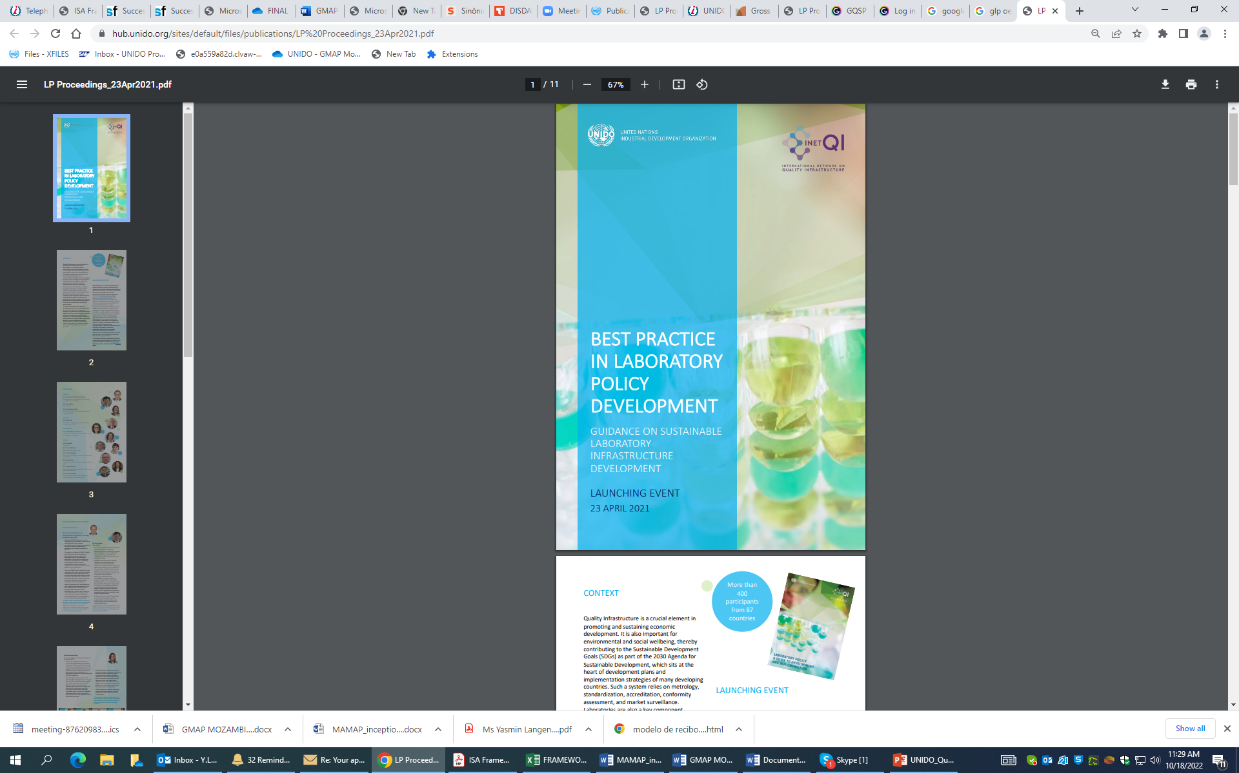
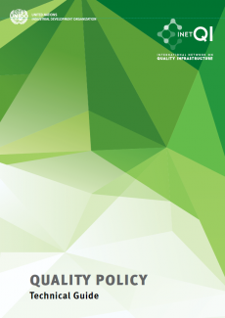
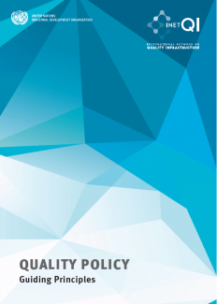
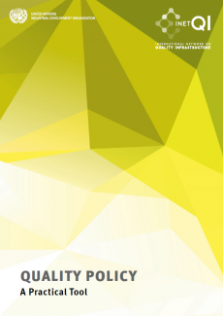
Development of a Roadmap for the National Quality Infrastructure System & Implementation of the National Laboratory Policy in Colombia
Contributions in the construction of Colombia’s Quality Policy through the Safe+ Programme
Results
Strengthening of the National Quality Infrastructure with a focus on cosmetics with natural ingredients
Adoption of good international practices
Implementation of OECD GLP in Colombia
Design of the National Laboratory Policy

Slide 20
3. QUALITY POLICY ACTION PLANS

Slide 21
Elements of the QP and implementation Plan and strategy
POLICY
Policy Vision
Policy Objective
Policy Measure
Policy Outcome
Implementation Institution
Activity
Timeline
Budget
Performance indicators
IMPLEMENTATION PLAN

Slide 22
UNIDO’s actions for NQP implementation
  Contribution to the Strategy and Action Plans formulation
Holistic and inclusive approach, involving QI experts, relevant ministries, NQI institutions, associations (producers/consumers) and other stakeholders
STRATEGY ACTION PLAN
per QI pillar & cross-cutting issues
01. Data Collection & Questionnaires
02. Workshops with relevant
stakeholders
03. Preparation of Strategy and Action Plans drafts
04. National Validation workshop
Objectives
Activities & Outcomes
Timeline & Responsibilities
Indicative budget
Specific activities and expected outcomes for each of the Quality Policy objectives and measures ensure the realization of the Quality Policy vision

Slide 23




UNIDO, the ideal partner to accelerate the modernization of the Brazilian QI system
Brazil’s wish to strengthen its QI system and modernize its regulatory framework
UNIDO, with its long-standing expertise in QI policy development, is ready to contribute to Brazil’s objectives

Slide 24

THANK YOU!
Alejandro Rivera Rojas A.Rivera-Rojas@unido.org
UNIDO´s team
Clovis Zapata, National Programme Officer, UNIDO Brazil
Yasmin Langendoerfer Atun, Project Administrator, UNIDO HQ
Rebeca Gallardo Gomez, Associate Expert, UNIDO HQ
Technical Experts
Nigel Croft, Expert on Quality Infrastructure and Quality Management
Nelson Al Assal Filho, Expert on Standardization and Digital Transformation
Marcos Aurélio Lima de Oliveira, Expert on Metrology

