Slide 1




2nd Master Class IWT
Session 4B - IWT Waste Management, examples from the Netherlands and China
29 November 2010, Brasilia (Brasil)
Jarl Schoemaker (NEA)

Slide 2
Content
Introduction
Movie 1: Waste management in inland navigation 1
Movie 2: European Convention on IWT Waste 2
Institutional setting and current practice in China
Blueprint / road map:
    Development concept
    Payment scheme
    Waste collection infrastructure
    Treatment options
    Regulations and enforcement

Slide 3
Introduction
IWT is priority in Chinese development policy
Increasing transport volumes will lead to more strain on the environment
Implementation of efficient and effective IWT waste management plan is imperative
Blueprint / road map developed for Three Gorges area and Hunan Province

Slide 4
IWT Waste types
Types of IWT waste:
Waste containing grease and oil (e.g. Bilge water)
Cargo-related waste
All other waste (e.g. Garbage, sanitary waste water)
Each type requires decisions on:
Collection system and infrastructure
Treatment location, type and level
Payment scheme (e.g. Direct, indirect)
Notes:
Bilge water: Does one whish to process on board or does one want to reduce on board of the vessel.

Slide 5
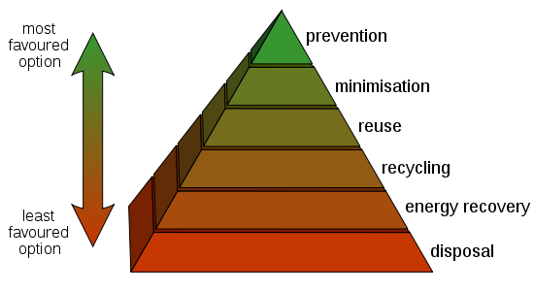
Principles of waste management
Notes:
In this slide the principles of waste management are shown. The prevention of waste is the most preferable option.

Slide 6
Movie 1: Waste management in inland navigation

Slide 7
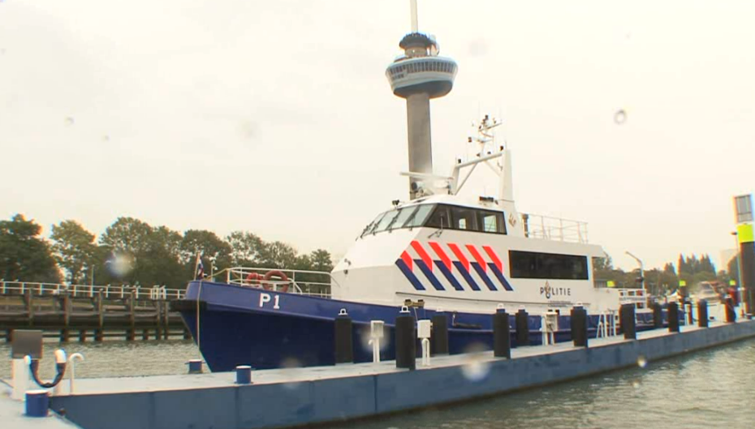
Movie 2: European Convention on IWT Waste 2

Slide 8
International policies and regulations
The MARPOL Convention on maritime pollution; MARPOL
The Convention concerning the collection, storage, and discharging of waste from ships navigating along the Rhine and other inland waters (CDNI convention);
The CEVNI-code: the framework for national legislation for navigation in Europe;
The Recommendations of the Danube Commission.

Slide 9
Development concept

Slide 10
Institutional setting

Slide 11
Comparison Chinese vs international regulations
Conclusions:
  Legal framework in China is in line with the international requirements
  Sometimes China exceeds the minimum prescribed standards.
Recommendations on improvement:
  Make the responsibilities of all involved competent authorities clear and well known;
  Share information between authorities regarding waste collection & enforcement;
  Make on board processing vs. on shore processing should a free choice;
  Consider tightening standards for on board processing of bilge water

Slide 12
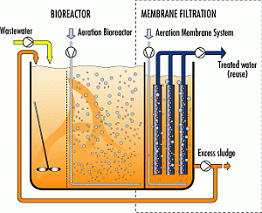
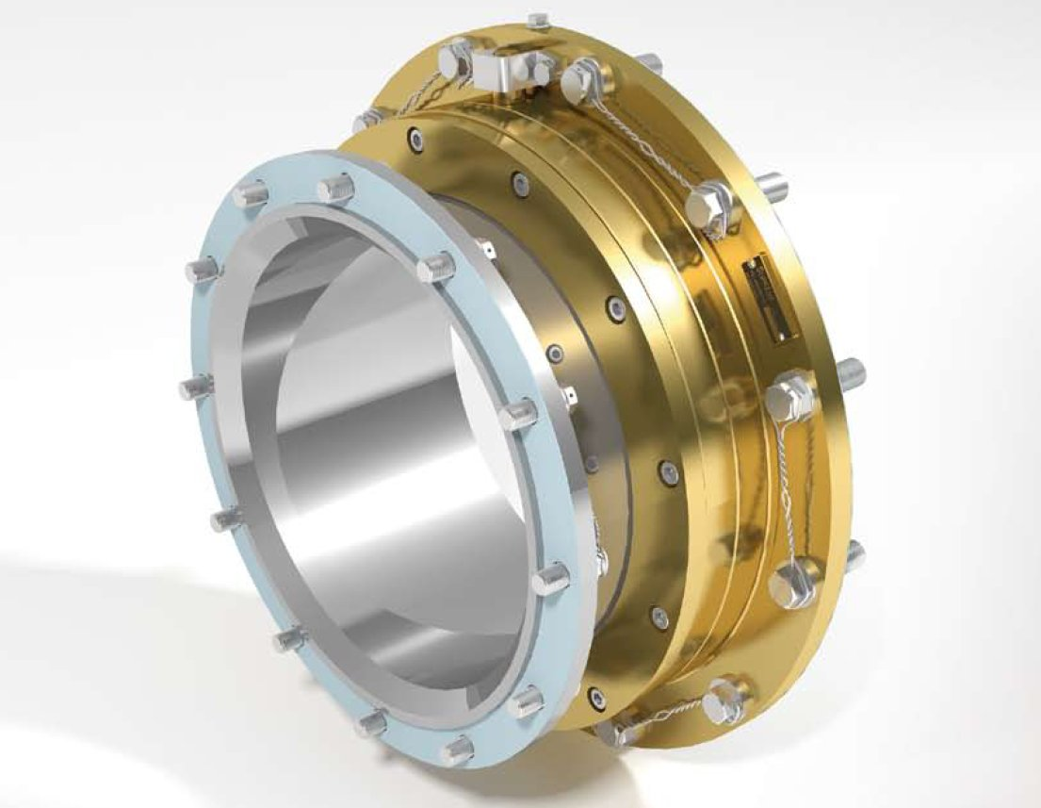
Technologies on vessels
On board biological waste water treatment
Bilge water reduction
Notes:
On board of inland waterway vessels various types of technologies can be used in order for waste processing and for waste reduction.

Slide 13
Payment scheme
“Polluter” pays (Y/N?)
Costs could stimulate non compliance (dumping)
How to improve compliance?
Indirect payment
- Subscription based
- Example in the Netherlands; quantities
- Surcharge(s) (e.g. Fuel surcharge)
Pro’s & Con’s

Slide 14
Payment scheme
Advantages | Disadvantages
Simple scheme - Limited to zero overhead costs | High threshold for proper waste disposal, which can cause non-compliance
Reduction of the generated amount of waste saves money
Polluter pays
Notes:
Even when one has an excellent infrastructure for waste. It can only work if key decisions are made regarding the payment model. Inland waterway ships are different.

Slide 15
Payment scheme
Advantages | Disadvantages
Stimulates proper waste disposal | Overhead costs
Polluter pays principle | No stimulus to reduce the generated amount of waste
More data available | Polluter pays principle is not optimized
Notes:
Even when one has an excellent infrastructure for waste. It can only work if key decisions are made regarding the payment model. Inland waterway ships are different.

Slide 16
Payment scheme
Advantages | Disadvantages
Stimulates proper waste disposal | Overhead costs
Polluter pays principle is optimized | Implementation is more complex
Stimulus to reduce the generated amount of waste
Notes:
Even when one has an excellent infrastructure for waste. It can only work if key decisions are made regarding the payment model. Inland waterway ships are different.

Slide 17
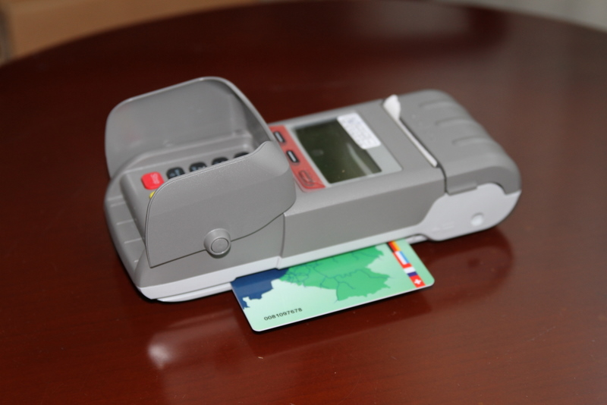
Payment scheme
Demo electronic payment system
CDNI Treaty CDNI

Slide 18
Monitoring and Information Sharing
Data is needed:
  Monitoring the capacity of the infrastructure
  Cost price indication
  Possibility for trend analysis
  Efficient & Effective Enforcement
    Vessel state control (database)
    Lower enforcement burden
    Cost reduction for operators and enforcers
Notes:
V

Slide 19
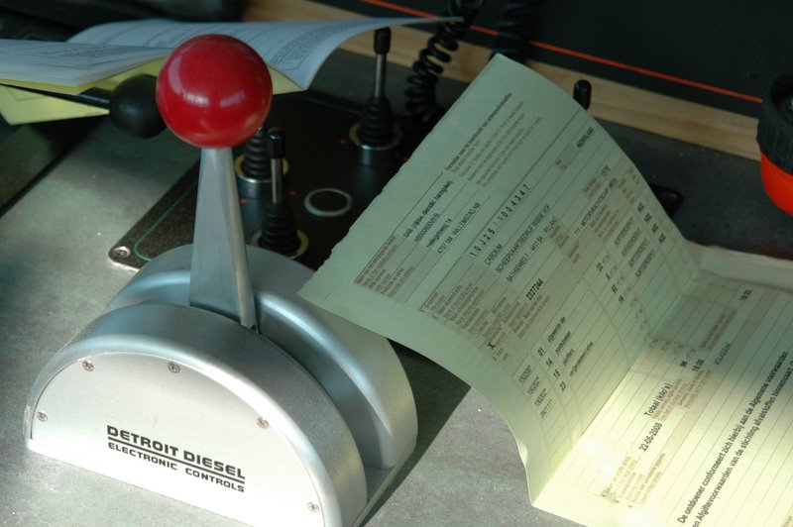
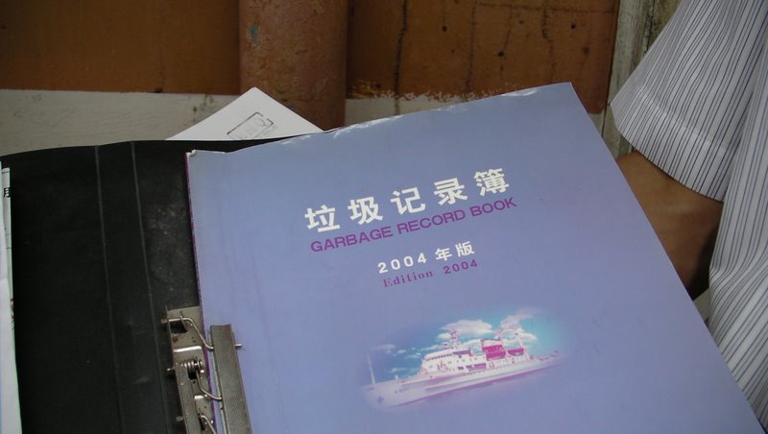
Monitoring and Information Sharing
Notes:
In the Netherlands and in China registration takes place of waste which is discharged.

Slide 20
Collection and treatment infrastructure
Collection
On shore: network density of collection points
With bilge boat
With trucks
Treatment
On board treatment
On shore treatment

Slide 21
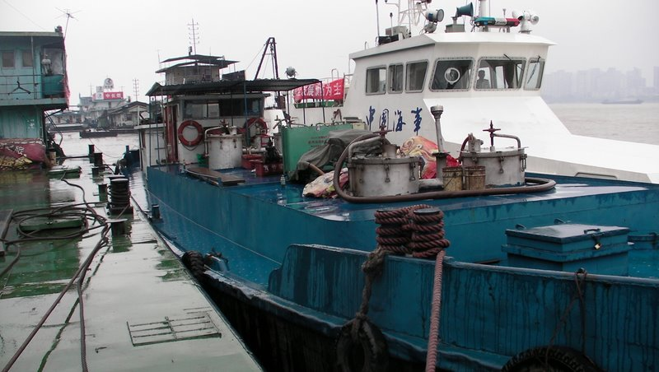
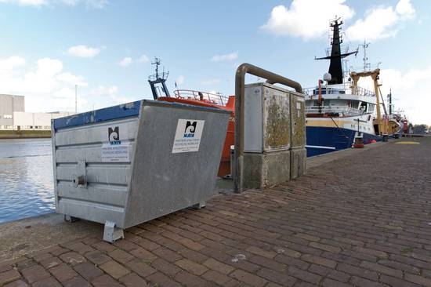
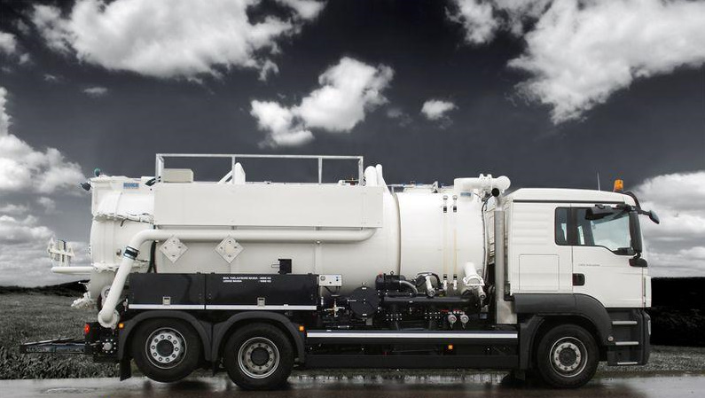
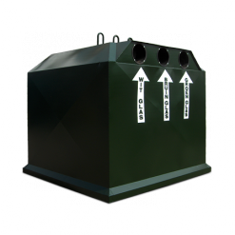
Collection and treatment infrastructure
Choices:
Collection
On shore: network density of collection points
With collection vessels
With collection trucks
Treatment
On board treatment
On shore treatment
  In the ports
  Elsewhere, e.g. cement factories
Notes:
Hoog kalorisch: energy containing waste like used oil, contaminated plastics

Slide 22
Enforcement
  Knowledgeable inspectors
  Vessel state control (database):
    Standardized inspection form – digital
    Inspection results are to be shared among all competent authorities
  Data analysis to help identify the priorities for enforcement
  Lower enforcement burden
  Cost reduction for operators and enforcers

Slide 23
Enforcement
Efficient & Effective Enforcement
- Vessel state control
Questions
In what do the various MSA offices share information regarding the inspection results ?
Does MSA share information with competent authorities for the waste reception facilities?

Slide 24
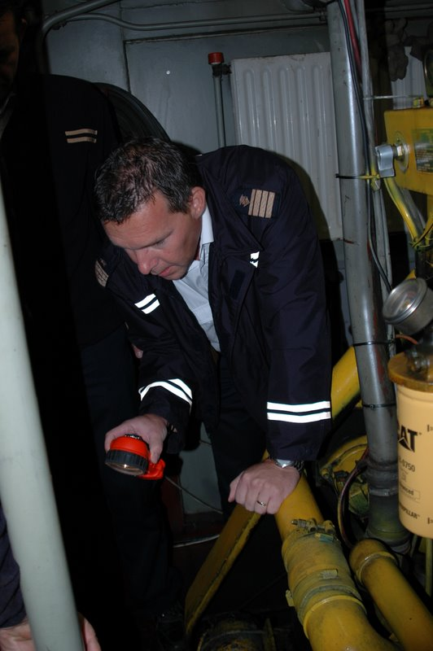
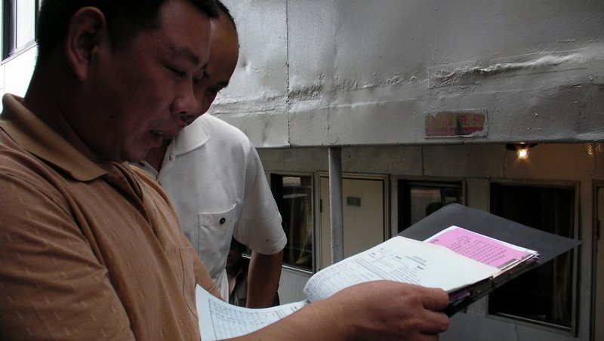
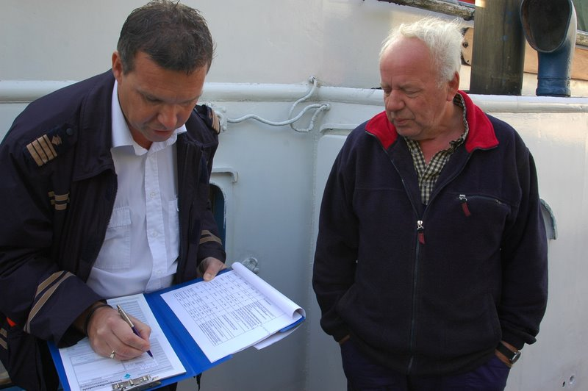
Enforcement

Slide 25
Waste forecast

Slide 26
Waste forecast
Estimating collection volumes
Sanitary waste water and garbage :
  The number of crew members on board;
  The number of passengers on board;
  Time per year that a ship is navigating with and without passengers (average number of navigation hours per day, navigation days per year);
  For passenger ships: the time passengers stay on board (short trips vs. trips of more than one day).

Slide 27
Waste forecast
Estimating sanitary waste amounts on vessels in the Netherlands
Cargo vessels:
Grey water: 90 liters per day per person
Black water: 40 liters per day per person
Passenger vessels:
Day trip vessels: 35 liters per day per passenger
Hotel vessels: 70 liters per day per passenger
Garbage:
0.6 to 1.1 kilogram per day per person

Slide 28
Prevention: Green award
  Certifies vessels which are above average standards on environmental performance and safety
  Takes safety, quality, technical and human factors into consideration
  A vessel with a Green Award certificate has various financial and non financial advantages:
    Lower port dues
    Lower bank loan rates
  Motivated crew
  Image
  Preference of shippers “cargo owners”

