Slide 1
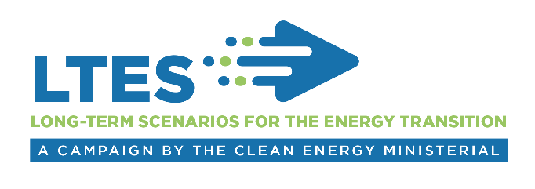
Setting the scene:
Long-term energy scenarios for the clean energy transition
Asami Miketa, Senior Programme Officer
IRENA Innovation Technology Center
Long-term Scenarios for the Clean Energy Transition in Latin America
25 February, 2019, Brasilia

Slide 2
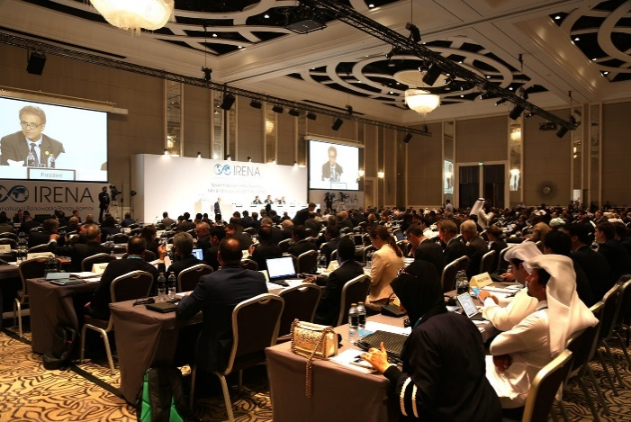
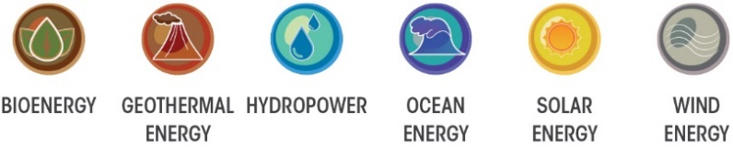
IRENA
Inter-governmental organization established in 2011.
162 Members
26 States in accession
Mandate: assist countries to accelerate renewable energy deployment
IRENA Assembly
Platforms for consultation and cooperation among members
Data and analysis
Tools and methodologies
Engagement and outreach
2
Notes:
IRENA, International Renewable Energy Agency, is an inter-governmental organisation established in 2011, headquartered in Abu Dhabi of UAE. The IRENA Innovation and Technology Centre is based in Bonn, Germany. Our mandate is to assist our Members, with the widespread and increased adoption and sustainable use of all forms of renewable energy.
Over the past 7 years since the Agency was established, the countries that have joined the Agency have grown quickly. Now we have 158 members and we are well on our way to global coverage.
China joined IRENA in 2014.
Our mandate is to help countries with accelerated renewable energy deployment and with energy transition based on renewable energy and energy efficiency. We have been helping the countries with our knowledge, advice, and facilitating exchange of best practice.
Assembly once a year and council twice a year are key platforms to facilitate consultations and cooperation among Members.
The agency’s key deliverables include
provision of data and analysis on the topic of renewable energy and more broadly on clean energy transition,
Development and dissemination of tools and methodologies to support decision making and to facilitate project development,
and engagement and outreach through regional and bilateral cooperation framework.

Slide 3
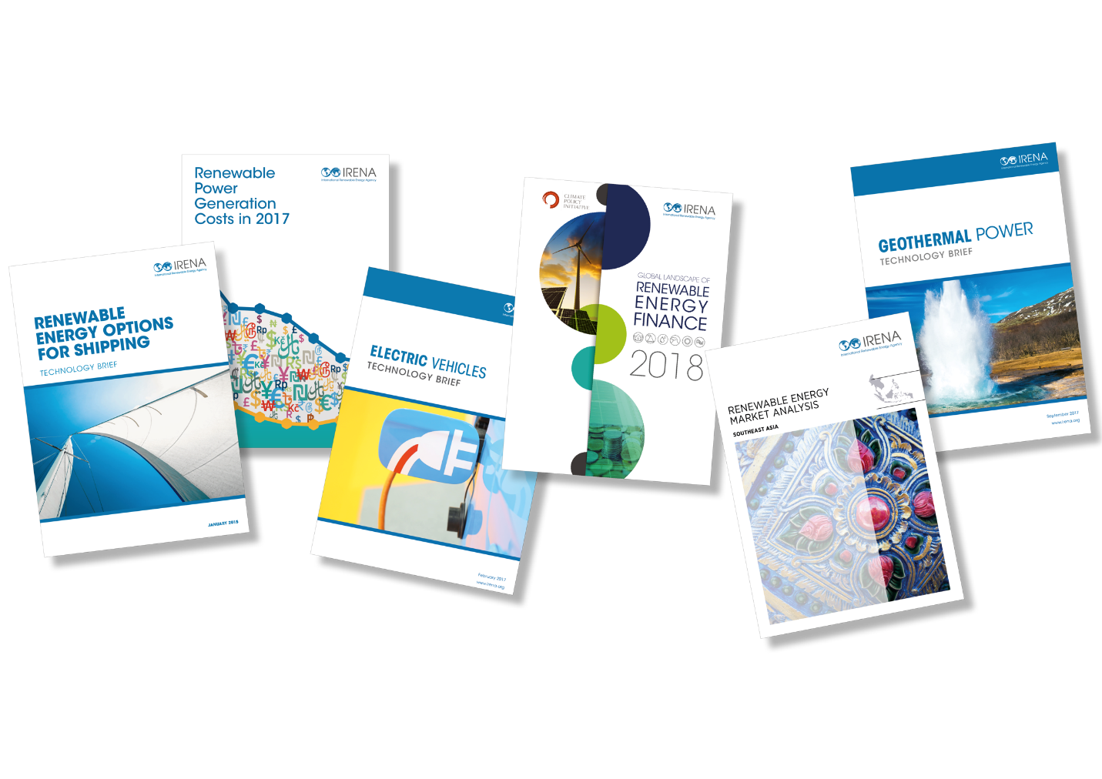
IRENA activities
Data and analysis
Renewable technology costs and performance
Renewable technology innovation and markets
Renewable energy socio-economic benefits
Renewable energy policies
Renewable statistics and resource assessment
Global, regional, and country scenarios
Engagement and outreach
Assembly and council
Regional corridor and action plans
Renewable readiness assessment
Technical assistance and long-term planning
Tools and methodologies
Renewable energy project facilitation
Modelling tools and scenarios – guidelines and disseminations
3
Notes:
IRENA, International Renewable Energy Agency, is an inter-governmental organisation established in 2011, headquartered in Abu Dhabi of UAE. The IRENA Innovation and Technology Centre is based in Bonn, Germany. Our mandate is to assist our Members, with the widespread and increased adoption and sustainable use of all forms of renewable energy.
Over the past 7 years since the Agency was established, the countries that have joined the Agency have grown quickly. Now we have 158 members and we are well on our way to global coverage.
China joined IRENA in 2014.
Our mandate is to help countries with accelerated renewable energy deployment and with energy transition based on renewable energy and energy efficiency. We have been helping the countries with our knowledge, advice, and facilitating exchange of best practice.
Assembly once a year and council twice a year are key platforms to facilitate consultations and cooperation among Members.
The agency’s key deliverables include
provision of data and analysis on the topic of renewable energy and more broadly on clean energy transition,
Development and dissemination of tools and methodologies to support decision making and to facilitate project development,
and engagement and outreach through regional and bilateral cooperation framework.

Slide 4
IRENA’s work on Long-term Scenarios
Goal: Integrate renewables in the main stream of the energy planning
Use of scenarios for policy making
REmap transition scenarios to raise the RE ambition
Development of scenarios for clean energy transition
Addressing variable renewable in long-term planning
REmap framework for end-use sector assessment
Flexibility assessment
Building and enhancing capacity
Energy planning capacity building programme
Capacity building framework discussions

Slide 5

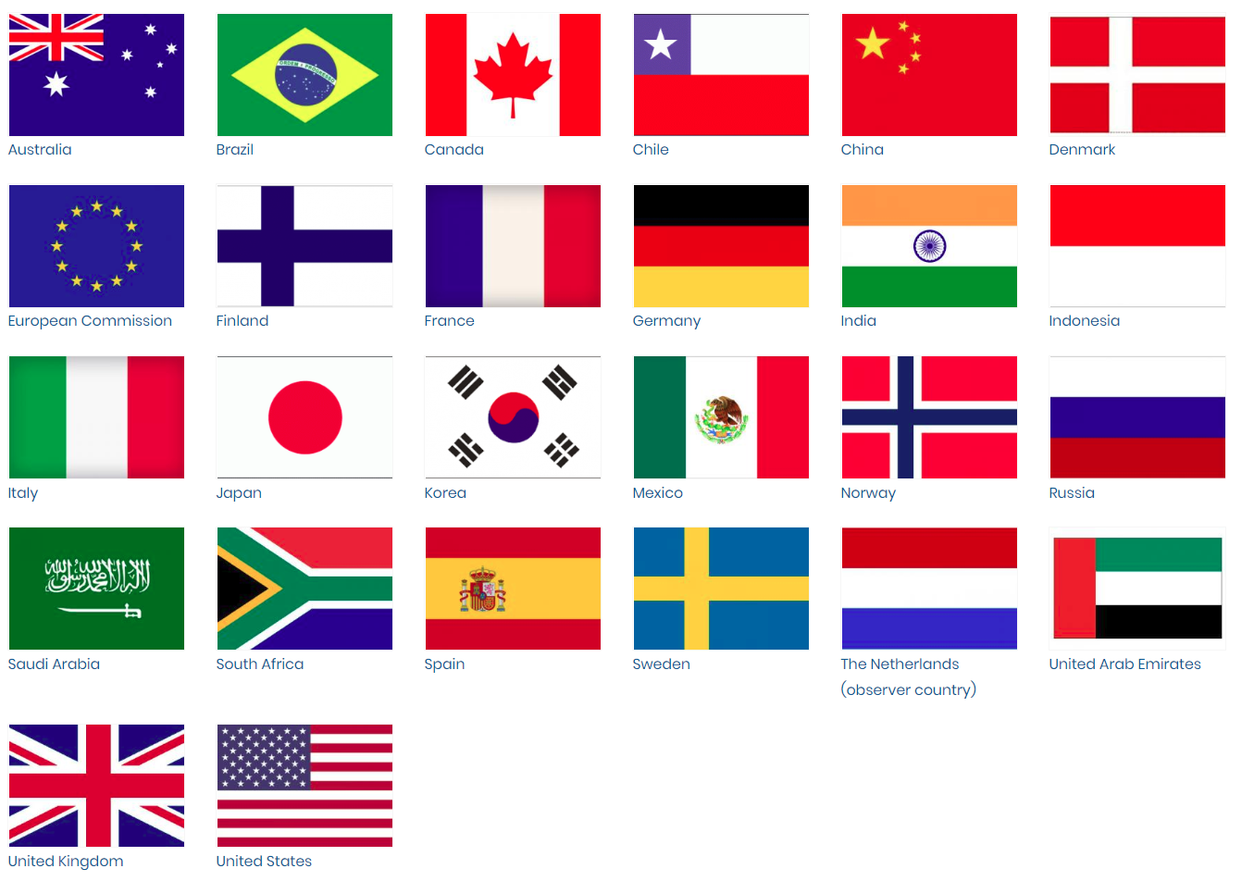
A campaign under the CEM
In 2018, Germany and Denmark proposed to launch a campaign to promote the wider adoption and improved use of long-term energy scenarios for clean energy transition to the members of Clean Energy Ministerial (CEM)
CEM: A partnership of 26 countries
Annual high-level Ministerial meeting
Time-bound campaigns to raise ambition or increase visibility of topics of potential impacts
5
5
Notes:
The campaign itself runs under the Clean Energy Ministerial.

Slide 6












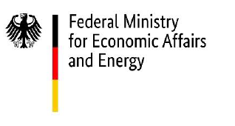





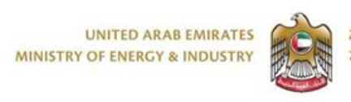

LTES Campaign
Long-term Energy Scenarios (LTES) for the Clean Energy Transition campaign was launched in 2018 May
11 Member countries
7 Technical partners
LTES Campaign is to be supplemented by IRENA’s global platform - Energy Transition Scenarios Network (ETS-Net) to be launched in April 2019 at the LTES International Forum in Berlin
6
6
Notes:
The campaign itself runs under the Clean Energy Ministerial.

Slide 7
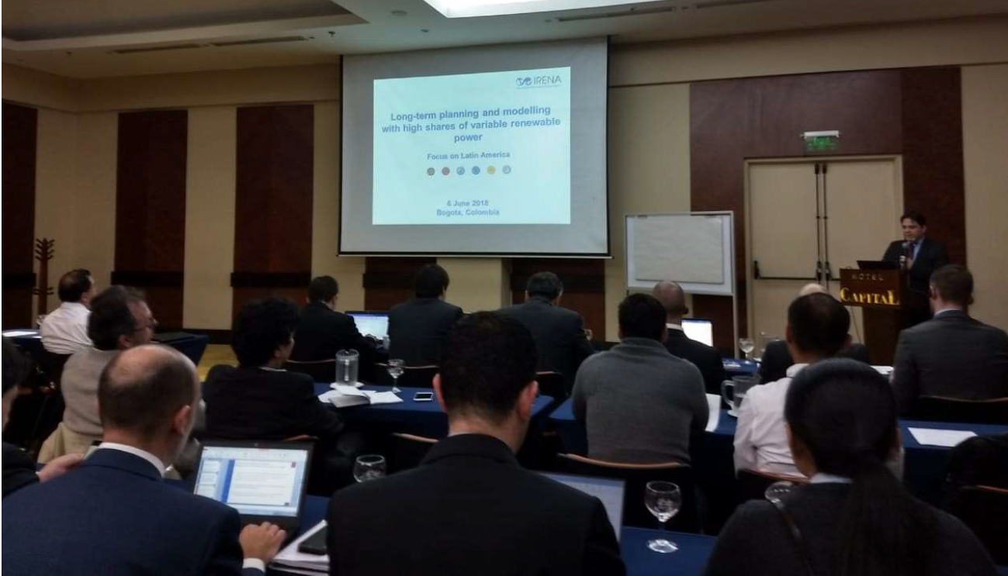
Regional context
CEPAL: Regional planners forum – exchange national plans and promote regional coordination
OLADE: REDLAC - data base with models, modelling assumptions and good practices’ available for energy planners in the region
IADB: Deep decarbonization pathways for Latin America
IRENA at the kick off meeting of CEPAL-led “Regional Planners Forum” in June 2018 in Bogota
7
7
Notes:
The campaign itself runs under the Clean Energy Ministerial.

Slide 8
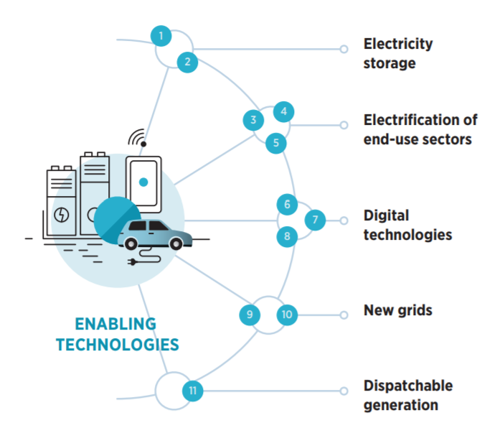




Why long-term energy scenarios?
Fundamental tool for policy making
  National policy making
  Global policy debates / public opinion
What is new?
  Global decarbonization (Paris Agreement)
  Massive technology innovation within and around the energy sector
Long-term visions for clean energy transition
  Avoiding risks of making poor, short-sighted decisions.
  Represent transformative changes of energy systems (e.g., VRE, disruptive innovations in end-use, digitalization, etc.)
Artificial intelligence
Blockchain
Platform business model
IoT
8
Notes:
Long-term energy scenarios are a fundamental tool for energy policy making. Many countries develop their country scenarios and use them as a basis for national policy making. International organizations, including IRENA, produce global scenarios to inform global policy debates. There are a number of technical institutions that produce various policy scenarios as a part of scientific exercise.
This approach is not new, it has been around for a long time. But what is new is that we have now a clear agreed mandate for global decarbinzation yet with massive technology innovation around energy transition, the future evolution of energy systems is uncertain than ever. And it is in this context, the role of long-term energy scenarios is becoming even more important as a tool to support making right decision to guide us though the clean energy transition under uncertainty.
A long-term vision is required to avoid risks of making poor, short-sighted decisions, e.g.:
Underestimating rapid renewable uptake, leading to stranded assets
Failing to utilize disruptive innovations
Long-term visions need to represent transformational changes, e.g.:
Very high shares of variable renewable energy in the power sector
Disruptive innovations in end-use sectors
Digitalization and its impacts
Countries with common interests in promoting better and wider use of long-term scenarios for clean energy transition, formed a group to initiate a campaign under clean energy ministerial.

Slide 9
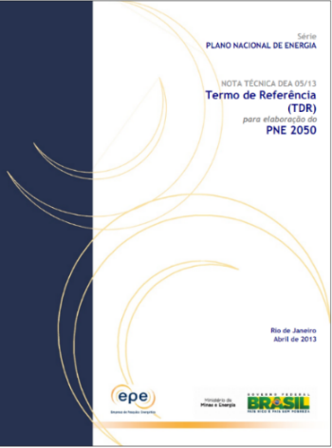
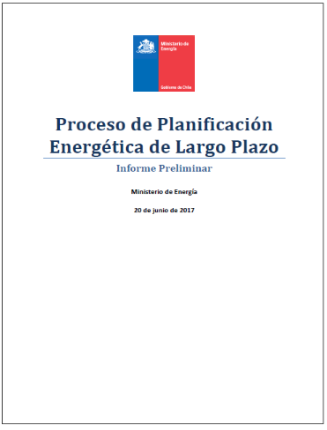
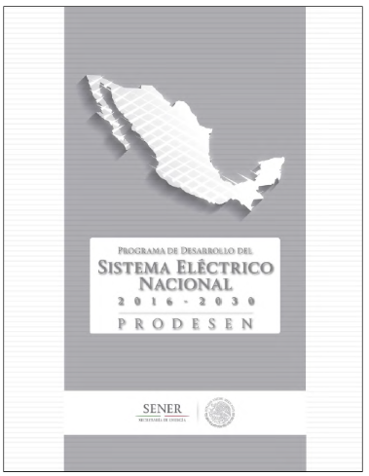

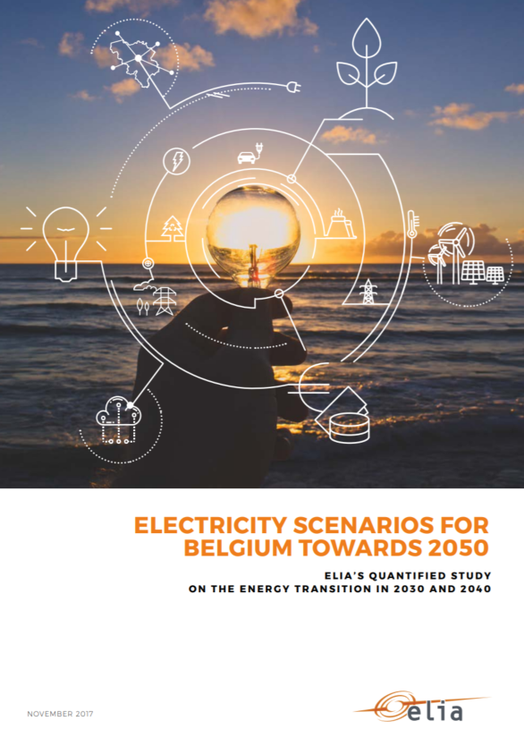
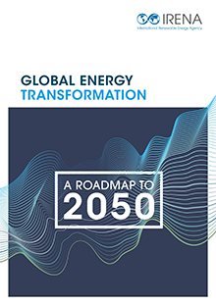

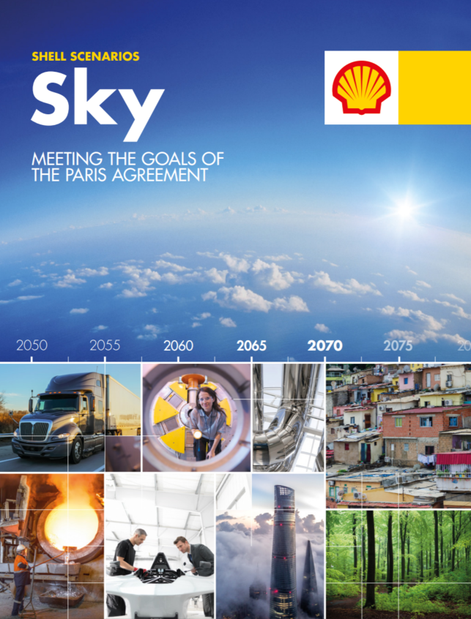
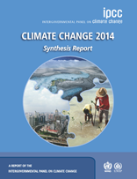
Types of scenarios
National focus
Government institutions
Private institutions
Brazil
Chile
Mexico
National Grid (UK)
Elia Grid (Belgium)
Global scenarios
IRENA REmap
IEA WEO
Shell
IPCC
Notes:
Examples for discussion
National:
- Brasil, Chile, Mexico: Long-term scenarios from dedicated planning offices
- UK & Belgium: TSO scenarios (National Grid’s annual Future Energy Scenarios in the UK, and Elia Grid electricity scenarios in Belgium)
Also to mention: Academic and NGO scenarios

Slide 10
Focus groups
“Use of scenarios” and “use of modelling tools” are considered as separate processes
Use of scenarios for clean energy policy making
Development of scenarios with modelling tools
Iterative
process
Government planning team
Policy makers
Decision makers
Civil society
Government modelling team
Academics and research community
International organizations
Private companies
Campaign
Target group
10
Notes:
Lead countries Germany and Denmark and 8 other countries are participating so far.

Slide 11
Three focus themes
Use of scenarios for policy making
Development of scenarios for clean energy transition
Approaches to capacity enhancement
Share experience in the use of energy scenarios for national and regional policy planning
Identify ways to make scenarios more relevant to policy and investment decisions
Showcase new tools & methods to address new, disruptive elements of the transition
Identify modelling gaps around e.g. end-use innovation, sector coupling, and variable renewable energy integration
Identify various institutional relationships between the use and development communities
Share experience in building capacity within your country (in-house vs out sourcing approaches for scenario development)
11
Notes:
There are three focused areas, somehow interlinked but perhaps involve slightly different partners.
The first one focused on use of scenarios for policy making. It is about how we can better use scenarios for policy making. It targets policy makers and planners, and aim to exchange the experiences in best practices in the use of scenarios for national and regional policy making. It also aims to discuss how to make the scenarios more relevant to the decision making in the private sector.
The second one is about development of scenarios for clean energy transition. The discussion under this theme may involve more technical discussion because scenarios are typically developed using tools and models. So here the target stakeholders would be modelers and planners both from the government sector as well as from technical institutions. We discuss the new disruptive elements of the transition of energy systems and how these elements can be addressed using modelling tools. In particular we plan to discuss how to improve modelling around end-use sectors, sector coupling, and variable renewable energy integration, which we feel that are not adequately captured in the current modelling practices.
The third one is about capacity building and enhancement on scenario planning in the government sector. We plan to discuss institutional aspects around the relationship between developer of energy scenarios and users of energy scenarios, and how countries have built and institutionalized scenario planning capacity within the government sector.
This includes sharing experience with building capacity in your own country.
Some countries are supporting to build planning capacity elsewhere, the discussion can include how the best practice can be shared with those who are less experienced

Slide 12
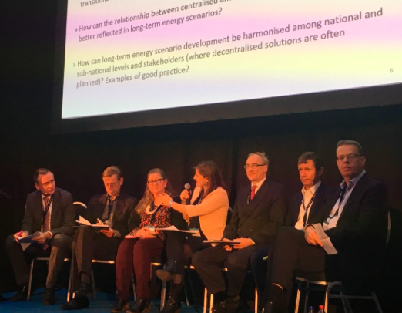
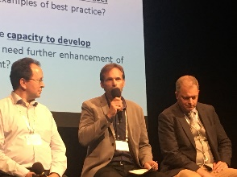
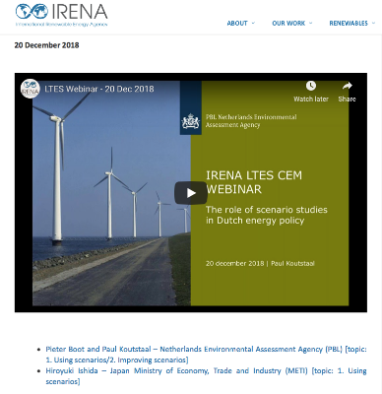
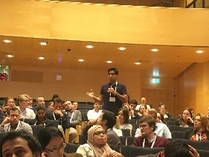
Activities
Dedicated campaign events
Brazil LTES Workshop – February 2019
Campaign Partner Forum – April 2019
CEM Ministerial Meeting – May 2019
Webinar series
Bi-weekly webinar series since November 2018
500+ Registrants
Campaign related events
8 workshops/events in energy conferences in 2018
Best Practice Report
Synthesizing over 100 topics discussed in the events
(2019-2020)
12
Notes:
Three types of activities are planned:
workshops dedicated to CEM campaign, focused on the best practice exchange among the partners, also to possibly to develop a proposal to enhance scenario planning capacity .
The second type is participation of partners to relevant events and to inform the campaign and to promote the use of scenario planning for clean energy transition
The third one is production of reports and recommendations, informed by events and also by IRENA’s analytical work.
Additionally: we launched a webinar series in which experts users and developers of models present the challenges and good practices in this regard.

Slide 13
Initial key insights
Mapping issues for energy scenario use and development
Mapped approx. 100 issues so far…
Use
Development
Capacity building
Exchange of experiences of CEM LTES campaign countries
New approaches
New tools
Civil society
Policy makers
NDC
Governance
Autonomy
Best practices
Modelling
Bias
Uncertainty
Models
Data
Innovation
Open models
In-house capacity
New tools and approaches

Slide 14
Lessons learnt through workshops
Future scenario exchange workshop by Renewable Grid Initiative
  Europe: NGO, TSOs (Brussels)
International Energy Workshop
  Global: research institutions, academics (Gothenburg)
Exchange of Experience with the Modelling of Energy Systems for Planning Purposes by IAEA
  Global: government planners (Zagreb)
IRENA innovation week
  Global Private companies (Bonn)
China Power System Modeling Workshop: Enabling Transformation
  Chinese modelling community (Suzhou)
Global Sustainable Technology & Innovation Conference: Combining central and local energy planning for energy positive communities
  Global: government, research, international organizations (brussels)
World Future Energy summit
  Global: government, research, international organizations (Abu Dhabi)
German Scenario workshop
  Germany: research institutes and government
14

Slide 15
Expected outcomes from this workshop
Facilitate exchange of experiences and mutual learning
Identify key lessons learnt (and remaining challenges) on three key themes of the LTES campaign
  How can long-term energy scenarios be made more relevant to policy making process or investment decisions towards clean energy
  How can methodologies for developing long-term energy scenarios be improved to represent key features for clean energy transitions
  How have countries developed scenario planning capabilty and what are the approaches for enhancing the capability?
Learn from key subject experts from academia
Discuss future regional cooperation opportunities

Slide 16

www.irena.org
Notes:
I took you though campaign objectives, planned activities and how we want to engage you. In designing the campaign proposal, we worked very closely with the two lead-countries, Germany and Denmark. What I presented today gives overall framework of the directions, but there is still time and space for accommodating additional suggestions from more partners. In particular, exact contents of the workshops can be firmed up though feedback from partners, and reflecting the interest of the host institutions. I hope that many of you can sign up and we can work together.

