Slide 1
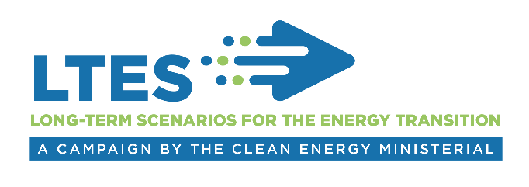
Technical Session 3
Approaches to building capacity of long-term energy scenarios planning
International experience from the LTES campaign
Pablo Carvajal, Associate Programme Officer
IRENA Innovation Technology Center
Long-term Scenarios for the Clean Energy Transition in Latin America
26 February, 2019, Brasilia

Slide 2

Approaches to capacity building
How and where should capacity be built for effective scenario planning?
IRENA Assembly
Identified challenges:
In-sourcing
Out-sourcing
Where scenario planning capacity is allocated. Effectiveness?
  Government, technical institutions, consultants, academia.
Type of capacity to be built within the government.
  Modelling or understanding models
  Quantitative and/or qualitative
Ownership of tools
  Open source vs. paid
2
Notes:
IRENA, International Renewable Energy Agency, is an inter-governmental organisation established in 2011, headquartered in Abu Dhabi of UAE. The IRENA Innovation and Technology Centre is based in Bonn, Germany. Our mandate is to assist our Members, with the widespread and increased adoption and sustainable use of all forms of renewable energy.
Over the past 7 years since the Agency was established, the countries that have joined the Agency have grown quickly. Now we have 158 members and we are well on our way to global coverage.
China joined IRENA in 2014.
Our mandate is to help countries with accelerated renewable energy deployment and with energy transition based on renewable energy and energy efficiency. We have been helping the countries with our knowledge, advice, and facilitating exchange of best practice.
Assembly once a year and council twice a year are key platforms to facilitate consultations and cooperation among Members.
The agency’s key deliverables include
provision of data and analysis on the topic of renewable energy and more broadly on clean energy transition,
Development and dissemination of tools and methodologies to support decision making and to facilitate project development,
and engagement and outreach through regional and bilateral cooperation framework.

Slide 3
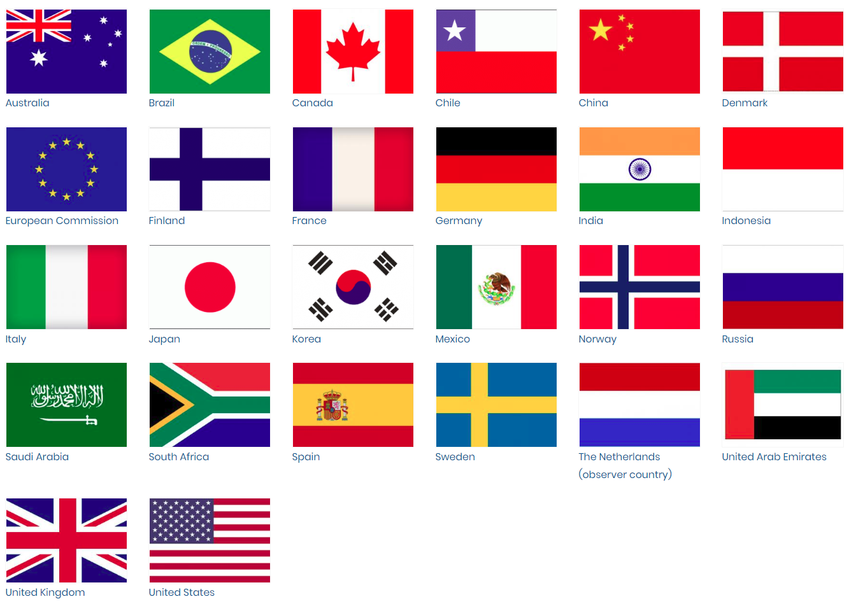
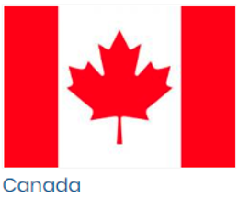
Capacity - Good practice examples
0% in-sourcing
Technical 1
Technical 2
Technical 3
50/50
Technical institution
100% in-sourcing
Gov
Gov
Various ways of managing scenario capacity in different countries
3
Notes:
Policy makers need to make short-term decisions, while scenarios provide long-term outlooks.
Scenarios are often too technical and therefore difficult to understand for broader audiences.

Slide 4
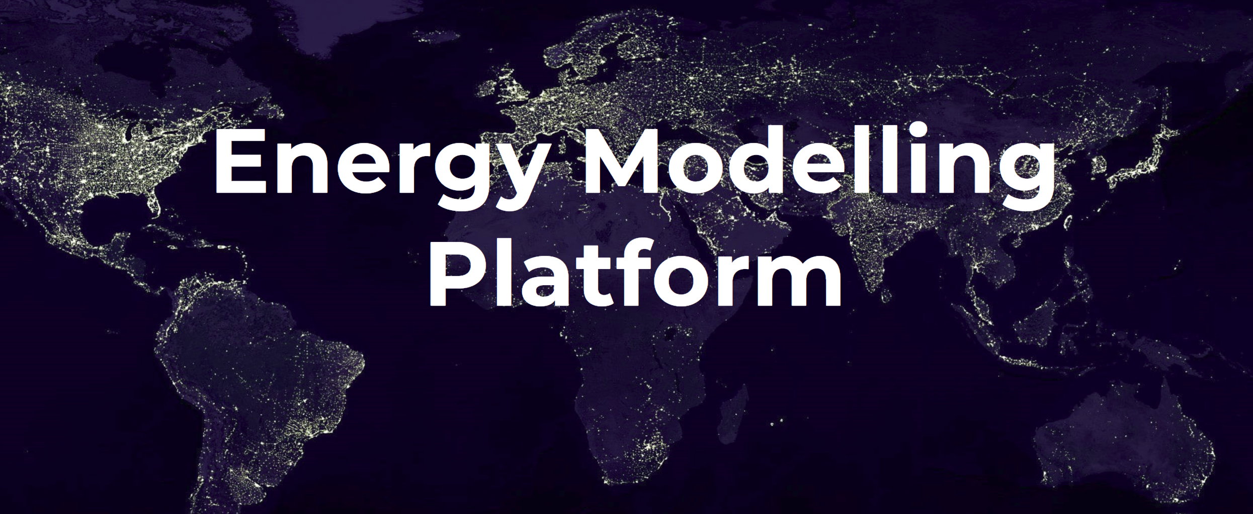
Approaches to capacity building
Organizers of EMP-LAC 2019:
Key contributors: UNDP, UNDESA, KTH Royal Institute for Technology, University of Cambridge, IEA, IADB
Latin American Centers of Excellence: Federal University of Ouro Preto, Universidad Nacional de Asunción, University of Costa Rica
Other partners: The World Bank Group, NREL, Fondazione Eni Enrico Mattei (FEEEM), Energy Strategy Reviews
Investment outlooks
Available models
Training
4
Notes:
Policy makers need to make short-term decisions, while scenarios provide long-term outlooks.
Scenarios are often too technical and therefore difficult to understand for broader audiences.

Slide 5

www.irena.org
Notes:
I took you though campaign objectives, planned activities and how we want to engage you. In designing the campaign proposal, we worked very closely with the two lead-countries, Germany and Denmark. What I presented today gives overall framework of the directions, but there is still time and space for accommodating additional suggestions from more partners. In particular, exact contents of the workshops can be firmed up though feedback from partners, and reflecting the interest of the host institutions. I hope that many of you can sign up and we can work together.

