Slide 1
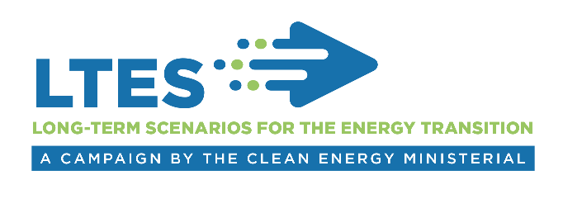
Technical Session 2
Development of long-term energy scenarios
International experience from the LTES campaign
Pablo Carvajal, Associate Programme Officer
IRENA Innovation Technology Center
Long-term Scenarios for the Clean Energy Transition in Latin America
25 February, 2019, Brasilia

Slide 2

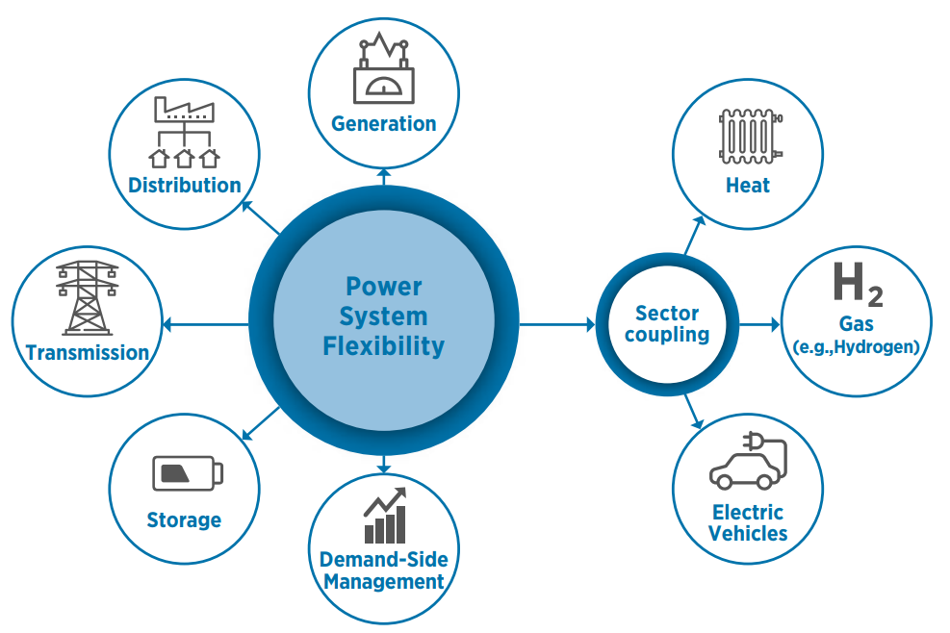
Development of Long-term energy scenarios
What are the main methodological issues in modelling long-term energy scenarios?
IRENA Assembly
Identified challenges:
Representation of the full spectrum of renewable options and sector coupling alternatives.
  Too optimistic for CCS and pessimistic about high shares of VRE.
Disruptive innovations and exogenous drivers – non-energy actors influence on the energy sector.
  “2nd phase of renewables” (Autonomous driving, end-use electrification, etc.)
  Changing environment – consumer behavior
Forced caps for VRE – low geospatial and time resolution.
2
Notes:
IRENA, International Renewable Energy Agency, is an inter-governmental organisation established in 2011, headquartered in Abu Dhabi of UAE. The IRENA Innovation and Technology Centre is based in Bonn, Germany. Our mandate is to assist our Members, with the widespread and increased adoption and sustainable use of all forms of renewable energy.
Over the past 7 years since the Agency was established, the countries that have joined the Agency have grown quickly. Now we have 158 members and we are well on our way to global coverage.
China joined IRENA in 2014.
Our mandate is to help countries with accelerated renewable energy deployment and with energy transition based on renewable energy and energy efficiency. We have been helping the countries with our knowledge, advice, and facilitating exchange of best practice.
Assembly once a year and council twice a year are key platforms to facilitate consultations and cooperation among Members.
The agency’s key deliverables include
provision of data and analysis on the topic of renewable energy and more broadly on clean energy transition,
Development and dissemination of tools and methodologies to support decision making and to facilitate project development,
and engagement and outreach through regional and bilateral cooperation framework.

Slide 3
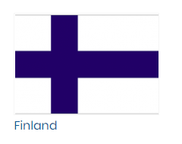
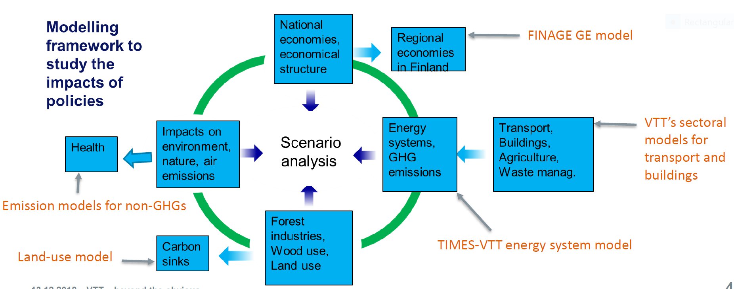
Development - Good practice example
Multi-model framework for policy impact – VTT Finland
Five research organizations, 20-40 researchers, more than 10 models to analyze the impacts of the 2030 policies in Finland’s national economy, energy economy, use of natural resources, emissions, health, ….
3
Notes:
Policy makers need to make short-term decisions, while scenarios provide long-term outlooks.
Scenarios are often too technical and therefore difficult to understand for broader audiences.

Slide 4

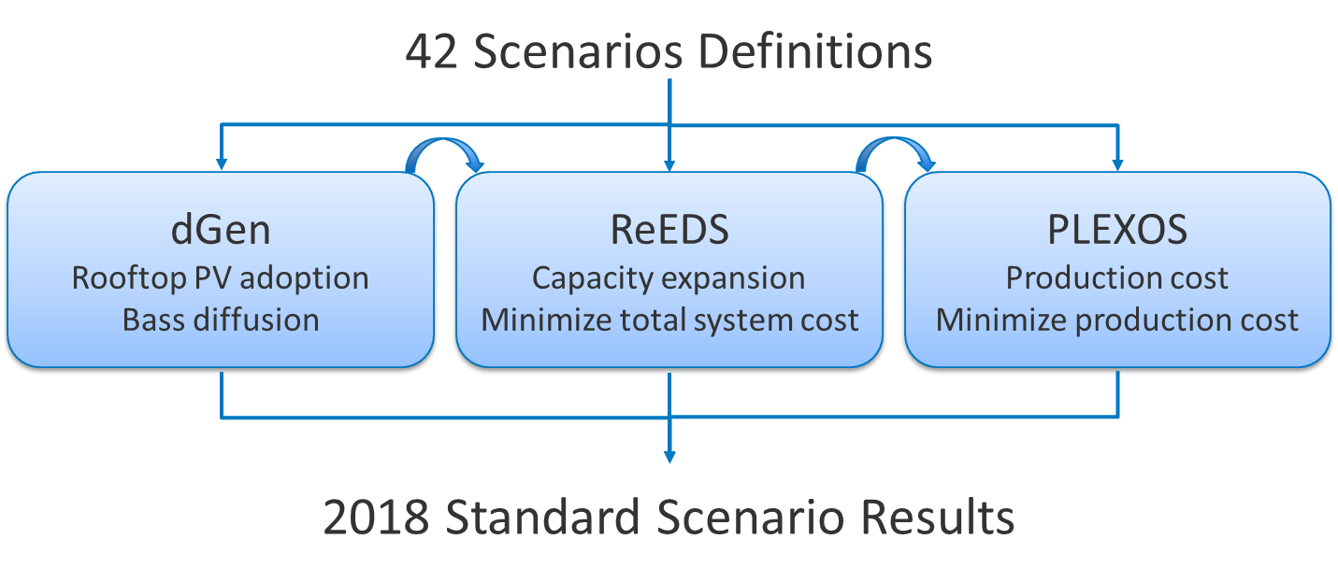
Development - Good practice example
Use of right tools – NREL USA
Some questions do not need sophisticated tools
Different tools are good at different things
Often best tool is a combination of existing tools rather than the creation of a new tool
4
Notes:
Policy makers need to make short-term decisions, while scenarios provide long-term outlooks.
Scenarios are often too technical and therefore difficult to understand for broader audiences.

Slide 5

www.irena.org
Notes:
I took you though campaign objectives, planned activities and how we want to engage you. In designing the campaign proposal, we worked very closely with the two lead-countries, Germany and Denmark. What I presented today gives overall framework of the directions, but there is still time and space for accommodating additional suggestions from more partners. In particular, exact contents of the workshops can be firmed up though feedback from partners, and reflecting the interest of the host institutions. I hope that many of you can sign up and we can work together.

