Slide 1
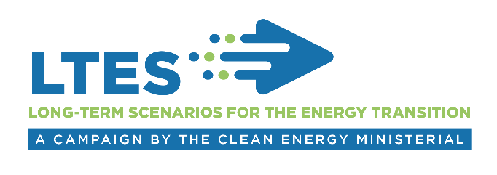
Technical Session 1
Use of long-term energy scenarios
International experience from the LTES campaign
Pablo Carvajal, Associate Programme Officer
IRENA Innovation Technology Center
Long-term Scenarios for the Clean Energy Transition in Latin America
25 February, 2019, Brasilia

Slide 2

Use of Long-term energy scenarios
IRENA Assembly
How to use the multiplicity of scenarios in the context of the clean energy transition?
Identified challenges:
Effective policy making vs. full range of exploratory scenarios.
Centralised planning vs. participatory process
Nature of scenarios: types according to organization and purpose.
Communication to policy makers: transparency, inter-comparability and diversity of assumptions.
Coordination of scenario planning.
Scenarios
Institutions
Goals
Policy?
Government
2
Notes:
IRENA, International Renewable Energy Agency, is an inter-governmental organisation established in 2011, headquartered in Abu Dhabi of UAE. The IRENA Innovation and Technology Centre is based in Bonn, Germany. Our mandate is to assist our Members, with the widespread and increased adoption and sustainable use of all forms of renewable energy.
Over the past 7 years since the Agency was established, the countries that have joined the Agency have grown quickly. Now we have 158 members and we are well on our way to global coverage.
China joined IRENA in 2014.
Our mandate is to help countries with accelerated renewable energy deployment and with energy transition based on renewable energy and energy efficiency. We have been helping the countries with our knowledge, advice, and facilitating exchange of best practice.
Assembly once a year and council twice a year are key platforms to facilitate consultations and cooperation among Members.
The agency’s key deliverables include
provision of data and analysis on the topic of renewable energy and more broadly on clean energy transition,
Development and dissemination of tools and methodologies to support decision making and to facilitate project development,
and engagement and outreach through regional and bilateral cooperation framework.

Slide 3

Modelling Work
Use - Good practice example
Federal Energy Information Framework - Canada
Natural Resources Canada
ECCC
Emission Trends
UNFCC National Inventory Report Submissions
Biennial report to UNFCC
GHG and CAC emissions
National End-Use Database
Energy Efficiency and Alternative Energy Programs Directory
Energy Fact Book
Report on Energy Supply and Demand
Statistics Canada
Market Snapshots
Resource Assessments
National Energy Board
Surveys and tables provide basis for energy data
Pipeline Profiles
Energy Market Assessments
CTS Trade Data
Energy Futures
National statistics program
Government of Canada
    National Energy Board: Modelling Canada’s energy future
    Environment and Climate Change Canada: A GHG perspective to energy modelling
Provincial Governments
Academia/Private companies
Federal responsibilities
Shared responsibilities
Provincial and Territorial
responsibilities
INDIGENOUS
3
Notes:
Policy makers need to make short-term decisions, while scenarios provide long-term outlooks.
Scenarios are often too technical and therefore difficult to understand for broader audiences.

Slide 4
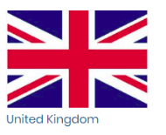


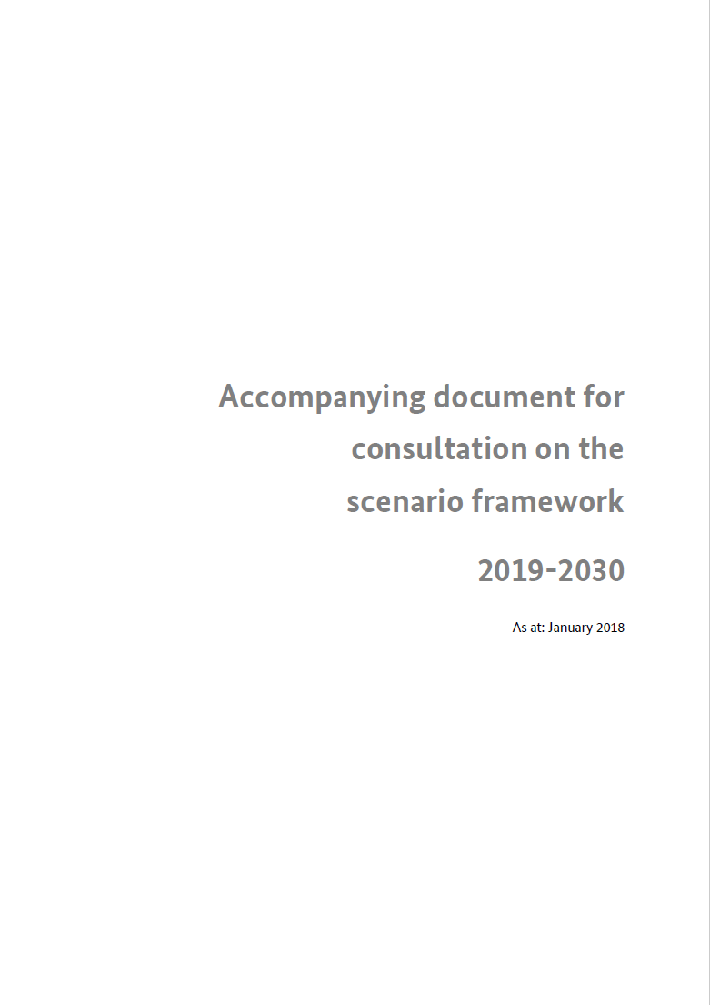
Use - Good practice example
Multi-stakeholder participatory processes for scenarios
Future energy scenarios – National Grid
Scenarios
Academia
Private sector
Civil society
Other Government
Utilities
NGO
Communities
Int. Organisations
Engaged with over 650 stakeholders in the public, private and academia sectors.
Consultation on scenario framework - Bundesnetzagentur
Engaged with over 1500 stakeholders to define scenarios of network expansion.
4
Notes:
Policy makers need to make short-term decisions, while scenarios provide long-term outlooks.
Scenarios are often too technical and therefore difficult to understand for broader audiences.

Slide 5

www.irena.org
Notes:
I took you though campaign objectives, planned activities and how we want to engage you. In designing the campaign proposal, we worked very closely with the two lead-countries, Germany and Denmark. What I presented today gives overall framework of the directions, but there is still time and space for accommodating additional suggestions from more partners. In particular, exact contents of the workshops can be firmed up though feedback from partners, and reflecting the interest of the host institutions. I hope that many of you can sign up and we can work together.

