Slide 1
IEA EBC Anexo 86 – Brasil
Participação brasileira no Anexo 86 da Agência Internacional de Energia durante o período 2020-2025
Daniela Mortari
Denner Ribeiro Machado
Marcos Batistella Lopes
Nathan Mendes
Curitiba, 22 de Abril de 2025

Slide 2
Visão Geral do Anexo 86
Ventilação inteligente em edificações residenciais (https://annex86.iea-ebc.org/)
Group | Subtasks (ST)
Methodology | ST1 - Metrics and Development of an IAQ Management Strategy Rating Method ST2 - Source Characterization and Typical Exposure in Residential Buildings
Application to Technology | ST3 - Smart Materials as an IAQ Management Strategy ST4 - Ensuring Performance of Smart Ventilation
New opportunities through IoT | ST5 - Energy Savings and IAQ Improvements and Validation Through Cloud Data and IoT Connected Devices
Dissemination and management | ST6 - Dissemination, Management and Interaction

Slide 3
Visão Geral do Anexo 86
ST | Title | Activities
1 | Metrics and development of an IAQ management strategy rating method | A1.1 Selecting performance metrics. A1.2 Setting up a rating method. A1.3 Use case testing.
2 | Source characterization and typical exposure in residential buildings | A2.1 Literature review. A2.2 Monitoring and measurement campaigns. A2.3 Reviewing, Testing, Developing models for source characterization.
3 | Smart materials as an IAQ management strategy | A3.1 Material properties and characterization of the products. A3.2 Modeling of the behavior under typical residential conditions. A3.3 Assessing energy saving and exposure reduction potential.
4 | Ensuring performance of smart ventilation | A4.1 Rating existing smart ventilation strategies. A4.2 Quality control of implementation. A4.3 Durability of smart ventilation systems and components. A4.4 Occupant interaction.
5 | Energy savings and IAQ: improvements and validation through cloud data and IoT connected devices | A5.1 Classifying and registering relevant online data-sets for IoT-enabled energy efficient IAQ management systems and services. A5.2 offline deduction and use of statistically representative data and knowledge for research, product/service development and performance assessment. A5.3 online use of IoT data, devices and services.
6 | Dissemination, management and interaction | A6.1 Dissemination of the reports and results of the subtasks as TechNotes, Webinars or Ventilation information Papers (depending on the subject). A6.2 Alignment of the Annex meetings with AIVC meetings. A6.3 Dedicated sessions during the AIVC conference. A6.4 Regular updates on the progress through the newsletters and social media activities. A6.5 Liaison with IEQ-GA and other annexes.

Slide 4





Time Brasileiro no Anexo 86/ST4
Daniela Mortari
Pós-doutorando
danielamortari@yahoo.com.br
Nathan Mendes
Coordenandor
nathan.mendes@pucpr.br
Denner R. Machado
Doutorando
denner_ribeiro@yahoo.com.br
Gaëlle Guyot
Líder da ST4
Gaelle.Guyot@cerema.fr
Marcos B. Lopes
Professor assistente
Batistella.marcos@pucpr. br

Slide 5
ST 4 – Common Exercise
Objetivos:
mostrar diferentes abordagens usando diferentes indicadores para avaliar o desempenho de estratégias de ventilação inteligente em diferentes países.
comparar as estratégias inteligentes com as estratégias tradicionais.
Escolher um caso de simulação:
análise de desempenho das estratégias de ventilação.
utilizar os indicadores de desempenho e os métodos.
Indicadores de desempenho:
DALYs (Anos de Vida Perdidos Ajustados por Incapacidade)
Umidade: porcentagem de tempo fora da faixa 25%-60%
Exposição do ocupante acumulada a um dado contaminante
Exposição aguda máxima ao longo de 1h
Taxa de ventilação
Consumo energético

Slide 6
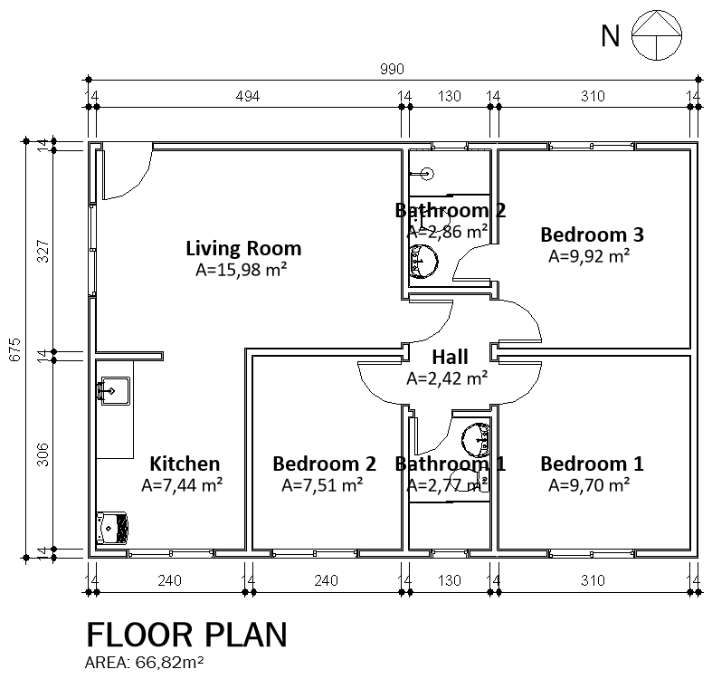
ST 4 – Common Exercise
BR2
LV
BD3
Estudo de caso brasileiro: “Minha casa minha vida” (Morishita, 2020)
Software: Domus-Contam
HALL
KIT
BD2
BD1
BR1

Slide 7
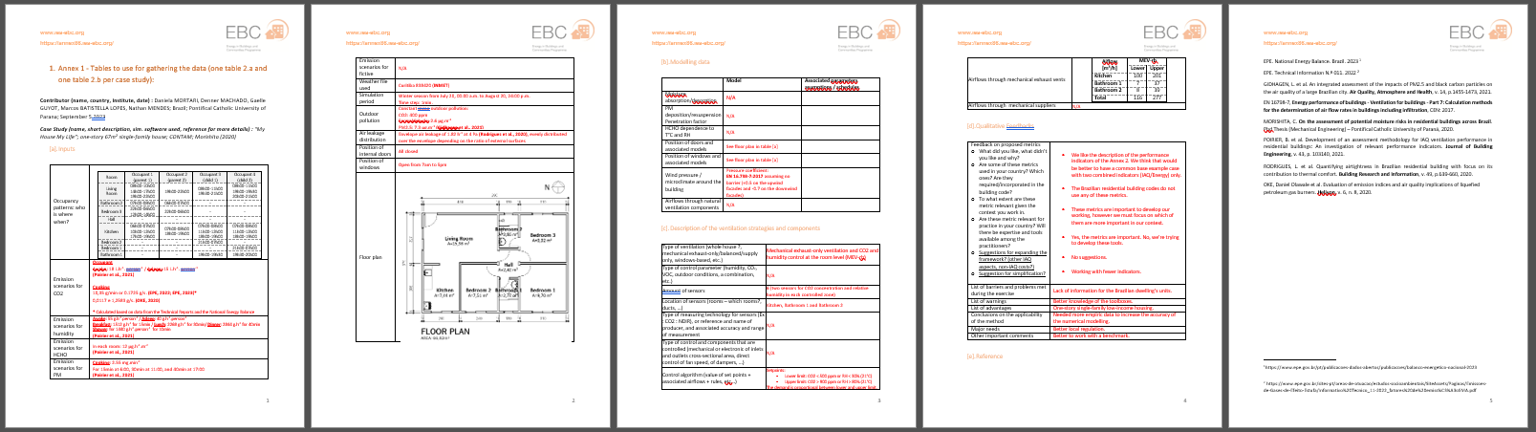
ST 4 – Common Exercise
Formulário com CI & CC das simulações:
[a] Dados de entrada
[b] Modelagem
[c] Estratégia de ventilação
[d] Feedback qualitativo

Slide 8
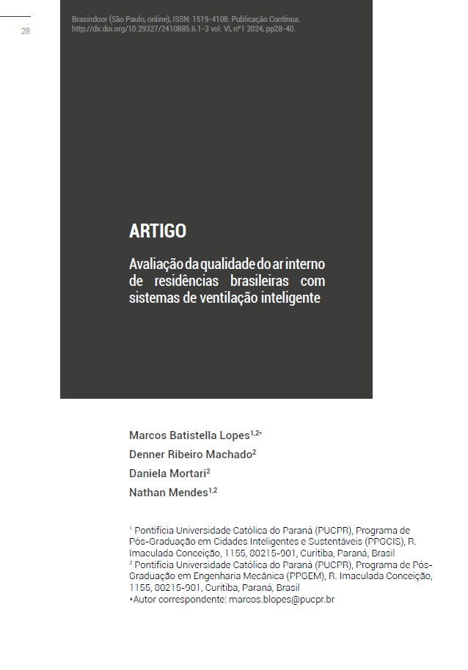
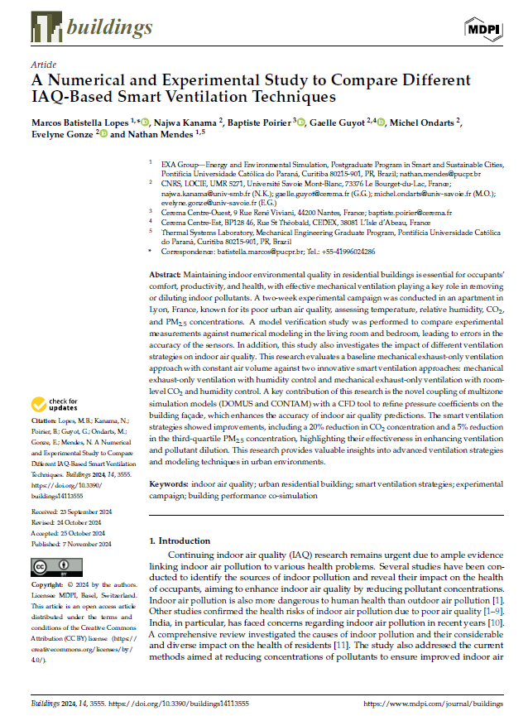
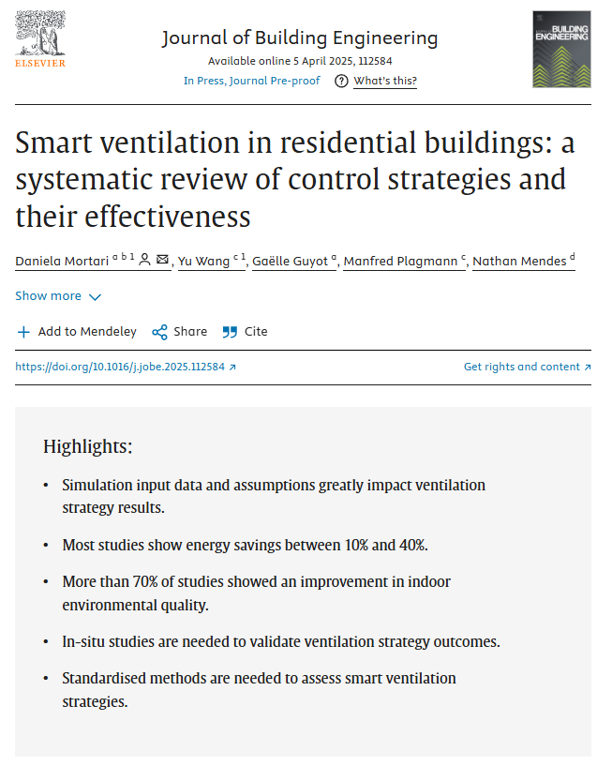
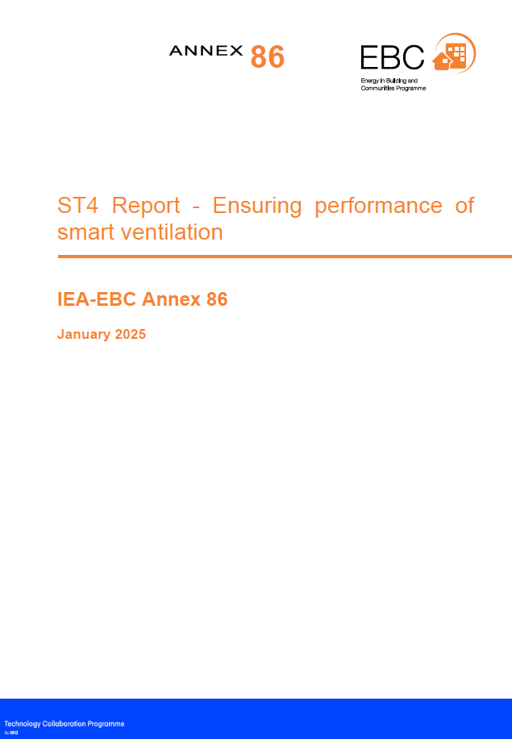
Publicações
LOPES, M. B. et al. Avaliação da qualidade do ar interno de residências brasileiras com sistemas de ventilação inteligente. Revista Brasindoor, v. VI, n. 1, p. 28–40, 2024. DOI: http://dx.doi.org/10.29327/2410885.6.1-3
LOPES, M. B. et al. A numerical and experimental study to compare different IAQ-based smart ventilation techniques. Buildings, 14, 3555, 2024. DOI: https://doi.org/10.3390/buildings14113555
MORTARI, D. et al. Smart ventilation in residential buildings: a systematic review of control strategies and their effectiveness. Journal of Building Engineering, 112584, 2025. DOI: https://doi.org/10.1016/j.jobe.2025.112584
GUYOT, G. et al. ST4 Report – Ensuring performance of smart ventilation, IEA-EBC Annex 86, 2025.

Slide 9

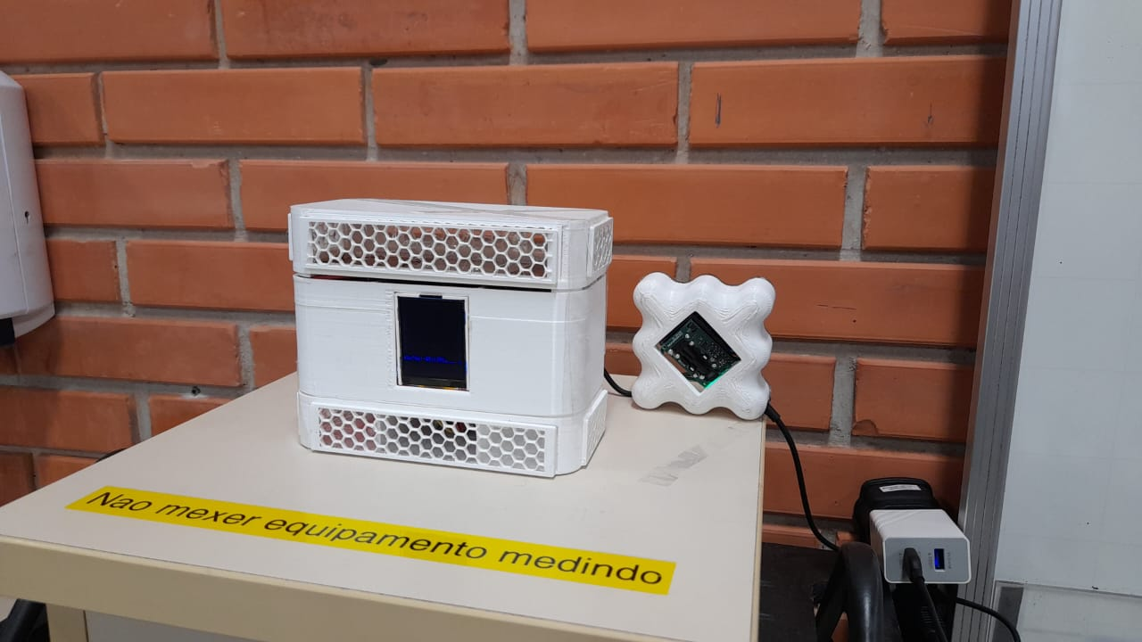



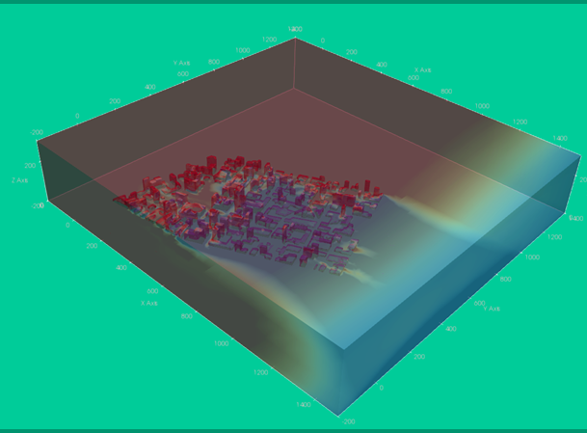
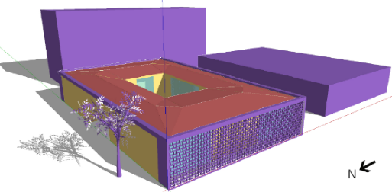
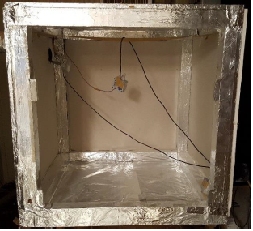
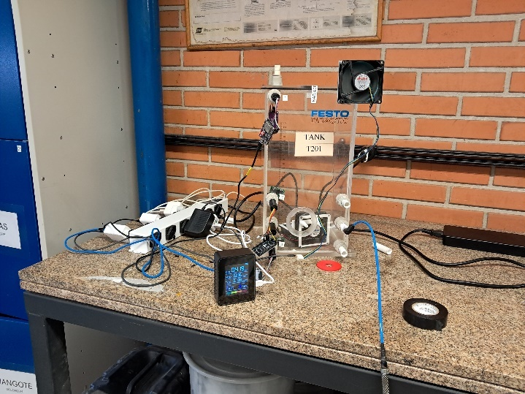

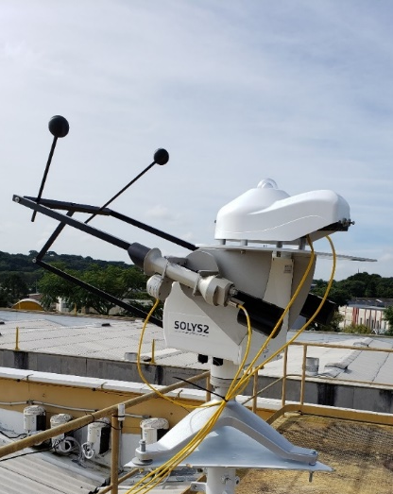

Perspectivas
Calorimeter
Chamber 1
Window
Chamber 2
IAQ EXA kit
Test cell (≈1m³)
PUCPR’s weather station
SmartVent prototype

