Slide 1
Future regional collaboration and way forward – IRENA’s perspective
Asami Miketa, Senior Programme Officer
IRENA Innovation Technology Center
Long-term Scenarios for the Clean Energy Transition in Latin America
26 February, 2019, Brasilia

Slide 2
IRENA’s work on Long-term Scenarios
Goal: Integrate renewables in the main stream of the energy planning
Use of scenarios for policy making
REmap transition scenarios to raise the RE ambition
Development of scenarios for clean energy transition
Addressing variable renewable in long-term planning
REmap framework for end-use sector assessment
Flexibility assessment
Building and enhancing capacity
Energy planning capacity building programme
Capacity building framework discussions

Slide 3
IRENA Energy Transition Scenario Network
Target: Support of governments pursuing political consensus and informed energy policy-making
Goal: Provide a global platform to facilitate exchange in best practice in long-term energy scenario development and use, among national and regional scenarios practitioners from around the world, while connecting them with experts from leading technical institutions.
Participants and partnerships:
Open to both government and research institutions.
Launch in April 2019
ETS-Net
IRENA Energy Transition Scenario Network
Notes:
We have done several workshops in disseminating the main insights from the AVRIL report.
Example from Argentina (September 2017)
Similar workshop planned in Jordan (April 2019), and possibly in Central Asia (Kazakhstan).

Slide 4

Proposed activities
Global and regional events
- Bring regional and thematic initiatives together
- Share the experiences and learn from other countries and from the subject experts
Webinar series
Bi-weekly webinar series since November 2018
500+ Registrants
Special focus events
- Planning process discussion
- Modelling methodology discussion
- Capacity building support
Pathways 2050
UNECA: Energy Modelling Platform Africa
UNECLAC: Regional Planners Forum
UNDP
NDC-Partnership
UK DFID: Roundtable on Strategic Energy Planning
Deep decarbonization pathways
4
Notes:
Three types of activities are planned:
workshops dedicated to CEM campaign, focused on the best practice exchange among the partners, also to possibly to develop a proposal to enhance scenario planning capacity .
The second type is participation of partners to relevant events and to inform the campaign and to promote the use of scenario planning for clean energy transition
The third one is production of reports and recommendations, informed by events and also by IRENA’s analytical work.
Additionally: we launched a webinar series in which experts users and developers of models present the challenges and good practices in this regard.

Slide 5
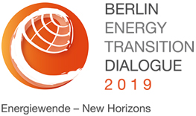
Long-term Energy Scenario (LTES) Campaign
2019 International Forum
April 10-12, 2019, Berlin
10 April 2019: Pre-Forum day
Side-event during the BETD
“Exploring the boundaries of rapid clean energy transition – the role of long-term scenarios”
11-12 April 2019: 2019 International Forum
Private sector, government and academia
Expert panelists and presentations + discussions
Discuss CEM LTES campaign outcomes and findings
Way forward
Notes:
We have done several workshops in disseminating the main insights from the AVRIL report.
Example from Argentina (September 2017)
Similar workshop planned in Jordan (April 2019), and possibly in Central Asia (Kazakhstan).

Slide 6
Possible topic of a common interest
Planning for high shares of VRE
Dissemination of improved planning methodologies with a high share of VRE
  Long-term planning guide with VRE in emerging economies
  Technical Planning for the integration of VRE in SIDS
6
Notes:
Highlight our strength – planning with VRE. This makes us particularly relevant and distinct from others.
The first aspect how IRENA supports Member States with energy modelling and planning is the dissemination of improved planning methodologies with a high share of VRE. Examples of that are the AVRIL report and the SIDS report.
The AVRIL report identifies the best practices in long-term planning and modelling to represent high shares of VRE.
Part One offers guidance to energy decision makers and planners by providing an overview of key long-term issues and concerns around the large-scale integration of variable renewables into the power grid.
Part Two offers guidance to technical practitioners in the field of energy modelling, specifically with a catalogue of practical VRE modelling methodologies for long-term scenario planning.

Slide 7
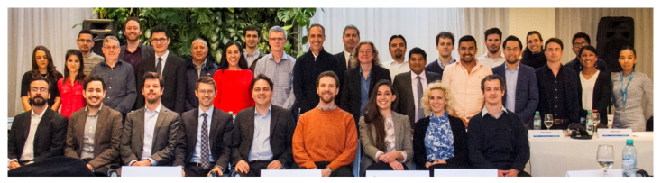
Sharing experience: VRE and long-term
planning in South America
Regional workshop in 2017 in Buenos Aires, “Exchanging best practices to incorporate variable renewable energy into long-term energy/power sector planning”
Topics covered: VRE capacity credit, flexibility, VRE siting, stability constraints
7
Notes:
We have done several workshops in disseminating the main insights from the AVRIL report.
Example from Argentina (September 2017)
Similar workshop planned in Jordan (April 2019), and possibly in Central Asia (Kazakhstan).

Slide 8
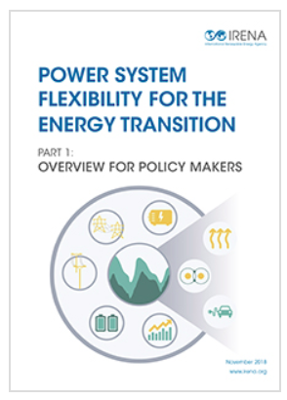
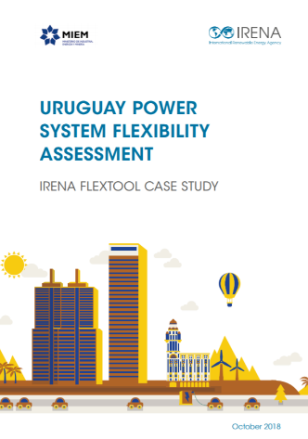
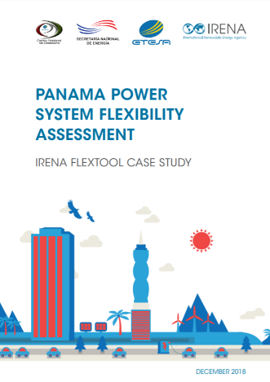
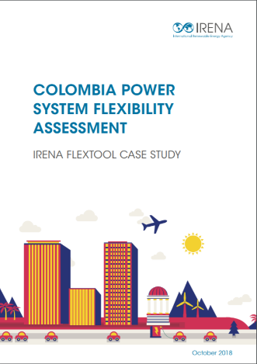
Possible topic of a common interest
Flexibility assessment
Power system flexibility is a key for reliable operation with a high share of VRE
Sources of flexibilities include dispatchable generators, storage, interconnectors, and DSM
Based on dispatch simulation, assess the level of curtailments, and propose flexibility investment options
To be used with any long-term planning model
8
Notes:
We have done several workshops in disseminating the main insights from the AVRIL report.
Example from Argentina (September 2017)
Similar workshop planned in Jordan (April 2019), and possibly in Central Asia (Kazakhstan).

Slide 9


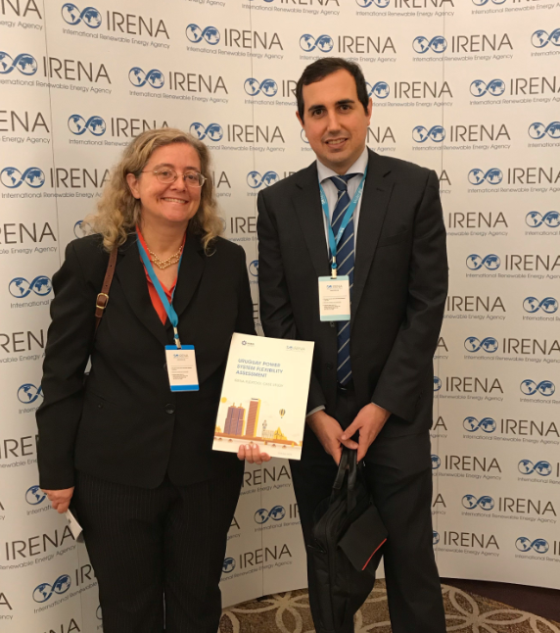
FLEXIBILITY ASSESSMENT
FOR URUGUAY
IRENA FLEXTOOL

Slide 10
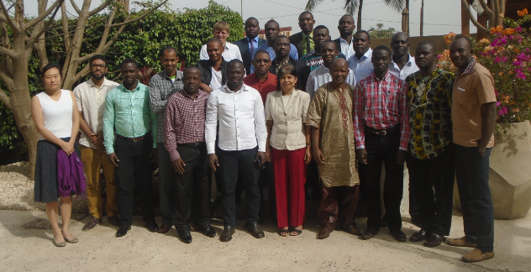
Possible topic of a common interest
Energy modelling/planning capacity building
RE modelling topics incorporate into capacity building programme
Active cooperation with IAEA; United Nations Economic Commission for Africa, UN-DESA
10
Notes:
We have done several workshops in disseminating the main insights from the AVRIL report.
Example from Argentina (September 2017)
Similar workshop planned in Jordan (April 2019), and possibly in Central Asia (Kazakhstan).

Slide 11



IRENA’s Renewable Energy Roadmap

Slide 12
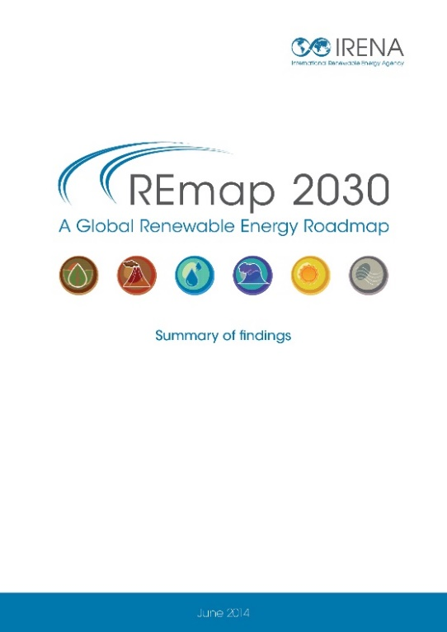
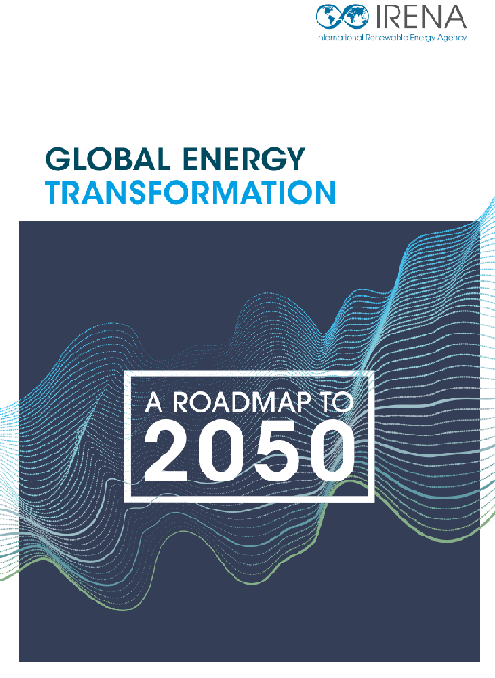
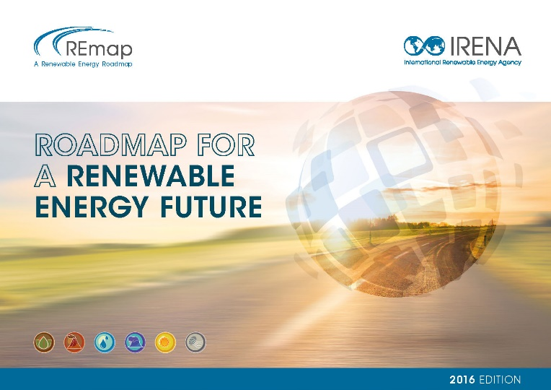
REmap – IRENA’s Renewable Energy Roadmap
REmap shows feasible, cost-effective ways to increase renewable energy deployment in world’s energy mix
Explores how to accelerate renewable energy deployment, 2030 / 2050 horizon
Identifies RE technology options (i.e. power, transport, industry, residential, services)
Country based approach and global, regional and country level coverage
Assesses policy and investment implications
Outlines benefits (economic, social, environmental)
In cooperation with 70 countries
More than 40 publications to date and datasets
https://www.irena.org/remap

Slide 13
Key features
Engagements: Joint implementation of studies with countries, and partnership with local experts (including secondment)
Methodologies: Technology approach (REmap options), with focus on end-use sector
Impacts: raise ambition for renewable energy in the national/regional policy making process

Slide 14





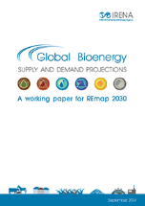
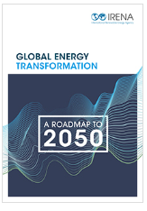
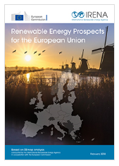
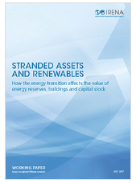
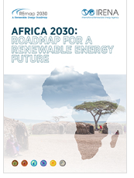


Areas of implementation
Country
Regional
Thematic
Global
Insights for policy and decision makers for areas in which action is needed at a country level
13 country reports for major economies (2 REmap – RRA joint reports)
  Assessment of technology options and regional disaggregation
  Identification of key technologies and trends, and cross-country opportunities
  3 regional reports (Africa, ASEAN and EU)
Provide detailed technical and economic analysis on specific topics (i.e. RE investments, stranded assets, district heating and cooling etc.)
9 thematic studies
  Design of technology pathways and RE and EE options in all sectors
  Assessment of investment and benefits at a global level
  4 global reports
14

Slide 15





Country Energy prospects and outlooks
Added value
  Definition of realistic and cost effective plans to reduce country carbon intensity
Identification of benefit and potential opportunities of the energy transformation at country level
Identification the countries most efficient technology mix
Enhance: – country-level NDCs / Readiness – policies and regulations
Content
  Country-level scenario, roadmap and energy outlook
  In-depth bottom-up analysis tailored on specific country needs and key sectors
  Insights on grid operation and resilience
  Action plans input to succeed in the country energy transformation
  Country level statistics and energy balance
Engagement
South Africa (ongoing)
Nigeria (working paper)
Lebanon
Republic of Korea
  Strong country-level relationship with different institutions and stakeholders
  Country lead consultation with interested parties
  Final reporting and presentation to country institutions and policy makers during events and conferences
  Enhance: running of country models and systematic network engagement
Remap Thailand- January, 2018
Joint REmap-RRA
Remap Egypt- October, 2018
Joint REmap-RRA

Slide 16
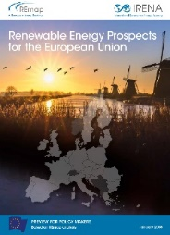
Regional Energy prospects and outlooks
Added value
Optimization of resources within the region
Optimization of impact in the achievement of SDGs and Paris Agreement targets by defining a regional common strategy
Opportunities to create economies of scale for market players
Analysis of regional cost and benefits of REmap Scenarios
Content
Assess regional level aggregated impact of national plans
Assess the role of renewables in long-term decarbonization.
Identify key technologies and trends as well as cross-country opportunities
Determine a common strategy among regions for energy transition
Regional level energy balances and statistics
South East Europe (ongoing), 2019
EU possible second phase, 2020
South East Asia, 2019/2020
Latin America (Central America), possible 2019/2020
Engagement
Involvement of Regional association and Institutions
Strengthening regional cooperation
Exchange views on policy making, planning, investment, stakeholder engagement
Dialogue and deepening of the analysis at regional level
Final reporting to key institutions and regional level policymakers.
16

Slide 17
Global Energy Transformation Report
Added value
Agency vision for the Global Energy Transformation
Provide Energy Scenarios to 2050 in line with the “well-below 2°C” requirements
Provide relevant insights on economic and social benefits of such transformations
Active contribution in the achievement of SDGs and Paris Agreement targets: what would be needed to steer the wheel (concrete actions, projects and mechanisms)
Enhancement -structural changes, sectorial and electrification
Content
Detail evolution of technologies available for decarbonization
Evolution of technologies, investments and market penetration, such as wind, solar, EVs
Scenario analysis (transport / industry / building / power sector)
Based on high energy efficiency and renewable energy
Combines IRENA REmap and Socio-economic analysis
Electrification and sector coupling
Engagement
Direct involvement of G20 countries’ focal points and experts: calls / webinars / missions
Increasing number of countries with detail analysis and better regional disaggregation
Yearly reporting of main outcomes at the Berlin Energy Transition Dialogue
Bilateral with countries: GET 2018 – Germany, Spain, Italy, France, EU, Brazil, APEC, India, China, South Africa, etc.
Other outreaches: meeting / presentation – financial institutions
17

Slide 18
REmap: Engagement, Benefits
Engagement
Benefits
00
Regional and Country workshops
Sectorial conferences
Remap countries network and direct engagement
Secondment from countries
Thematic/Technological conferences
Communication through IRENA platforms, Webinars
Support to energy planners in developing action plans to succeed in their energy transformation.
Contribution on National Decarbonization Strategies
Platform for exchanging views on policy making, planning, investment, stakeholder engagement, etc.
Identifying synergies in e.g. infrastructure development

Slide 19

www.irena.org
Notes:
I took you though campaign objectives, planned activities and how we want to engage you. In designing the campaign proposal, we worked very closely with the two lead-countries, Germany and Denmark. What I presented today gives overall framework of the directions, but there is still time and space for accommodating additional suggestions from more partners. In particular, exact contents of the workshops can be firmed up though feedback from partners, and reflecting the interest of the host institutions. I hope that many of you can sign up and we can work together.

Slide 20
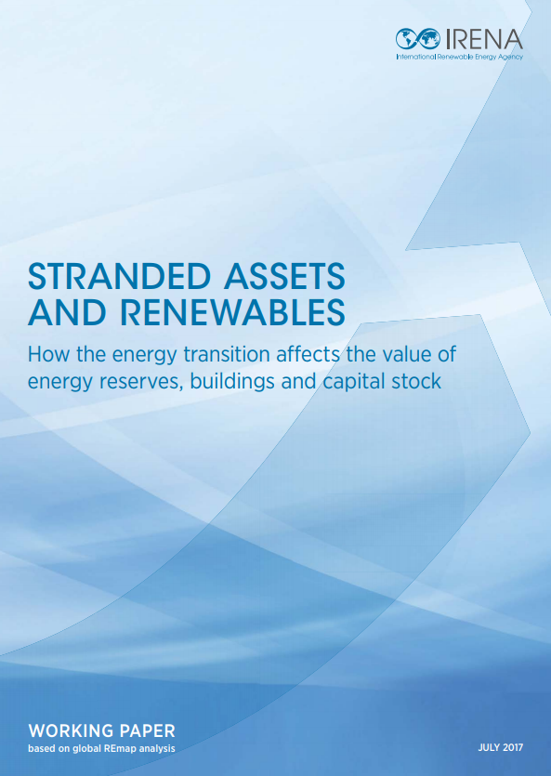
Technology / Sectorial Roadmaps
Added value
  Contribution to determine and drive investments in a specific sector
  Identification of specific sector weaknesses and potential improvements
  Outline market trends and investors interests
  Enhance: analyze the impact of structural changes / new techs in sectors
Content
  Detailed cross-country and cross-regional thematic analysis
  Application of a structured methodology tailored on country specific sectors and requirements
  Market specific trends evaluation / technological development
  Enhance: mapping of new and disruptive technologies
Engagement
Investments and stranded assets, 2018
Technology roadmaps: Wind, Solar, 2018
Subsidy analysis, RE-electrification 2018/2019
  Direct relation with sector’s specialist and stakeholders
  Involvement of sectorial association and academics experts
  Direct participation of investors and market experts
  Cross-country engagement
  Presentation and reporting during key sectorial events

