Slide 1

Digitalization – A problem or solution for Quality Infrastructure.
David Tomlinson
Associate Technical Expert

Slide 2
Presentation Outline
1. | Why are we so concerned about Digitalization?
2. | How is Quality Infrastructure embracing Digital Transformation?
3. | How has UNIDO been supporting Digitalization in Quality Infrastructure?

Slide 3



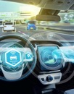

Industrial Revolution
1
2
3
4
5
MECHANIZATION
Steam and waterpower
ELECTRIFICATION
Mass production
AUTOMATION
Computers, CAD-CAM
DIGITALIZATION
Cyber-physical systems
SOCIETY 5.0
Quantum Computing
HEALTH & SAFETY
RISK & WORKING CONDITIONS
INTEROPERABILITY & CYBER SECURITY
  CONVERGENCE OF NEW TECHNOLOGIES
3

Slide 4
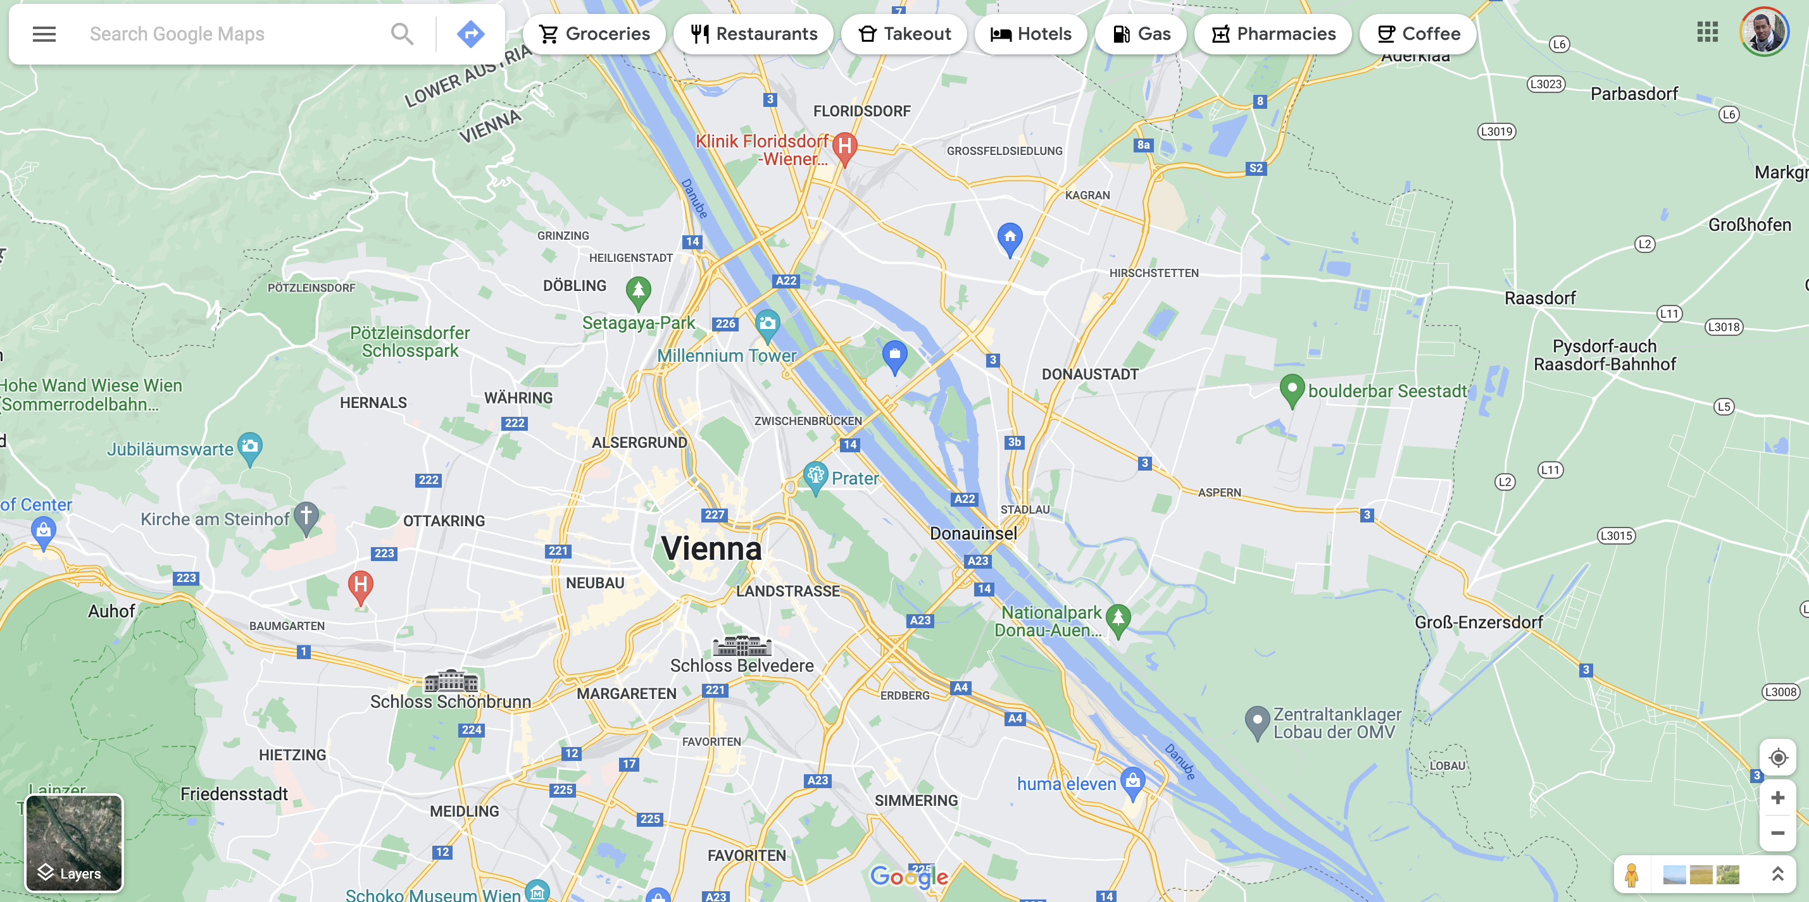
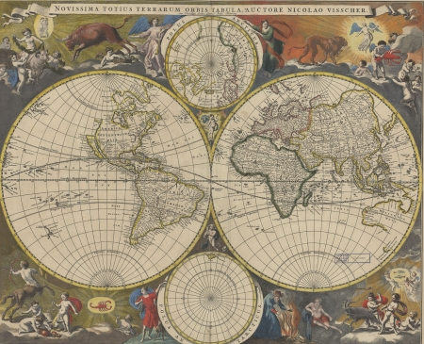

digitization
“the representation of an object, image, sound, document or signal (usually an analogue signal) by generating a series of numbers that describe a discrete set of its points or samples."
digitalization
the use of digital technologies to change a business model and provide new revenue and value-producing opportunities; it is the process of moving to a digital business".
digital transformation
“the total and overall effect of
digitalization".
Paper Map
+
=
Scanner

Slide 5
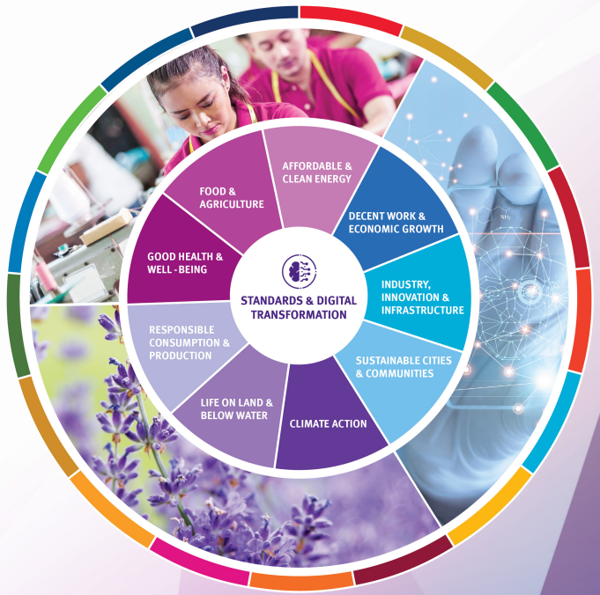
Digital Transformation impacts People, Planet & Prosperity
People - Digitalization is unevenly distributed but offers the potential for overcoming spatial and social barriers to benefit people.
Prosperity - Digital transformation is fundamentally changing the commercial world, impacting competition whilst disrupting markets and affecting prosperity.
Planet - Unchecked digital transformation unaligned with the environmental constraints of the earth will negatively impact the planet, increasing resource and energy consumption, exacerbating damage to terrestrial and water ecosystems and accelerating climate change.

Slide 6


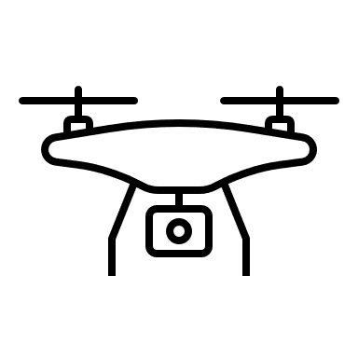

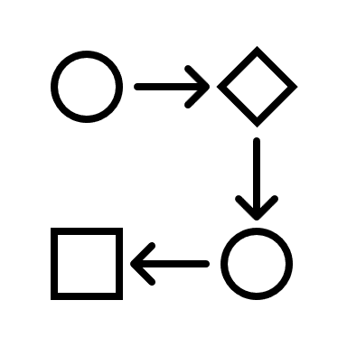
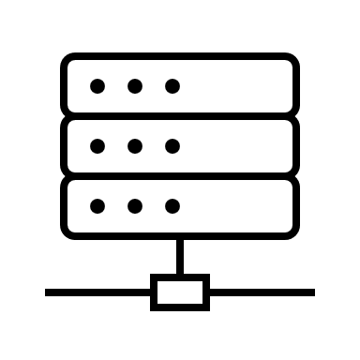


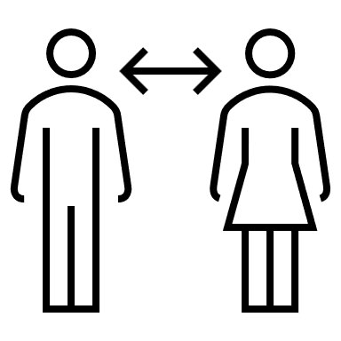

Challenges
TECHNOLOGY
DATA
PROCESS
CHANGE MANAGEMENT

Slide 7





Technology and infrastructure
Energy
Robust internet connectivity
Document sharing platforms
Remote access to process control and system information
Remote meeting and virtual videoconferencing
Real time video access to facilities.
Virtual reality headsets
Drones and remotely operated vehicles.

Slide 8




Data and Information
Cyber Security / information security
Ensure:
  Reliability
  Accuracy
  Access
Protect
  Confidentiality: stop unauthorized access.
  Integrity: Stop unauthorized modification/destroyed/corrupted.
  Availability: to the right people at the right time.
Storage
ISO 27001 standards
Notes:
ii. Data and information. Information—many times confidential information—flows during any assessment process. In a digital context, ensuring the data is secured at both ends (information/data generators and users), protected, credible and not susceptible to manipulation is critical both during the assessment and after the information has been stored.

Slide 9
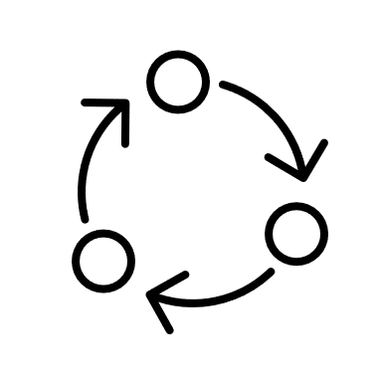
Process
IAF ID3:2011 “Management of Extraordinary Events or Circumstances”
IAF MD 4:2018 Mandatory Document “Use of ICT for Auditing/Assessment Purposes”. This latest version of MD4 clarifies that all requirements, including those involving the observation of auditee processes and activities, can be audited remotely.
ISO 19011:2018 – “Guidance on Auditing Management Systems”. Annex A16 includes extensive guidance on the use of remote auditing
IAF ID 12:2015 “Principles on Remote Assessment” provides further information and guidance on the principles of assessment of CABs by ABs (including remote witness assessments).
ISEAL Alliance Remote Auditing Good Practices v1.0 (June 2021) provides examples of good practice in particular for the Social and Environmental auditing arena.
Re-engineering
Anticipation/Planning
Sampling
Conducting the assessment
Previous agreement
Comply with Regulations
Notes:
iii. Process. Remote assessment requires a rethinking and adaptation of the methods to incorporate the desired technologies, improvement and redesign of existing processes and the incorporation of new ones to meet customer and wider societal requirements.
SOURCES OF GUIDANCE ON CONDUCTING REMOTE ASSESSMENTS

Slide 10


Culture (change management)
All changes are made possible by people
IT literacy
Leadership
Teamwork
Emotional intelligence.
Keep trust of key stakeholders
Notes:
iv. Organizational culture change. Using new technologies, though a new process, requires adaptation from the users, improved IT literacy, leadership, teamwork, trust, and emotional intelligence to overcome frustration when the results are not immediately forthcoming

Slide 11

Quality Infrastructure &
Digital Transformation

Slide 12

”
Quality Infrastructure - The system comprising the organizations (public and private) together with the policies, relevant legal and regulatory framework, and practices needed to support and enhance the quality, safety and environmental soundness of goods, services and processes.
The quality infrastructure is required for the effective operation of domestic markets, and its international recognition is important to enable access to foreign markets. It is a critical element in promoting and sustaining economic development, as well as environmental and social wellbeing.
It relies on metrology, standardisation, accreditation, conformity assessment, and market surveillance.
This is the definition of Quality Infrastructure adopted by the members of the INetQI.

Slide 13
Digitalization in Quality Infrastructure
National Standards Body
National Metrology Institutes
Digital standards development
Integration to digital processes.
Interoperability
Smart standards
Machine readable calibration certificates
Integration to digital processes.
Accreditation Body(ies)
Machine readable certificate.
Digital services
Certification Body(ies)
Inspection Body(ies)
Testing Laboratories
Calibration Laboratories
Legal Metrology Authority(ies)
Industry
Machine readable certificate.
Digital services
Society

Slide 14
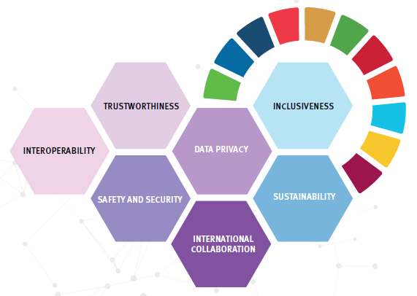
Principles for Digital Transformation
The rapid and extensive adoption of digital technologies and their far-reaching pervasive impact on people, their prosperity and the planet suggest a core set of distinct principles is needed to guide standards developed for digital transformation governance.

Slide 15
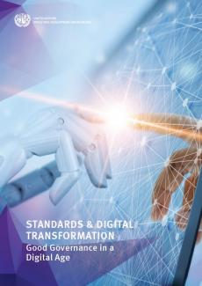

Standardization 4.0
Digitalization of the NSBs
Virtual standards development (e.g. virtual TC work)
Introduction of AI into the standardization process
DIGITALIZATION
OF NSBs
Readiness Assessment
Machine-readable content: earmarked information
Machine-interpretable content: Information models describing and explaining the content and the relationships between items of information, self-learning analysis
Machine-controllable content: The content of a standard is be amended automatically and adopted by automated decision-making processes

Slide 16
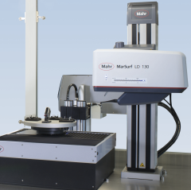
Metrology 4.0
Metrology for Industry 4.0:
robot-assisted measuring station with workpiece recognition and labeling
The metrology of the future will be intelligent and networked, and take on an important role in the control of production in the smart factory of the future.
Metrology 4.0 is used to describe existing innovations in non-contact metrology, such as applying smart measuring sensors, 3D scanning, and mobile-tools for real-time calibration and measurement.
Smart: measures automatically and quickly
Connected: communicates measuring data (between hardware and software)
Controlled: cloud monitoring through sensors
Autonomous: adjustment of measures, e.g. variant tolerances
Traceability
Digital Calibration Certificates
Metrology Cloud

Slide 17


Accreditation 4.0: Remote Assessment
Remote Assessment / Auditing
    different conformity assessment scenarios, including management system, product and personnel certification, certification to Voluntary Sustainability Standards / Organic certification, inspection and testing, accreditation and peer assessments, among others
COVID-19 accelerated the use of digital assessment techniques!
Digital (Calibration) Certificates
    Contains information about the subject of certification, the identity of its owner, and the digital signature of an entity that has verified the certificate's contents
REMOTE ASSESSMENT
Opportunities, Challenges & Implications

Slide 18

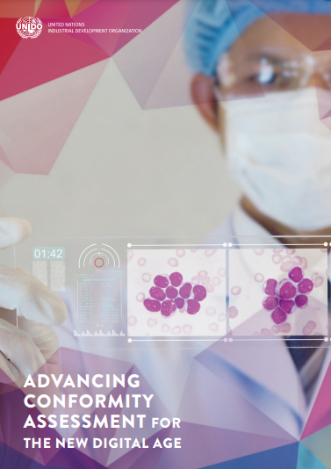
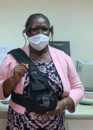
Conformity Assessment in the Digital Age Smart Laboratories
Ghana
The smart glasses solution enabled an international expert on laboratory analysis, based in Rome, to provide technical support and to assess the laboratory during a live visit to the laboratory in Accra.
Where automation and informatics can come together to drive change. Examples of the kinds of technologies in Smart Laboratories include:
AI and machine learning, such as using digital images in a semi-automated process to reduce mistakes and take away the uncertainty of conformity assessments in industrial testing.
Big Data, to help the management and analysis of the increasing qualities and types of data available for testing and inspecting products.
Cloud computing, to share data instantly, report issuing and automate certification. This has already been developed in some CABs, resulting in greater insight for customers and their supply chains.

Slide 19

UNIDO’s Experiences & Support

Slide 20
National approaches to QI development
Top Down Approach
Study QI needs and international trends and best practices
or
React to a problem
Offer QI
Services
Create standards
Adopt/adapt standards
Develop local
capacity
Collaborate with Industry
Offer QI
Services
Facilitate innovation & research
Bottom Up Approach

Slide 21
Challenges faced by Developing Economies
High training costs for new hires since there are limited training opportunities available in the traditional education system.
High staff attrition.
Government restrictions on hiring new staff.
Staff do not have the capacity or time or the Institution does not have the resources to stay relevant with new developments.
Not a Member of key international and regional QI organizations.
Limited inhouse IT expertise.
Either large geographic area that makes it challenging to provide services in all areas (supply challenges) or limited geographic area that results in a financially unsustainable demand (demand challenges).

Slide 22
Digital Solutions to Support Developing Economies
Digitalization of Knowledge Management.
Online and virtual training resources.
Use of available Artificial Intelligence, software or smart systems to reduce the need for human input.
Use of virtual services such as cloud servers.

Slide 23


Slide 24
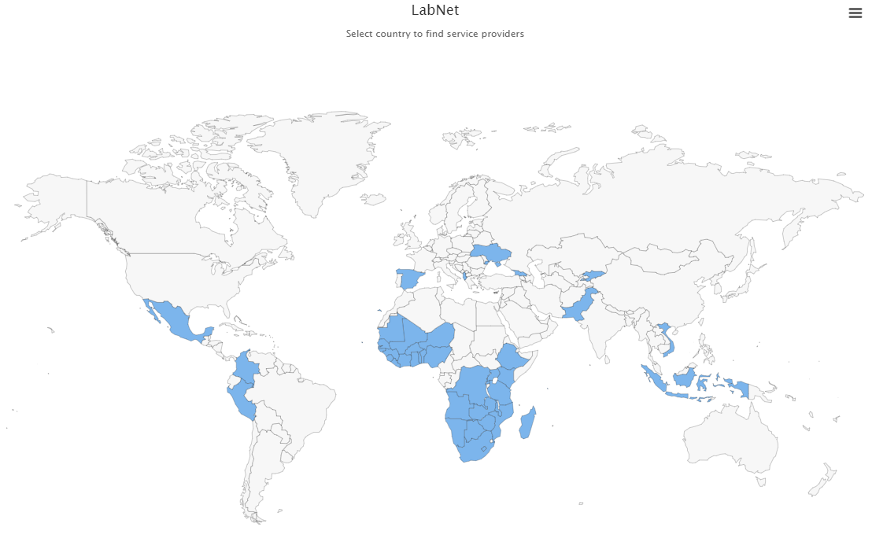
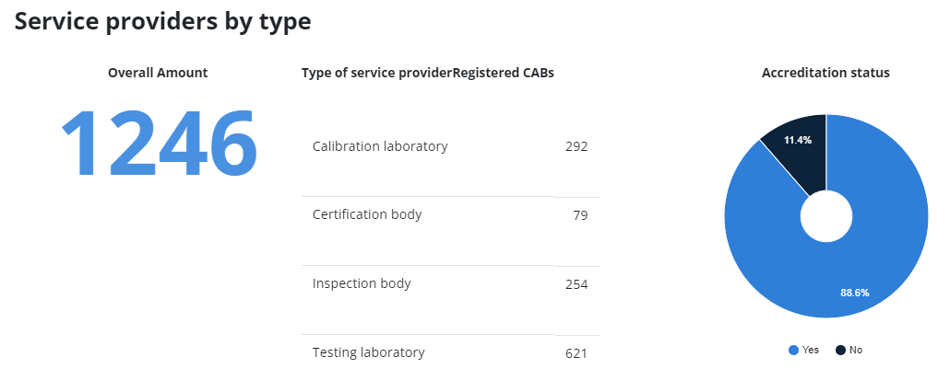
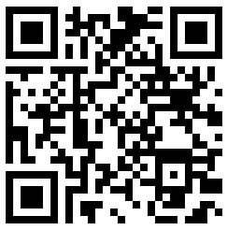

Laboratory Network (LabNet)
This innovative database provides information on services offered by Conformity Assessment Bodies (CABs) around the world in the area of calibration, testing, certification, and inspection.
Scan me!

Slide 25
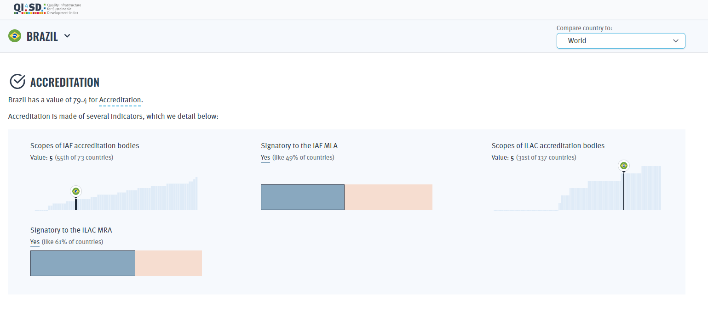
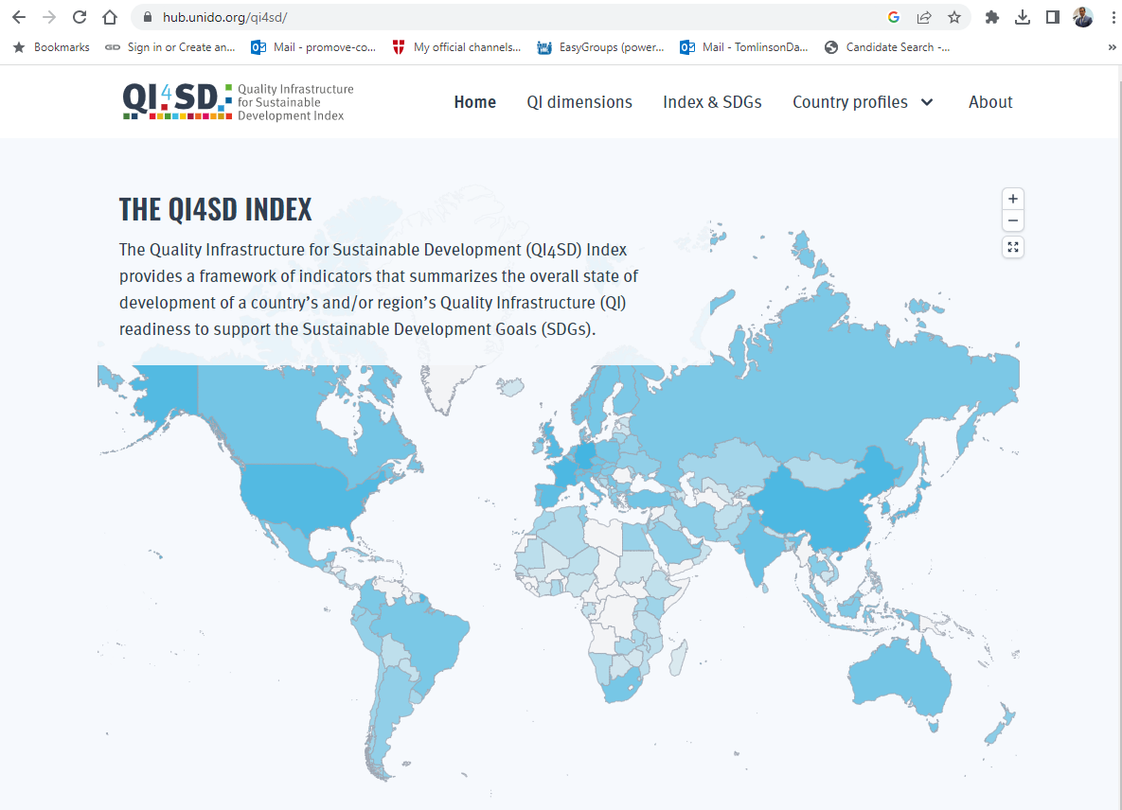
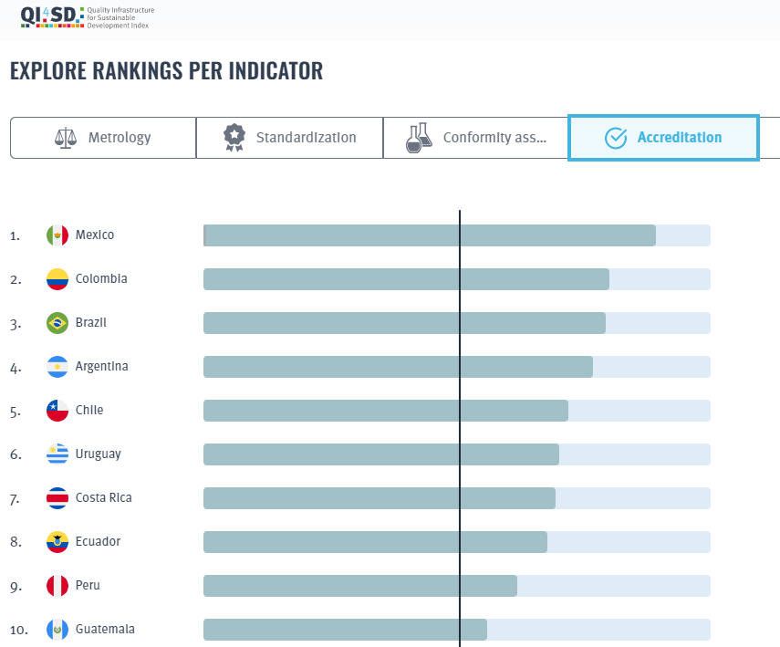
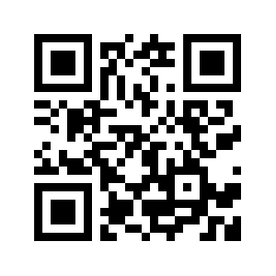

Quality Infrastructure for Sustainable
Development (QI4SD)Index
Scan me!

Slide 26
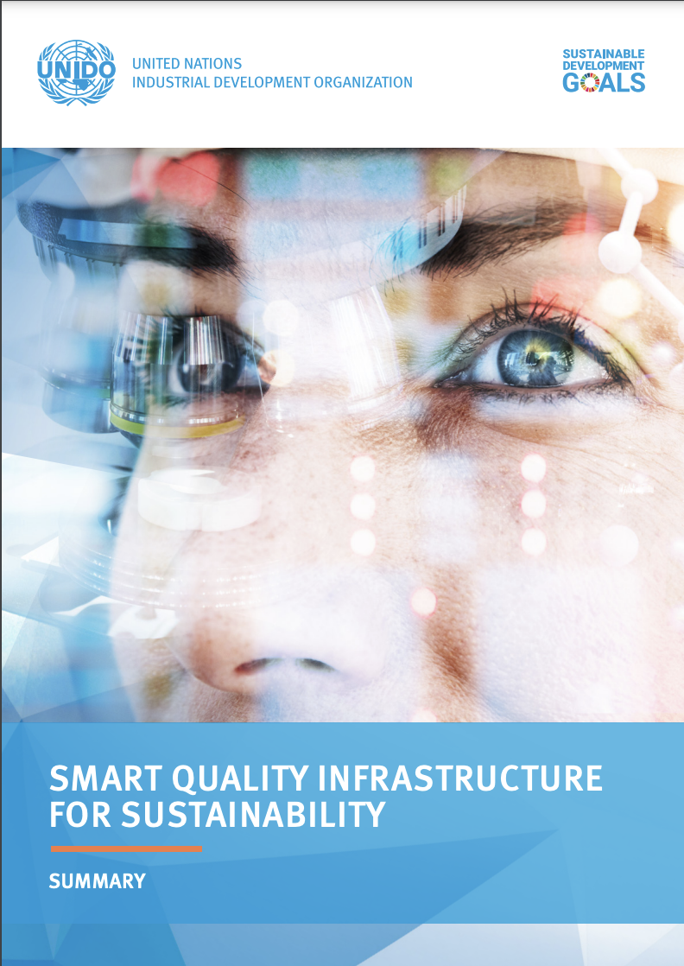
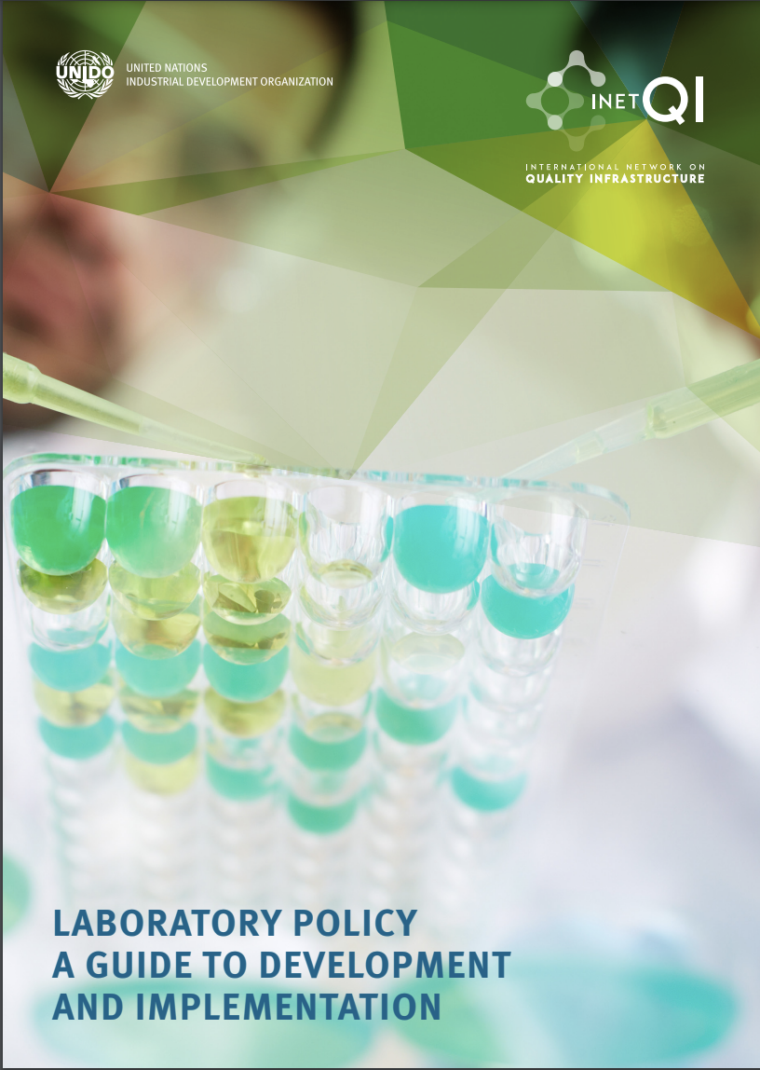
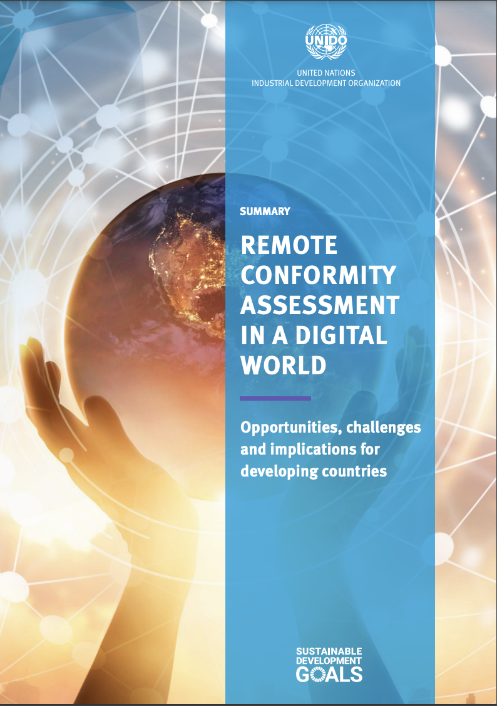
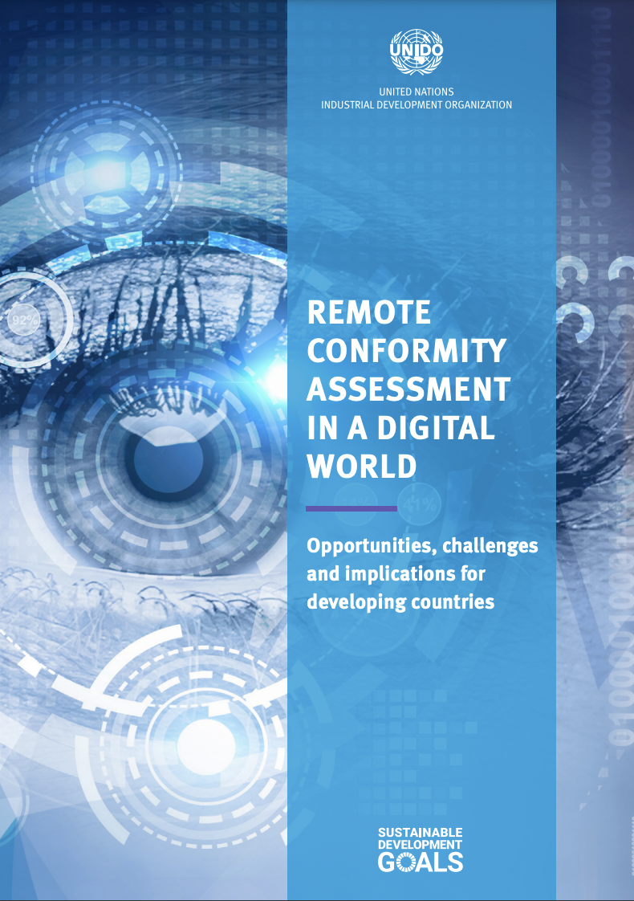
Publications

Slide 27

Looking to the future

Slide 28
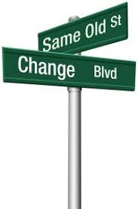
Conclusions
Digital transformation is not the end, is a means to an end.
Should be focused on problems/opportunities of greatest need for the organization. (Planet, People, Prosperity)
Technology, Data, Process and Culture may need to follow an appropriate sequence. But not a rule.
Culture for Quality principles: Continuous improvement, customer focus, risk assessment, engagement of people, leadership, etc.
A blended approach is foreseen.
Notes:
» We can foresee accelerated and increased concerns impacting the demographics/skill set on future auditor/assessor resource availability
» Aging demographic of auditors/assessors
» Increased digitalization requires different competence
» Need to stimulate ongoing commitments to growth/learning
» Witnessing and sampling still poses challenges in remote assessing and will need to be further explored for use with remote evaluation
» Audit durations are about the same for physical and remote audits but we can expect to spend more time on planning and the use of technology (including training)
» Need to be conscious of the possibility that remote assessment can become discriminatory (favouring the more educated sectors in developed economies)
» Need to avoid remote assessments becoming “tick-box” audits focusing only on documentation

Slide 29
The Way Forward
Quality needs to catch up with the 4IR pace of development to support the sustainable development for people, planet & prosperity
PLANET
Ensure
environmental
protection & improve
ecological
performance
PROSPERITY
Promote adoption
of new technologies,
ensure interoperability,
safety & security
PEOPLE
Social
responsibility

Slide 30
Thank You
David Tomlinson
Associate Technical Expert

