Slide 1
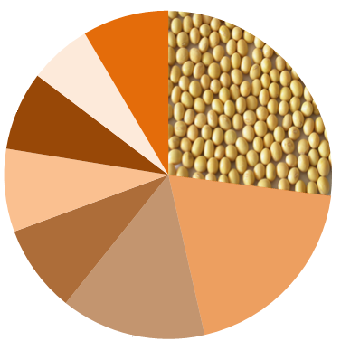
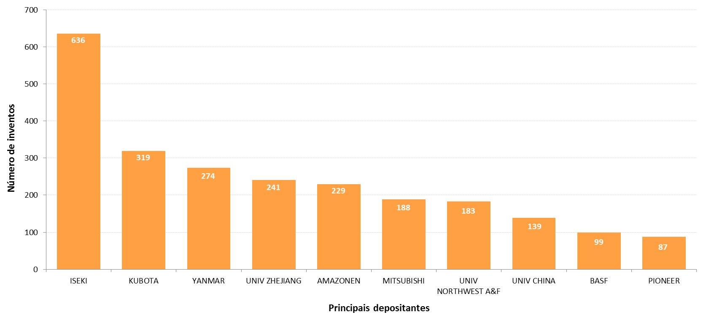
Nº 6 Year 2015
AGRICULTURAL MACHINERY 2
(Sowing – A01C): 2009-2013
Technological areas in patent documents
Total of inventions = 17,645
Distributing devices for liquid manure
Others
9%
6%
27%
Sowing*
Making or covering furrows
8%
Emphasis on parts for conducting and depositing seeds
Fertiliser distributors
8%
9%
19%
Methods of fertilising
Apparatus for testing or treating seeds
14%
Transplanting machines
While the technological area of sowing concentrates the largest number of patent documents, the main applicants concentrate their inventions in transplanting machines.
Main applicants
These applicants together hold approximately 15% of all patent documents relating to sowing
Number of inventions
Main applicants
* The figure inserted in the chart is available in the Microsoft Office 2010.
For more information, visit INPI web site www.inpi.gov.br (extended radar) or contact by e-mail radartecnologico@inpi.gov.br .

Slide 2

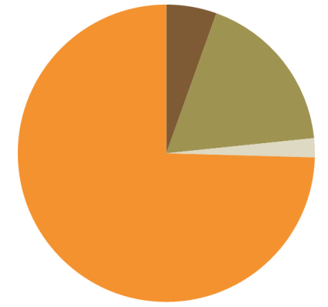
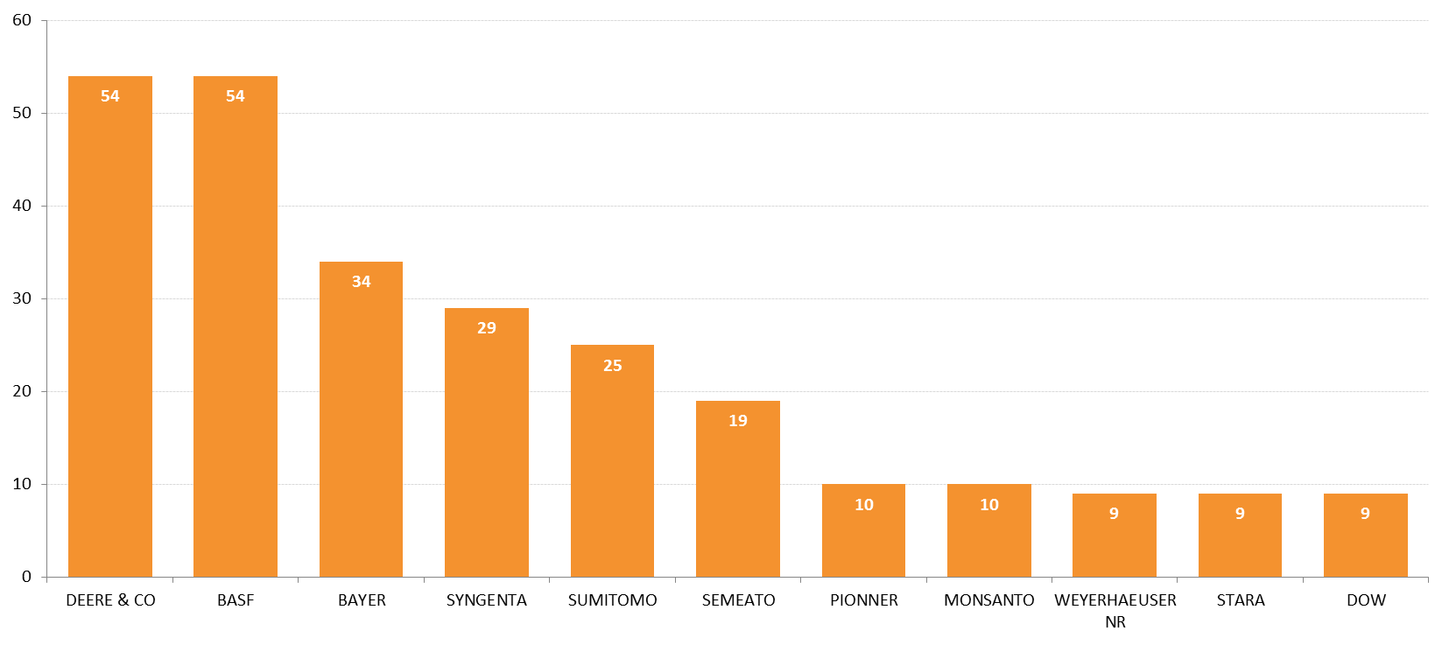
Nº 6 Year 2015
AGRICULTURAL MACHINERY 2
(Sowing – A01C): 2009-2013
Freedom to operate (FTO) in Brazil - patents
World
Brazil
Free
5%
Abandoned/
Withdrawn
Filed in Brazil
18%
Granted
4%
2%
3%
Can still be filed in Brazil *
75%
93%
Under examination process
Free
(not filed in Brazil)
Total: 17,645 inventions - nearly 93% of the inventions are free to be exploited in Brazil.
The data used for this analysis is updated until 21/10/2014 – RPI** number: 2285.
Main applicants in Brazil
Brazilian Company
Number of inventions
Brazilian Company
Main applicants in Brazil
* The amount of documents that can still be filed in Brazil is estimated, taking into account patent applications that may enter national phase in Brazil through the PCT agreement. This international agreement, managed by WIPO, facilitates the procedure of filing patent applications in different countries, reducing costs and extending the period for entering into the national phases in countries where patent protection is aimed.
** INPI-BR gazette.

