Slide 1
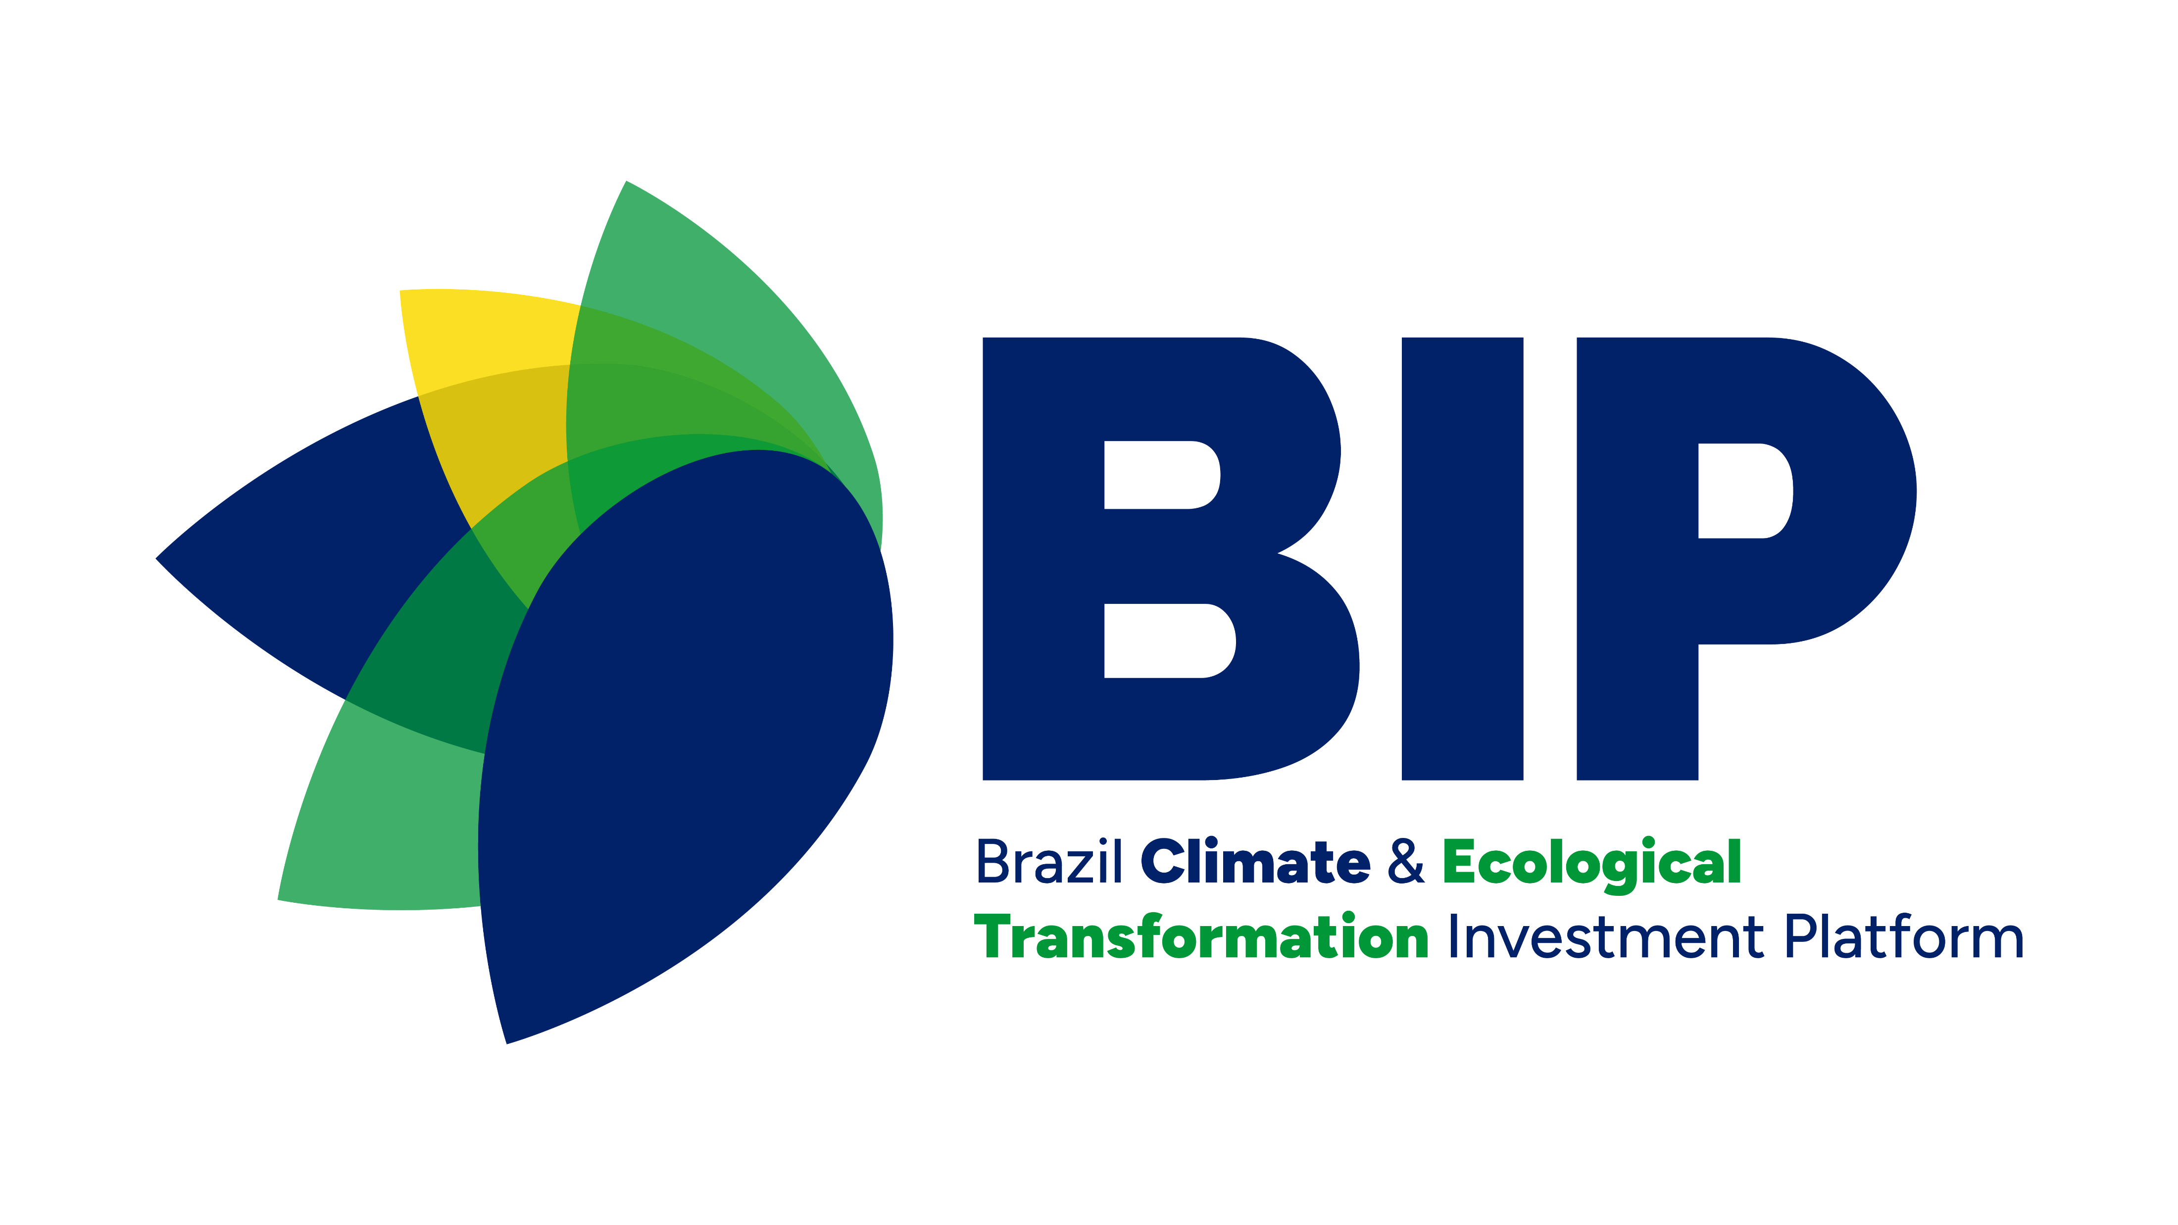
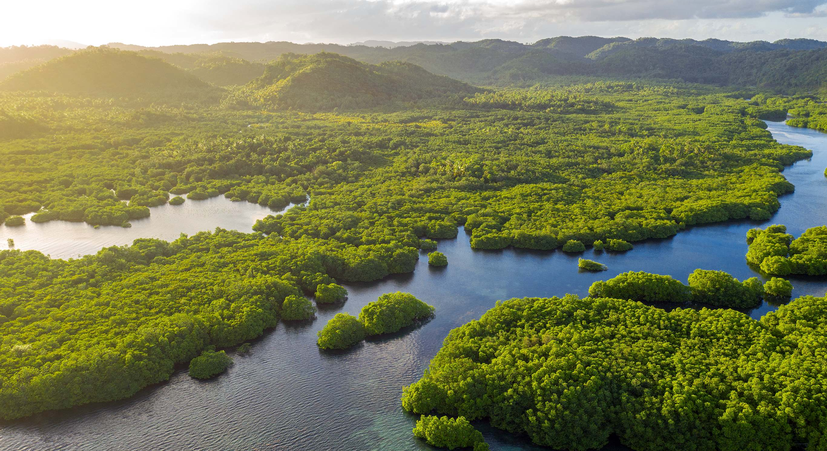





Brazil Climate and
Ecological Transformation
Investment Platform
Executive presentation
2026

Slide 2



Brazil has set an ambitious goal of achieving net zero emissions by 2050; reaching this target will require collaboration across multiple sectors
Emissions history
(GTCO2e, per year)
~2.00
Energy
Industry
& Mobility
Nature
0.85 – 1.05
The Paris Climate Agreement established Nationally Determined Contributions (NDC) to combat climate change
Net zero reduction of emissions aiming to achieve net zero emissions by 2050
Based on the G20 country platform Reference Framework for voluntary country-level mechanisms, set out by governments and designed to foster collaboration among development partners, based on a shared strategic vision and priorities
2022
2035
target
2050
Source: DPMA/SMC/MMA

Slide 3












The Brazilian government is already making progress toward achieving net zero through its various government transition plans
With the support of...
as Platform Secretariat lead
PPCDs
Estratégia Nacional de Bioeconomia
… BIP will further support the efforts of advancing Brazil’s NDC, with the government transition plans as strategic guidelines
Plano Nacional de Transição Energética
3

Slide 4
A Government-Led Platform to connect Projects and PE funds with Financial Institutions
BIP’s Ambition
Investors
Public and private Brazilian and international financial institutions seeking to invest in climate and ecological transformation
BIP
Facilitates connections based on alignment with government transition plans and climate priorities
Projects
“Support the achievement of Brazil's ambitious climate goals by scaling up transition investments from all sources, aligned with the government's climate transition plans in key sectors."
Projects aligned with the climate transition in prioritized sectors and seeking financing
Private equity funds
Concessional Mechanisms
Funds aligned with the climate transition in prioritized sectors, at the fundraising stage
Concessional mechanisms aligned to the climate transition on prioritized sectos

Slide 5





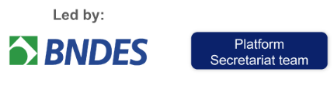
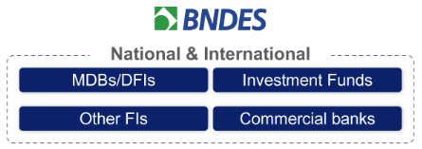


Governance
GROUPS
PARTICIPANTS
ROLES
Lead and elevate the Platform agenda within the government to advocate for necessary policy changes that unlock financing and enabling environment barriers to scaling investment flows –The Ministry of Finance is the coordinating ministry within the government
Establish the Platform as the main collaborative body for Brazil’s net zero transition by integrating existing pathways and programmes to mobilize capital at scale
Decide on inclusion of new government participants (i.e., Ministries, based on programmes)
Steering Committee
Secretariat
Set and drive the Platform workplan
Provide overall administrative and project management support
Facilitate communication and collaboration among Platform and external stakeholders
Financial Institution
Network
Participate in regularly scheduled meetings related to the Platform’s pipeline to explore potential investment opportunities
Participate in discussions regarding key investment barriers and potential solutions, according to themes prioritized by the Secretariat
Partner
Network
Provide technical and/or organizational support to the Secretariat, General Session and Working Groups, utilizing network and/or capabilities to support the Platform objectives
Supporter
Network
Facilitate connection between the Platform and external stakeholders to support the development of project pipeline and overall objectives and provide input with sector-specific knowledge
Participate in meetings on Platform progress, workplan and pipeline

Slide 6

BIP operates in four main ways
BIP ambition
To support the advancement of Brazil's ambitious climate goals, increasing transition investment from all sources
in support of the government's climate transition plans in key sectors
Connecting projects to
financial institutions
Connecting equity funds
in fundraising to potential investors
Connecting concessional mechanisms to projects and potential investors
Addressing main barriers
Identification, screening, and integration of a pipeline of projects aligned with BIP's objectives
Identification and integration of a long list of financial institutions interested in climate transition investments
Connecting projects to FIs
Identification, screening, and integration of a pipeline of equity funds in fundraising aligned with BIP's objectives
Connecting equity funds in fundraising to potential investors (national and international) and projects in BIP’s pipeline aligned with them
Identification, screening, and integration of a pipeline of concessional mechanisms aligned with BIP's objectives
Support on structuring and fundraising of mechanisms, mobilizing the platform’s expert network and investors
Connecting concessional mechanisms to interested FIs and projects in BIP’s pipeline aligned with them
Understanding the lifecycle and status of the projects
Deep dive analysis on project barriers
Mapping, prioritization and implementation of potential solutions
DELIVERY MECHANISMS
Project calls
Formally introduction of projects to FIs
Portfolio meetings with investors
Formal introduction of funds and mechanisms to investors
Partnerships to leverage existing mechanisms
Creation of new mechanisms
Coordinating key market stakeholders and actions for the climate transition
Facilitate connection and communication between the platform and external stakeholders (e.g., MDBs, DFIs, government initiatives) to consolidate efforts, support overall objectives, and gather insights on sector-specific topics.
Government initiatives
(E.g., Eco Invest, Arc of Restoration)
Sectoral initiatives
(E.g., Industrial Transition Accelerator Brazil programme, Nature Investment Lab)
Other stakeholders
(E.g., MDBs, DFIs, national associations, vertical climate funds)

Slide 7
BIP operates in four main ways
BIP ambition
To support the advancement of Brazil's ambitious climate goals, increasing transition investment from all sources
in support of the government's climate transition plans in key sectors
Connecting projects to
financial institutions
Connecting equity funds
in fundraising to potential investors
Connecting concessional mechanisms to projects and potential investors
Addressing main barriers
Identification, screening, and integration of a pipeline of projects aligned with BIP's objectives
Identification and integration of a long list of financial institutions interested in climate transition investments
Connecting projects to FIs
Identification, screening, and integration of a pipeline of equity funds in fundraising aligned with BIP's objectives
Connecting equity funds in fundraising to potential investors (national and international) and projects in BIP’s pipeline aligned with them
Identification, screening, and integration of a pipeline of concessional mechanisms aligned with BIP's objectives
Support on structuring and fundraising of mechanisms, mobilizing the platform’s expert network and investors
Connecting concessional mechanisms to interested FIs and projects in BIP’s pipeline aligned with them
Understanding the lifecycle and status of the projects
Deep dive analysis on project barriers
Mapping, prioritization and implementation of potential solutions
DELIVERY MECHANISMS
Project calls
Formally introduction of projects to FIs
Portfolio meetings with investors
Formal introduction of funds and mechanisms to investors
Partnerships to leverage existing mechanisms
Creation of new mechanisms
Coordinating key market stakeholders and actions for the climate transition
Facilitate connection and communication between the platform and external stakeholders (e.g., MDBs, DFIs, government initiatives) to consolidate efforts, support overall objectives, and gather insights on sector-specific topics.
Government initiatives
(E.g., Eco Invest, Arc of Restoration)
Sectoral initiatives
(E.g., Industrial Transition Accelerator Brazil programme, Nature Investment Lab)
Other stakeholders
(E.g., MDBs, DFIs, national associations, vertical climate funds)

Slide 8
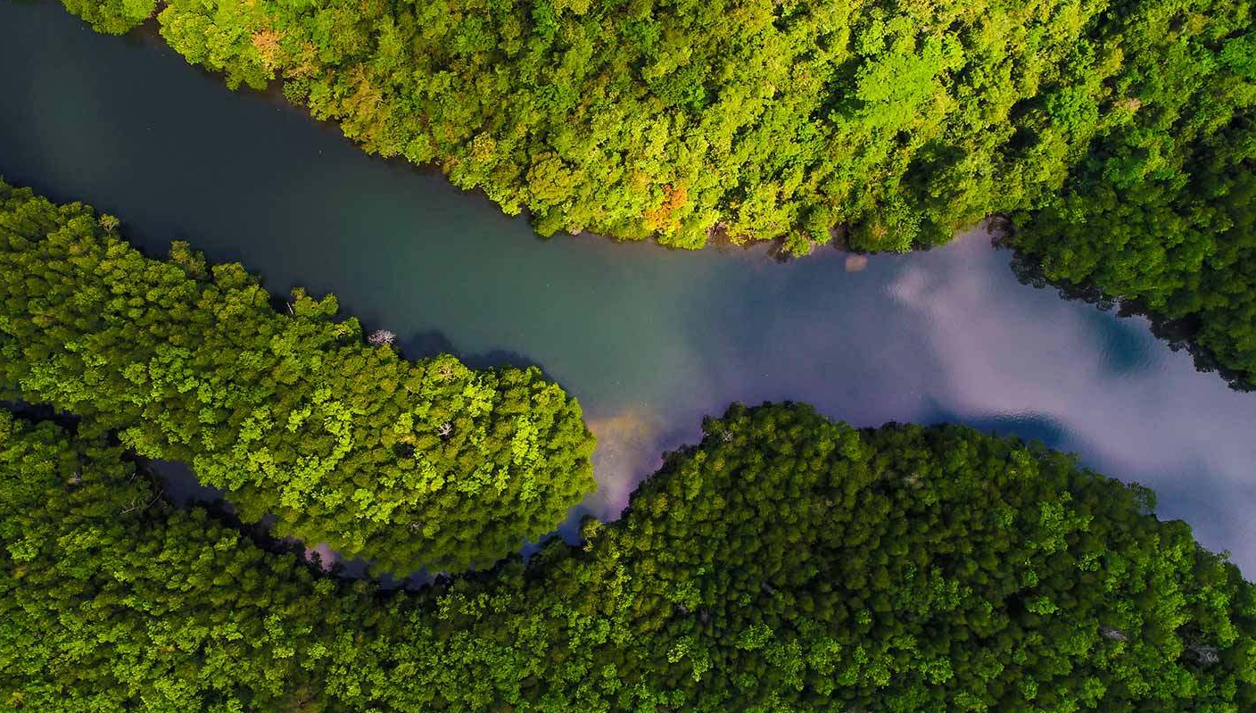
BIP will focus initially on three main sectors
GUIDED BY
Ecological Transformation Plan
Climate Plan
National Native Vegetation Recovery Plan
New Industry
Brazil
National Energy
Transition Plan
Bioeconomy National Strategy
sectors
National Solid Waste Plan
Subsectors
Nature-based Solutions & Bioeconomy
Industry & Mobility
Energy
Sustainable fuels
Recovery of native vegetation
Electric urban mobility
Resilient renewable systems
for isolated systems
Sustainable management
of native vegetation
Low carbon emissions hydrogen
Agricultural bio inputs and green fertilizer
Technologies for resilient power grids
Waste management
Low carbon emissions steel / aluminum
Offshore wind
Conversion of degraded pastures
Low carbon emissions cement
Sustainable agriculture and livestock
Energy efficiency
Biotechnology
Strategic minerals

Slide 9

BIP has six main parameters for project qualification
Alignment with transition plans and national programmes
Is the project aligned with the government’s transition plans and programmes that were prioritized by the platform’s Steering Committee?
Material environmental impact
Is the end-product expected to generate significant positive environmental impact?
  E.g., CO2e emissions reduction, avoidance, absorption and/or sequestration
Minimum parameters
Material amount of capital mobilization and support from the platform needed
Is the amount of capital requested relevant¹? Does the project need support to raise funds with private and/or public financial institutions?
Socio-economic co-benefits
Are there additional socio-economic co-benefits associated with the project?
  E.g.: job creation, regional development, improvement in the quality of life of communities
Promotion of technological development
Does the project promote technological development in its sector?
Other considerations
Alignment with credible climate frameworks, including private FIs' net-zero commitments
Is the project aligned with globally accepted climate frameworks, where applicable?
  E.g.: if seeking international funding, is the project aligned with internationally accepted climate frameworks?
Note: 1) details can be found at gov.br/bip

Slide 10























Current BIP pipeline has 22 approved projects, totaling ~USD 26.4B in potential investments
Energy
Industry and Mobility
Nature-Based Solutions and Bioeconomy
Low-carbon cement
(USD 700M)
Low-carbon steel/aluminum
(USD 3.0B)
Sustainable fuels
(USD 3.7B)
Agricultural bioinputs and green fertilizer
(USD 1.1B)
Sustainable agriculture and livestock
(USD 50M)
Low-carbon hydrogen
(USD 3.0B)
Low-carbon steel/aluminum
(USD 2.0B)
Strategic minerals
(USD 400M)
Sustainable agriculture and livestock
(USD 60M)
Sustainable fuels
(USD 1.0B)
Native vegetation restoration
(USD 60M)
Strategic minerals
(USD 565M)
Strategic minerals
(USD 440M)
Low-carbon hydrogen
(USD 5.0B)
Sustainable agriculture and livestock
(USD 810M)
Strategic minerals
(USD 1.2B)
Strategic minerals
(USD 390M)
Sustainable fuels
(USD 415M)
Native vegetation restoration
(USD 48M)
Low-carbon hydrogen
(USD 2.1B)
Strategic minerals
(USD 125M)
Native vegetation restoration
(USD 140M)

Slide 11

Current BIP pipeline has 22 approved projects, totaling ~USD 26.4B in potential investments (1/2)
Label
Nature-based solutions & Bioeconomy
Industry and mobility
Energy
PreliminarY
Agricultural bioinputs and green fertilizer
Brazil’s first industrial-scale green fertilizer plant in Uberaba, MG.
Total potential investment: USD 1.1B
Recovery of native vegetation
Restoration of 15,000 hectares of vegetation in the Amazon and Atlantic Forest.
Total potential investment: USD 140M
Recovery of native vegetation
Restoration of 5,000 hectares of vegetation in the Atlantic Forest.
Total potential investment: USD 60M
Recovery of native vegetation
Restoration of 4,000 hectares of vegetation in the Atlantic Forest and 1,000 in Southern Amazon.
Total potential investment: USD 48M
Regenerative agriculture
Cocoa plantation in Bahia that aims to restore native vegetation.
Total potential investment: USD 810M
Regenerative agriculture
Recovery of 30,000 ha of degraded pastures through silvopastoral systems.
Total potential investment: USD 50M
Regenerative agriculture
Expansion of 4,000 ha of agroforestry systems focused on cocoa production and carbon credits.
Total potential investment: USD 60M
Low-carbon cement
Production of activated clay as a SCM to substitute clinker in cement.
Total potential investment: USD 700M
Low-carbon steel/aluminum
Construction of industrial hubs for green hydrogen and hot-briquetted iron (HBI).
Total potential investment: USD 2.0B
Low-carbon steel/aluminum
Production of Hot-Briquetted Iron (HBI) aimed at decarbonizing the steel industry.
Total potential investment: USD 3.0B
Strategic minerals
Expansion of an ionic clay mine for rare earth carbonate mining.
Total potential investment: USD 565M
Strategic minerals
High grade class-1 nickel production in Pará, with class-leading GHG emission credentials.
Total potential investment: USD 400M
Strategic minerals
Development of low-emission extraction methods for rare earth elements.
Total potential investment: USD 440M
Strategic minerals
Mining and processing of rare earths.
Total potential investment: USD 390M
Strategic minerals
Production of low emission nickel and cobalt.
Total potential investment: USD 1.2B
Strategic minerals
Refurbishment and reactivation of the only Class 1 nickel and cobalt refinery in Latin America.
Total potential investment: USD 125M

Slide 12

Current BIP pipeline has 22 approved projects, totaling ~USD 26.4B in potential investments (2/2)
Label
Nature-based solutions & Bioeconomy
Industry and mobility
Energy
PreliminarY
Sustainable fuels
Project development aimed at producing HVO and SAF from macaúba.
Total potential investment: USD 3.7B
Sustainable fuels
Project development aimed at producing SAF and RD from winter rotational oil seeds.
Total potential investment: USD 1.0B
Sustainable fuels
Treatment of agro-industrial waste and its use for biomethane production.
Total potential investment: USD 415M
Low-carbon hydrogen
Production of green hydrogen and transformation into green ammonia.
Total potential investment: USD 2.1B
Low-carbon hydrogen
Establish a green hydrogen plant to produce green ammonia.
Total potential investment: USD 5.0B
Low-carbon hydrogen
Establishing a green hydrogen plant in Pecém, Ceará.
Total potential investment: USD 3.0B

Slide 13

BIP already has 4 projects that have successfully secured funding
Get to know BIP’s projects that are moving into implementation after securing funding
Strategic minerals
(USD 565M)
Sustainable fuels
(Plant 2: USD 40M)
Expansion of the mine’s production capacity in Minaçu, Goiás, through financing obtained from the U.S. International Development Finance Corporation (DFC)
Implementation of plant 2 (out of 10) to produce biomethane from organic waste, through equity and debt mobilization
Native vegetation restoration
(Phase 1 : USD 20M)
Sustainable fuels
(Phase 1: USD 1.5B)
Acelen brought together an international consortium to secure the total funding for the construction of a biorefinery in Bahia (phase 1)
Funding for the implementation of the Muçununga Project through the Fundo Clima (BNDES) aimed at restoring 1,300 hectares of Atlantic Forest in southern Bahia.
+ MORE TO COME

Slide 14


BIP sets up Project Calls to facilitate the initial connection between projects and FIs
HOW IT
WORKS
PROJECT CALL
RESULTS
as of Aug-2025
During the project call
1ST PROJECT CALL
2ND PROJECT CALL
3RD PROJECT CALL
4TH PROJECT CALL
Projects are connected to FIs who are part of BIP, which include MDBs/DFIs, private banks, insurance players, asset managers and funds
  Presentations are open to the full FI audience simultaneously, maximizing visibility and comparability
Each project has 25 minutes: 10 minutes for a presentation of key project points (i.e. sector, impact, capital sought, barriers, etc.) and 15 minutes for Q&A with all FIs at once
5TH PROJECT CALL
6TH PROJECT CALL
7TH PROJECT CALL
8TH PROJECT CALL
After the project call
The BIP Secretariat facilitates connections between interested FIs and the project sponsors
Negotiations are done bilaterally, between FIs and projects, and are independent from the BIP Secretariat
BIP keeps track of project evolution to identify barriers and assess how the platform can help unlock financing (e.g., access to catalytic capital, guarantees, insurance, offtake, etc.)
+ MORE MEETINGS TO COME
60+
Unique FIs have joined project calls
195+
Participants from FIs have joined project calls
80+
Connections facilitated by BIP

Slide 15





BIP expects continuous engagement of the projects as a counterpart to integration into the platform
Project calls
Periodic meetings
Milestone updates
Engagement in communication
Participation in project calls to present the project to financial institutions within the platform’s network
Availability for regular meetings with the Platform to update on project status and progress, including negotiations with FIs connected through BIP
Keep the Secretariat informed about relevant project milestones such as: offtakes, licensing, completed fundraising, FID, FC, among others
Collaborate with the BIP communication team to promote the project and share progress through the platform’s official channels
Communication of withdrawal
Projects that are discontinued and therefore no longer wish to integrate the platform must formally communicate this to the secretariat

Slide 16
BIP operates in four main ways
BIP ambition
To support the advancement of Brazil's ambitious climate goals, increasing transition investment from all sources
in support of the government's climate transition plans in key sectors
Connecting projects to
financial institutions
Connecting equity funds
in fundraising to potential investors
Connecting concessional mechanisms to projects and potential investors
Addressing main barriers
Identification, screening, and integration of a pipeline of projects aligned with BIP's objectives
Identification and integration of a long list of financial institutions interested in climate transition investments
Connecting projects to FIs
Identification, screening, and integration of a pipeline of equity funds in fundraising aligned with BIP's objectives
Connecting equity funds in fundraising to potential investors (national and international) and projects in BIP’s pipeline aligned with them
Identification, screening, and integration of a pipeline of concessional mechanisms aligned with BIP's objectives
Support on structuring and fundraising of mechanisms, mobilizing the platform’s expert network and investors
Connecting concessional mechanisms to interested FIs and projects in BIP’s pipeline aligned with them
Understanding the lifecycle and status of the projects
Deep dive analysis on project barriers
Mapping, prioritization and implementation of potential solutions
DELIVERY MECHANISMS
Project calls
Formally introduction of projects to FIs
Portfolio meetings with investors
Formal introduction of funds and mechanisms to investors
Partnerships to leverage existing mechanisms
Creation of new mechanisms
Coordinating key market stakeholders and actions for the climate transition
Facilitate connection and communication between the platform and external stakeholders (e.g., MDBs, DFIs, government initiatives) to consolidate efforts, support overall objectives, and gather insights on sector-specific topics.
Government initiatives
(E.g., Eco Invest, Arc of Restoration)
Sectoral initiatives
(E.g., Industrial Transition Accelerator Brazil programme, Nature Investment Lab)
Other stakeholders
(E.g., MDBs, DFIs, national associations, vertical climate funds)

Slide 17
BIP can be used as credibility reference and to increase visibility of funds in fundraising
Fundraising
Selection of new investments
Funding for investees
ACCESS TO BIP PIPELINE
INCLUSION OF PROJECTS IN BIP
BIP STAMP
FUNDRAISING
BIP stamp can strengthen credibility in fundraising negotiations, as recognition of alignment with the national climate transition agenda
Support and connection activities led by BIP with selected investors (climate funds, sovereign organizations, commercial investors, etc.)
Access to pre-selected projects pipeline aligned with the government's climate transition agenda
Potential for inclusion of companies invested by the fund in BIP's project pipeline¹
Value Proposition
Approach
As part of the platform, the fund can use BIP's logo in its institutional materials and website to support its fundraising actions
Elaboration of one-pager with public information
Adhoc meetings with investors to present selected funds
Direct connection of interested investors with funds
Participation in project presentations organized by BIP
Direct connection to projects of interest
Project presentations for FIs organized by BIP
Direct connection with interested FIs
Participation in discussions on project financing barriers for potential Platform action
Note: (1) Subject to the approval of the project in the BIP project qualification criteria, analyzed by the BIP Secretariat

Slide 18
Criterias for equity funds to join the Platform for fundraising
CRITERIA
Fundraising
Preliminary
Need for financing
Private equity funds in accordance with the terms of CVM Resolution 175
Funds must offer diversification of exposure, with single-asset funds considered as projects
Investment Requirements
The fund must be dedicated to companies and projects in Brazil and hold at least USD 50 million in Target Committed Equity (Energy and Industry sectors)
The fund must be dedicated to companies and projects in Brazil and hold at least USD 30 million in Target Committed Equity (NBS)
Phase
Minimum parameters
Funds in the fundraising phase, which are already constituted, with up to 24 months from the date of incorporation
Sectoral restrictions
Provision in regulation
  Allocate at least half of the investments, either by value or number of companies invested, in BIP subsectors¹
  Investment restriction clause for sectors vetoed by the unsupported List^{1,2}
1
2
Impact
Preparation of public impact monitoring report, with minimum annual frequency, covering social, environmental and climate indicators of the companies/projects invested individually or in aggregate¹
Sustainable fund
Sustainable investment fund, as defined by the Brazilian Association of Financial and Capital Markets Entities (ANBIMA) or aligned with other sustainability standards adopted by development institutions
Fund in accordance with the principles defined by Article 9 of the SFDR, for sustainable funds
Investment fund aligned with the Brazilian sustainable taxonomy
Other considerations
Note: (1) It must be provided in the Fund’s regulation; (2) For NBS solutions, additional exclusion criteria may be requested

Slide 19
BIP is focused on three main sectors
GUIDED BY
1
Ecological Transformation Plan
Climate Plan
PLANAVEG
New Industry Brazil
National Energy Transition Plan
PLANARES
Sectors
ENBio
Subsectors
Industry and Mobility
Nature-based solutions and bioeconomy¹
Energy
Provision in the Fund’s regulation is required for the allocation of at least half of the investments, either by value or number of companies invested, in BIP subsectors
Sustainable fuels (except 1st generation ethanol)²
Recovery of native vegetation
Electric urban mobility
Resilient renewable systems
for isolated systems
Sustainable management
of native vegetation
Low-carbon hydrogen
Agricultural bioinputs and green fertilizer
Technologies for resilient power grids
Waste management
Low-carbon emissions steel/aluminum
Offshore wind
Conversion of degraded pastures
Low-carbon emissions cement
Sustainable agriculture and livestock
Energy efficiency
Biotechnology
Strategic minerals³
Note: (1) For NBS, additional criteria may be considered; (2) Exception for first-generation ethanol; (3) They are: Cobalt, Copper, Tin, Graphite, Lithium, Manganese, PGMs, Molybdenum, Niobium, Nickel, Silicon, Tantalum, Rare Earths, Titanium, Tungsten, Uranium, Vanadium, Zinc, Phosphate, Potassium or other minerals for promoting soil fertility, including remineralizers

Slide 20
Exclusionary criteria for funds to enter the platform
LIST OF UNsupported ACTIVITIES
2
Agriculture and livestock | Agricultural businesses not registered in the Rural Environmental Registry (CAR)
Mining and energy | Extraction, transport, marketing or generation of energy from mineral coal
 | Extraction, transportation, marketing or generation of energy from petroleum and its derivatives
 | Extraction, transportation, commercialization or generation of energy from natural gas with no foreseen transition¹
 | Mining enterprises that incorporate a rudimentary or artisanal mining process
 | Mining enterprises, including in the research phase, located on indigenous lands of traditional occupation (art. 231 of the Federal Constitution)
Other | Other pollutants²
 | Gambling and betting
 | Adult per-hour stay hotels
 | Saunas and hot springs
 | Clubs
 | Commercialization of weapons and ammunition
 | Tobacco industry
 | Alcoholic beverages (except wine and beer)
 | Pornography/prostitution
 | Media
Provision in the Fund’s regulation is required for an investment restriction clause for sectors vetoed by the List of Non-Supportable Activities BIP
Note: (1) Investment in natural gas will be allowed in the hypotheses of transition provided in the Brazilian Sustainable Taxonomy; (2) Includes hazardous substances subject to international prohibition

Slide 21
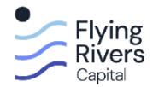

Current BIP pipeline has 2 approved funds
PreliminarY
Energy Transition and Decarbonization
Reforest Fund I
+ MORE FUNDS TO COME
Focus on restoring degraded ecosystems into productive and climate-resilient assets
Target fund size: US$ 370 M
Orchestrating high-impact opportunities in energy transition, sustainable agriculture and supply chain decarbonization

Slide 22
BIP operates in four main ways
BIP ambition
To support the advancement of Brazil's ambitious climate goals, increasing transition investment from all sources
in support of the government's climate transition plans in key sectors
Connecting projects to
financial institutions
Connecting equity funds
in fundraising to potential investors
Connecting concessional mechanisms to projects and potential investors
Addressing main barriers
Identification, screening, and integration of a pipeline of projects aligned with BIP's objectives
Identification and integration of a long list of financial institutions interested in climate transition investments
Connecting projects to FIs
Identification, screening, and integration of a pipeline of equity funds in fundraising aligned with BIP's objectives
Connecting equity funds in fundraising to potential investors (national and international) and projects in BIP’s pipeline aligned with them
Identification, screening, and integration of a pipeline of concessional mechanisms aligned with BIP's objectives
Support on structuring and fundraising of mechanisms, mobilizing the platform’s expert network and investors
Connecting concessional mechanisms to interested FIs and projects in BIP’s pipeline aligned with them
Understanding the lifecycle and status of the projects
Deep dive analysis on project barriers
Mapping, prioritization and implementation of potential solutions
DELIVERY MECHANISMS
Project calls
Formally introduction of projects to FIs
Portfolio meetings with investors
Formal introduction of funds and mechanisms to investors
Partnerships to leverage existing mechanisms
Creation of new mechanisms
Coordinating key market stakeholders and actions for the climate transition
Facilitate connection and communication between the platform and external stakeholders (e.g., MDBs, DFIs, government initiatives) to consolidate efforts, support overall objectives, and gather insights on sector-specific topics.
Government initiatives
(E.g., Eco Invest, Arc of Restoration)
Sectoral initiatives
(E.g., Industrial Transition Accelerator Brazil programme, Nature Investment Lab)
Other stakeholders
(E.g., MDBs, DFIs, national associations, vertical climate funds)

Slide 23
Value proposition for mechanisms in the BIP
Structuring¹
Fundraising for the mechanisms
Access to projects
Visibility of supported projects
STRUCTURING
SUPPORT
ACCESS TO THE
BIP PIPELINE
INCLUSION OF
PROJECTS IN BIP
BIP STAMP
FUNDRAISING
On-demand structuring support, mobilizing networks and expertise to refine the mechanism
BIP Stamp can strengthen credibility in fundraising negotiations, as recognition of alignment with the national climate transition agenda
Support actions and connections led by the BIP with selected investors (sovereign organizations, foundations, climate funds, family offices, MDBs, companies, etc.)
Access to a pre-selected projects pipeline aligned with the government's climate transition agenda
Potential for inclusion of projects supported by the mechanisms in the pipeline of the BIP²
Value proposition
Engagement in mechanism’s refinement meetings
Connection with projects on BIP pipeline or other related networks within BIP to validate the mechanisms’ model
As part of the platform, the mechanism can use the BIP’s logo in its institutional materials and website to support its fundraising efforts
Inclusion of the mechanism on the website/materials of the BIP
Support in preparing presentation materials for the mechanism
Ad hoc meetings with investors to present selected mechanisms
Direct connection of interested investors with mechanisms
Direct connection to projects of interest
Project presentations to FIs organized by the BIP
Direct connection with interested FIs
Operating model
Note: (1) Exclusive to mechanisms that joined the BIP during the structuring phase; (2) Subject to project approval based on BIP's project qualification criteria, reviewed by the BIP Secretariat

Slide 24







Criterias for concessional mechanisms to join the Platform
Minimum parameters | Phase | Mechanisms in the structuring phase (post-ideation) or fundraising phase, provided they remain within 24 months of establishment
 | Mechanism robustness | The mechanism must fulfill all robustness criteria outlined below: Manager, proponent, or anchor investor with a proven track record aligned with the proposed mechanism, demonstrating relevant technical contributions to development and indicative financial commitment through declarations or equivalent instruments Significant potential for transformative impact in at least one of BIP's priority sectors, supported by a plan to publish an annual public impact monitoring report covering social, environmental, and climate indicators for projects, either individually or in aggregate Absence of relevant processes or controversies (regulatory, environmental, labor, reputational) Mechanisms in the fundraising phase must additionally have a financial structure consistent with the proposed challenge
 | Investment requirements | The mechanism must have at least USD 10M in Target Committed Capital (NBS) or USD 20M (Industry and Energy)
 | Nature of the mechanism | The mechanism must function as a financial instrument (e.g., credit or guarantees) incorporating a component of concessionality compared to standard market conditions in its investments (e.g., concessionality in access, risk, rate, or term) The instrument must be registered or demonstrate a commitment to register with the CVM, specifying the instrument under which it intends to operate The mechanism must ensure exposure diversification, prohibiting instruments dedicated to a single project or company, except for cooperatives and supplier chains
 | Sectoral restrictions | Regulatory provision Allocate at least 65% of investments, by value or number of companies invested, financed, or benefited, to subsectors within the BIP¹ Investment restriction clause for sectors prohibited under the Non-Supportable Activities List^{1,2}
 | Geographic scope | The mechanism must be dedicated to companies and projects in Brazil, with either national or subnational coverage Mechanisms with a regional or global scope are eligible if they establish a compartment dedicated to Brazil, which will exclusively qualify for BIP support
Other considerations | Desirable characteristics | Mechanism with a provision for incentivizing long-term operations Mechanism with a provision for a technical assistance component (TA) for benefited projects Sustainable financial mechanism, or any other terms related to sustainable finance, as defined by ANBIMA, CVM, or other sustainability standards adopted by development institutions Mechanism aligned with the Brazilian Sustainable Taxonomy Mechanism in compliance with the principles defined in the SFDR for sustainable mechanisms
1
2
Note: (1) Must be included in the mechanism's regulations; internal regulations require submission for BIP evaluation (2) NBS solutions may require additional exclusion criteria

Slide 25
BIP is focused on three main sectors
GUIDED BY
1
Ecological Transformation Plan
Climate Plan
PLANAVEG
New Industry Brazil
National Energy Transition Plan
PLANARES
Sectors
ENBio
Subsectors
Industry and Mobility
Nature-based solutions and bioeconomy¹
Energy
Provision in the Mechanism’s regulation is required for the allocation of at least 65% of the investments, either by value or number of companies invested, in BIP subsectors
Sustainable fuels (except 1st generation ethanol)²
Recovery of native vegetation
Electric urban mobility
Resilient renewable systems
for isolated systems
Sustainable management
of native vegetation
Low-carbon hydrogen
Agricultural bioinputs and green fertilizer
Technologies for resilient power grids
Waste management
Low-carbon emissions steel/aluminum
Offshore wind
Conversion of degraded pastures
Low-carbon emissions cement
Sustainable agriculture and livestock
Energy efficiency
Biotechnology
Strategic minerals³
Note: (1) For NBS, additional criteria may be considered; (2) Exception for first-generation ethanol; (3) They are: Cobalt, Copper, Tin, Graphite, Lithium, Manganese, PGMs, Molybdenum, Niobium, Nickel, Silicon, Tantalum, Rare Earths, Titanium, Tungsten, Uranium, Vanadium, Zinc, Phosphate, Potassium or other minerals for promoting soil fertility, including remineralizers

Slide 26
Exclusionary criteria for mechanisms to enter the platform
LIST OF UNsupported ACTIVITIES
2
Agriculture and livestock | Agricultural businesses not registered in the Rural Environmental Registry (CAR)
Mining and energy | Extraction, transport, marketing or generation of energy from mineral coal
 | Extraction, transportation, marketing or generation of energy from petroleum and its derivatives
 | Extraction, transportation, commercialization or generation of energy from natural gas with no foreseen transition¹
 | Mining enterprises that incorporate a rudimentary or artisanal mining process
 | Mining enterprises, including in the research phase, located on indigenous lands of traditional occupation (art. 231 of the Federal Constitution)
Other | Other pollutants²
 | Gambling and betting
 | Adult per-hour stay hotels
 | Saunas and hot springs
 | Clubs
 | Commercialization of weapons and ammunition
 | Tobacco industry
 | Alcoholic beverages (except wine and beer)
 | Pornography/prostitution
 | Media
Provision in the mechanisms’ regulation is required for an investment restriction clause for sectors vetoed by the List of Non-Supportable Activities BIP
Note: (1) Investment in natural gas will be allowed in the hypotheses of transition provided in the Brazilian Sustainable Taxonomy; (2) Includes hazardous substances subject to international prohibition

Slide 27
BIP operates in four main ways
BIP ambition
To support the advancement of Brazil's ambitious climate goals, increasing transition investment from all sources
in support of the government's climate transition plans in key sectors
Connecting projects to
financial institutions
Connecting equity funds
in fundraising to potential investors
Connecting concessional mechanisms to projects and potential investors
Addressing main barriers
Identification, screening, and integration of a pipeline of projects aligned with BIP's objectives
Identification and integration of a long list of financial institutions interested in climate transition investments
Connecting projects to FIs
Identification, screening, and integration of a pipeline of equity funds in fundraising aligned with BIP's objectives
Connecting equity funds in fundraising to potential investors (national and international) and projects in BIP’s pipeline aligned with them
Identification, screening, and integration of a pipeline of concessional mechanisms aligned with BIP's objectives
Support on structuring and fundraising of mechanisms, mobilizing the platform’s expert network and investors
Connecting concessional mechanisms to interested FIs and projects in BIP’s pipeline aligned with them
Understanding the lifecycle and status of the projects
Deep dive analysis on project barriers
Mapping, prioritization and implementation of potential solutions
DELIVERY MECHANISMS
Project calls
Formally introduction of projects to FIs
Portfolio meetings with investors
Formal introduction of funds and mechanisms to investors
Partnerships to leverage existing mechanisms
Creation of new mechanisms
Coordinating key market stakeholders and actions for the climate transition
Facilitate connection and communication between the platform and external stakeholders (e.g., MDBs, DFIs, government initiatives) to consolidate efforts, support overall objectives, and gather insights on sector-specific topics.
Government initiatives
(E.g., Eco Invest, Arc of Restoration)
Sectoral initiatives
(E.g., Industrial Transition Accelerator Brazil programme, Nature Investment Lab)
Other stakeholders
(E.g., MDBs, DFIs, national associations, vertical climate funds)

Slide 28

Beyond the Project Calls, BIP is currently focused on 4 key workstreams to address key project barriers
01
02
03
04
Initiative
Objective | Advance in the mobilization of concessional and commercial capital, expanding BIP's network of partners and consolidating the offer of concessional resources | Unlocking industrial and energy transition projects through catalytic equity | Enable investments through de-risking instruments and discussion on IF risk assessment procedures | Expand use of insurance to unlock financing for higher-risk projects
Current Focus | Conduct international missions for direct engagement with investors Build partnerships with climate funds, MDBs/DFIs, sovereign wealth funds and philanthropic funds Coordinate and consolidate existing concessional offerings | Structuring of a catalytic equity fund in partnership with the GCF Network with other potential investors | Structure de-risking initiatives with concessional resources from DFIs Map enablers to reduce risks in reforestation and agriculture projects | Identify barriers to accessing/deploying insurance in Brazil Build risk matrix for NBS Map solutions and partners for insurance coverage
Capital mobilization
Develop catalytic equity instruments
Develop de-risking mechanisms
Foster insurance mechanisms for emerging sectors

Slide 29


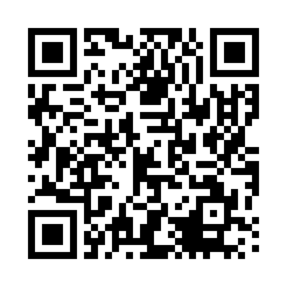

Thank you!
Financial institutions
Project owners/developers and fund or mechanism managers
Should you be interested in learning more about projects, funds or mechanisms in the BIP pipeline, you may reach out to the Secretariat to join the Platform’s network
If you have a project, private equity fund or mechanism that aligns with the BIP sectors, please contact the Secretariat to submit it for consideration
Please contact the Secretariat via bip@bndes.gov.br to submit a project, fund or mechanism for consideration or to be included in the network of financial institutions
More information at gov.br/bip
Follow us on linkedin.com/company/bip-plataforma-brasil

Slide 30
