Slide 1



I Defense Acquisition Management Seminar: Perspectives and New Challenges for Defense Acquisition Management in Brazil
War College
Rio de Janeiro
Is defence acquisition inherently
difficult? Perspectives on the UK
Ron Matthews
Centre for Defence Management and Leadership
Defence Academy of the United Kingdom
© Crown Copyright 2018

Slide 2
Presentation outline
Challenge of cost escalation
Structure
Appropriate procurement options
Holy grail: ‘smart’ acquisition
Addressing acquisition challenges

Slide 3
Introduction
Disciplinary home of defence acquisition: defence economics
Calibrating defence and economics
Strategic implications of acquisition policy: sovereignty and national security
Wider economic considerations: affordability

Slide 4
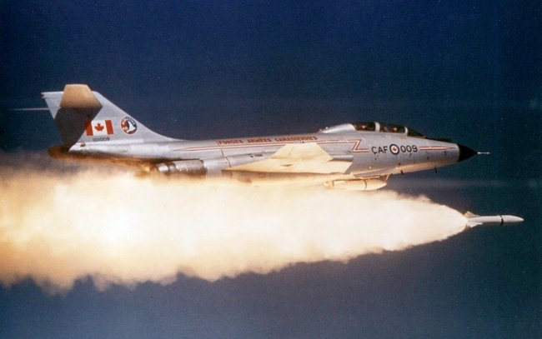
Defence Economics at the heart of the 21st Century Revolution in Military Affairs (RMA)
Defence Technology
Technology Management
Affordability through Defence Management
Cost Effectiveness

Slide 5
Defining the RMA
Defence Technology
Transformational warfare:
- Coalition
- Capability - focus
Defence
Technology
RMA
Defence Management
Technology Management
VFM
Economy
Efficiency
Effectiveness
RBA
RMA
Management
DIS
Offset
CMI

Slide 6
Defence Acquisition Options
SELF-SUFFICIENCY
Indigenous
Research,
Development &
Production
S2 v S3
COLLABORATION
Joint Research,
Development &
Production
Bi/Multilateral coop
Private Finance Initiative
LICENSED PRODUCTION
No Indigenous R&D
Indigenous Manufacture
OFF-THE-SHELF
No Indigenous Development or Production
TECHNOLOGICAL
DEPENDENCE
SELF-SUFFICIENCY

Slide 7
Challenges to effective defence acquisition: the UK Case
2015 10yr Defence equipment acquisition plan: £178bn
2018: £21bn black hole in MoD budget caused by:
  Technological immaturity of prospective acquisition
  Strategic ‘over-reach’
  Cost escalation
  Programme ‘over-heating’
  Budgetary ‘spread and squeeze’
  Conspiracy of optimism
  Dynamic Technology requirements
  Increasing risk coupled with poor management and weak oversight
  L/R decline of MILEX/GDP
  Declining £/$ exchange rate

Slide 8
Addressing Acquisition Challenges
Short run expediencies:
  Cut procurement
  Stretch delivery schedules
  Reduce systems capability
Long-run initiatives:
  Link strategic ambitions to military capability
  Introduce change programmes to improve institutional culture and programme management
  Limit customer ability to continually modify requirements
  Constrain political interference
  Promote Open Systems Architecture
  Enhance Whole-Life Cost (WLC) capabilities
g of offset project implementation to ensure policy compliance
Essentiality of inter-departmental and other stakeholder coordination (eg. universities and regional councils)
Long-term strategy
P
E

Slide 9
UK Experience Implementing WLC
UK MoD mandates WLC on all new acquisitions
WLC: 9/10 of total acq. cost iceberg (below water line)
11 WLC components: 6 – CADM and 5 – inservice
WLC hard to estimate:
  Big value = political interference
  Immature systems, long life, mid-life u/g, tech/strat/econ/politics
  Defence Lines of Development (DLODs)
  Problem of estimating at concept stage
  Concurrent acquisition WLCs must be included
  Staff rotation, weak skills, armed branch differences
  Adversarial relations, unanticipated cost changes

Slide 10
UK Experience Implementing WLC
UK MoD still unable to effectively implement WLCs on major new weapons acquisitions
This lack of awareness of WLC carries the potential of negatively impacting on acquisition choice by distorting total cost of ownership, and thus critically undermining optimal defence resource allocation

Slide 11

Conclusions
Increasingly complex systems
raises uncertainty re cost, time
and performance
Inevitably misalignment between ambitions and affordability
Emphasis on ensuring an
intelligent customer
Whole-life costs need to be
included into delivery equation,
But….!?

Slide 12

www.cranfield.ac.uk
T: +44 (0)1793 785810
Defence Academy of the United Kingdom
© Crown Copyright 2018

