Slide 1

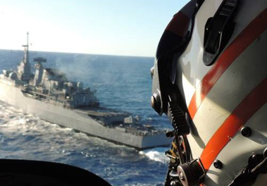
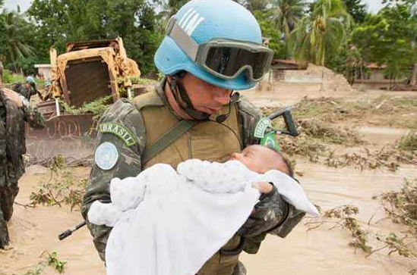
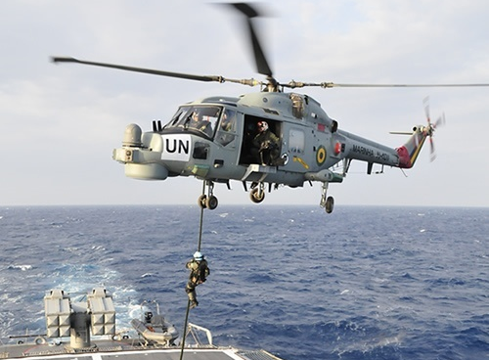
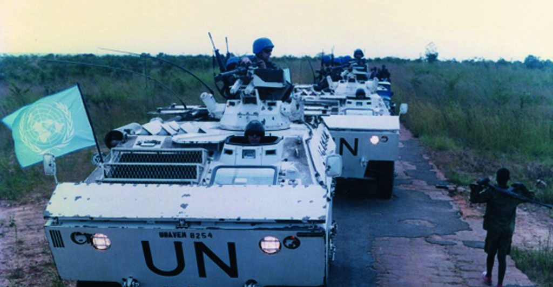
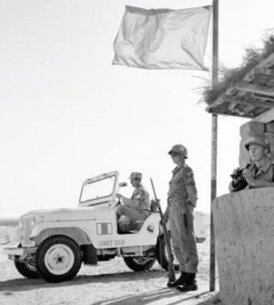
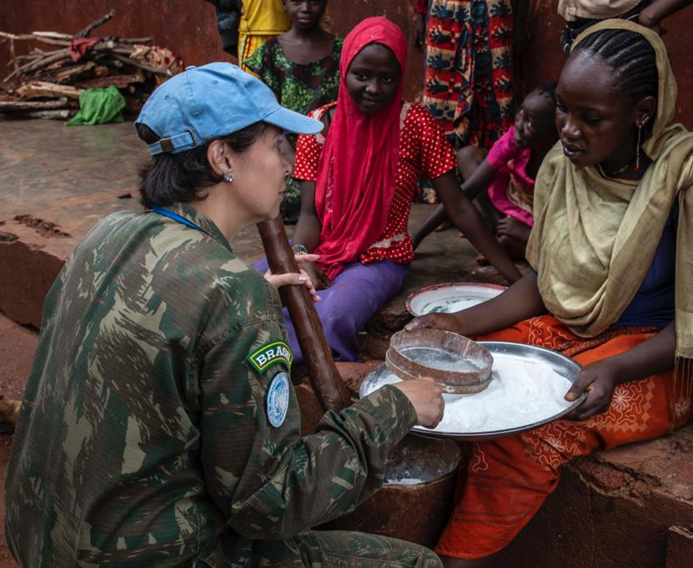
Fonte: MB
(Foto – FTM/UNIFIL)
Fonte: UN Nations
(Foto – MINUSCA)
Fonte: Site Instituto Boina Azul (Foto – UNAVEM III)
LINHA DO TEMPO
DAS OPERAÇÕES DE PAZ SOB A ÉGIDE DA ONU
Fonte: Facebook da Associação do Batalhão Suez (Foto- UNEFI)
Atualizado em 27/05/2026
Fonte: Site Diálogo Américas (Foto - MINUSCA)
Notes:
FOTO 1 – Marinha do Brasil (https://tecnodefesa.com.br/marinha-realiza-exercicio-visando-missao-de-paz/)
FOTO 2 - Fonte: United Nations - Peace, dignity and equality on a healthy planet (https://www.un.org/uk/file/121841)
FOTO 3 - Fonte: Instituto Boina Azul (https://institutoboinaazul.com.br/copia-copia-copia-home-2-1-1)
FOTO 4 - Fonte: Facebook da Associação do Batalhão Suez. (Militares do 4º Contingente do Batalhão Suez em seus postos de serviço na LDA) - https://www2.fab.mil.br/incaer/images/eventgallery/instituto/Opusculos/Textos/opusculo_SUEZ.pdf
FOTO 5 - Fonte: Site Diálogo Américas (https://dialogo-americas.com/pt-br/articles/brasil-aumenta-presenca-de-mulheres-em-missoes-de-paz-da-onu/)
https://dialogo-americas.com/pt-br/articles/brasil-aumenta-presenca-de-mulheres-em-missoes-de-paz-da-onu/

Slide 2


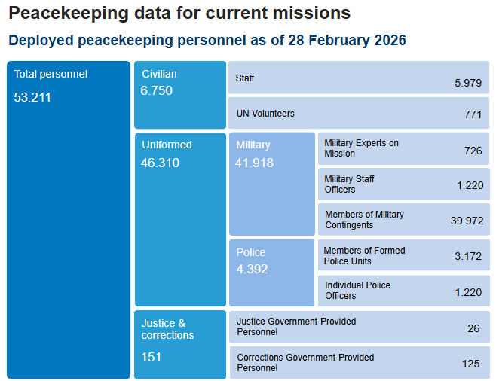
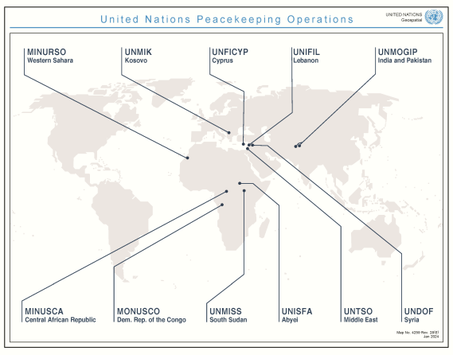
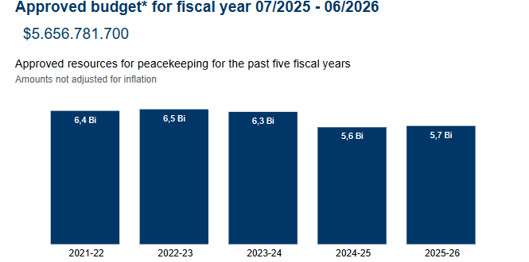
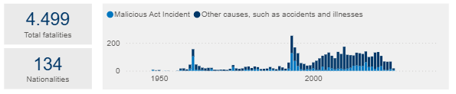

OPERAÇÕES DE MANUTENÇÃO DA PAZ - OMP
(https://peacekeeping.un.org/en/data)
DADOS GERAIS

Slide 3
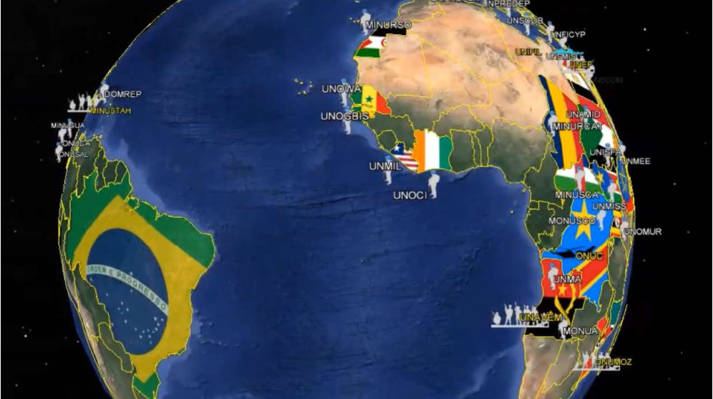
PARTICIPAÇÃO BRASILEIRA EM OPERAÇÕES DE MANUTENÇÃO DA PAZ - OMP
Em mais de 80 anos
da criação da ONU,
cerca de 55 mil
militares e policiais
estiveram presentes em
43 das 71 Op Paz realizadas

Slide 4
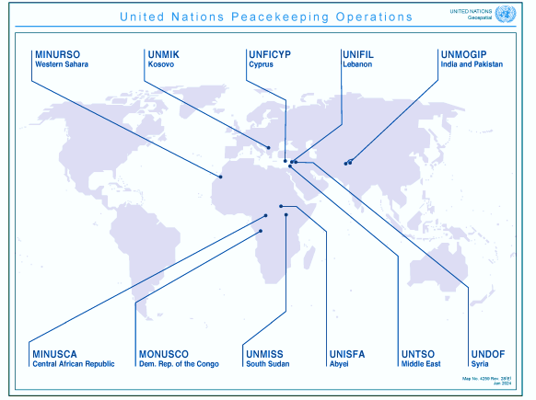




OPERAÇÕES DE MANUTENÇÃO DA PAZ - OMP
MINURSO
Saara Ocidental
*
*
UNMIK
Kosovo
UNIFYP
Chipre
UNIFIL
Líbano
UNMOGIP
Índia e Paquistão
OMP ATUAIS TOTAL: 11
MINUSCA
RCA
MONUSCO
RDC
UNMISS
Sudão do Sul
UNISFA
Região de Abyei
UNTSO
Oriente Médio
UNDOF
Síria
MONUSCO
RDC
07 OMP
* O Brasil participou da UNMIK de Nov 2023 a Jan2009 com policiais militares dos Estados e do Distrito Federal; e da UNMOGIP, de Nov 2024 a Nov 2025, com um militar

Slide 5

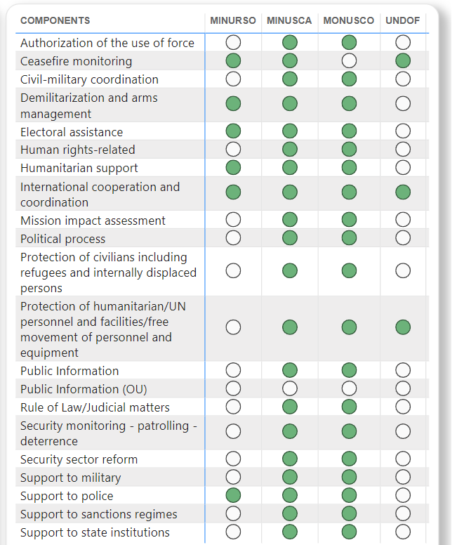
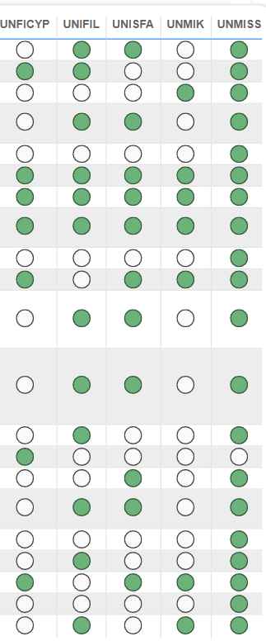
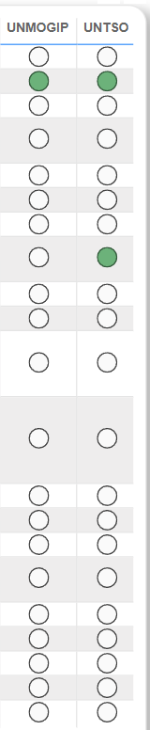
TAREFAS
OMP
ATUAIS
https://www.un.org/securitycouncil/content/field-missions-dashboard

Slide 6

United Nations Multidimensional Integrated Stabilization Mission in Mali (MINUSMA) | Abr 2013 - Dez 2023
African Union - United Nations Hybrid Operation in Darfur (UNAMID) | Jul 2007 - Dez 2020
United Nations Mission in Liberia (UNMIL) | Set 2003 - Mar 2018
United Nations Operations in Côte d'Ivoire (UNOCI) | Abr 2004 - Jun 2017
United Nations Mission in the Sudan (UNMIS) | Mar 2005 - Jul 2011
United Nations Mission in the Central African Republic and Chad (MINURCAT) | Set 2007 - Dez 2010
United Nations Organization Mission in the Democratic Republic of the Congo (MONUC) | Nov 1999 - Jun 2010
United Nations Mission in Ethiopia and Eritrea (UNMEE) | Jul 2000 - Jul 2008
United Nations Operation in Burundi (ONUB) | Maio 2004 - Dez 2006
United Nations Mission in Sierra Leone (UNAMSIL) | Out 1999 - Dez 2005
United Nations Mission in Côte d'Ivoire (MINUCI) | Maio 2003 - Abr 2004
United Nations Mission in the Central African Republic (MINURCA) | Mar 1998 - Fev 2000
United Nations Observer Mission in Sierra Leone (UNOMSIL) | Jul 1998 - Out 1999
United Nations Observer Mission in Angola (MONUA) | Jun 1997 - Fev 1999
United Nations Observer Mission in Liberia (UNOMIL) | Set 1993 - Set 1997
United Nations Angola Verification Mission III (UNAVEM III) | Fev 1995 - Jun 1997
United Nations Assistance Mission for Rwanda (UNAMIR) | Out 1993 - Mar 1996
United Nations Operation in Somalia II (UNOSOM II) | Mar 1993 - Mar 1995
United Nations Angola Verification Mission II (UNAVEM II) | Maio 1991 - Fev 1995
United Nations Operation in Mozambique (ONUMOZ) | Dez 1992 - Dez 1994
United Nations Observer Mission Uganda - Rwanda (UNOMUR) | Jun 1993 - Set 1994
United Nations Aouzou Strip Observer Group (UNASOG) | Maio 1994 - Jun 1994
United Nations Operation in Somalia I (UNOSOM I) | Abr 1992 - Mar 1993
United Nations Angola Verification Mission I (UNAVEM I) | Dez 1989 - Jun 1991
United Nations Transition Assistance Group (UNTAG) | Abr 1989 - Mar 1990
United Nations Operation in the Congo (ONUC) | Jul 1960 - Jun 1964
OMP ENCERRADAS
África (26)
16 OMP

Slide 7
United Nations Mission for Justice Support in Haiti (MINUJUSTH) | Out 2017 - Out 2019
United Nations Stabilization Mission in Haiti (MINUSTAH) | Jun 2004 - Out 2017
United Nations Civilian Police Mission in Haiti (MIPONUH) | Nov 1997 - Mar 2000
United Nations Transition Mission in Haiti (UNTMIH) | Jul 1997 - Nov 1997
United Nations Support Mission in Haiti (UNSMIH) | Jun 1996 - Jul 1997
United Nations Verification Mission in Guatemala (MINUGUA) | Jan 1997 - Maio 1997
United Nations Mission in Haiti (UNMIH) | Set 1993 - Jun 1996
United Nations Observer Mission in El Salvador (ONUSAL) | Maio 1991 - Abr 1995
United Nations Observer Group in Central America (ONUCA) | Nov 1989 - Jan 1992
Mission of the Representative of the Secretary - General in the Dominican Republic (DOMREP) | Maio 1965 - Out 1966
OMP
ENCERRADAS
América (10)
06 OMP
https://peacekeeping.un.org/en/past-peacekeeping-operations

Slide 8
United Nations Integrated Mission in Timor - Leste (UNMIT) | Ago 2006 - Dez 2012
United Nations Mission of Support in East Timor (UNMISET) | Maio 2002 - Maio 2005
United Nations Transitional Administration in East Timor (UNTAET) | Out 1999 - Maio 2002
United Nations Mission of Observers in Tajikistan (UNMOT) | Dez 1994 - Maio 2000
United Nations Transitional Authority in Cambodia (UNTAC) | Fev 1992 - Set 1993
United Nations Advance Mission in Cambodia (UNAMIC) | Out 1991 - Mar 1992
United Nations Good Offices Mission in Afghanistan and Pakistan (UNGOMAP) | Maio 1988 - Mar 1990
United Nations India - Pakistan Observation Mission (UNIPOM) | Set 1965 - Mar 1966
United Nations Security Force in West New Guinea (UNSF) | Out 1962 - Abr 1963
OMP ENCERRADAS
Ásia e Oceania (09)
05 OMP
https://peacekeeping.un.org/en/past-peacekeeping-operations

Slide 9
United Nations Observer Mission in Georgia (UNOMIG) | Ago 1993 - Jun 2009
United Nations Mission of Observers in Prevlaka (UNMOP) | Fev 1996 - Dez 2002
United Nations Mission in Bosnia and Herzegovina (UNMIBH) | Dez 1995 - Dez 2002
United Nations Preventive Deployment Force (UNPREDEP) | Mar 1995 - Fev 1999
United Nations Civilian Police Support Group (UNCPSG) | Jan 1998 - Out 1998
United Nations Transitional Administration for Eastern Slavonia, Baranja and Western Sirmium (UNTAES) | Jan 1996 - Jan 1998
United Nations Confidence Restoration Operation in Croatia (UNCRO) | Mar 1995 - Jan 1996
United Nations Protection Force (UNPROFOR) | Fev 1992 - Mar 1995
OMP ENCERRADAS
Europa (08)
05 OMP
* O Brasil participou da UNMIK de Nov 2003 a Jan2009 com efetivo de policiais militares dos Estados e do Distrito Federal. Esta missão ainda se encontra em curso.
https://peacekeeping.un.org/en/past-peacekeeping-operations

Slide 10
United Nations Supervision Mission in Syria (UNSMIS) | Abr 2012 - Ago 2012
United Nations Iraq - Kuwait Observation Mission (UNIKOM) | Abr 1991 - Out 2003
United Nations Iran - Iraq Military Observer Group (UNIIMOG) | Ago 1988 - Fev 1991
United Nations Emergency Force II (UNEF II) | Out 1973 - Jul 1979
United Nations Emergency Force I (UNEF I) | Nov 1956 - Jun 1967
United Nations Yemen Observation Mission (UNYOM) | Jun 1963 - Set 1964
United Nations Observation Group in Lebanon (UNOGIL) | Jun 1958 - Dez 1958
OMP ENCERRADAS
Oriente Médio (07)
02 OMP
* O Brasil participou da UNMOGIP, de Nov 2024 a Nov 2025, com um militar da MB.
https://peacekeeping.un.org/en/past-peacekeeping-operations

Slide 11
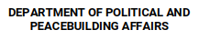
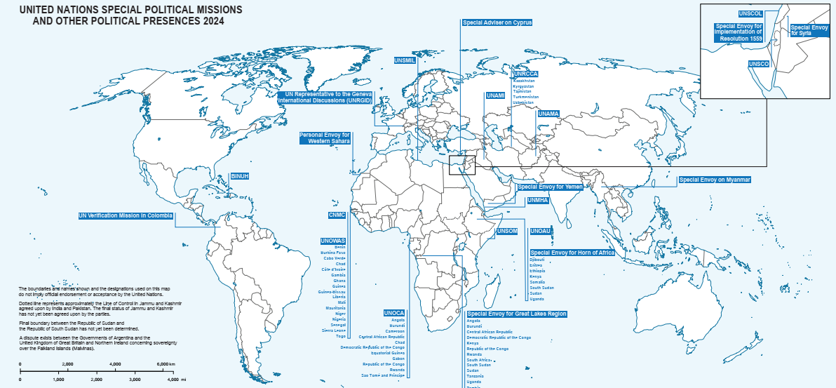
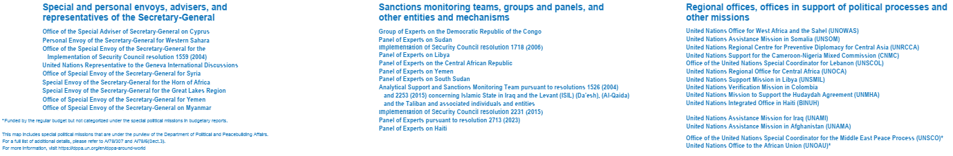

PRESENÇA POLÍTICA DAS NAÇÕES UNIDAS
https://dppa.un.org/en/dppa-around-world
Notes:
DPPA Around the World | Department of Political and Peacebuilding Affairs
Special Political Missions and Good Offices Engagements
The Department of Political and Peacebuilding Affairs (DPPA) manages Special Political Missions (SPMs) engaged in conflict prevention, peacemaking and post-conflict peacebuilding around the world.
These field operations include country-specific missions and regional offices. They are headed by senior representatives of the Secretary-General and provide a forward platform for preventive diplomacy and other activities across a range of disciplines, helping prevent and resolve conflict and supporting complex political transitions, in coordination with national actors and UN development and humanitarian entities on the ground.
DPPA also provides guidance and support to traveling envoys and special advisers of the Secretary-General who bring his “good offices” to bear in the service of conflict resolution or the implementation of other UN mandates. For more information about the UN global leadership team, visit: https://www.un.org/sg/en/global-leadership/home
The term ‘Special Political Mission’ encompasses entities that are not managed or directed by DPPA such as the Office of the Special Adviser on the Prevention of Genocide. These SPMs also include panels established by the Security Council, such as the Monitoring Group on Somalia; the Group of Experts on the Democratic Republic of the Congo; the Panels of Experts on the Democratic People’s Republic of Korea, on Libya, on the Central African Republic, on Yemen, on South Sudan and on Mali; the Analytical Support and Sanctions Monitoring Team established pursuant to Security Council resolution 1526 (2004) concerning Al-Qaida and the Taliban and associated individuals and entities; the Office of the Ombudsperson established pursuant to resolution 1904 (2009); the Implementation of Security Council Resolution 2231 (2015); the Support for the Security Council Committee established pursuant to resolution 1540 (2004) on the non-proliferation of all weapons of mass destruction; the Counter-Terrorism Committee Executive Directorate (CTED) and the United Nations Investigative Team for Accountability of Da’esh (ISIL).
Typology of Special political missions (SPMs
Because of the wide range of activities described as SPMs, they are commonly grouped into three clusters, as follows:
Cluster I: Special and personal envoys, advisers and representatives of the Secretary-General;
Cluster II: Sanctions monitoring teams, groups and panels, and other entities and mechanisms; and
Cluster III: Regional offices, offices in support of political processes and other missions.
Large missions that would ordinarily be grouped into Cluster III, including the United Nations Assistance Mission in Afghanistan (UNAMA) and the United Nations Assistance Mission in Iraq (UNAMI), are often presented separately given the size of their budgets.
Note that the cluster system is a budgetary typology. SPMs can be field- or Headquarters-based, and they can be mandated by the General Assembly or Security Council (or established by the Secretary-General following an exchange of letters with the Security Council), but these considerations are not directly linked to the assignment of SPMs into a particular cluster.

Slide 12
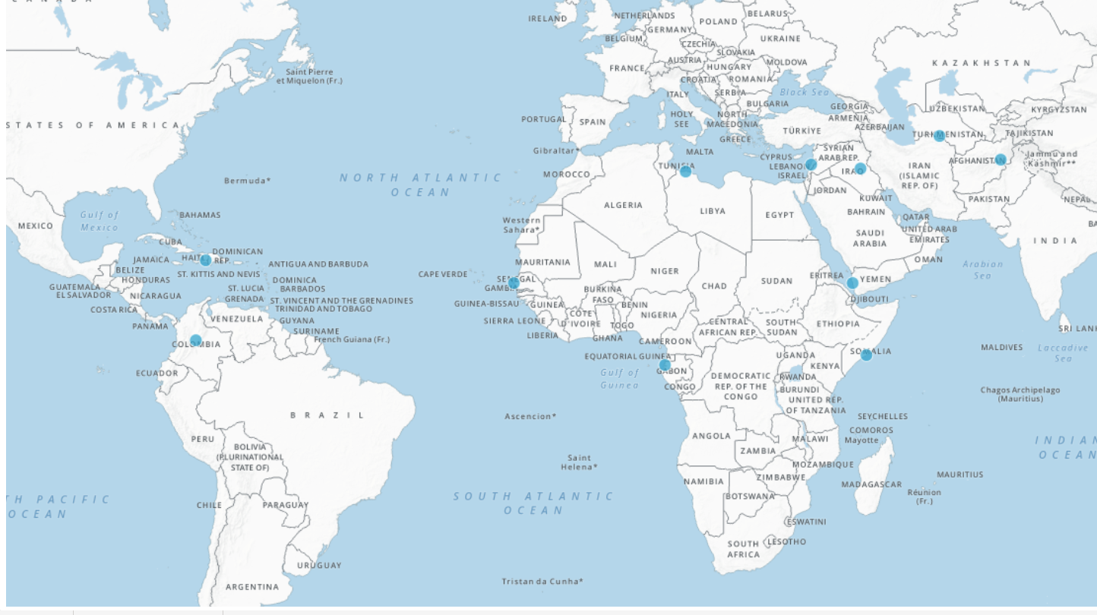
MISSÕES POLÍTICAS ESPECIAIS - MPE
Office of the United Nations Special Coordinator for Lebanon (UNSCOL)
United Nations Assistance Mission in Afghanistan (UNAMA)
United Nations Integrated Office in Haiti (BINUH)
United Nations Support Mission in Libya (UNSMIL)
MPE
ATUAIS
TOTAL: 09
United Nations Office for West Africa and the Sahel (UNOWAS)
United Nations Regional Centre for Preventive Diplomacy for Central Asia (UNRCCA)
United Nations Verification Mission in Colombia (UNVMC)
United Nations Regional Office for Central Africa (UNOCA)
United Nations Transitional Assistance Mission in Somalia (UNTMIS)
02 MPE
https://www.un.org/securitycouncil/content/field-missions-dashboard
Notes:
The Special Representative of the Secretary General for West Africa (UNOWAS) also serves as Chairman of the Cameroon-Nigeria Mixed Commission (CNMC), established in November 2002 by the UN Secretary-General at the request of Presidents Paul Biya and Olusegun Obasanjo of Cameroon and Nigeria respectively. The goal of the CNMC is to facilitate the implementation of the 10 October 2002 judgment of the International Court of Justice (ICJ) on the Cameroon-Nigeria boundary dispute.

Slide 13
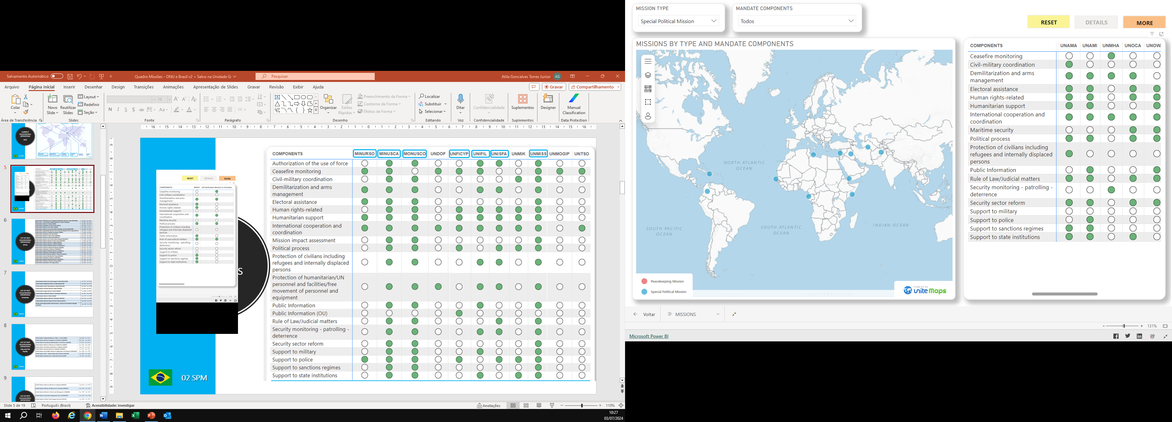
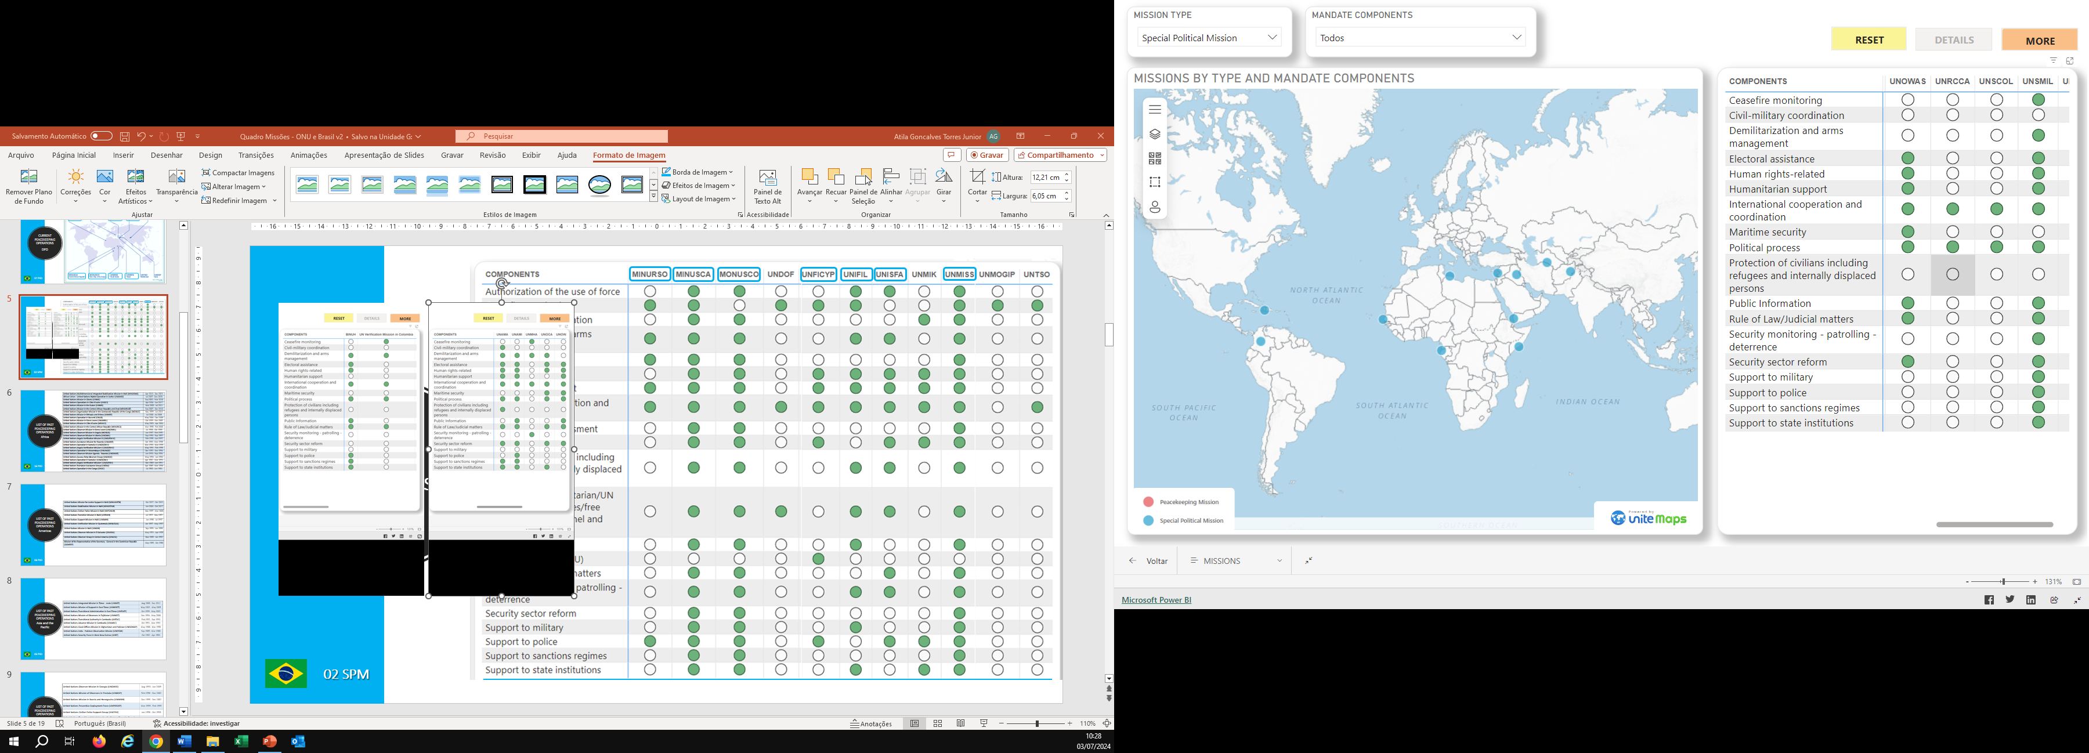
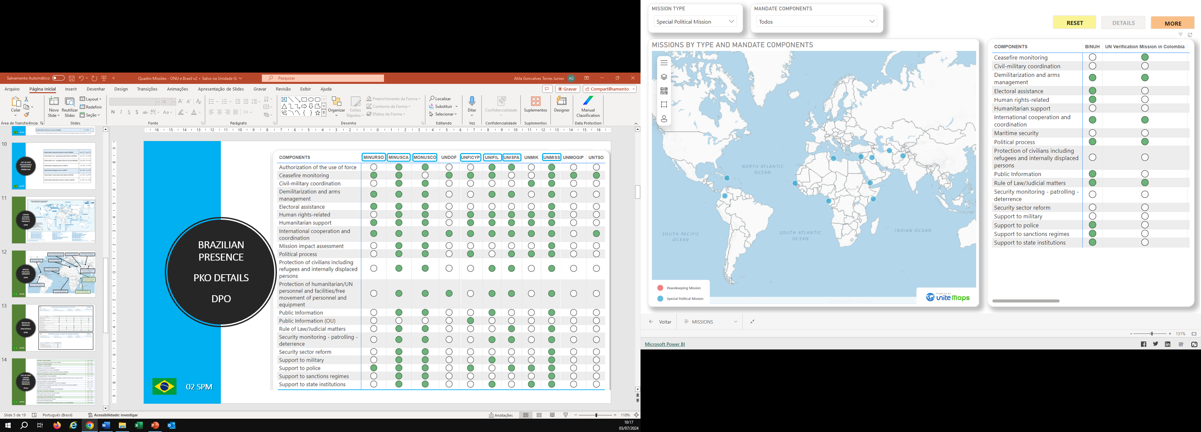
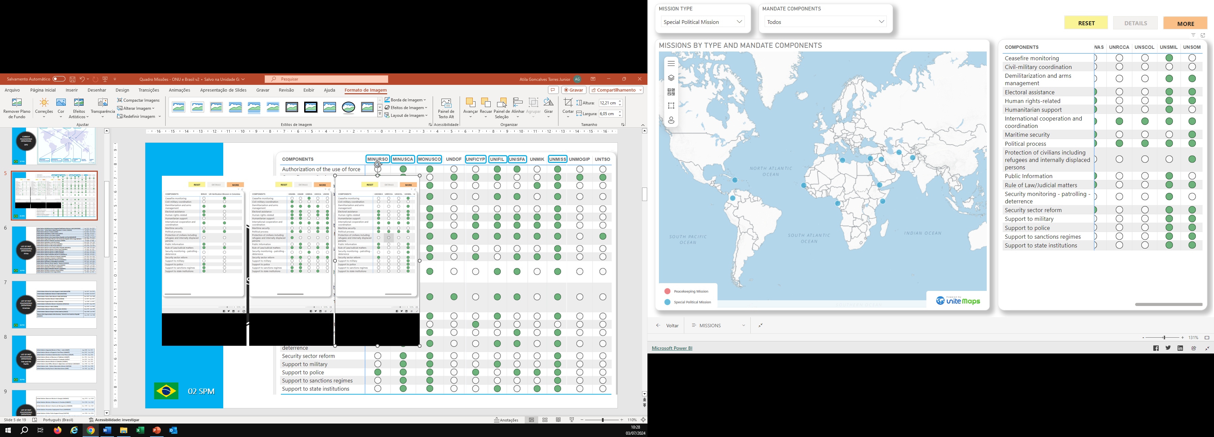
UNVMC
UNTMIS
TAREFAS
MPE
ATUAIS
https://www.un.org/securitycouncil/content/field-missions-dashboard

Slide 14
UNVMC
UNTMIS
TAREFAS
MPE
ATUAIS
https://www.un.org/securitycouncil/content/field-missions-dashboard

Slide 15
UN Office in Angola (UNOA) | 1999 - 2002
UN Peacebuilding Support Office in Liberia (UNOL) | 1997 – 2003
UN Mission in Angola (UNMA) | 2002 – 2003
UN Office in Burundi (UNOB) | 1993 – 2004
UN Mission in Cote d'Ivoire (MINUCI) | 2003 – 2004
UN Integrated Office in Sierra Leone (UNIOSIL) | 2005 – 2008
UN Peacebuilding Office in the Central African Republic (BONUCA) | 2000 – 2009
UN Peacebuilding Support Office in Guinea-Bissau (UNOGBIS) | 1999 – 2009
UN Integrated Office in Burundi (BINUB) | 2006 – 2010
UN International Commission of Inquiry mandated to establish the facts and circumstances of the events of 28 September 2009 in Guinea | 2009 – 2010
UN Political Office for Somalia (UNPOS) | 1995 – 2013
UN Integrated Peacebuilding Office in Sierra Leone (UNIPSIL) | 2008 – 2014
UN Integrated Peacebuilding Support Office in the Central African Republic (BINUCA) | 2009 – 2014
UN Office in Burundi (BNUB) | 2011 – 2014
UN Electoral Observation Mission in Burundi (MENUB) | 2015
UN Office for West Africa (UNOWA) | 2001 – 2016
Office of the Special Envoy for the Sahel (OSES) | 2013 – 2016
Good Offices Sudan and South Sudan | 2016 – 2018
UN Integrated Peacebuilding Office in Guinea-Bissau (UNIOGBIS) | 2010 – 2020
Office of the Special Envoy for Burundi | 2016 – 2021
Personal Envoy for Mozambique | 2019 – 2023
United Nations Assistance Mission in Somalia (UNSOM) | 2013 – 2024
United Nations Integrated Transition Assistance Mission in Sudan (UNITAMS) | 2020 – 2024
MPE ENCERRADAS
África (23)
07 MPE

Slide 16
UN Mission in El Salvador (MINUSAL) | 1995
UN Office of Verification in El Salvador (UNOV) | 1996
OAS/UN International Civilian Mission in Haiti (MICIVIH) | 1993 - 1999
International Civilian Mission in Haiti (MICAH) | 2000 - 2001
United Nations Mission for the Verification of Human Rights and of Compliance with the Commitments of the Comprehensive Agreement on Human Rights in Guatemala | 1994 - 2004
Good Offices Guyana – Venezuela | 1990 - 2017
UN Mission in Colombia | 2016 - 2017
International Commission Against Impunity in Guatemala (CICIG) | 2007-2019
Personal Envoy of the Secretary-General for Bolivia | 2019-2020
MPE ENCERRRADAS
América (09)
https://dppa.un.org/en/past-missions

Slide 17
MPE ENCERRRADAS
Ásia e Oceania (05)
UN Mission in East Timor (UNAMET) | 1999
UN Political Office in Bougainville (UNPOB) | 1998 - 2003
UN Observer Mission in Bougainville (UNOMB) | 2004 - 2005
UN Office in Timor-Leste (UNOTIL) | 2005 - 2006
UN Mission in Nepal (UNMIN) | 2007 - 2010
03 MPE
https://dppa.un.org/en/past-missions

Slide 18
MPE ENCERRADAS
Oriente Médio e Ásia Ocidental (07)
UN Special Mission in Afghanistan (UNSMA) | 1993 - 2001
UN Tajikistan Office of Peacebuilding (UNTOP) | 2000 - 2007
UN International Independent Investigation Commission (UNIIIC) | 2005 - 2009
UN Commission of Inquiry into the facts and circumstances of the assassination of former Pakistani Prime Minister Mohtarma Benazir Bhutto | 2009 - 2010
OPCW-UN Joint Mission in Syria | 2013 - 2014
United Nations Assistance Mission for Iraq (UNAMI) | 2003 - 2025
UN Mission to Support the Hudaydah Agreement (UNMHA) | 2019 - 2026
01 MPE
https://dppa.un.org/en/past-missions

Slide 19
MPE ENCERRADAS
Europa (01)
Good Offices Greece - the former Yugoslav Republic of Macedonia | 1993 - 2019
https://dppa.un.org/en/past-missions

Slide 20
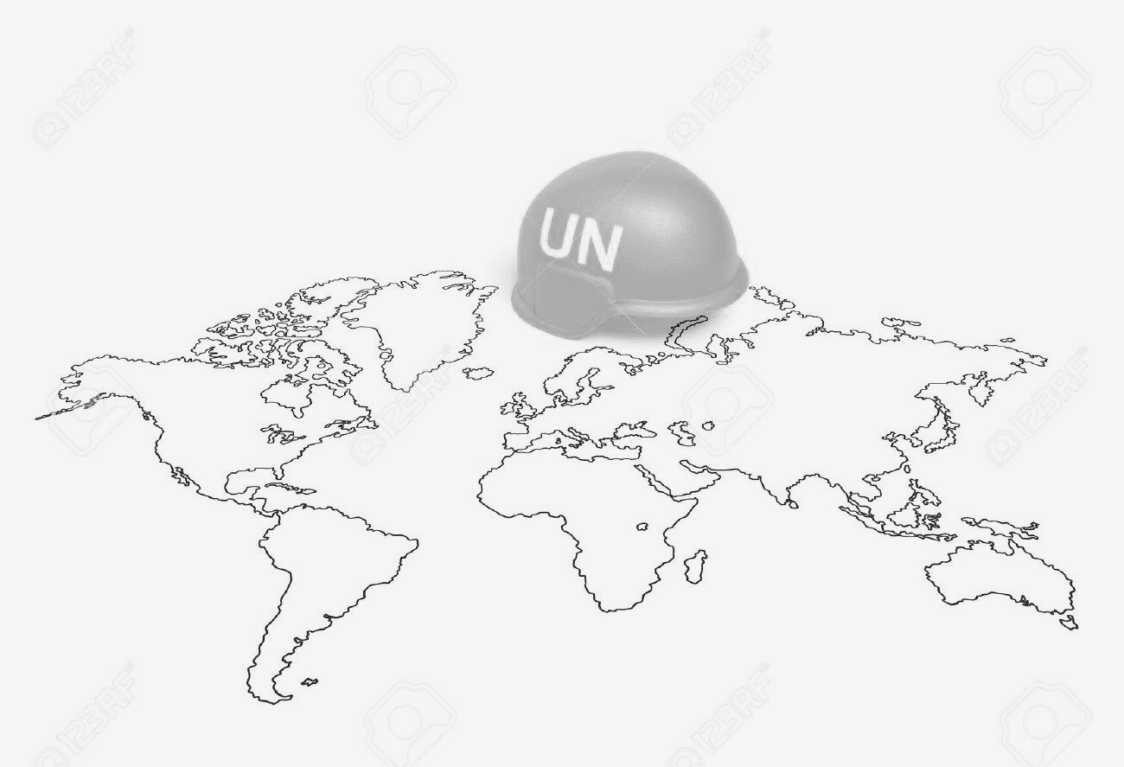
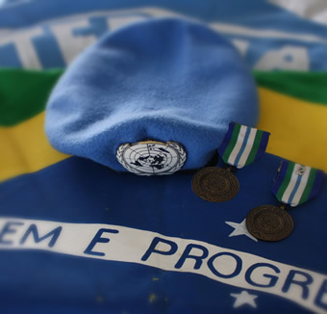

Fonte: Seção de Estudos da Subchefia de Operações Internacionais
PERGUNTAS
Cel R1 ÁTILA – atila.junior@defesa.gov.br
Atualizado em 06/05/2026

