Slide 1


National Nuclear Energy Commission
Título da Apresentação (máximo de 3 linhas)
Nome do palestrante • Cargo

Slide 2

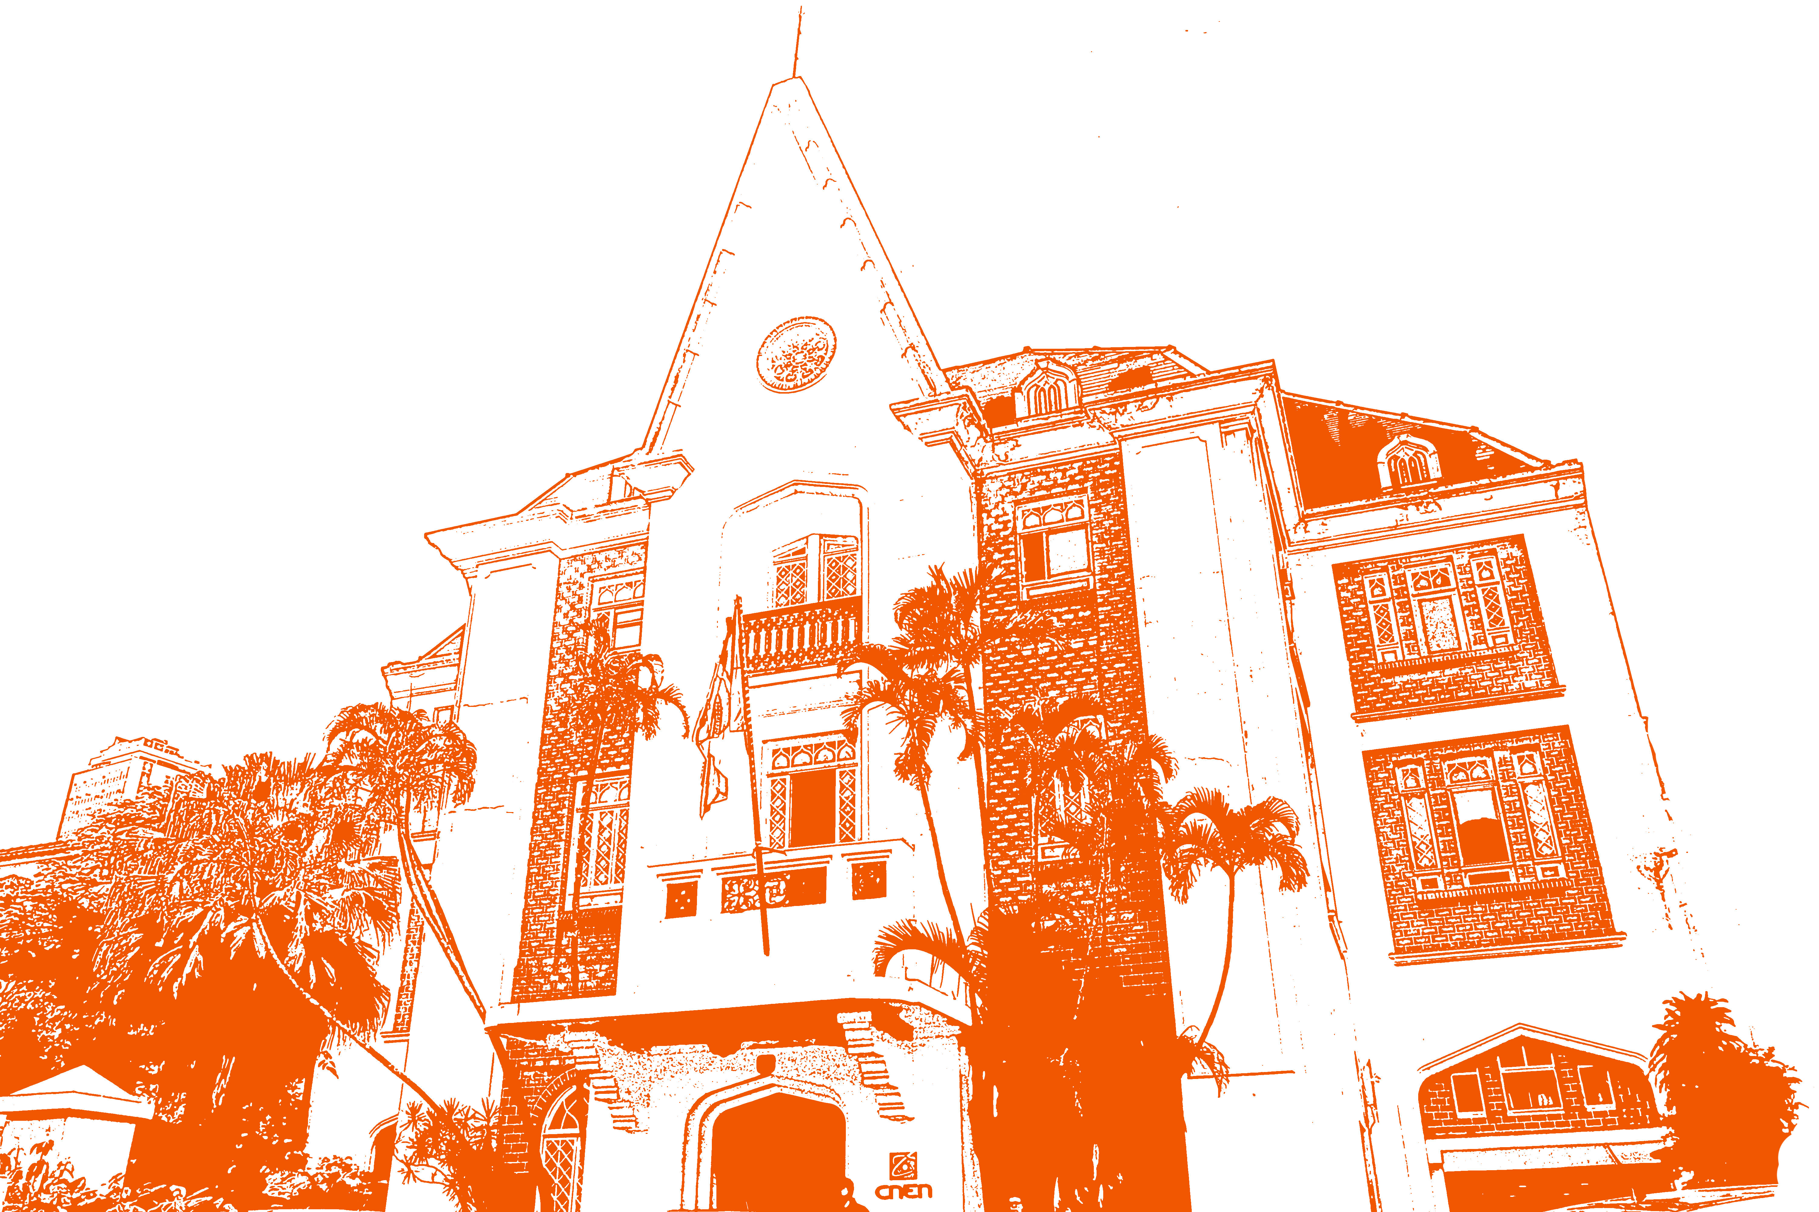
Where we are
NORTHEAST REGIONAL CENTER FOR NUCLEAR SCIENCES (CRCN-NE)
Recife (PE)
Brasilia Office ESBRA
Brasilia (DF)
MIDWEST REGIONAL CENTER FOR NUCLEAR SCIENCES (CRCN-CO)
Abadia de Goiás (GO)
NATIONAL NUCLEAR ENERGY COMMISSION (CNEN) - HEADQUARTERS
CENTER FOR NUCLEAR TECHNOLOGY DEVELOPMENT (CDTN)
Rio de Janeiro (RJ)
NATIONAL NUCLEAR ENERGY COMMISSION (CNEN) – HEADQUARTERS,
IN RIO DE JANEIRO
Belo Horizonte (MG)
INSTITUTE OF NUCLEAR ENGINEERING (IEN)
Rio de Janeiro (RJ)
BRAZILIAN MULTIPURPOSE RESEARCH REACTOR (RMB)
Iperó (SP)
INSTITUTE OF ENERGY AND NUCLEAR RESEARCH (IPEN)
São Paulo (SP)

Slide 3
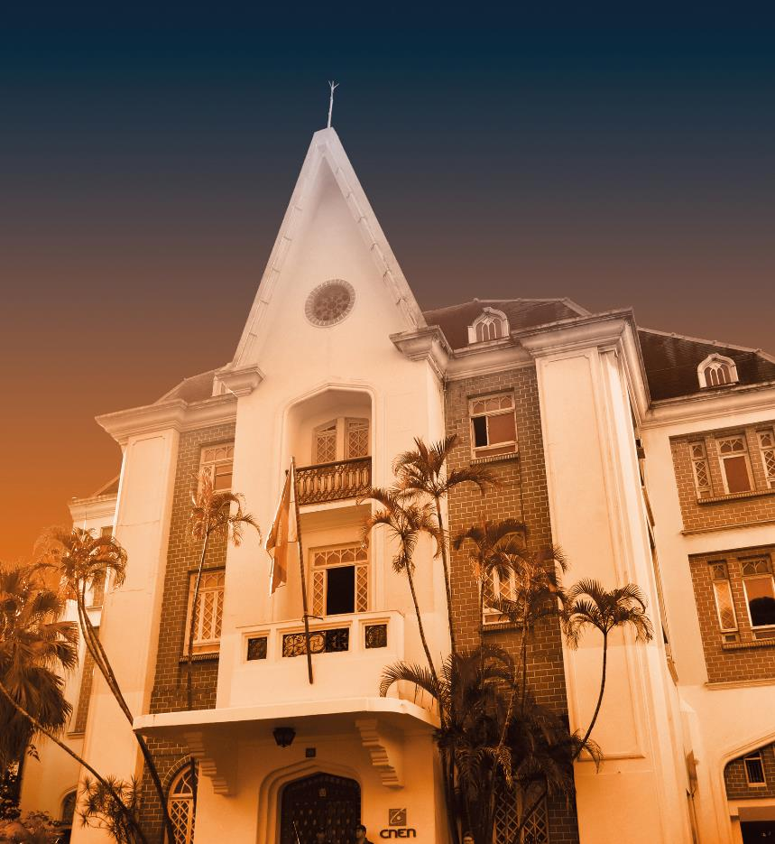

Slide 7
National Nuclear Energy Commission
Thank you!
Nome do Palestrante
E-mail: @@@@@@@
Contato: 000000000
Inserir Foto do Palestrante

