Slide 1



Reunião ANS COSAUDE – 07/04/2015
Inclusão no Rol ANS 2016 :
  a) Implante de Cardiodesfibrilador Multissítio – TRC-D (Gerador e Eletrodos) – CBHPM 3.09.04.16-1
  b) Implante de Monitor de Eventos - (Looper Implantável) – CBHPM 3.09.04.17-0
Eduardo R. B. Costa
Departamento de Estimulação Cardíaca Artificial da Sociedade Brasileira de Cirurgia Cardiovascular – DECA SBCCV
educosta.cardiol@uol.com.br

Slide 2
Reunião ANS COSAUDE – 07/04/2015
Inclusão no Rol ANS 2016 :
  a) Implante de Cardiodesfibrilador Multissítio – TRC-D (Gerador e Eletrodos) – CBHPM 3.09.04.16-1
  b) Implante de Monitor de Eventos - (Looper Implantável) – CBHPM 3.09.04.17-0
Eduardo R. B. Costa
Departamento de Estimulação Cardíaca Artificial da Sociedade Brasileira de Cirurgia Cardiovascular – DECA SBCCV
educosta.cardiol@uol.com.br

Slide 3
GT FormSus/Procedimentos e DUT
Propostas:
Construção de metodologia para critérios de priorização:
  Segurança e Eficácia
  Eficácia Clínica
  Nível de Evidência e Grau de Recomendação
  Força do Desfecho medido (Desfecho Duro ou intermediário)
  Relevância Clínica
  Prevalência
  Custo-Efetividade
Agenda:
17/03 – Tarde
24/03 – Dia todo

Slide 4
Ativação Normal
Nó Sinusal
Nó AV
Kass D. New dimensions in device-based therapy for heart failure–mechanisms of stimulation for heart failure. Heart Failure Society of America 2000.
Notes:
Normally the atrium and ventricle are sequentially activated, separated by short delay. Then activation spreads rapidly from the septum to the laterals walls through the fast Purkinje fibers so the septal and lateral walls are activated together. This sequence is delayed or altered in the target CHF patients by bundle branch or diffuse blocks in the ventricle. One consequence of this is an abnormally long delay between atrial and ventricular activation. This has several mechanical consequences, including a less effective active filling, because atrial systole ends before ventricular systole begins; ineffective MV closure and a long time for presystolic MR; ventricular systole is delayed, so there is less time for filling.

Slide 5
Bloqueio do Ramo Esquerdo
Nó Sinusal
Nó AV
BRE
Kass D. New dimensions in device-based therapy for heart failure–mechanisms of stimulation for heart failure. Heart Failure Society of America 2000.
Notes:
Normally the atrium and ventricle are sequentially activated, separated by short delay. Then activation spreads rapidly from the septum to the laterals walls through the fast Purkinje fibers so the septal and lateral walls are activated together. This sequence is delayed or altered in the target CHF patients by bundle branch or diffuse blocks in the ventricle. One consequence of this is an abnormally long delay between atrial and ventricular activation. This has several mechanical consequences, including a less effective active filling, because atrial systole ends before ventricular systole begins; ineffective MV closure and a long time for presystolic MR; ventricular systole is delayed, so there is less time for filling.

Slide 6
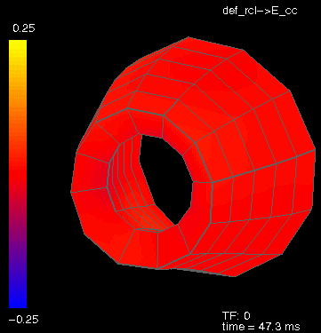
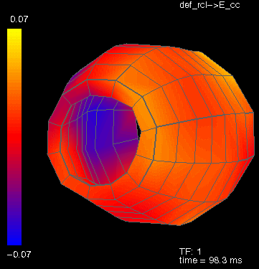
Consequências Clínicas do Dissincronismo Ventricular
Movimento Paradoxal do Septo IV ¹
↓ da dP/dt ^{3,4}
↓ da Pressão de Pulso ⁴
↓ da FE e DC ⁴
↓ do tempo de enchimento diastólico ^{1,2,4}
↑ da Regurg. Mitral ^{1,2,4}
¹ Grines CL, Bashore TM, Boudoulas H, et al. Circulation 1989;79:845-853.
² Xiao, HB, Lee CH, Gibson DG. Br Heart J 1991;66:443-447.
³ Xiao HB, Brecker SJD, Gibson DG. Br Heart J 1992;68:403-407.
⁴ Yu C-M, Chau E, Sanderson JE, et al. Circulation. 2002;105:438-445.

Slide 7
Duração do QRS – Aumento da Mortalidade Proporcional
Vesnarinone Study (VEST study analysis)
ICC classe II-IV NYHA
3.654 ECGs
A duração do QRS foi identificada como um fator preditor independente da mortalidade
O risco relativo do maior QRS foi 5 vezes maior que no menor
100%
Duração do QRS
(msec)
90%
<90
90
-
-
120
Sobrevida Cumulativa
80%
120
-
-
170
170
-
220
70%
>220
60%
0
60
120
180
240
300
360
Dias no Estudo
Gottipaty V, Krelis S, Lu F, et al. JACC 1999;33(2) :145 [Abstr847-4].
Notes:
Vesnarinone: ação mista: inibidor da fosfodiesterase e modificação dos canais iônicos

Slide 8
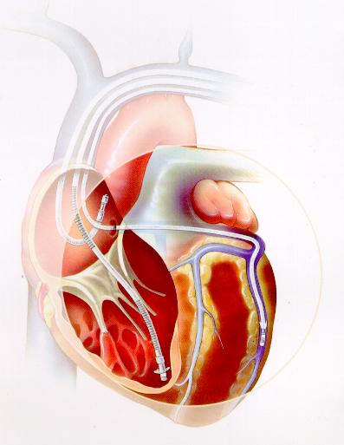

Ressincronização Ventricular

Slide 9
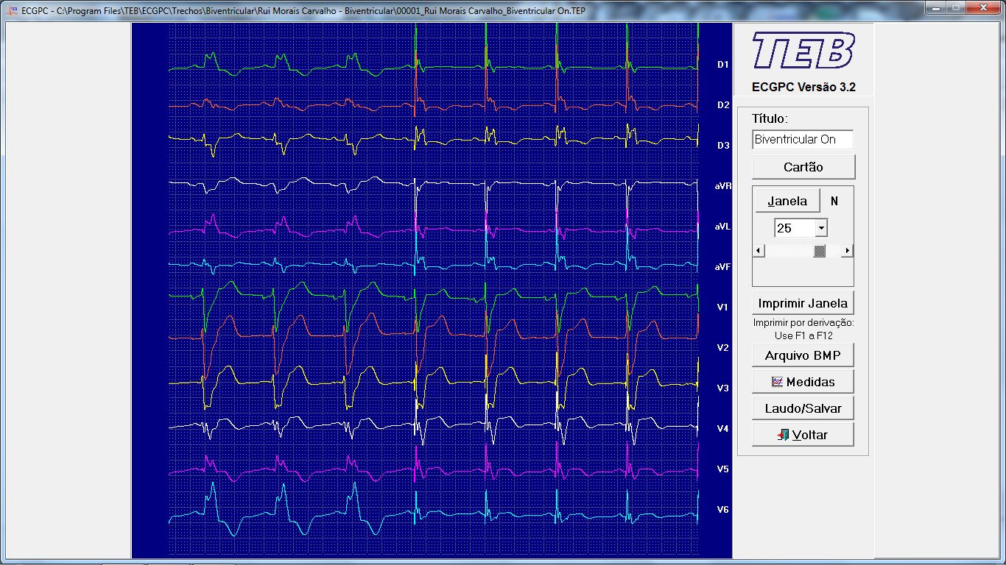

Slide 10
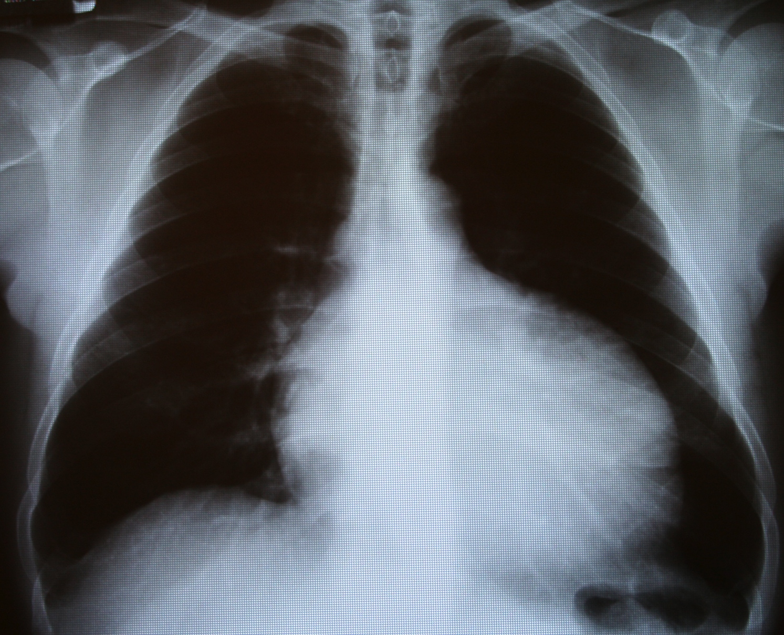
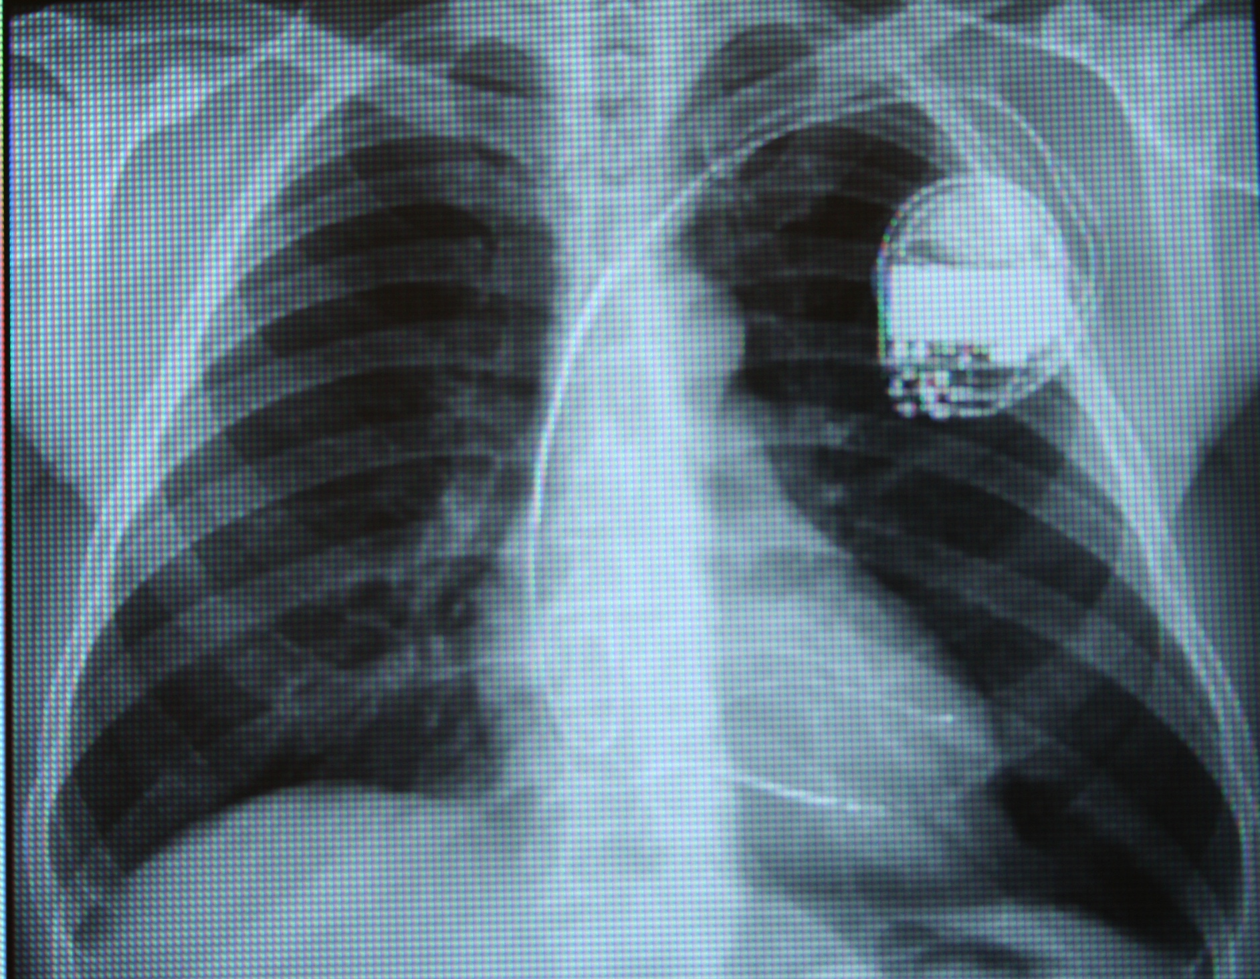
AFS, 61 anos, Masc, MCD Idiopática, ICC
Pré TRC – FEVE: 24%
Pós TRC – FEVE: 65%
Hiper-responder: 10-30%
Non-Responder: 15-30%

Slide 11
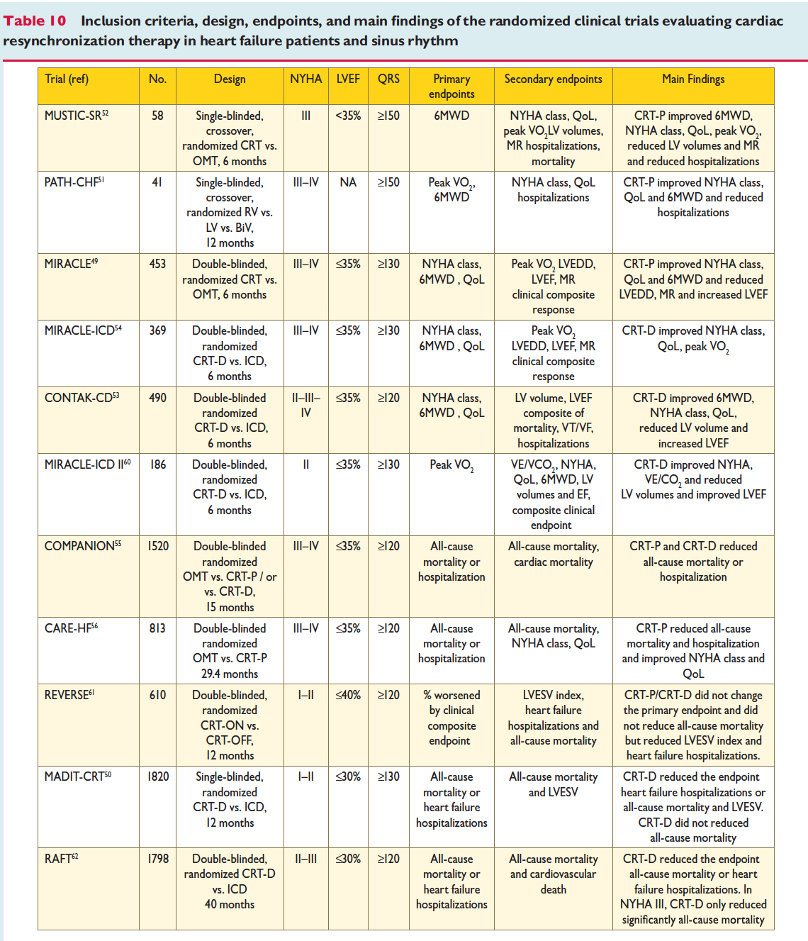

Slide 12
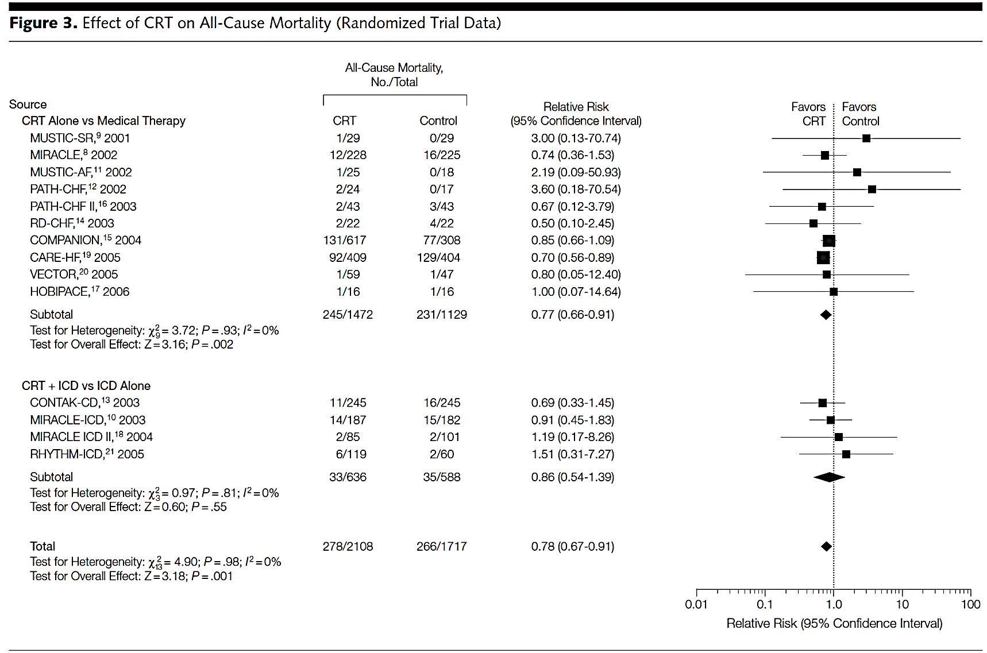
A TRC Reduz a Mortalidade Total
JAMA. 2007;297(22):2502-2514

Slide 13

Terapia de Ressincronização Ventricular – TRC
Marcapasso Multisítio
Melhora a função cardíaca
Reduz internações por ICC
Melhora a qualidade de vida
Promove ação anti-arrítmica, com redução de arritmias ventriculares
Aumenta a sobrevida
Indicação Classe I / Nível de Evidência A
Ermis C, Benditt DG. Europace 2006; 8: 499–501

Slide 14

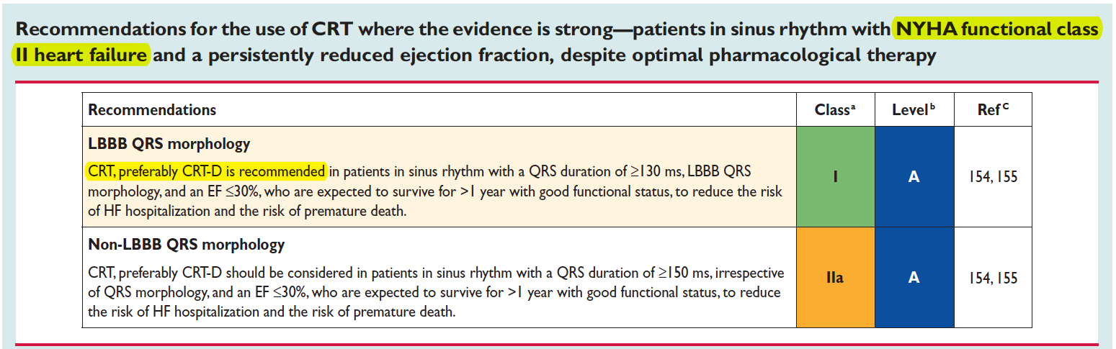

Slide 15
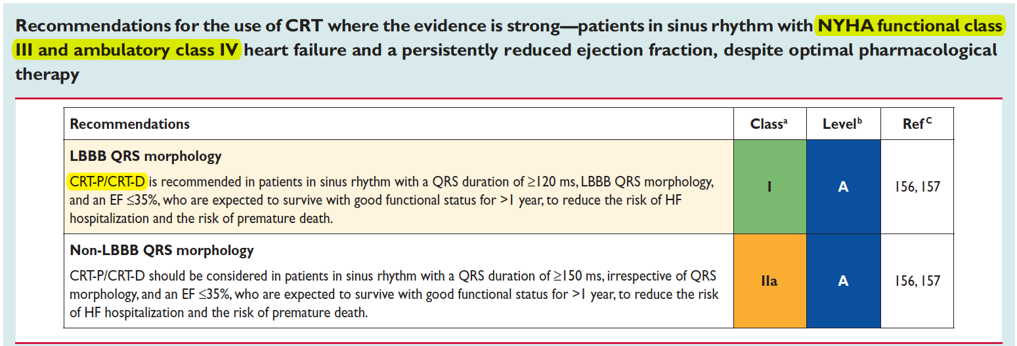

Slide 16
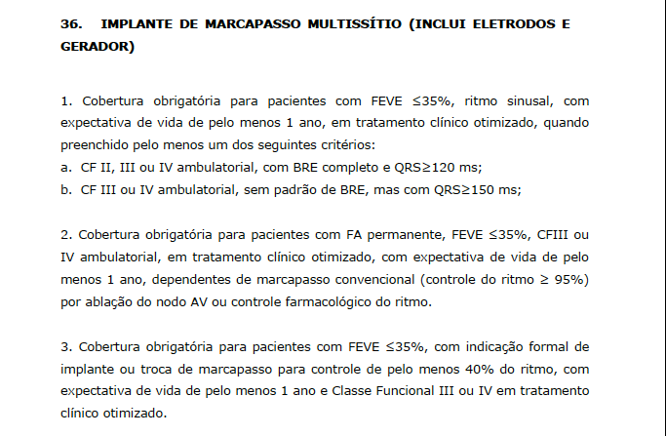
DUT -- ROL ANS 2014

Slide 17
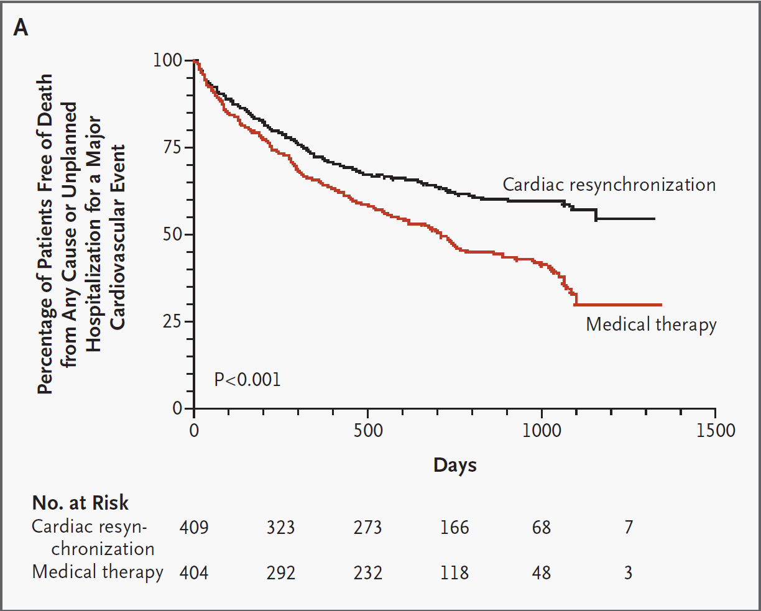
CARE HF – Objetivos Primários

Slide 18
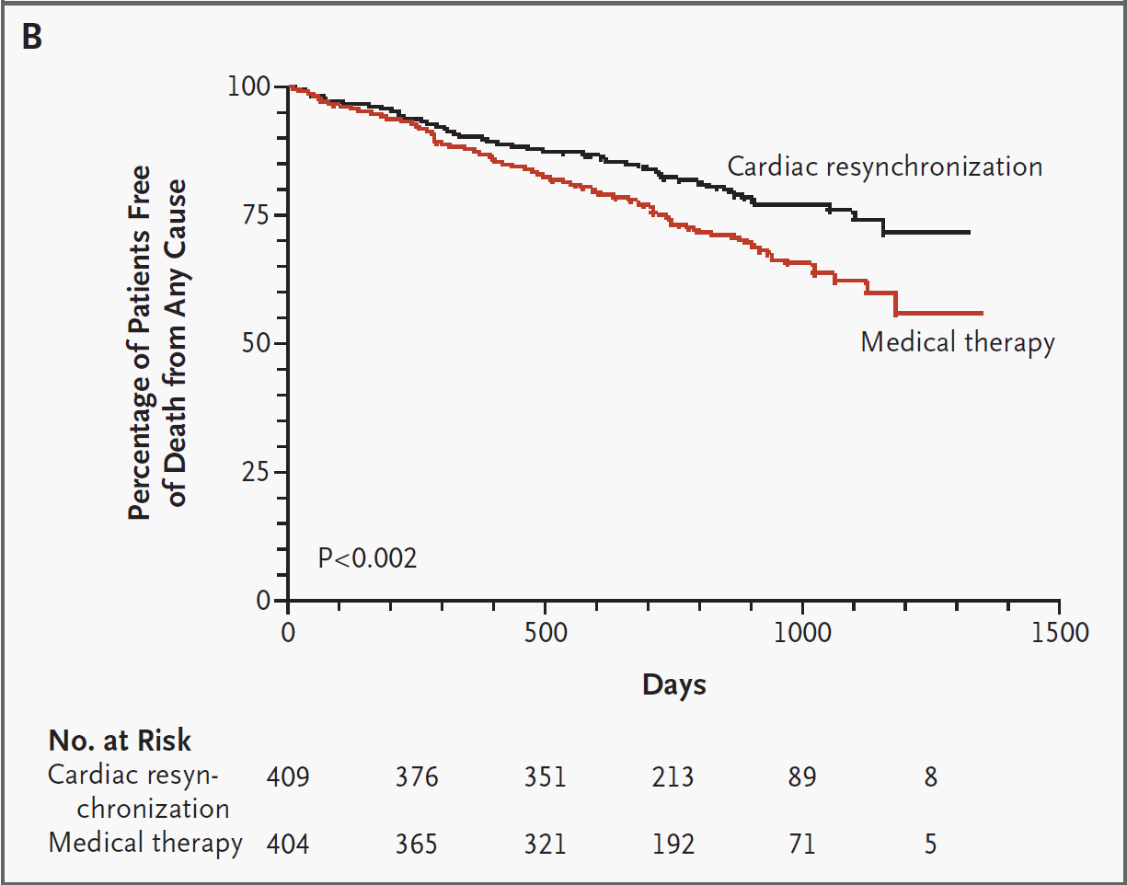
CARE HF – Objetivos Secundários

Slide 19
CARE HF - Mortalidade
P<0,001
35%
Bristow et al. NEJM 2004 May 20:350(21), 2140-2150

Slide 20
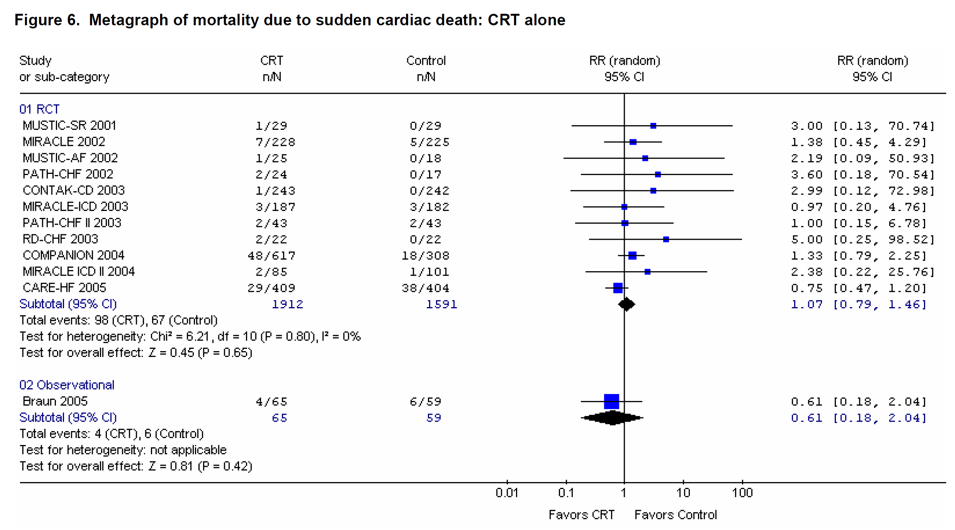
McAlister FA et al. Evid Rep Technol Assess (Full Rep) 2007;152:1-199.
Notes:
Cardiac Resynchronization Therapy and Implantable
Cardiac Defibrillators in Left Ventricular
Systolic Dysfunction
Prepared for:
Agency for Healthcare Research and Quality
U.S. Department of Health and Human Services
540 Gaither Road
Rockville, MD 20850
www.ahrq.gov
Contract No. 290-02-0023
Prepared by:
University of Alberta Evidence-based Practice Center, Edmonton, AB, Canada
Investigators
Finlay A. McAlister, M.D., M.S.
Justin Ezekowitz, M.B.B.Ch., M.S.
Donna M. Dryden, Ph.D.
Nicola Hooton, M.P.H.
Ben Vandermeer, M.S.
Carol Friesen, M.A., M.L.I.S.
Carol Spooner, B.Sc.N., M.S.
Brian H. Rowe, M.D., M.S.
Structured Abstract
Objectives: To determine the efficacy, effectiveness, and safety of cardiac resynchronization
therapy (CRT) and/or implantable cardioverter defibrillators (ICD) in patients with left
ventricular systolic dysfunction (LVSD).
Data Sources: A systematic and comprehensive literature search was conducted to identify
randomized controlled trials (RCTs) evaluating efficacy and observational studies evaluating
effectiveness or safety of CRT and/or ICD in patients with LVSD.
Review Methods: Study selection, quality assessment, and data extraction were completed by
several investigators in duplicate and independently. Random-effects models were used for
analyses.
Results: From 11,340 citations, we identified 14 RCTs (4,420 patients) for the CRT efficacy
review, 106 studies (9,209 patients) for the CRT effectiveness review, 89 studies (9,677 patients)
for the CRT safety review, 12 RCTs (8,516 patients) for the ICD efficacy review, 48 studies
(15,097 patients) for the ICD effectiveness review, and 49 studies (12,592 patients) for the ICD
safety review—all studies enrolled only patients with LVSD. An additional 12 studies (68,848
patients) were included for an analysis of peri-implant outcomes for all patients with ICD (i.e.,
not only LVSD patients).
All patients in the CRT studies had LVSD (mean LVEF from 21 to 30 percent) and
prolonged QRS duration (mean from 155 to 209 msec), and 91 percent had New York Heart
Association (NYHA) class III or IV symptoms. In patients with LVSD and heart failure
symptoms, CRT improved ejection fraction (weighted mean difference 3.0 percent [95% CI, 0.9
to 5.1]), quality of life (weighted mean reduction in Minnesota Living with Heart Failure
Questionnaire 8.0 points [95% CI, 5.6 to 10.4 points]), and function (59 percent of CRT
recipients vs. 37 percent of controls improved by at least one NYHA class in the RCTs and
between 63 percent and 82 percent of CRT recipients improved by at least one NYHA class in
observational studies). The proportion of patients hospitalized for HF was reduced by 37 percent
(95% CI, 7 to 57 percent) and all-cause mortality was reduced by 22 percent (95% CI, 9 to 33
percent; NNT=29 over 6 months). Implant success rate was 93 percent, 0.3 percent of patients
with LVSD died during implantation. Over a median 11-month followup, 6.6 percent of CRT
devices exhibited lead problems and 5 percent malfunctioned.
In patients with LVSD, ICD reduced all-cause mortality by 20 percent (95% CI, 10 to 29
percent; NNT=20 over 35 months). ICD implant success rate was 99 percent and peri-implant
deaths occurred in 1.2 percent of LVSD patients and 1.3 percent of all implantees. The frequency
of post-implantation complications in LVSD patients per 100 patient years included 1.4 (95% CI,
1.2 to 1.6) device malfunctions, 1.5 (95% CI, 1.3 to 1.8) lead problems, 0.6 (95% CI, 0.5 to 0.8)
implant site infections, and 19.1 (95% CI, 16.5 to 22.0) inappropriate discharges in RCT
participants and 4.7 (95% CI, 4.3 to 5.1) inappropriate discharges in patients enrolled in
observational studies.
Conclusions: ICD and CRT reduce all-cause mortality in patients with LVSD meeting RCT
entry criteria. The incremental benefit of CRT plus ICD over CRT alone in patients with LVSD
vi
remains uncertain. None of the trials reported differences in the efficacy of CRT or ICD across
patient subgroups, nor did our meta-regression detect any subgroup effects; however, subgroup
analyses and meta-regression using aggregate trial data are post-hoc analyses and were
underpowered to detect such effects. Examination of individual patient trial data is urgently
needed to define which clinical subgroups are most likely to benefit from these devices.

Slide 21
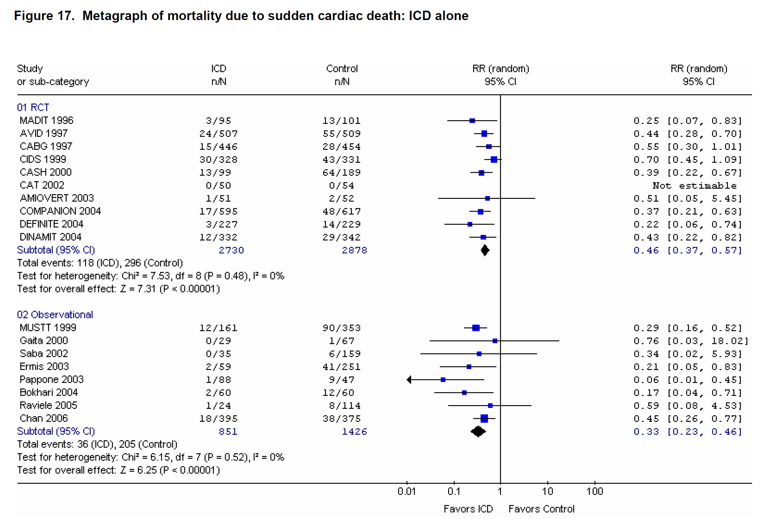
McAlister FA et al. Evid Rep Technol Assess (Full Rep) 2007;152:1-199.

Slide 22

Cardio-Desfibriladores
Extremamente eficientes no tratamento de arritmias ventriculares malignas
Reduzem a mortalidade súbita
Reduzem a mortalidade total
Indicados na prevenção secundária de TV/FV
Indicados na prevenção primária de pacientes de alto risco de MS arrítmica
A maioria dos pacientes candidatos à TRC também são candidatos ao implante de CDI para prevenção primária

Slide 23
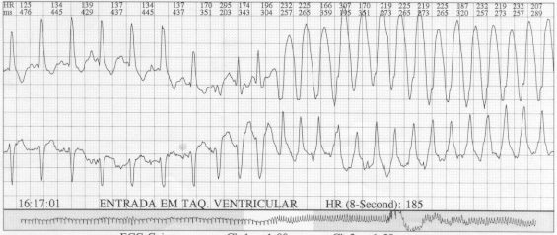
M.T, masc, 65 anos, cardiopatia isquêmica crônica, CF II NYHA

Slide 24
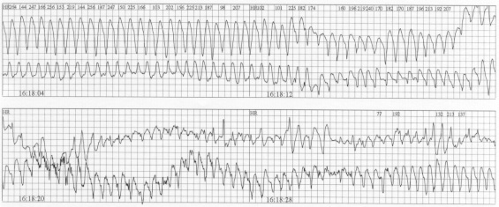
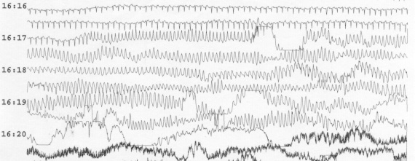

Slide 25
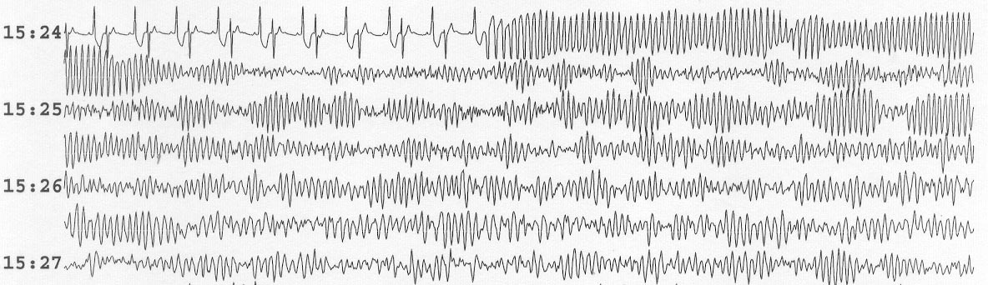
J.C., masc, 70 anos, insuf. aórtica, CF II NYHA

Slide 26
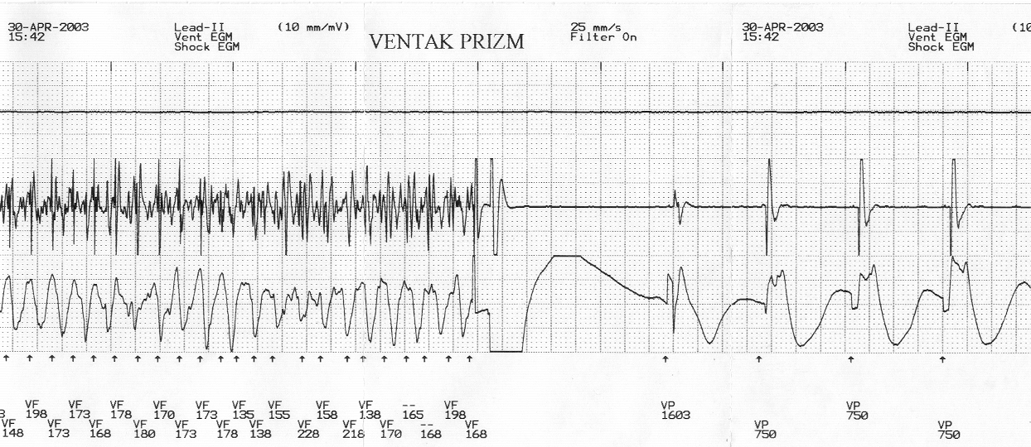
O CDI é a única forma eficiente de prevenção da Morte Súbita

Slide 27
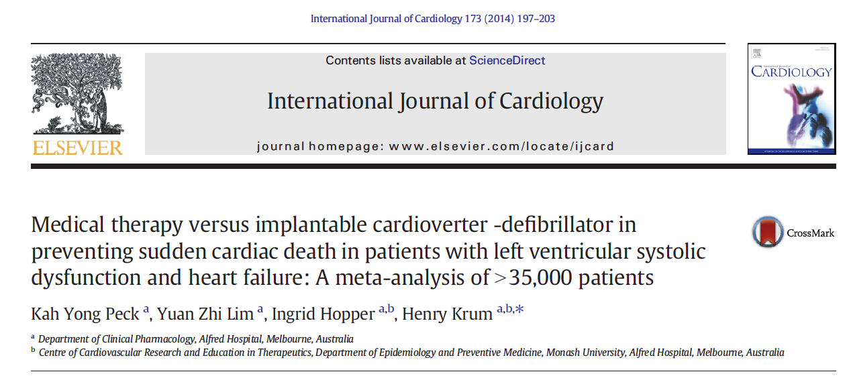
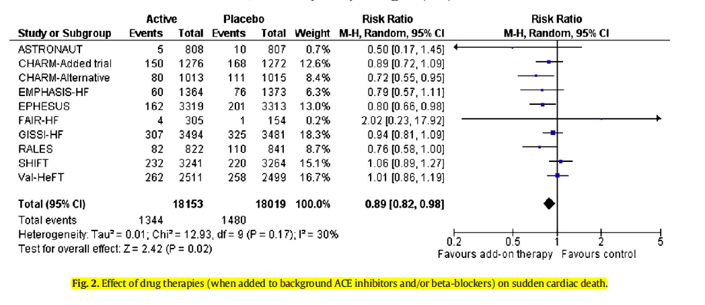

Slide 28
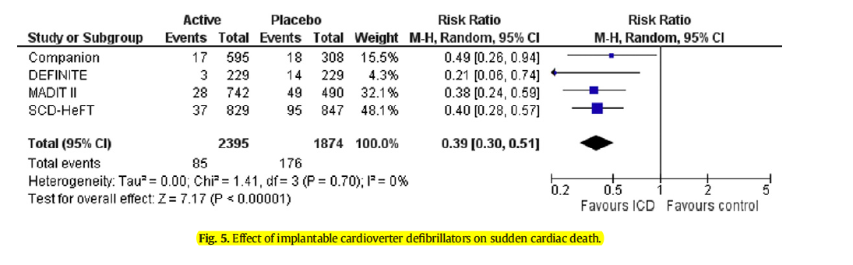

Slide 29
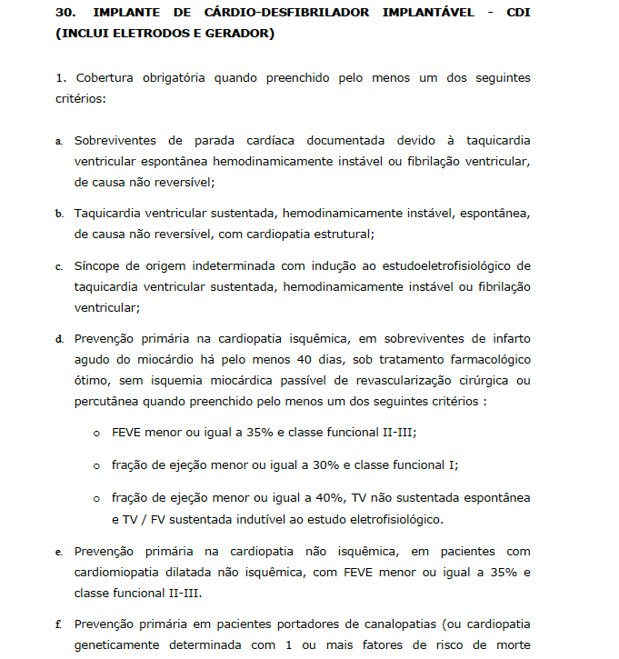
DUT -- ROL ANS 2014

Slide 30
TRC-p + D = trc-d
Procurar obter os benefícios da ressincronização (TRC-P) com a proteção dos desfibriladores (D)

Slide 31
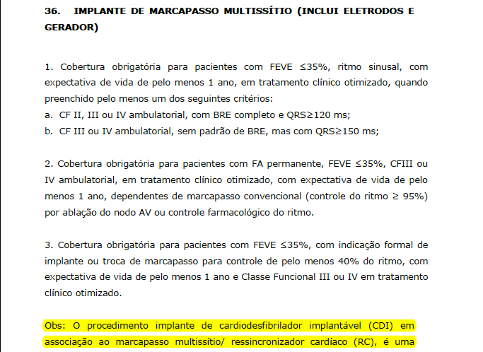
DUT -- ROL ANS 2014

Slide 32
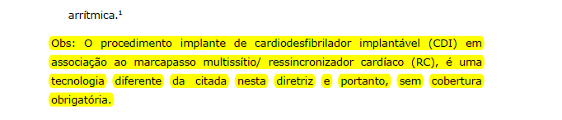
DUT -- ROL ANS 2014

Slide 33
Problemas com a DUT ANS 2014
Não baseada em qualquer dado científico
Predispõe, através de legislação oficial, o número de mortes súbitas cardíacas
Aumenta as reoperações desnecessárias
Aumenta as complicações cardiovasculares
Aumenta os custos das reitervenções
Não contempla os pacientes com indicações em comum ( TRC + CDI)
O que fazer com paciente com ICC / Dissincronismo e Taq. Ventricular / FV??? Implantam-se 2 dispositivos??
Incentiva a judicialização da Medicina
Dá à ao Sistema de “Saúde Complementar” uma cobertura obrigatória menor do que a do próprio SUS

Slide 34
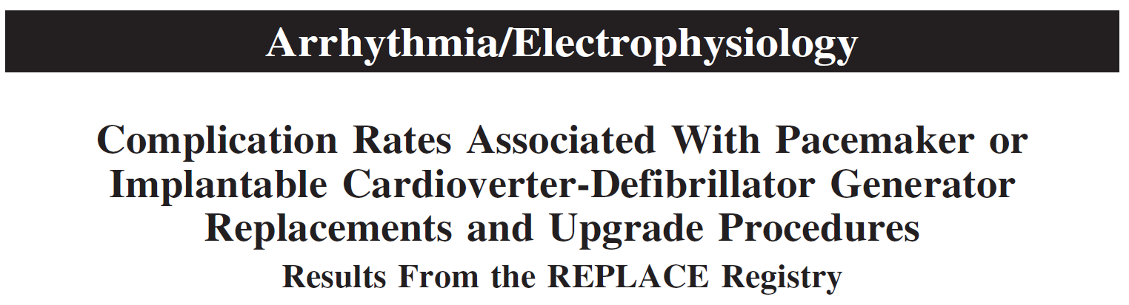
REPLACE Registry
  Registro prospectivo de complicações relativas a reintervenções (trocas) em pacientes com MPs / CDIs
  Análise de complicações imediatas ou após 6 meses
  72 centros acadêmicos / privados nos EUA
  1031 pts no grupo sem necessidade de colocação de eletrodo adicional (grupo 1)
  713 pts no grupo com necessidade de colocação de eletrodo adicional (upgrade, grupo 2)
  Taxa de complicações: 4,0% vs 15,3% entre os grupos
Poole JE et al. Circulation. 2010;122:1553-1561
Notes:
Background—Prospective studies defining the risk associated with pacemaker or implantable cardioverter-defibrillator
replacement surgeries do not exist. These procedures are generally considered low risk despite results from recent
retrospective series reporting higher rates.
Methods and Results—We prospectively assessed predefined procedure-related complication rates associated with elective
pacemaker or implantable cardioverter-defibrillator generator replacements over 6 months of follow-up. Two groups
were studied: those without (cohort 1) and those with (cohort 2) a planned transvenous lead addition for replacement
or upgrade to a device capable of additional therapies. Complications were adjudicated by an independent events
committee. Seventy-two US academic and private practice centers participated. Major complications occurred in 4.0%
(95% confidence interval, 2.9 to 5.4) of 1031 cohort 1 patients and 15.3% (95% confidence interval, 12.7 to 18.1) of
713 cohort 2 patients. In both cohorts, major complications were higher with implantable cardioverter-defibrillator
compared with pacemaker generator replacements. Complications were highest in patients who had an upgrade to or a
revised cardiac resynchronization therapy device (18.7%; 95% confidence interval, 15.1 to 22.6). No periprocedural deaths
occurred in either cohort, although 8 later procedure-related deaths occurred in cohort 2. The 6-month infection rates were
1.4% (95% confidence interval, 0.7 to 2.3) and 1.1% (95% confidence interval, 0.5 to 2.2) for cohorts 1 and 2, respectively.
Conclusions—Pacemaker and implantable cardioverter-defibrillator generator replacements are associated with a notable
complication risk, particularly those with lead additions. These data support careful decision making before device
replacement, when managing device advisories, and when considering upgrades to more complex systems.
Clinical Trial Registration—URL: http://www.clinicaltrials.gov. Unique identifier: NCT00395447.
(Circulation. 2010;122:1553-1561.)

Slide 35
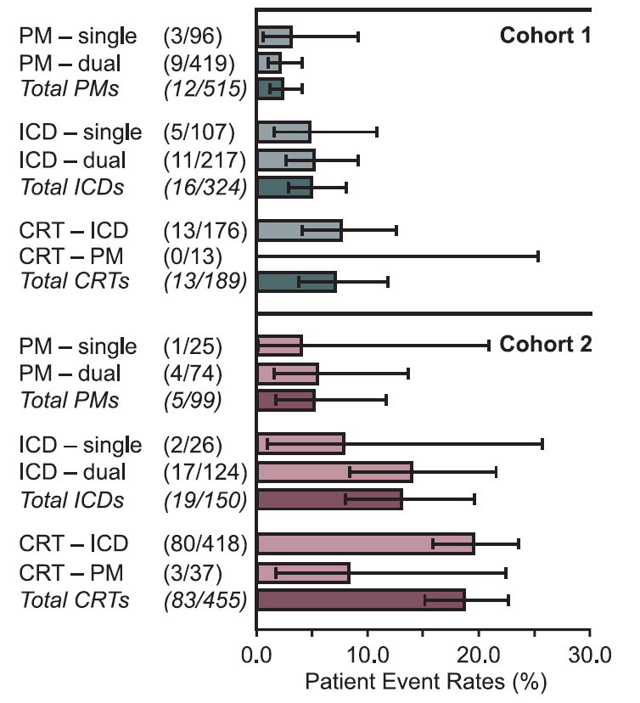
REPLACE Registry
Poole JE et al. Circulation. 2010;122:1553-1561

Slide 36
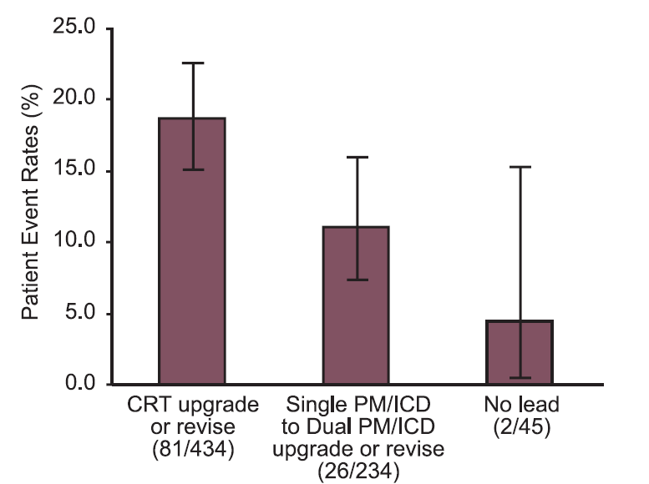
REPLACE Registry
Poole JE et al. Circulation. 2010;122:1553-1561

Slide 37
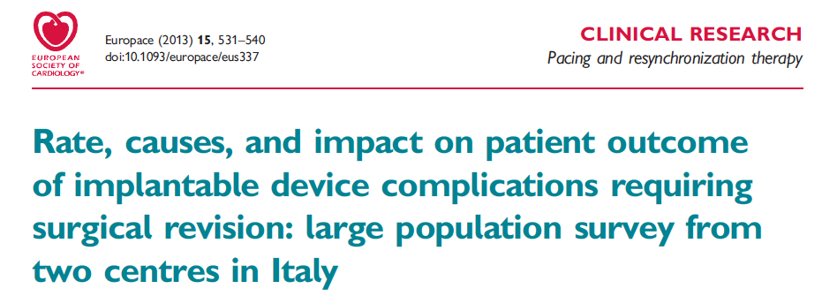
2671 procedimentos
CRT: maior risco de complicações: odds ratio 6,6, p<0,001)
Pacientes com complicações têm:
  Maior taxa de hospitalização: 2,3 ± 0,6 vs 1,0 ± 0,1, p<0,001)
  Maior duração de internação: 15,7 ± 25,1 vs 3,6 ± 1,1, p<0,001)
Palmisano P et al. Europace (2013) 15, 531–540
Notes:
Aims The long-term impact of implantable device-related complications on the patient outcome has not been thoroughly
evaluated. The aims of this retrospective, bi-centre study were to analyse the rate and nature of device-related complications
requiring surgical revision in a large series of patients undergoing device implantation, elective generator
replacement and pacing system upgrade and to systematically assess the impact of such complications on patient
outcome and healthcare utilization.
Methods
and results
Data from 2671 consecutive procedures (1511 device implantations, 1034 elective generator replacements, and 126
pacing system upgrades) performed between January 2006 and March 2011 were retrospectively analysed. The
outcome measures recorded were complication-related mortality, number of re-operations, need for complex surgical
procedures, number of re-hospitalizations, and additional hospital treatment days. Over a median follow-up of
27 months, the overall rate of complications was 2.8% per procedure-year [9.5% in cardiac resynchronisation therapy
(CRT) device implantation, 6.1% in pacing system upgrade, 3.5% in implantable cardioverter defibrillator implantation,
1.7% in pacemaker implantation, and 1.7% in generator replacement). The procedure with the highest risk of complications
was CRT device implantation (odds ratio: 6.6; P , 0.001); these complications primarily involved coronary
sinus lead dislodgement and device infection. Patients with complications had a significantly higher number of devicerelated
hospitalizations (2.3+0.6 vs. 1.0+0.1; P , 0.001) and hospital treatment days (15.7+25.1 vs. 3.6+1.1;
P , 0.001) than those without complications. Device infection was the complication with the greatest negative
impact on patient outcome.
Conclusion Cardiac resynchronisation therapy implantation was the procedure with the highest risk of complications requiring
surgical revision. Complications were associated with substantial clinical consequences and a significant increase in
the number and length of hospitalizations.

Slide 38
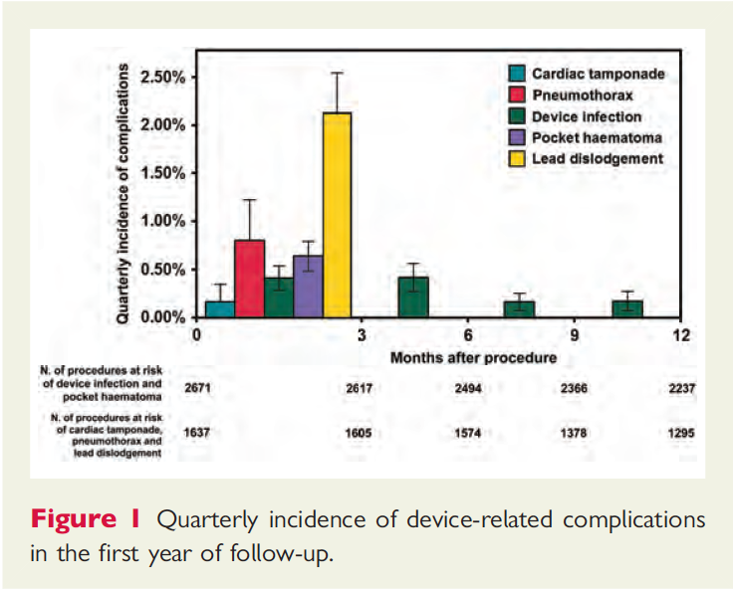
Palmisano P et al. Europace (2013) 15, 531–540
Notes:
Aims The long-term impact of implantable device-related complications on the patient outcome has not been thoroughly
evaluated. The aims of this retrospective, bi-centre study were to analyse the rate and nature of device-related complications
requiring surgical revision in a large series of patients undergoing device implantation, elective generator
replacement and pacing system upgrade and to systematically assess the impact of such complications on patient
outcome and healthcare utilization.
Methods
and results
Data from 2671 consecutive procedures (1511 device implantations, 1034 elective generator replacements, and 126
pacing system upgrades) performed between January 2006 and March 2011 were retrospectively analysed. The
outcome measures recorded were complication-related mortality, number of re-operations, need for complex surgical
procedures, number of re-hospitalizations, and additional hospital treatment days. Over a median follow-up of
27 months, the overall rate of complications was 2.8% per procedure-year [9.5% in cardiac resynchronisation therapy
(CRT) device implantation, 6.1% in pacing system upgrade, 3.5% in implantable cardioverter defibrillator implantation,
1.7% in pacemaker implantation, and 1.7% in generator replacement). The procedure with the highest risk of complications
was CRT device implantation (odds ratio: 6.6; P , 0.001); these complications primarily involved coronary
sinus lead dislodgement and device infection. Patients with complications had a significantly higher number of devicerelated
hospitalizations (2.3+0.6 vs. 1.0+0.1; P , 0.001) and hospital treatment days (15.7+25.1 vs. 3.6+1.1;
P , 0.001) than those without complications. Device infection was the complication with the greatest negative
impact on patient outcome.
Conclusion Cardiac resynchronisation therapy implantation was the procedure with the highest risk of complications requiring
surgical revision. Complications were associated with substantial clinical consequences and a significant increase in
the number and length of hospitalizations.

Slide 39
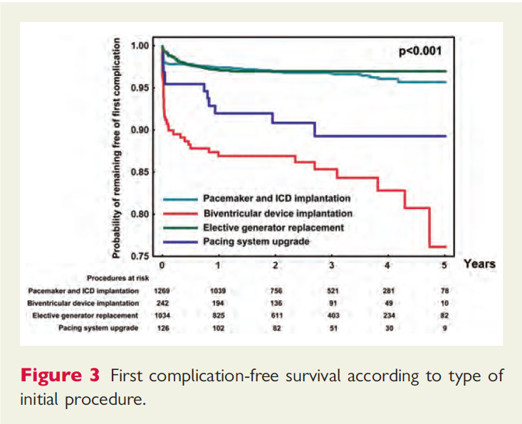
Palmisano P et al. Europace (2013) 15, 531–540
Notes:
Aims The long-term impact of implantable device-related complications on the patient outcome has not been thoroughly
evaluated. The aims of this retrospective, bi-centre study were to analyse the rate and nature of device-related complications
requiring surgical revision in a large series of patients undergoing device implantation, elective generator
replacement and pacing system upgrade and to systematically assess the impact of such complications on patient
outcome and healthcare utilization.
Methods
and results
Data from 2671 consecutive procedures (1511 device implantations, 1034 elective generator replacements, and 126
pacing system upgrades) performed between January 2006 and March 2011 were retrospectively analysed. The
outcome measures recorded were complication-related mortality, number of re-operations, need for complex surgical
procedures, number of re-hospitalizations, and additional hospital treatment days. Over a median follow-up of
27 months, the overall rate of complications was 2.8% per procedure-year [9.5% in cardiac resynchronisation therapy
(CRT) device implantation, 6.1% in pacing system upgrade, 3.5% in implantable cardioverter defibrillator implantation,
1.7% in pacemaker implantation, and 1.7% in generator replacement). The procedure with the highest risk of complications
was CRT device implantation (odds ratio: 6.6; P , 0.001); these complications primarily involved coronary
sinus lead dislodgement and device infection. Patients with complications had a significantly higher number of devicerelated
hospitalizations (2.3+0.6 vs. 1.0+0.1; P , 0.001) and hospital treatment days (15.7+25.1 vs. 3.6+1.1;
P , 0.001) than those without complications. Device infection was the complication with the greatest negative
impact on patient outcome.
Conclusion Cardiac resynchronisation therapy implantation was the procedure with the highest risk of complications requiring
surgical revision. Complications were associated with substantial clinical consequences and a significant increase in
the number and length of hospitalizations.

Slide 40
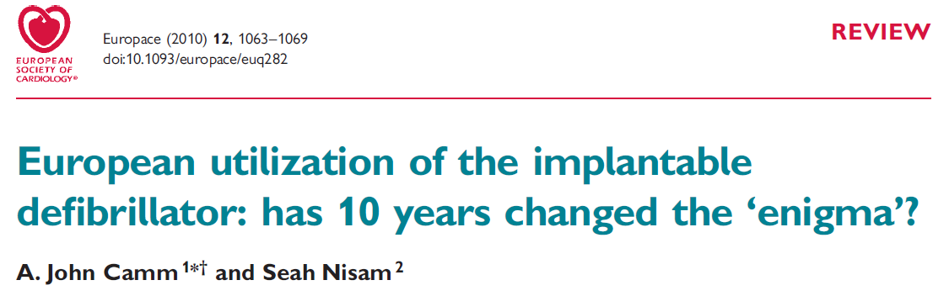
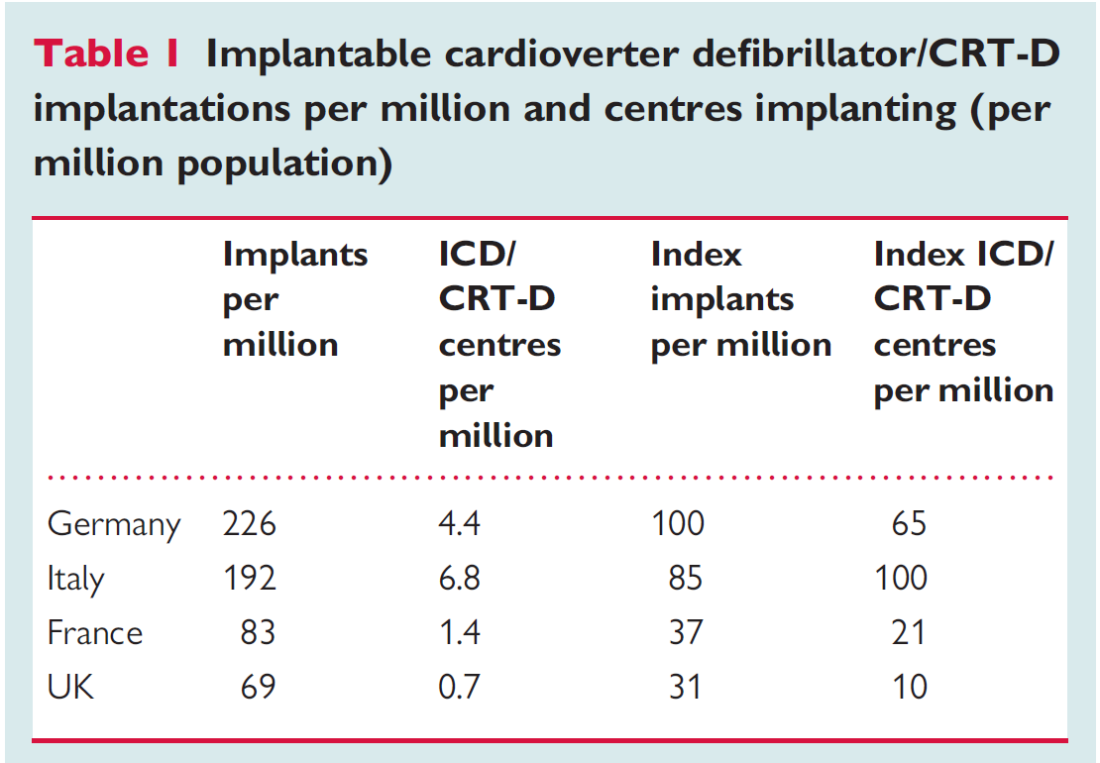

Slide 41
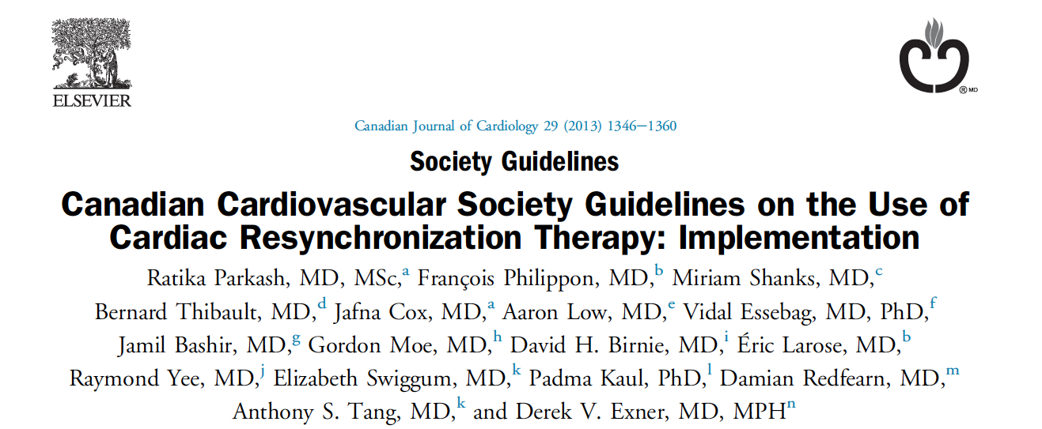
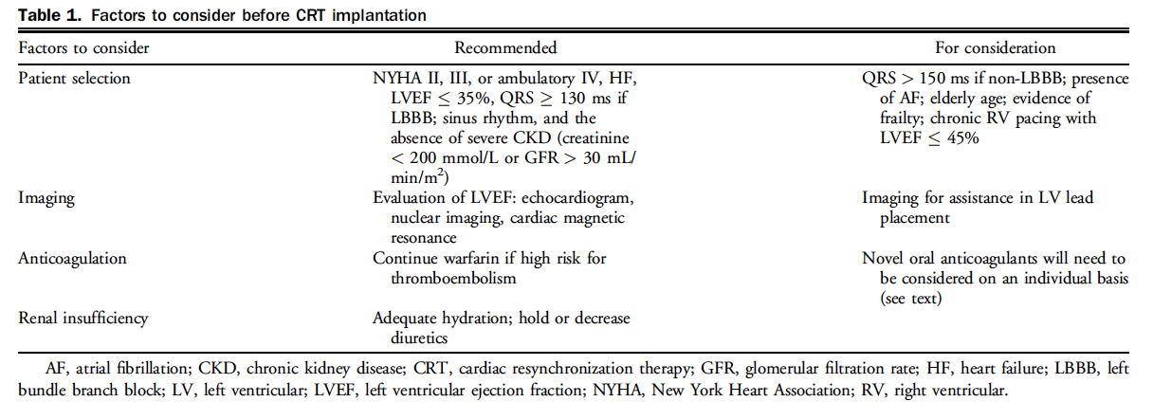
Parkash R et al. Canadian Journal of Cardiology 29 (2013) 1346e1360

Slide 42
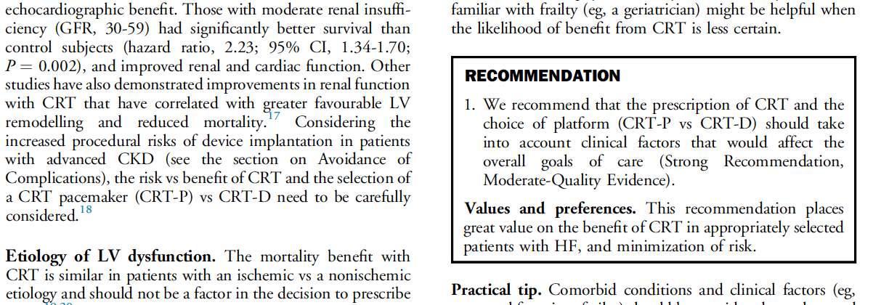
Parkash R et al. Canadian Journal of Cardiology 29 (2013) 1346e1360

Slide 43


Slide 44
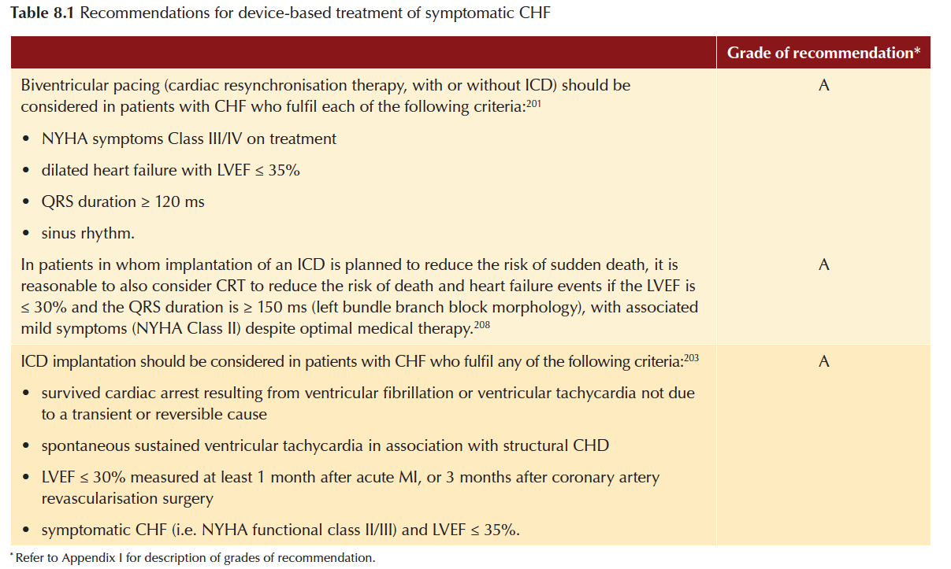

Slide 45
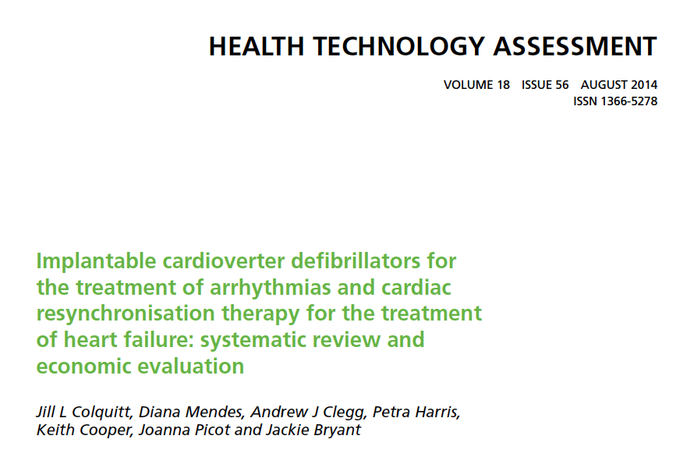
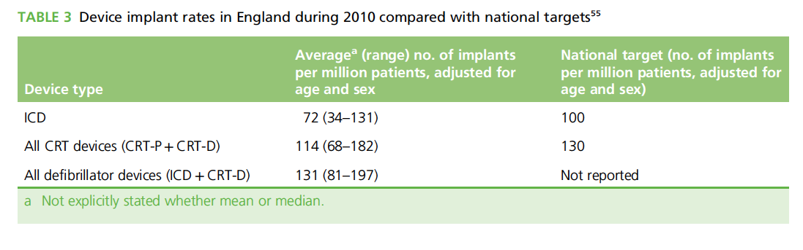

Slide 46
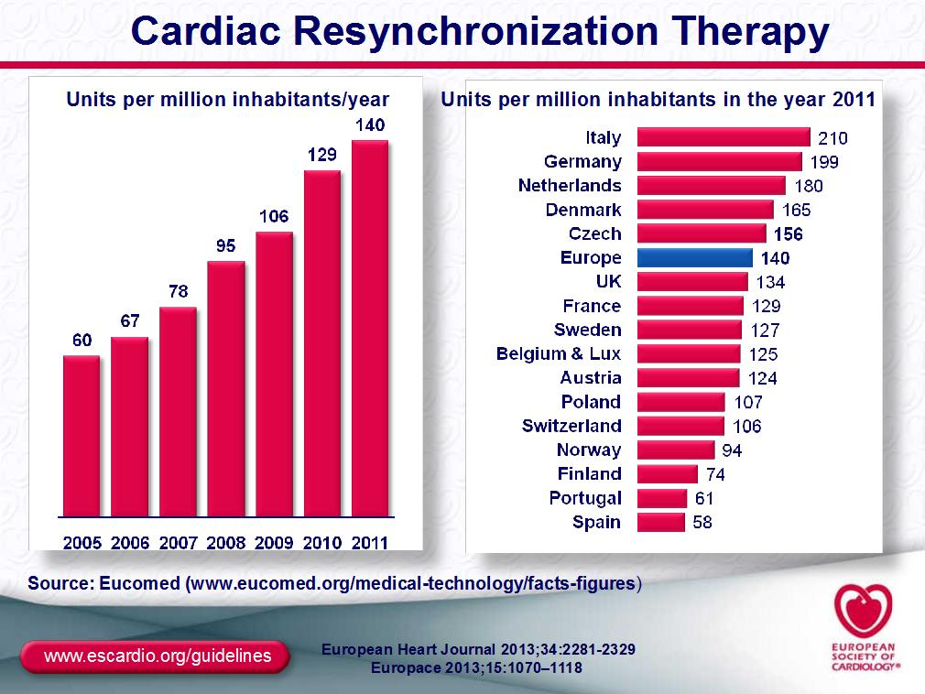

Slide 47
Número de Implantes de MPs E CDIs por Milhão de Habitante – 2001 World Survey
País | MP | CDI
EUA | 789 | 169
Bélgica | 685 | 42
França | 628 | 16
Brasil | 64* | 5*
Argentina | 250 | 13
Uruguai | 362 | 19
* Ref. 2006
Pachón MJC e Cols. Relampa 2008;21(1):5-12

Slide 48
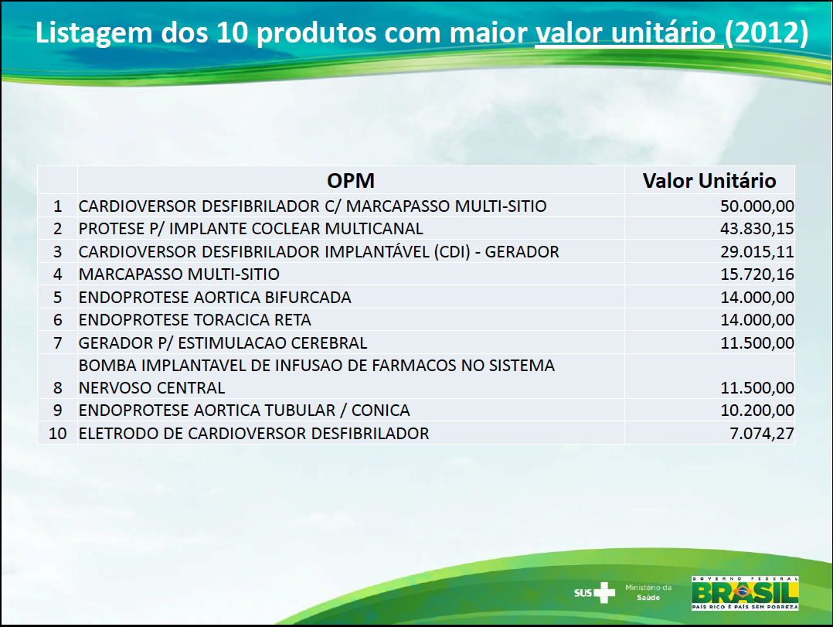

Slide 49
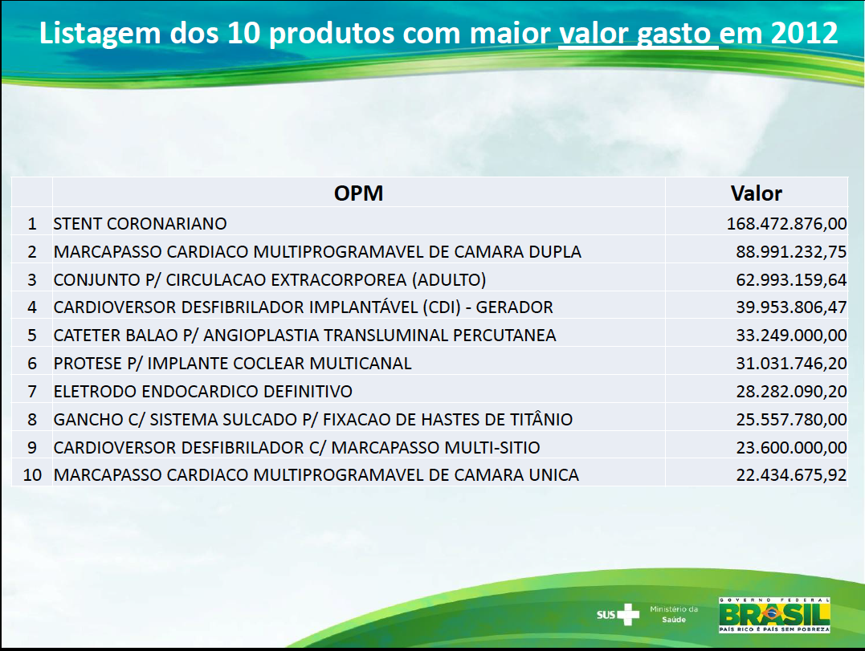
472 unidades: 2,38 unidades / milhão de habitantes

Slide 50
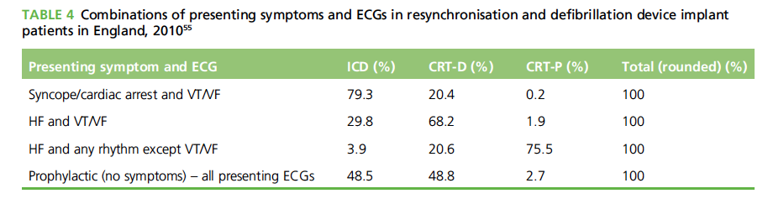

Slide 51
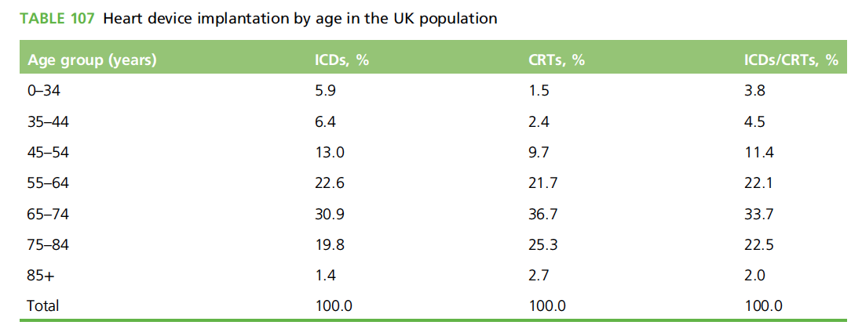

Slide 52
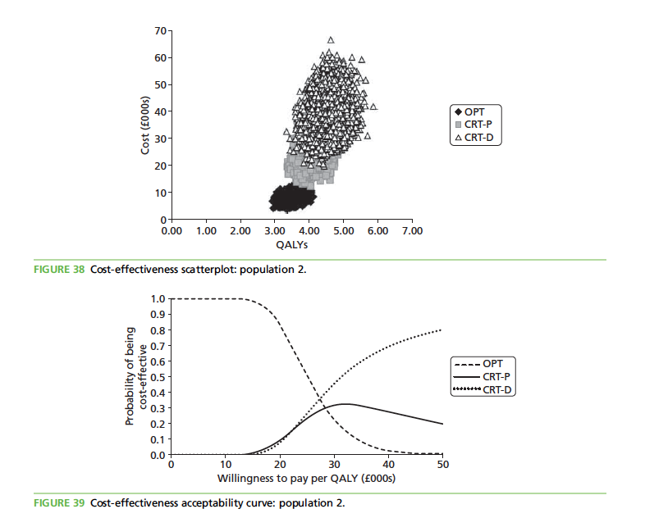
Notes:
Probabilistic sensitivity analysis
Probabilistic sensitivity analysis was performed for the base case to estimate the impact of joint parameter
uncertainty on the model’s cost-effectiveness results. Appendix 15 reports the variables (mean values and
CIs) included in the probabilistic sensitivity analysis, the form of distribution used for sampling and the
parameters of the distribution. Table 137 reports the estimated probabilistic results of 10,000 iterations in
terms of costs and QALYs for each strategy and their relative cost-effectiveness.
The probabilistic results are consistent with the deterministic base-case analysis. Both CRT-P + OPT and
CRT-D + OPT have ICERs of < £30,000 per QALY gained compared with initial management with OPT
alone, as well as CRT-D + OPT compared with CRT-P + OPT. The IQR estimated for the probabilistic ICER
for the comparison between CRT-D + OPT and CRT-P + OPT reflects the overlap in model results for CRT-P
and CRT-D.
The probabilistic sensitivity analysis results are presented in Figure 38 in terms of incremental costs and
QALYs, showing their dispersion on the cost-effectiveness scatterplot and the partial overlap of the
cost-effectiveness results for the three strategies, particularly between CRT-P and CRT-D.
Figure 39 shows the variation in the probability of the three treatment strategies being cost-effective as the
WTP threshold increases from £0 to £50,000 per QALY gained. At a WTP threshold of £20,000 per QALY gained, the probability of OPT alone (with subsequent upgrades), CRT-P + OPT and CRT-D + OPT being
cost-effective is 83%, 9% and 8% respectively. Above a WTP threshold of £28,000 per QALY gained,
the intervention with the highest probability of being cost effective is CRT-D + OPT (38%). At a WTP
threshold of £30,000 per QALY gained, CRT-D + OPT and CRT-P + OPT have a 46% and 31% probability
of being cost-effective, respectively, whereas OPT alone has a 23% probability of being cost-effective.

Slide 53
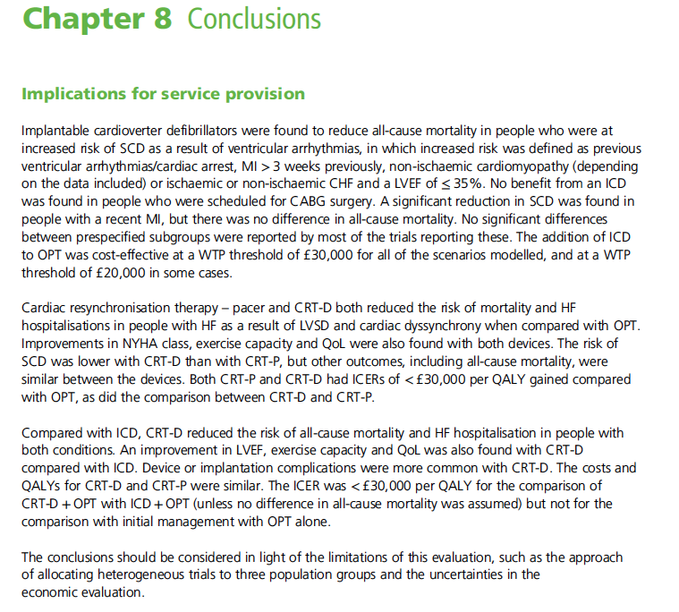

Slide 54
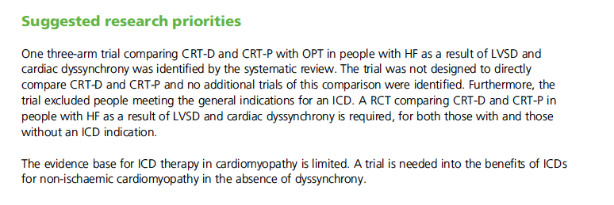

Slide 55
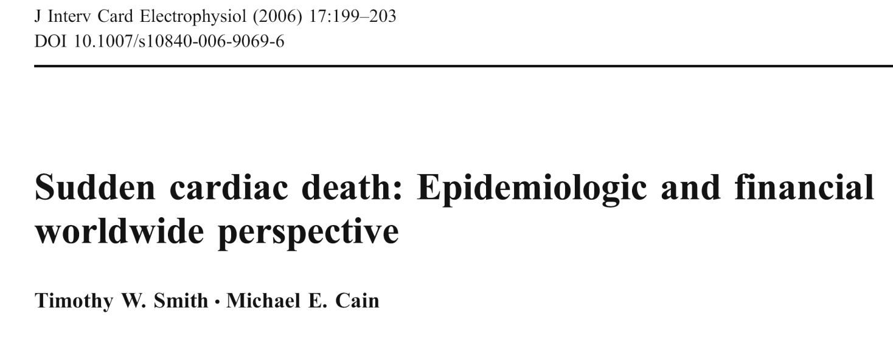
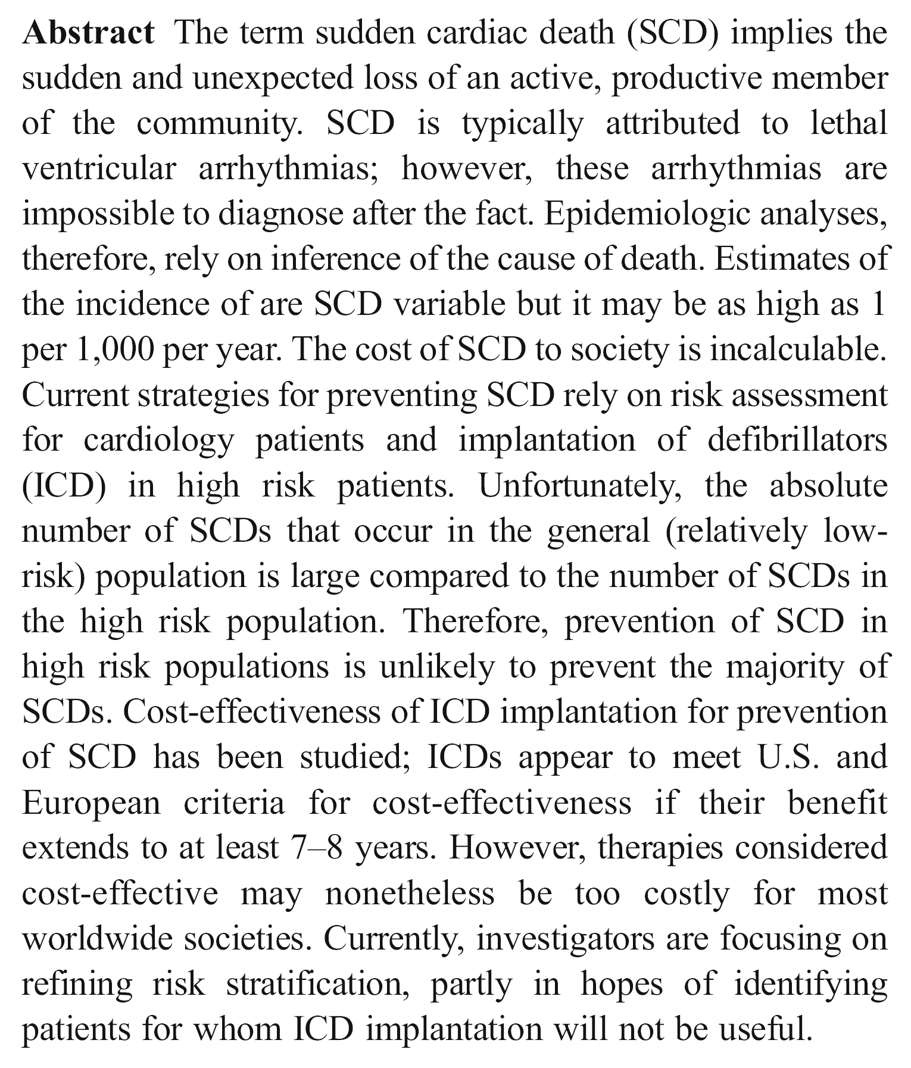
Notes:
T. W. Smith : M. E. Cain
Cardiovascular Division, Department of Medicine,
Washington University School of Medicine,
St. Louis, USA

Slide 56


Slide 57
Implante de Cardiodesfibrilador Multissítio – TRC-D
  PROPOSTA DUT ANS AMB CBHPM
1. Cobertura obrigatória para pacientes com FEVE ≤35%, ritmo sinusal, com expectativa de vida de pelo menos 1 ano, em tratamento clínico otimizado, quando preenchido pelo menos um dos seguintes critérios:
  a. CF II, III ou IV ambulatorial, com BRE completo e QRS≥120 ms;
  b. CF III ou IV ambulatorial, sem padrão de BRE, mas com QRS≥150 ms;
2. Cobertura obrigatória para pacientes com FA permanente, FEVE ≤35%, CFIII ou IV ambulatorial, em tratamento clínico otimizado, com expectativa de vida de pelo menos 1 ano, dependentes de marcapasso convencional (controle do ritmo ≥ 95%) por ablação do nodo AV ou controle farmacológico do ritmo.
3. Cobertura obrigatória para pacientes com FEVE ≤35%, com indicação formal de implante ou troca de marcapasso para controle de pelo menos 40% do ritmo, com expectativa de vida de pelo menos 1 ano e Classe Funcional III ou IV em tratamento clínico otimizado.
4. Cobertura obrigatória para quaisquer uma das condições listadas acima para a Terapia de Ressincronização Cardíaca, quando se objetiva a prevenção primária ou secundária da morte súbita cardíaca arrítmica em paciente com expectativa de vida de pelo menos 1 ano.
Notes:
Os critérios de exclusão da TRC-D são principalmente a taquicardia ventricular incessante, as infecções sistêmicas ativas, as doenças psiquiátricas limitantes, a recusa do paciente e as doenças debilitantes com expectativa de vida inferior a um ano.

Slide 58
TRC-D ou TRC-P ???
TRC-D ?
TRC-P?
TRC-D
TRC-P
COMORBIDADES /
CF ICC
IDADE
Notes:
Comentários de Daubert JC et al. Europace 2009; 11,:v87–v92
It is not morally wrong to address the issue of priority of therapeutic
objectives in this majority of patients with HF, whose longevity
remains limited despite all therapeutic efforts. Improving
quality of life, lowering the rates of hospitalizations for management
of HF, and preserving patient autonomy are probably priorities
for elderly patients. A treatment that moreover lowers
mortality and prolongs life under comfortable conditions, which
the CRT-P achieves at a modest cost, may be viewed as successful.

Slide 59
Reunião ANS COSAUDE – 07/04/2015
Inclusão no Rol ANS 2016 :
  a) Implante de Cardiodesfibrilador Multissítio – TRC-D (Gerador e Eletrodos) – CBHPM 3.09.04.16-1
  b) Implante de Monitor de Eventos - (Looper Implantável) – CBHPM 3.09.04.17-0
Eduardo R. B. Costa
Departamento de Estimulação Cardíaca Artificial da Sociedade Brasileira de Cirurgia Cardiovascular – DECA SBCCV
educosta.cardiol@uol.com.br

Slide 60


Slide 61

Síncope
“Those who suffer from frequent and
severe fainting often die suddenly.”
Hippocrates, 1000 BC

Slide 62
Prognóstico
1.0
Sem síncope
Vasovagal e
outras causas
0.8
Causa desconhecida
Causa neurológica
Causa cardíaca
0.6
Probabilidade de Sobrevida
0.4
0.2
Pacientes com causas cardíacas de síncope têm um aumento significante do risco de mortaldade (p<0,001).
0.0
0
5
10
15
20
25
Seguimento (anos)
Soteriades ES, Evans JC, Larson MG, et al. NEJM. 2002;347:878-85.
Notes:
Figura 2. Sobrevida total dos participantes com síncope de acordo com a causa, e participantes sem síncope.
P<0.001 para a comparação entre os participantes com e sem síncope. A categoria “Vasovagal
e outras causas” inclui vasovagal, ortostática, medicação-induzida e outras causas infreqüêntes de síncope.

Slide 63


Síncope
ANOF, 63 anos, Síndrome Bradi-Taquicardia

Slide 64


Síncope
JAS, 41 anos, CMHO, CDI

Slide 65

740.000 atendimentos de emergência nos EUA
460.000 admissões hospitalares
Custos hospitalares: US$2,4 bilhões
Utilização inadequada de diversos métodos diagnósticos
Baixa eficiência diagnóstica
Sun BC. Progress in Carddiovasc Diseases 2013;55:370-375

Slide 66

Sun BC. Progress in Carddiovasc Diseases 2013;55:370-375

Slide 67

Sun BC. Progress in Carddiovasc Diseases 2013;55:370-375

Slide 68

Sun BC. Progress in Carddiovasc Diseases 2013;55:370-375

Slide 69

Avaliação Inicial
História Clínica
Exame Físico (incluindo medição da PA na posição ortostática)
Massagem Carotideana em pts acima de 40 anos
Eletrocardiograma
Após, se houver necessidade:
  Ecocardiograma, nos pts com suspeita de doença cardíaca estrutural ou suspeita de síncope cardiovascular
  Monitorização eletrocardiográfica na suspeita de causa arrítmica
  Testes Ortostáticos
  Testes neurológicos: na suspeita de T-LOC não sincopal
Moya A et al. Guidelines for the diagnosis and management of syncope. European Heart Journal 2009; 30:2631–2671

Slide 70
Moya A et al. Guidelines for the diagnosis and management of syncope. European Heart Journal 2009; 30:2631–2671

Slide 71


Síncope - Síndrome Bradi-Taquicardia

Slide 72
Moya A et al. Guidelines for the diagnosis and management of syncope. European Heart Journal 2009; 30:2631–2671

Slide 73
Moya A et al. Guidelines for the diagnosis and management of syncope. European Heart Journal 2009; 30:2631–2671

Slide 74

Moya A et al. Guidelines for the diagnosis and management of syncope. European Heart Journal 2009; 30:2631–2671

Slide 75

Moya A et al. European Heart Journal 2009; 30:2631–2671

Slide 76
Síncope: Quando Há Risco?
Doença Cardíaca Estrutural: ICO, ICC, CMD, HVE, CMHO, DAVD, Valvopatias
Síncope Arrítmica:
  Exercício
  Palpitações
  MSC familiar
  TV / TVNS
  Distúrbios da condução
  Bradiarritmias
  Canalopatias

Slide 77


Slide 78

Síncope na Cardiopatia Isquêmica
Notes:
Orlando, Cardiopatia Isquemica

Slide 79


Slide 80


A H V
HV Normal: 55 ms

Slide 81

A H V

Slide 82


Slide 83

A H
A H
A H

Slide 84


Slide 85


Slide 86
Moya A et al. Guidelines for the diagnosis and management of syncope. European Heart Journal 2009; 30:2631–2671

Slide 87

Moya A et al. Guidelines for the diagnosis and management of syncope. European Heart Journal 2009; 30:2631–2671

Slide 88
Teste de Inclinação
Desmascara a susceptibilidade à Síncope Vasovagal (SVV)
Reproduz os sintomas
Os pacientes aprendem a reconhecer os sintomas de advertência da SVV
Fornece respaldo ao médico para melhor definir o prognóstico e o tratamento
Notes:
The rationale for undertaking head-up tilt (HUT) testing in patients suspected of having vasovagal syncope is summarized here. In essence, the test may not only provide useful diagnostic information, but it also provides an opportunity for patients to become more familiar with the condition and its possible warning signs. The latter may prove to be of considerable diagnostic utility in many individuals.

Slide 89
Moya A et al. Guidelines for the diagnosis and management of syncope. European Heart Journal 2009; 30:2631–2671

Slide 90


Moya A et al. Guidelines for the diagnosis and management of syncope. European Heart Journal 2009; 30:2631–2671

Slide 91

J.L.C., masc, 72 anos DAC, FA e síncope

Slide 92

Bloqueio AV Total - Paroxístico

Slide 93


Slide 94
Síncope – Métodos Diagnósticos Convencionais
Teste / Procedimento | Capacidade Diagnóstica (baseada em tempo diagnóstico médio de 5,1 meses⁷
História e Exame Físico (Incluindo Massagem Carotideana) | 49-85% ^{1, 2}
ECG | 2-11% ²
Estudo Eletrofisiológico sem DC Estrutural | 11% ³
Estudo Eletrofisiológico com DC Estrutural | 49% ³
Tilt Table Test (sem DC Estrutural) | 11-87% ^{4, 5}
Monitorização Ambulatorial:
Holter | 2% ⁷
Looper Externo (2-3 semanas de duração) | 20% ⁷
Looper Implantável (monitorização de até 14 meses) | 65-88% ^{6, 7}
Investigação Neurológica † (TC Crânio, Doppler Carótidas, EEG) | 0-4% ^{4,5,8,9,10}
¹ Kapoor, et al N Eng J Med, 1983.
² Kapoor, Am J Med, 1991.
³ Linzer, et al. Ann Int. Med, 1997.
⁴ Kapoor, Medicine, 1990.
⁵ Kapoor, JAMA, 1992
⁶ Krahn, Circulation, 1995
⁷ Krahn, Cardiology Clinics, 1997.
⁸ Eagle K,, et al. The Yale J Biol and Medicine. 1983; 56: 1-8.
⁹ Day S, et al. Am J Med. 1982; 73: 15-23.
¹⁰ Stetson P, et al. PACE. 1999; 22 (part II): 782.
^{† RNM Não Avaliada}
Notes:
A yield is defined as information that will point to more finely focused tests, specialties, or treatments.
Patient history and physical exam are the most productive diagnostic tools for recurrent syncope, accounting for 49-85% of all syncope diagnoses.^{1,2} An ECG, also considered a first-line test, is diagnostic in 2-11% of cases.²
Beyond that, other tests have variable diagnostic yields. Holter monitors (worn for 1-3 days) capture ECGs during a syncopal episode in only 1% of patients, based on a mean time to recurrent event of 5.1 months.⁷
The effectiveness of tilt table tests, a common tool used to identify vasovagal syncope, depends on several factors, including patient selection and use of provocative drugs. Depending on these factors, the rate of positive tests has been reported in the range of 11-87%.^{3,5} However, about 10% or more of the population (who do not experience syncope) will have positive tilt table tests.^{4,6}
External loop recorders (worn for 2-3 weeks) are most productive in motivated patients who experience relatively frequent syncope. They provide a diagnostic yield of 20%.⁷
Electrophysiology (EP) studies are generally more productive in patients with structural heart disease (SHD) and therefore are generally a higher priority for patients in this group.¹
EP studies are used to diagnose syncope by inducing symptoms under controlled conditions, thereby attaining a “presumptive” diagnosis.¹
EP testing usually fails to identify intermittent bradycardia as a cause of syncope (6%) and may sometimes reveal unrelated rhythm disturbances that may be mistakenly identified as the cause of syncope.²
1. Kapoor W, et al. A prospective evaluation and follow-up of patients with syncope. N Engl J Med 1983;309:197-204.
2. Kapoor W. Diagnostic evaluation of syncope. Amer J Med 1991;90:91-106.
3. Linzer M, et al. Clinical guideline: Diagnosing syncope: Part 2: Unexplained syncope. Ann Intern Med 1997;127:76-86.
4. Kapoor W. Evaluation and outcome of patients with syncope. Medicine 1990;69:160-175.
5. Kapoor W. Evaluation and management of the patient with syncope. JAMA 1992;268:2553-2560.
6. Krahn A, et al. The etiology of syncope in patients with negative tilt table and electrophysiological testing. Circulation 1995;92:1819-1824.
Krahn A, Klein G, Yee R: Recurrent syncope. Experience with an implantable loop recorder. Cardiology Clinics 1997; 15(2):313-326.
8. Eagle K,, et al. The Yale J Biol and Medicine. 1983; 56: 1-8.
9. Day S, et al. Am J Med. 1982; 73: 15-23.
10. Stetson P, et al. PACE. 1999; 22 (part II): 782.
Please also see:
Brignole M, Alboni P, Benditt DG, et al. “Guidelines on Management (Diagnosis and Treatment) of Syncope. Eur Heart Journal 2001; 22: 1256-1306.

Slide 95


Looper Implantável
Implante com anestesia local
Gravação automática de bradi e taquiarritmias
Gravação manual (acionada pelo paciente) em caso de sintomas
Memória retrógrada
Duração da bateria de até 36 meses

Slide 96


Looper Implantável

Slide 97





Slide 98
Looper Implantável - Síncope
Ponto de Auto-Ativação
Ponto de Ativação pelo Paciente

Slide 99

Looper Implantável - Síncope
Momento da Ativação
Linzer M. Am J Cardiol. 1990;66:214-219.
Notes:
Example of a symptomatic wide-QRS tachycardia recorded during a near syncope in a patient undergoing AECG monitoring.

Slide 100


Conventional:
Tilt-Test
EEF
Looper Externo
Krahn AD et al. J Am Coll Cardiol 2003;42:495–501
Notes:
OBJECTIVES We sought to assess the cost implications of two investigation strategies in patients with
unexplained syncope.
BACKGROUND Establishing a diagnosis in patients with unexplained syncope is complicated by infrequent
and unpredictable events. The cost-effectiveness of immediate, prolonged monitoring as an
alternative to conventional diagnostic strategies has not been studied.
METHODS Sixty patients (age 66 14 years; 33 males) with unexplained syncope and LV ejection
fraction 35% were randomized to conventional testing with an external loop recorder, tilt
and electrophysiologic (EP) testing, or prolonged monitoring with an implantable loop
recorder with one-year monitoring. If patients remained undiagnosed after their assigned
strategy, they were offered a crossover to the alternate strategy. Cost analysis of the two testing
strategies was performed.
RESULTS Fourteen of 30 patients who were being monitored were diagnosed at a cost of $2,731 $285
per patient and $5,852 $610 per diagnosis. In contrast, only six of 30 conventional patients
were diagnosed (20% vs. 47%, p 0.029), at a cost of $1,683 $505 per patient (p
0.0001) and $8,414 $2,527 per diagnosis (p 0.0001). After crossover, a diagnosis was
obtained in 1 of 5 patients undergoing conventional testing, compared with 8 of 21 patients
who completed monitoring (20% vs. 38%, p 0.44). Overall, a strategy of monitoring
followed by tilt and EP testing was associated with a diagnostic yield of 50%, at a cost of
$2,937 $579 per patient and $5,875 $1,159 per diagnosis. Conventional testing followed
by monitoring was associated with a diagnostic yield of 47%, at a greater cost of $3,683
$1,490 per patient (p 0.013) and a greater cost per diagnosis ($7,891 $3,193, p 0.002).
CONCLUSIONS A strategy of primary monitoring is more cost-effective than conventional testing in
establishing a diagnosis in recurrent unexplained syncope. (J Am Coll Cardiol 2003;42:
495–501) © 2003 by the American College of Cardiology Foundation

Slide 101

Radomized Assessment of Syncope Trial: Conventional vs a Prolonged Monitoring Stategy (RAST)
Krahn A, Klein GJ, Skanes Y. Circulation 2001; 104:46-51.
Krahn, Klein GJ, Raymond Y et at. JACC 2003;42:495-501
Notes:
OBJECTIVES We sought to assess the cost implications of two investigation strategies in patients with
unexplained syncope.
BACKGROUND Establishing a diagnosis in patients with unexplained syncope is complicated by infrequent
and unpredictable events. The cost-effectiveness of immediate, prolonged monitoring as an
alternative to conventional diagnostic strategies has not been studied.
METHODS Sixty patients (age 66 14 years; 33 males) with unexplained syncope and LV ejection
fraction 35% were randomized to conventional testing with an external loop recorder, tilt
and electrophysiologic (EP) testing, or prolonged monitoring with an implantable loop
recorder with one-year monitoring. If patients remained undiagnosed after their assigned
strategy, they were offered a crossover to the alternate strategy. Cost analysis of the two testing
strategies was performed.
RESULTS Fourteen of 30 patients who were being monitored were diagnosed at a cost of $2,731 $285
per patient and $5,852 $610 per diagnosis. In contrast, only six of 30 conventional patients
were diagnosed (20% vs. 47%, p 0.029), at a cost of $1,683 $505 per patient (p
0.0001) and $8,414 $2,527 per diagnosis (p 0.0001). After crossover, a diagnosis was
obtained in 1 of 5 patients undergoing conventional testing, compared with 8 of 21 patients
who completed monitoring (20% vs. 38%, p 0.44). Overall, a strategy of monitoring
followed by tilt and EP testing was associated with a diagnostic yield of 50%, at a cost of
$2,937 $579 per patient and $5,875 $1,159 per diagnosis. Conventional testing followed
by monitoring was associated with a diagnostic yield of 47%, at a greater cost of $3,683
$1,490 per patient (p 0.013) and a greater cost per diagnosis ($7,891 $3,193, p 0.002).
CONCLUSIONS A strategy of primary monitoring is more cost-effective than conventional testing in
establishing a diagnosis in recurrent unexplained syncope. (J Am Coll Cardiol 2003;42:
495–501)

Slide 102
Radomized Assessment of Syncope Trial: Conventional vs a Prolonged Monitoring Stategy (RAST)
SOI
n=60
13/30
Sem Diagnóstico Após Monitorização
6 aceitaram crossover para Convencional
24/30
Sem Diagnóstico Após Convenc.
21 aceitaram crossover para Looper
Diagnóst.
n=1
S/ Diagn.
n=5
Diagnóst.
n=8
Sem Diagn.
n=5
Em Acomp.
n=8
17% vs 62%, P=0,069
Total: 55% vs 19%, P=0,0014
Custo por diagnóstico (total):
$ 5875 vs $ 7891, p=0.002
Krahn A, Klein GJ, Skanes Y. Circulation 2001; 104:46-51.
Krahn, Klein GJ, Raymond Y et at. JACC 2003;42:495-501
Notes:
OBJECTIVES We sought to assess the cost implications of two investigation strategies in patients with
unexplained syncope.
BACKGROUND Establishing a diagnosis in patients with unexplained syncope is complicated by infrequent
and unpredictable events. The cost-effectiveness of immediate, prolonged monitoring as an
alternative to conventional diagnostic strategies has not been studied.
METHODS Sixty patients (age 66 14 years; 33 males) with unexplained syncope and LV ejection
fraction 35% were randomized to conventional testing with an external loop recorder, tilt
and electrophysiologic (EP) testing, or prolonged monitoring with an implantable loop
recorder with one-year monitoring. If patients remained undiagnosed after their assigned
strategy, they were offered a crossover to the alternate strategy. Cost analysis of the two testing
strategies was performed.
RESULTS Fourteen of 30 patients who were being monitored were diagnosed at a cost of $2,731 $285
per patient and $5,852 $610 per diagnosis. In contrast, only six of 30 conventional patients
were diagnosed (20% vs. 47%, p 0.029), at a cost of $1,683 $505 per patient (p
0.0001) and $8,414 $2,527 per diagnosis (p 0.0001). After crossover, a diagnosis was
obtained in 1 of 5 patients undergoing conventional testing, compared with 8 of 21 patients
who completed monitoring (20% vs. 38%, p 0.44). Overall, a strategy of monitoring
followed by tilt and EP testing was associated with a diagnostic yield of 50%, at a cost of
$2,937 $579 per patient and $5,875 $1,159 per diagnosis. Conventional testing followed
by monitoring was associated with a diagnostic yield of 47%, at a greater cost of $3,683
$1,490 per patient (p 0.013) and a greater cost per diagnosis ($7,891 $3,193, p 0.002).
CONCLUSIONS A strategy of primary monitoring is more cost-effective than conventional testing in
establishing a diagnosis in recurrent unexplained syncope. (J Am Coll Cardiol 2003;42:
495–501)

Slide 103

Estudo multicêntrico (29), randomizado, placebo-controlado
511 pacientes com síncopes recorrentes (3), acima de 40 anos, receberam ILR
Em 12 meses, 89 tiveram registro de síncope associado a assistolia (> 3 seg) ou assistolia assintomática (< 6 seg) e receberam indicação para implante de MP
Randomizados em 2 grupos: MP ON e MP OFF
Recorrência de síncope em 25% (95% CI, 13–45) no grupo MP ON e de 57% (95% CI, 40–74) no grupo MP OFF, p=0,039
A estratégia invasiva reduziu em 32% o risco absoluto e de 57% o risco relativo de recorrência da síncope
Brignole M et al. Circulation. 2012;125:2566-2571
Notes:
Background—The efficacy of cardiac pacing for prevention of syncopal recurrences in patients with neurally mediated
syncope is controversial. We wanted to determine whether pacing therapy reduces syncopal recurrences in patients with
severe asystolic neurally mediated syncope.
Methods and Results—Double-blind, randomized placebo-controlled study conducted in 29 centers in the Third
International Study on Syncope of Uncertain Etiology (ISSUE-3) trial. Patients were 40 years, had experienced 3
syncopal episodes in the previous 2 years. Initially, 511 patients, received an implantable loop recorder; 89 of these had
documentation of syncope with 3 s asystole or 6 s asystole without syncope within 1210 months and met criteria
for pacemaker implantation; 77 of 89 patients were randomly assigned to dual-chamber pacing with rate drop response
or to sensing only. The data were analyzed on intention-to-treat principle. There was syncope recurrence during
follow-up in 27 patients, 19 of whom had been assigned to pacemaker OFF and 8 to pacemaker ON. The 2-year
estimated syncope recurrence rate was 57% (95% CI, 40–74) with pacemaker OFF and 25% (95% CI, 13–45) with
pacemaker ON (log rank: P0.039 at the threshold of statistical significance of 0.04). The risk of recurrence was
reduced by 57% (95% CI, 4–81). Five patients had procedural complications: lead dislodgment in 4 requiring correction
and subclavian vein thrombosis in 1 patient.
Conclusions—Dual-chamber permanent pacing is effective in reducing recurrence of syncope in patients 40 years with
severe asystolic neurally mediated syncope. The observed 32% absolute and 57% relative reduction in syncope
recurrence support this invasive treatment for the relatively benign neurally mediated syncope.

Slide 104

Brignole M et al. Circulation. 2012;125:2566-2571
Notes:
Background—The efficacy of cardiac pacing for prevention of syncopal recurrences in patients with neurally mediated
syncope is controversial. We wanted to determine whether pacing therapy reduces syncopal recurrences in patients with
severe asystolic neurally mediated syncope.
Methods and Results—Double-blind, randomized placebo-controlled study conducted in 29 centers in the Third
International Study on Syncope of Uncertain Etiology (ISSUE-3) trial. Patients were 40 years, had experienced 3
syncopal episodes in the previous 2 years. Initially, 511 patients, received an implantable loop recorder; 89 of these had
documentation of syncope with 3 s asystole or 6 s asystole without syncope within 1210 months and met criteria
for pacemaker implantation; 77 of 89 patients were randomly assigned to dual-chamber pacing with rate drop response
or to sensing only. The data were analyzed on intention-to-treat principle. There was syncope recurrence during
follow-up in 27 patients, 19 of whom had been assigned to pacemaker OFF and 8 to pacemaker ON. The 2-year
estimated syncope recurrence rate was 57% (95% CI, 40–74) with pacemaker OFF and 25% (95% CI, 13–45) with
pacemaker ON (log rank: P0.039 at the threshold of statistical significance of 0.04). The risk of recurrence was
reduced by 57% (95% CI, 4–81). Five patients had procedural complications: lead dislodgment in 4 requiring correction
and subclavian vein thrombosis in 1 patient.
Conclusions—Dual-chamber permanent pacing is effective in reducing recurrence of syncope in patients 40 years with
severe asystolic neurally mediated syncope. The observed 32% absolute and 57% relative reduction in syncope
recurrence support this invasive treatment for the relatively benign neurally mediated syncope.

Slide 105





Symptom-Rhythm Correlation:
ILR Syncope Cases with
Brady- and Tachyarrhythmias
Case: 56 year old woman with refractory syncope accompanied with ‘seizures’.
Case: 65 year old man with syncope accompanied by brief retrograde amnesia.
*Medtronic data on file
Notes:
These are examples of ECG recordings obtained by the Reveal® ILR system in two symptomatic patients.
The gold standard for determining if a syncope episode is due to an arrhythmia is to record the rhythm during symptoms, ie, symptom-rhythm correlation. The ILR may help rule-in or rule-out arrhythmogenic causes.
These strips depict findings from an ILR interrogation as they appear on the programmer screen. In order to view the event in greater detail, one taps the screen over the ECG of interest.
On-screen calipers are available at every zoom level to measure cycle length in milliseconds or beats per minute.
Note that the ‘A’ represents an auto-activated event; the P indicates when the patient activated the device.
Upper strip: Infra-Hisian AV block: dual chamber pacemaker.
Lower strip: VT and VF: ICD, meds.

Slide 106


Slide 107

Davis S et al. Europace (2012) 14, 402–409

Slide 108

650 pacientes (2006-2008)
570 no seguimento
Período médio após o implante do Looper: 10±6 meses
Notes:
Of a total 650 enrolled subjects, follow-up visit data (with or without events) were available for 570 subjects who were included in the analysed population. Most implants were performed on the day of enrolment. Fifty-three patients had to wait a median of 3 days (IQ range 1–14) from enrolment to implant. The follow-up dates were missing for three patients and implant date for one patient. These patients were included in the follow-up analysis but excluded from the survival analysis. The average follow-up time after ILR implant was 10 ± 6 months.

Slide 109

Médicos Consultados Antes do Implante – Por Especialidade
Média de 3 especialistas consultados previamente para o diagnóstico da Síncope!!!
Notes:
The first specialist consulted for syncope in almost 23% of patients was an emergency medicine consultant. Cardiologists were the first specialists consulted in 43% of cases and neurologists in 11%.
The last specialist consulted before the referral for implant of the ILR was a cardiologist in 72% of cases, with no other specialties represented in more than 10% of cases.
Cardiologists were the most frequently consulted specialists, with general practitioners second-most consulted physicians overall. Forty-seven per cent of the study population had consulted a neurologist at some point.
Overall, patients had seen an average of three different specialists for management of their syncope.

Slide 110
Métodos Diagnósticos Utilizados Antes do ILR
Total recruitment | 570 (100%)
Standard ECG | 556 (98%)
Echocardiography | 490 (86%)
Basic laboratory tests | 488 (86%)
Ambulatory ECG monitoring | 382 (67%)
In-hospital ECG monitoring | 311 (55%)
Exercise testing | 297 (52%)
Orthostatic blood pressure measurements | 275 (48%)
MRI / CT scan* | 267 (47%)
Neurological or psychiatric evaluation | 270 (47%)
EEG | 222 (39%)
Carotid sinus massage | 205 (36%)
Tilt test | 201 (35%)
Electrophysiology testing | 144 (25%)
Coronary angiography | 133 (23%)
External loop recording | 67 (12%)
ATP test | 15 (3%)
Other tests | 52 (9%)
No tests performed | 1 (0%)
O Número médio de exames realizados por paciente foi de 13 !!!! (interquartie range 9 - 20)
”No studies evaluated the use of brain imaging for syncope.
CT or MRI in uncomplicated syncope should be avoided.”
ESC Guidelines 2009: Moya A et al. Eur Heart J 2009; doi 10.1093/eurheartj/ehp298.
Notes:
The median number of tests performed per patient in the total study population was 13. The tests performed most frequently were echocardiography, ECG, ambulatory ECG monitoring, in-hospital ECG monitoring, exercise testing, and orthostatic blood pressure measurements. About half the patient population had undergone an MRI/CT scan (47%), neurological or psychiatric evaluation (47%), or electroencephalography (EEG; 39%). In contrast, carotid sinus massage or tilt tests were only undertaken in one-third of subjects. The ILR was implanted during the initial phase of the diagnostic work-up (up to four diagnostic tests) in 128 patients (22%).
In PICTURE, the EEG rates are most likely explained by the high percentage of referrals to neurologists. The clinical picture of syncope frequently includes neurological symptoms and is often mistaken for epilepsy, which probably explains why neurologists are frequently consulted. Conversely, epilepsy may be mistaken as syncope, but in such patients a Reveal may be a faster way to arrive at the correct diagnosis, if a Reveal recording can be obtained during a typical episode.Furthermore, almost half the patient population had undergone an MRI / CT scan, neurological or psychiatric evaluation. There were, however, simple diagnostic tests that could have been used more widely and would have been included in the initial phase of evaluation, e.g. carotid sinus pressure and orthostatic blood pressure measurements.

Slide 111

Poder Diagnóstico do ILR
Linha Azul: Tempo até o episódio sincopal
Linha Vermelha: Tempo até o episódio sincopal onde o IRL fez o diagnóstico
Durante o seguimento, 36% dos pacientes (218) tiveram recorrência da síncope em 12 meses (linha azul).
A maioria dos pacientes (70%) tiveram que ser hospitalizados pelo menos uma vez e 1/3 teve trauma significante associado a síncope

Slide 112

Tratamento dos Pacientes com Síncope
Dos 170 diagnósticos de síncope pelo ILR, 75% eram cardíacas (59% de todos os episódios de síncope recorrentes).
Notes:
Of the 170 Reveal-guided diagnoses: 75%, or 128 cases, were cardiac. This represented 59% of all recurrences of syncope.
Reveal-guided diagnosis led to pacemaker implants in 86 patients, 51% of diagnosed cases.
Antiarrhythmic drug therapy (7%)
Implantable cardioverter defibrillators (6%) and ablation (5%) were also utilized as treatment.
No specific treatment was used in 18% of cases.
Therapies were similar in the total population with an event (n= 218) but more patients in this population remained untreated upon diagnosis. In the 48 patients with an episode but without Reveal-guided diagnosis, 12% received dual-chamber pacemakers, 4% anti-arrhythmic drug therapy, 4% had other drug therapy, and 4% education/counselling. There were no ICD implants or catheter ablations in these patients. The basis for diagnosis was not captured in these 48 subjects.

Slide 113
Estatística dos Tratamentos
170 Diagnósticos pelo ILR (78%)
Implantes de Marcapassos (86) 51%
Drogas antiarrítmicas 7%
Implantes de CDI (10) 6%
Ablação por cateter 5%
Sem tratamento específico 18%
Etc.

Slide 114



Notes:
Figure2 The tests performed per patient. (A) The box showsthe IQR and that the middle 50% of the patients had between 9 and 20 tests. The line inside the box defines the median number of tests
(13). The line is below the middle of the box illustrating that the median is smaller than the mean (17). The whiskers around the box are drawn at 1.5 times the IQR, with the upper whisker at 36.5
tests. The black dots outside the whiskers are considered as outliers. The box plot illustrates that many patients received farmore than the median number of tests. (B) The histogram shows the tests performed by patient in more detail. Note that patients who had more than 100 tests are only shown in the box plot.
Figure 3 The total costs of diagnostic tests per patient. (A) The distribution of the total costs shows high costs for a substantial share of patients. The median (£1114) is much smaller than the
mean costs of tests (£1613). The box shows the IQR of £569– £2246. All costs above the upper whisker of £4762 are considered outliers. (B) The histogram shows the distribution of total costs per
patient in more detail and illustrates the significant costs incurred for patients in whom a large number of tests were done. In the most expensive, 10% of patients the cost exceeded £3539 per
patient.
Aims The observational PICTURE (Place of Reveal In the Care pathway and Treatment of patients with Unexplained Recurrent
Syncope) registry enrolled 570 patients with unexplained syncope, documented their care pathway and the various tests
they underwent before the insertion of an implantable loop recorder (ILR). The aimswere to describe the extent and cost
of diagnostic tests performed before the implant.
Methods
and results
Actual costs of 17 predefined diagnostic tests were characterized based on a combination of data from PICTURE and a
micro-costing study performed at a medium-sized UK university hospital in the UK. The median cost of diagnostic tests
per patientwas £1114 (95% CI £995–£1233). As many patients receivedmorethan the mediannumberof tests, themean
expenditure per patient was higher with £1613 (95% CI £1494–£1732), and for 10% of the patients the cost exceeded
£3539. Testswere frequently repeated, and early use of specific and expensive tests was common. In the 12% of patients
with types of tests entirely within the recommendations for an initial evaluation before ILR implant, the mean cost
was £710.
Conclusion Important opportunities to reduce test-related costs before an ILR implantwere identified, e.g. by more appropriate use
of tests recommended in the initial evaluation, by decreasing repetition of tests, and by avoiding early use of specialized
and expensive tests. A structured multidisciplinary approach would be the best model to achieve an optimal outcome.

Slide 115

Notes:
Figure 5 Some of the tests that are recommended in the guidelines in the (A) initial and the (B) extended evaluation of syncope. While several tests of the initial evaluation were performed much
less often than recommended, some more specific tests were performed more often and more early than recommended.
Aims The observational PICTURE (Place of Reveal In the Care pathway and Treatment of patients with Unexplained Recurrent Syncope) registry enrolled 570 patients with unexplained syncope, documented their care pathway and the various tests they underwent before the insertion of an implantable loop recorder (ILR). The aimswere to describe the extent and cost of diagnostic tests performed before the implant.
Methods
and results
Actual costs of 17 predefined diagnostic tests were characterized based on a combination of data from PICTURE and a
micro-costing study performed at a medium-sized UK university hospital in the UK. The median cost of diagnostic tests
per patientwas £1114 (95% CI £995–£1233). As many patients receivedmorethan the mediannumberof tests, themean
expenditure per patient was higher with £1613 (95% CI £1494–£1732), and for 10% of the patients the cost exceeded
£3539. Testswere frequently repeated, and early use of specific and expensive tests was common. In the 12% of patients
with types of tests entirely within the recommendations for an initial evaluation before ILR implant, the mean cost
was £710.
Conclusion Important opportunities to reduce test-related costs before an ILR implantwere identified, e.g. by more appropriate use
of tests recommended in the initial evaluation, by decreasing repetition of tests, and by avoiding early use of specialized
and expensive tests. A structured multidisciplinary approach would be the best model to achieve an optimal outcome.

Slide 116

Guidelines da National Clinical Guideline Centre utilizando-se da metodologia da National Institute for Health and Clinical Excellence – United Kingdom National Health Service
Objetivo: traçar diretriz para a conduta de pacientes com TLoC, baseados em modelo econômico cientificamente embasado
Cooper PN el al. Ann Intern Med. 2011;155:543-549
Notes:
Description: Transient loss of consciousness (TLoC) is common and
often leads to incorrect diagnosis, unnecessary investigation, or
inappropriate choice of specialist referral. In August 2010, the National
Institute for Health and Clinical Excellence published a guideline
that addressed the initial assessment of and most appropriate
specialist referral for persons who have experienced TLoC. The
guideline focused on correct diagnosis and relevant specialist referral
and did not make treatment recommendations. This synopsis
describes the principal recommendations concerning assessment
and referral of a patient with TLoC.
Methods: The National Clinical Guideline Centre developed the
guidelines by using the standard methodology of the National
Institute for Health and Clinical Excellence. A multidisciplinary
guideline panel generated review questions, discussed evidence,
and formulated recommendations. The panel included a technical
team from the National Clinical Guideline Centre, who reviewed
and graded all relevant evidence identified from literature searches
published in English up to November 2009 and performed healtheconomic
modeling. Both guideline development and final modifications
were informed by comments from stakeholders and the
public.
Recommendations: The panel made clear recommendations regarding
the assessment of a person after TLoC, which emphasized
the importance of clinical reasoning in diagnosis. Persons with uncomplicated
faint, situational syncope, or orthostatic hypotension
should receive electrocardiography but do not otherwise require
immediate further investigation or specialist referral. Persons with
features that suggest epilepsy should be referred for specialist neurologic
assessment; brief seizure-like activity was recognized as a
common occurrence during syncope that should not be regarded as
indicating epilepsy. Persons with a suspected cardiac cause for TLoC
or in whom TLoC is unexplained after initial assessment should
receive specialist cardiovascular assessment. Guidance was provided
on the appropriate choices of cardiovascular investigation, according
to the presenting clinical circumstances.

Slide 117

Cooper PN el al. Ann Intern Med. 2011;155:543-549

Slide 118

Cooper PN el al. Ann Intern Med. 2011;155:543-549

Slide 119


Slide 120

Moya A et al. Guidelines for the diagnosis and management of syncope. European Heart Journal 2009; 30:2631–2671

Slide 121


Mod. de Moya A et al. Guidelines for the diagnosis and management of syncope. European Heart Journal 2009; 30:2631–2671

Slide 122

Proposta de Fluxograma

Slide 123
Reunião ANS COSAUDE – 07/04/2015
Inclusão no Rol ANS 2016 :
  a) Implante de Cardiodesfibrilador Multissítio – TRC-D (Gerador e Eletrodos) – CBHPM 3.09.04.16-1
  b) Implante de Monitor de Eventos - (Looper Implantável) – CBHPM 3.09.04.17-0
Eduardo R. B. Costa
Departamento de Estimulação Cardíaca Artificial da Sociedade Brasileira de Cirurgia Cardiovascular – DECA SBCCV
educosta.cardiol@uol.com.br

