Slide 1
Latest IPv6 Enhanced Technical Standards and Practices
Alvaro Retana
VP of Technology Strategy in Future Networks
Futurewei Technologies, Inc

Slide 2



IP Network Protocol Evolution
IP
MPLS
Segment Routing (SR)
Reachability
Connectivity & Services
Simplification & Programming
1980~
1997~Now
2015~next 20 Years
Service
Internet
VoIP, IPTV, VPN
Cloud, 4K, 5G, IoT
Management
Command line
CLI & NMS
SDN, Telemetry
MPLS, LDP/RSVP-TE
VLL, VPLS, L3VPN
IPv6, SR/SRv6,
EVPN
IPv4
Protocol
Best-effort
Peer-to-peer
Global Optimal Path

Slide 3
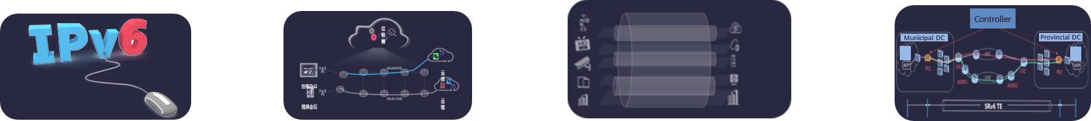


IPv6 Related Research and Standard Planning
3.0
APN6: App-aware network
1.0
SRv6 Basic Capabilities
2.0
New Network Services for 5G/Cloud
Quick provisioning
Traffic steering, path optimization
Committed SLA
In-band flow measurement
Visualized and optimal experience
Application driven network
Per-flow SLA assurance
Controller
Service slice 1
Control platform
Municipal DC
Provincial DC
Service slice 1
Control platform
Internet
Service slice 2
Internet
Service slice 2
Service slice 3
MCU conference platform
MCU conference platform
Monitoring platform
Service slice 3
Monitoring platform
HQ/branch
HQ/branch
SRv6 VPN
SRv6 TE
SRv6 FRR
Network Slicing/VPN+
In-situ Telemetry/IFIT
BIERv6
SFC
SRv6 Compression/G-SRv6
Forwarding Plane：Conveying Application information via IPv6 extension header
Control Plane：Exchange Application information through control protocols

Slide 4



SRv6 is The Best Technology for Future-oriented IP Network
Inter-domain
Network Communication
Experience
Differentiated Assurance
Application-aware Networking (APN)
Complex Protocols and Cannot extend to other networks
Un-routable 20-bits label with Limited capacity
No solutions(MPLS)
MPLS
MPLS
Label
EXP
S
TTL
VLL
MPLS Header
VPLS
L3VPN
Access
Aggregation
Cloud
Unified & simplified Protocols
Programmable Paths & Services
Programmable Applications
SRv6
SRv6 Segment List
SRv6 Optional TLV
Programmable segments, enabling service programmability
Programmable Optional TLVs, enabling application programmability
Service chain TLV
EVPN
EVPN
Locator
+
Function
+
Argument
APP ID
Type
Access
Aggregation
Cloud
Location info
Reachability
Service function definition
Enhancement
User ID
Length
Net Req.
Service Meta

Slide 5
SRv6 Related Standards Progress
Area | Topic | Draft | work group
Architecture | SRv6 Network Programming | RFC8986 | spring
SRH | IPv6 Segment Routing Header (SRH) | RFC8754 | 6man
IGP | ISIS Extensions for SRv6 | draft-ietf-lsr-isis-srv6-extensions | lsr
 | OSPFv3 Extensions for SRv6 | draft-ietf-lsr-ospfv3-srv6-extensions | lsr
 | BGP Link State Extensions for SRv6 | draft-ietf-idr-bgpls-srv6-ext-14 | idr
 | Path Computation Element Communication Protocol (PCEP) Extensions for Segment Routing | draft-ietf-pce-segment-routing-ipv6-16 | pce
 | Path Computation Element Communication Protocol (PCEP) Extensions for Associated Bidirectional Segment Routing (SR) Paths | draft-ietf-pce-sr-bidir-path-11 | pce
VPN | SRv6 VPN | RFC9252 | bess
SDN Interface | BGP-LS for SRv6 | draft-ietf-idr-bgpls-srv6-ext | idr
Policy | SR Policy Architecture | RFC9256 | spring
 | BGP for SRv6 | draft-ietf-idr-segment-routing-te-policy | idr
 | PCEP for SRv6 | draft-ietf-pce-segment-routing-ipv6 | pce
 | Circuit-style | draft-schmutzer-pce-cs-sr-policy | pce
Yang Models | SRv6 Base Yang | draft-ietf-spring-srv6-yang | spring
 | SRv6 TE Yang (SR Policy Yang) | draft-ietf-spring-sr-policy-yang | spring
 | SRv6 ISIS Yang | draft-ietf-isis-srv6-yang | lsr
 | SRv6 OSPF Yang | draft-ietf-lsr-ospf-srv6-yang | lsr
 | SRv6 PCEP Yang | draft-ietf-pce-pcep-srv6-yang | pce
 | SRv6 VPN YANG | draft-ietf-bess-srv6-services-yang | bess
SRv6 Deployment Migration | SRv6 Deployment Status | draft-matsushima-spring-srv6-deployment-status | spring
 | SRv6 Deployment Consideration | draft-tian-spring-srv6-deployment-consideration | spring
SRv6 Security | SRv6 Security Framework | draft-li-spring-srv6-security-consideration | spring
 | SRH and IP header protection | draft-chen-spring-srv6-srh-security | spring
Interworking | MPLS SRv6 | draft-agrawal-spring-srv6-mpls-interworking | spring
 | SR-MPLS / SRv6 Transport Interworking | draft-bonica-spring-srv6-end-dtm | spring
PMTU | Path MTU (PMTU) for SR Policy | draft-peng-spring-pmtu-sr-policy | spring
 | Segment Routing Path MTU in BGP | draft-ietf-idr-sr-policy-path-mtu | idr
 | BGP-LS Extensions for Advertising Link MTU | draft-ietf-idr-bgp-ls-link-mtu | idr
 | PMTU in PCEP | draft-ietf-pce-pcep-pmtu | pce
 | PMTU in ISIS | draft-hu-lsr-igp-path-mtu | lsr
Flowspec | BGP Flowspec for SRv6 | draft-ietf-idr-flowspec-srv6 | idr
 | SRH TLV Processing Programming | draft-li-spring-srh-tlv-processing-programming | spring
OAM | OAM in SRv6 | RFC 9259 | 6man
5 RFCs are released include architecture，SRH，SRv6 VPN, Policy, OAM
40+ Drafts are becoming Standard RFC

Slide 6























Rich Eco-system & Record-Speed Deployment in Global Carriers
Mainstream Vendors already support SRv6
Global SRv6 Cases
POST Luxembourg
China Mobile
Orange Spain
China Telecom
China Unicom
Algeria Telecom
Zain Saudi Arabia
MTN South Africa
MTN Rwanda
MTN Uganda
XL Axiata
AM Ecuador
…more
SingTel Singapore
EANTC Continuous SRv6 Inter-op Test (2018 – 2023)
10+
60+
100+
160+
Source: EANTC interconnectivity report
2019
2020
2021
2022

Slide 7

Operator I Completed SRv6 Micro-SID Interoperability Test
SRv6 Interoperability Test Success
SRv6 Brings Great Value to Customer’s Network
41%
35%
15+
100%
Excellent
Transmission overhead
reduce
Forwarding efficiency
improve
Complete cases
Pass rate
Test effect
Outstanding Contribution to Regional IPv6 Innovation

Slide 8
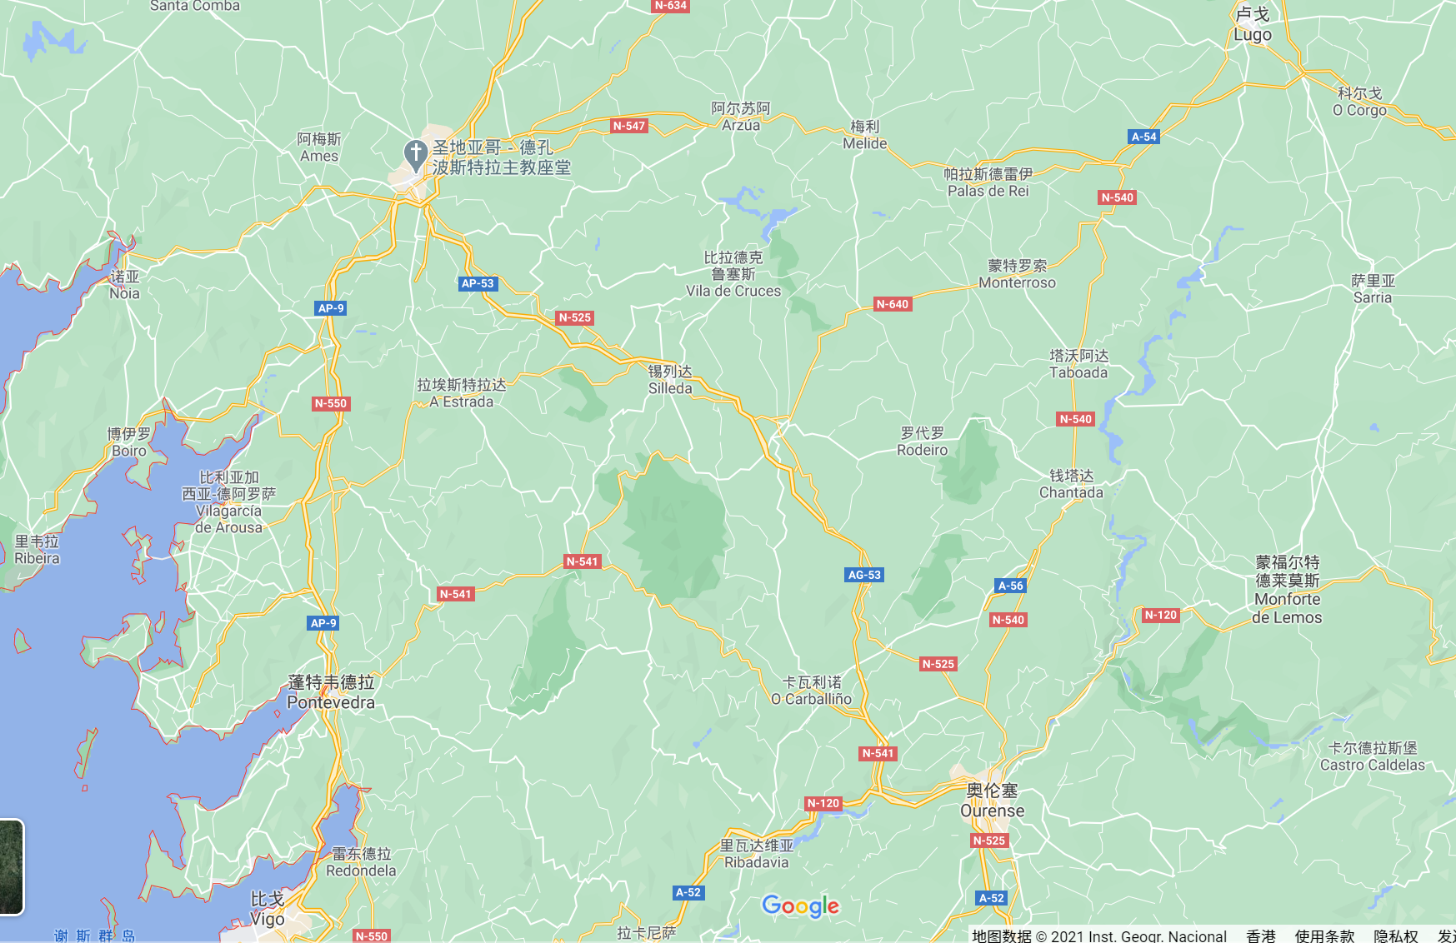
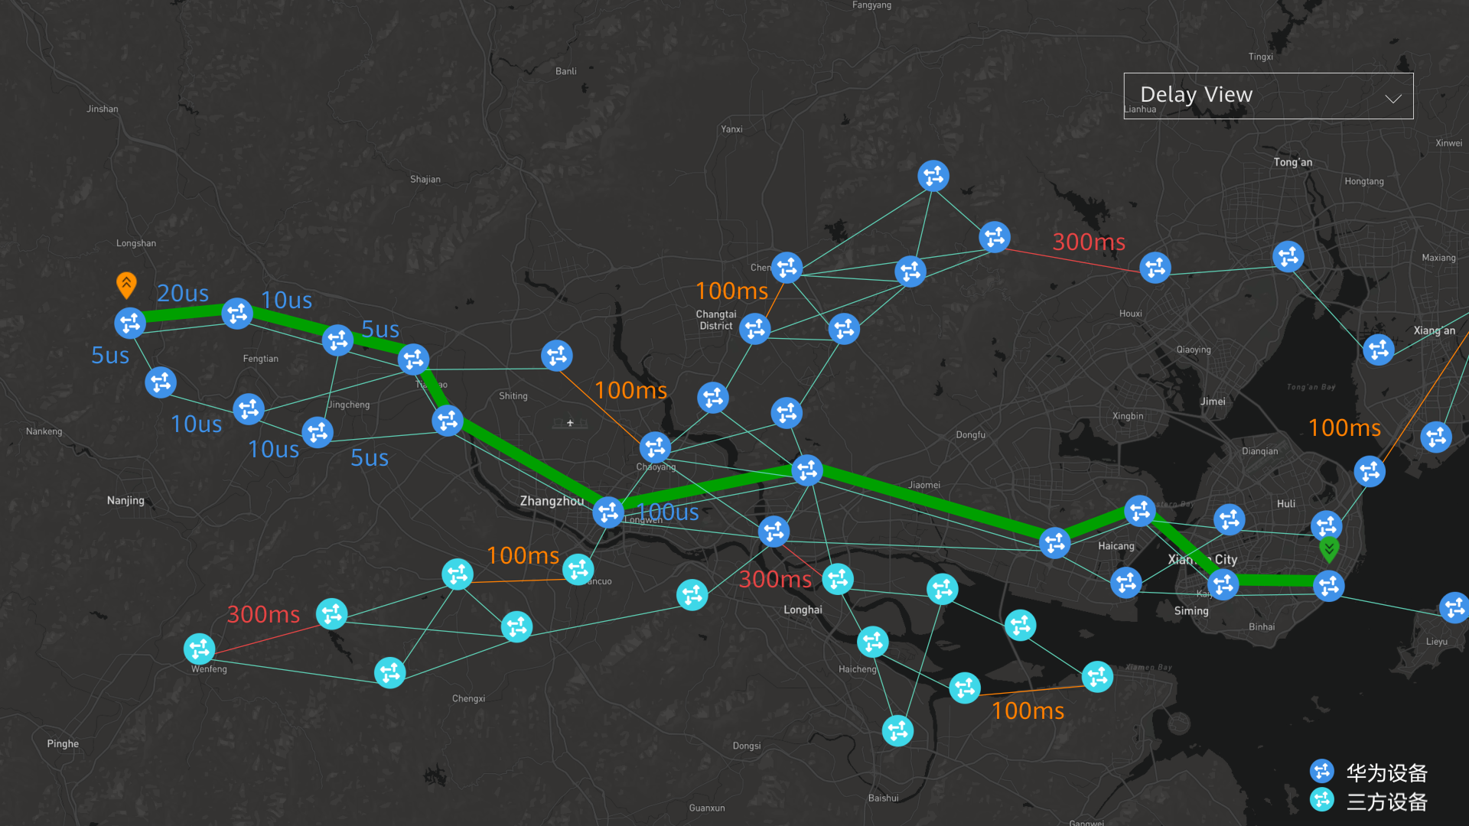



Implements SRv6 Compression to Promote Rapid Traffic Growth
High BW Usage and Insufficient Available Resources
GSRv6+SDN+precise expansion
supports SRv6 successfully deployed
46%
100%
IPCORE
90%
89%
BW usage
95%
P1
87%
82%
93%
95%
99%
55%
61%
69%
ASG
Micro Wave
GSRv6
45%
100%
53%
RSG
Fiber
PE1
PE2
67%
200 times/day
--Typical Aggregation Ring Topology of From Operator U
Too much microwave link: 50% for aggregation(15/30) and 80% for access
Measure 1: Reduce the SRv6 header size with GSRv6
Measure 2: Identify network bottlenecks and perform precise expansion.
Measure 3: SRv6 Based SDN UC
Real-time automatic optimization
ensuring optimal paths at any time
Long service path: 4 aggregation rings have 60 NE on average, and 52 access rings have 8 NE on each ring. The service path is 17 hops on average.
High bandwidth utilization: 70% on average and over 90% in some cases
Key Challenge: How to ensure smooth SRv6 cutover without network-wide capacity expansion?
Long service path
High bandwidth utilization
To much microwave link
+15.4%
427.6GB
SRv6 packet carry path info
Bandwidth usage definitely increases with SRv6.
The longer the path
the larger the packet size
High risk of rash cutover
Large investment in network expansion unaccepted
The available bandwidth resources is insufficient
370.4GB
Before SRv6
After SRv6
After SRv6 is deployed in area N
Suppressed traffic is rapidly released
Challenge: How to ensure smooth SRv6 cutover without network-wide capacity expansion?

Slide 9
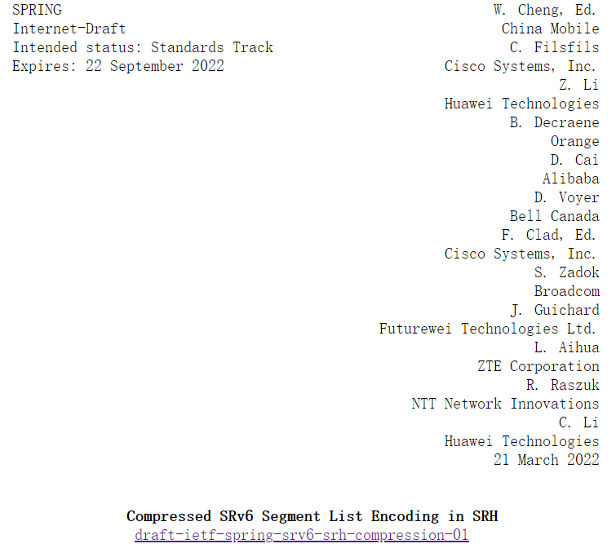
SRv6 Compression: Converged Single Solution and C-SID draft adopted by WG
IETF SPRING WG
draft-ietf-spring-srv6-srh-compression(C-SID) is adopted.
C-SID draft defines flavors for the SR endpoint behaviors, which enable a compressed SRv6 Segment-List encoding in the Segment Routing Header (SRH).
Replace-C-SID Flavor a.k.a G-SRv6
Next-C-SID Flavor a.k.a uSID
Next-and-Replace-C-SID Flavor
All the flavors are defined under the SRv6 network programming architecture RFC8986.
Replace-C-SID flavor SID and Next-C-SID can be encoded in a single SRH for better interop, and the interop test had been done in 2020.
C-SID is the recommended solution as per the DT’s analysis result, which meet all the compression reqs

Slide 10
Network Slicing Related Standards Progress
Framework
Network Slice Concept
and general framework
VPN+ framework
for network slice realization
Mapping of 5G E2E network slice
to IETF network slices
I-D-teas-ietf-network-slices
I-D-teas-transport-slice-definition
I-D-teas-ns-framework
I-D-teas-enhanced-vpn
I-D-teas-network-slice-mapping
Management Plane
Management Plane
Network Slice NBI Service YANG
I-D-teas-ietf-network-slice-nbi-yang
I-D-teas-transport-slice-yang
Network Slice Realization YANG
I-D-teas-transport-network-slice-yang
I-D-ietf-teas-actn-vn-yang
I-D-teas-nrp-yang
SR based
Network Slice realization
Scalable IETF
Network Slice realization
End-to-End
IETF Network Slice
Hierarchical
IETF Network Slice
SR based VPN+ Data Plane
NRP/VTN scalability
E2E IETF network slice realization framework
Hierarchical IETF network slice realization
I-D-spring-sr-for-enhanced-vpn
I-D-idr-sr-policy-nrp
I-D-teas-e2e-ietf-network-slicing
IPv6 HBH based VPN+ data plane
I-D-teas-hierarchical-ietf-network-slice
SR based E2E IETF network slice realization
SR Resource-aware Segments
I-D-6man-enhanced-vpn-vtn-id
I-D-spring-sr-e2e-ietf-network-slicing
I-D-spring-resource-aware-segments
MPLS based VPN+ data plane
IPv6 based E2E IETF network slice realization
MT based IGP/BGP-LS
control plane for SR VPN+
I-D-6man-e2e-ietf-network-slicing
Control plane extensions
for scalable SR VPN+
WG document
I-D-lsr-isis-sr-vtn-mt
MPLS based E2E IETF network slice realization
I-D-idr-bgpls-sr-vtn-mt
I-D-lsr-sr-enhanced-vpn
I-D-teas-ns-ip-mpls
Individual draft
I-D-idr-bgpls-sr-enhanced-vpn
Framework, management/data/control plane/encapsulation standards are basically mature
carriers’ B2B deployment slicing scenarios, cross-domain E2E scenarios, and hierarchical slicing of complex services are fully considered
Currently, slices have been deployed on more than 80 customers' live networks

Slide 11












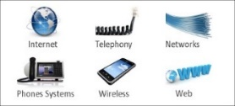
Network Slicing Cases: Slice-Based Industry Private Network
Challenges
Slicing On Demand Guarantees Differentiated Experience
Benefit
Medical Industry
AS-IS：One industry one private network
1~2 Months
Healthcare private network
Education private network
Video, cloud access
High class SLA
High class isolation
…...
2 Days
Before
Now
Education Industry
Service deployment period
TO-BE ：One network for multiple purposes
1800+
private lines/year
Video, cloud access
Committed latency
Data isolation
600
private lines/year
Healthcare
Slicing N
Public Cloud
Education
Slicing 2
Commercial
Slicing 1
Hyper Cloud
Consumer Service
Public Service
Default Slicing
Private Cloud
Before
Now
Refined Management
Slicing Automation
SLA Visualization
1800+ Healthcare Access
2400+ Schools Access Education Clouds
Internet, VoIP, IPTV
High bandwidth
100K slicing management capability
Slicing on Demand
Lossless Scaling
Tenant level SLA visualization
Please refer to visit draft-ma-teas-ietf-network-slice-deployment for details

Slide 12
iFIT Related Standards Process
iFIT1.0
iFIT2.0
iFIT3.0
Network E2E Intelligent OAM
Big Data analysis, main in DC
Network and Application integration
Effect for packet loss and delay measurement
Rich detection data
Automation and device association
80+ Commercial case
In study
concept
In-situ Flow Information Telemetry Framework(draft-song-ifit-framework)
Framework
Clustered Alternate Marking Method
(RFC 9342)
ALT-MK
IOAM，IOAM-DEX
Alternate-Marking Method(RFC 9341)
Data Fields for In-situ OAM(RFC 9197)
In-situ OAM Direct Exporting(RFC 9326)
Enhanced Alternate Marking Method(draft-zhou-ippm-enhanced-alternate-marking)
Data plane
IPv6 Application of the Alternate Marking(RFC 9343)
In-situ OAM IPv6 Options(draft-ietf-ippm-ioam-ipv6-options)
SRH for the Alternate Marking(draft-fz-spring-srv6-alt-mark)
Multicast On-path Telemetry Solutions(draft-ietf-mboned-multicast-telemetry)
SR-Policy, PCEP, BGP
Control plane
BGP SR Policy for IFIT（draft-ietf-idr-sr-policy-ifit）
Path Computation Element Communication Protocol Extensions to Enable IFIT（draft-ietf-idr-bgp-ifit-capabilities）
BGP Extension for Advertising In-situ Flow Information Telemetry Capabilities （draft-ietf-idr-bgp-ifit-capabilities）
UDP-Notif, IPFIX extension, IOAM YANG
Management plane
A YANG Data Model for In-Situ OAM(draft-ietf-ippm-ioam-yang)
iFIT 1.0 is mature for commercial deployment

Slide 13
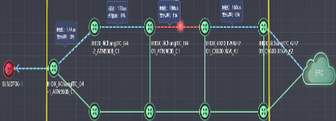










SDN + iFIT, Enable Fault locating within minutes
As-Is: Complaint-Driven, Manual Fault Locating, More Than 6 Hours
To-Be: Real-Time Awareness, Service-Level Presentation, Fault Locating In Minutes
Wireless complaints
Core network complaints
Real-time awareness of QoE Degrade
Quick demarcation to avoid disputes
Transport network
backhaul network
Base station
Core network
At 09:20, received more than 300 complaints about IPTV artifacts.
At 11:04, services were switched node by node, and packet loss was found to occur on the MINT device.
At 15:10, the LPU of the MINT device was replaced, The fault was rectified.
Packet loss
"To achieve zero service faults and quickly support new services on 5G networks, device vendors must have 5G automatic fault locating capabilities in the initial phase of 5G network construction."
VEPC
Service flow identification
Measurement based on real service packets
Per-packet count loss of any packet can be detected.
CloudVR
Service non-visualization > Service visualization
Manual > Automatic
Hours > Minutes
Service visualization is the basis of SLA assurance.
Proactive prevention, avoiding complaint storms
Quick recovery, ensuring user experience
With the advantages of technologies such as NCE intelligent O&M, Huawei successfully won the new 5G transport network construction with a 70% share, building the world's first 5G-ready intelligent transport network.

Slide 14
Related Standardization Work Layout
RFC8402: SR Architecture
RFC8754: SRH
RFC8986: SRv6 Network Programming
1.0
SRH
RFC8754
SRv6
SR Policy
RFC9256
IS-IS
RFC queue
OSPFv3
WGLC
VPN
RFC9252
BGP-LS
RFC queue
BGP SR-Policy
WGLC
PCEP
Protection
YANG
Slicing
Framework
SR SID DP
IPv6 Slice ID DP
SR SID CP
IPv6 Slice ID CP
Inter-Domain Slicing
Hierarchical Slicing
YANG
IFIT
Framework
Alternate Marking
IOAM
IGP
BGP-LS
BGP
SR-Policy
PCEP
YANG
2.0
5G & Cloud
SRv6 Compression
MSR6/BIERv6
Requirements
Analysis
Framework
Requirements
Problem Statement
Encapsulation
OAM
Path Segment
Path MTU
DETNET
SFC
3.0
APN/CATS
Problem Statement
Use cases
Framework
Encapsulation
Protocol Extensions
RFC
WG Draft
Potential WG Draft
Individual Draft
Please visit www.ipv6plus.net for the latest progress

