Slide 1


Slide 2

Safety II: rethinking safety
Ronaldo Wajnberg Gamermann
ronaldo.gamermann@anac.gov.br
ANAC

Slide 3

What is Safety?

Slide 4
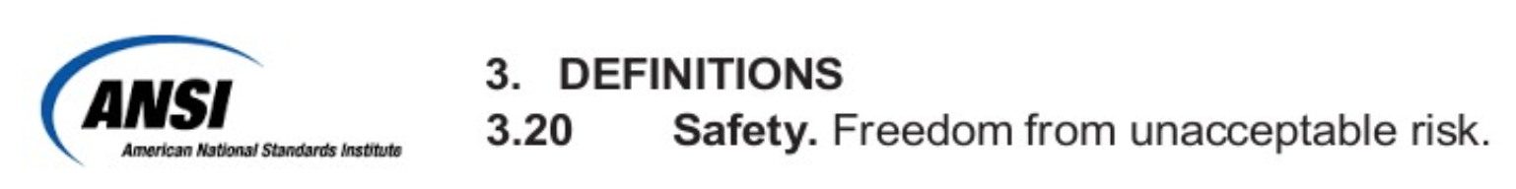
Safety
We usually define safety by thinking of a negative outcome (accident, incident…)
When something does not happen
ANNEX 19:
Safety. The state in which risks associated with aviation activities, related to, or in direct support of the operation of aircraft, are reduced and controlled to an acceptable level.

Slide 5
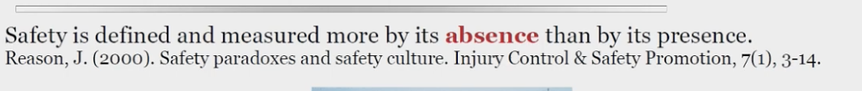
Safety
Avoid Accidents
Ensure that negative outcomes don’t happen
Focus on what went “wrong” (Accidents, Incidents, Near-Misses…)

Slide 6



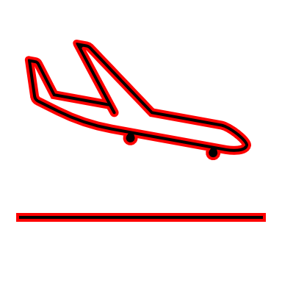
How often does the “wrong” happen?
Positive
99,9%
00,1%
Negative
Incidents
* Brazilian Commercial Scheduled Flights (2023)
What can we learn from what goes “wrong”?

Slide 7

Safety I
Explaining what went wrong
00,1%
Ensure it will be as low as possible

Slide 8
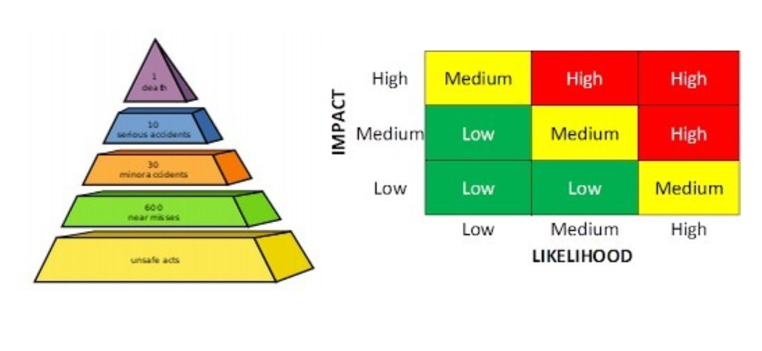
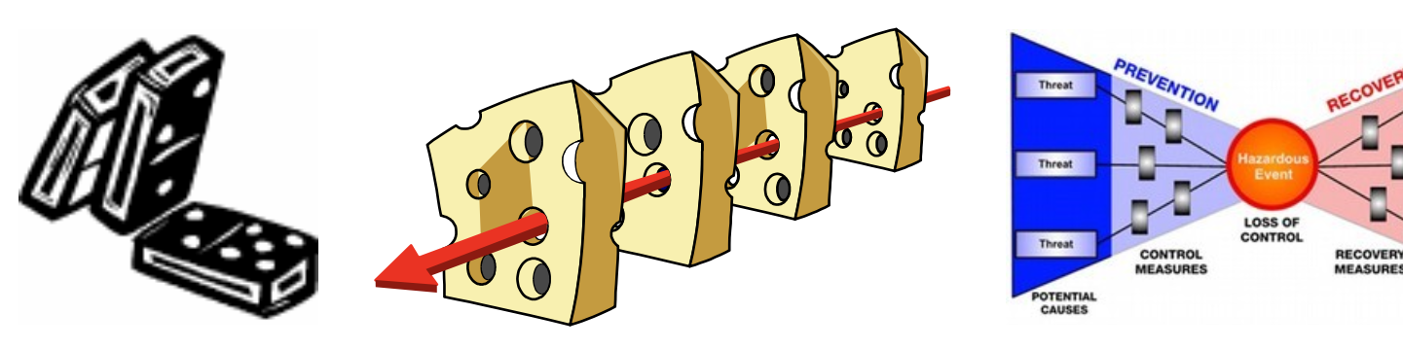
Safety I
Explaining what went wrong
Implications
00,1%
Identification
Mitigation
Control

Slide 9

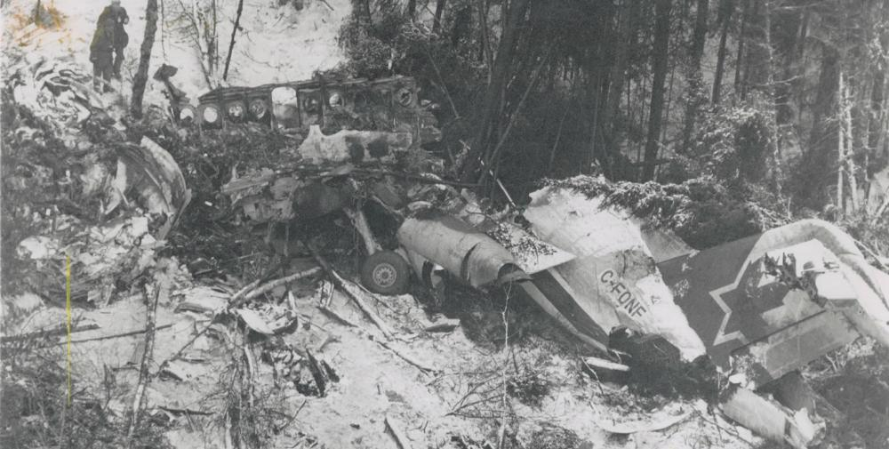
Happy Marriage ?
Is it possible to understand what a happy marriage is by analysing and learning from divorces alone?
Is it possible to understand what safety is by analysing and learning from accidents and incidents alone?

Slide 10
How often does the “right” happen?
Positive
99,9%
00,1%
Negative
Incidents
* Brazilian Commercial Scheduled Flights (2023)
Non-Events | Everyday work

Slide 11
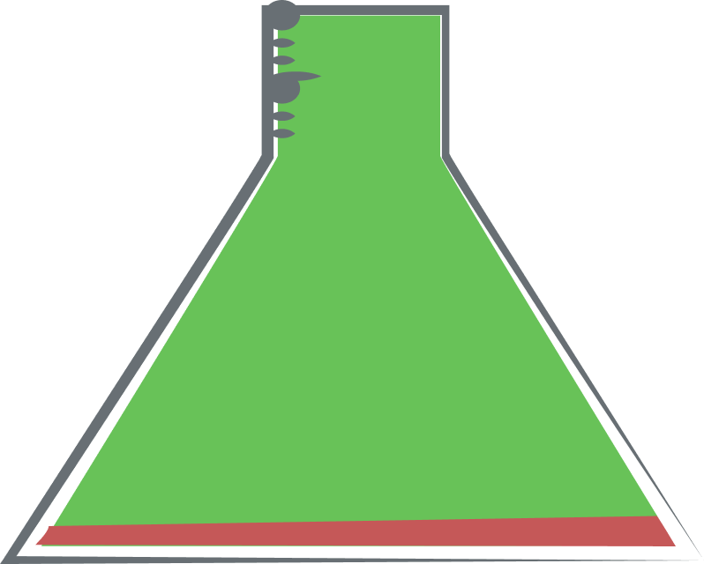
Safety II
Explaining what went well
99,9%
Ensure it will be as much as possible

Slide 12
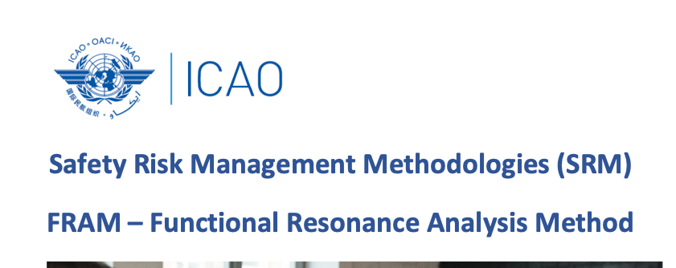
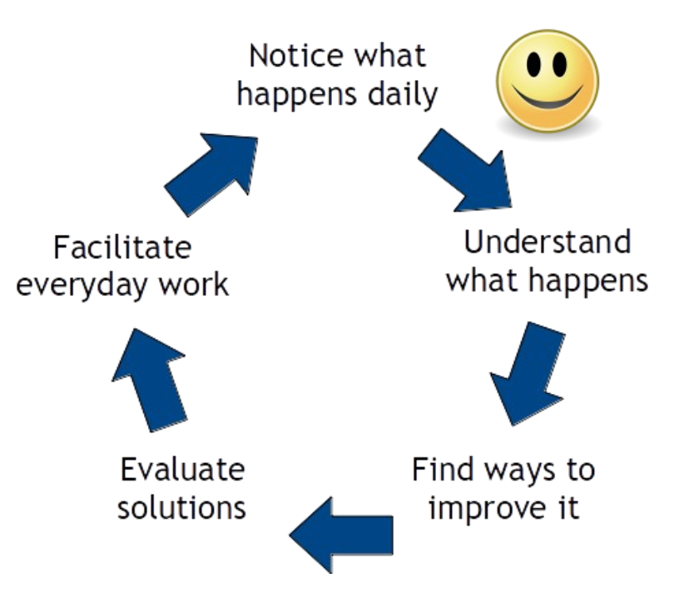
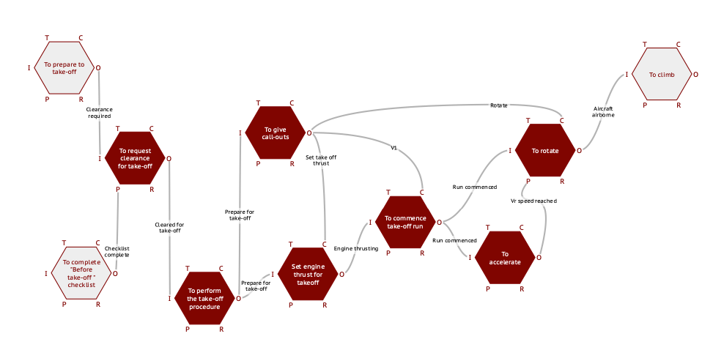
Safety II
https://www4.icao.int/smi
Explaining what went well
Implications
99,9 %
Resilience

Slide 13

Ronaldo Wajnberg Gamermann
ronaldo.gamermann@anac.gov.br
ANAC

