Slide 1


Slide 2

RUNWAY SAFETY
Runway Condition Report Implementations at Santos Dumont Airport – based on ICAO’s GRF
PAULO EDUARDO CAVALCANTE
Superintendent of Operation Management - INFRAERO
paulopec@infraero.gov.br

Slide 3

RUNWAY SAFETY
Contents
GRF – RCR – Santos Dumont Airport – Current Situation
RCR Tool – Proposed Innovation
Benefit Analysis
Project Schedule

Slide 4
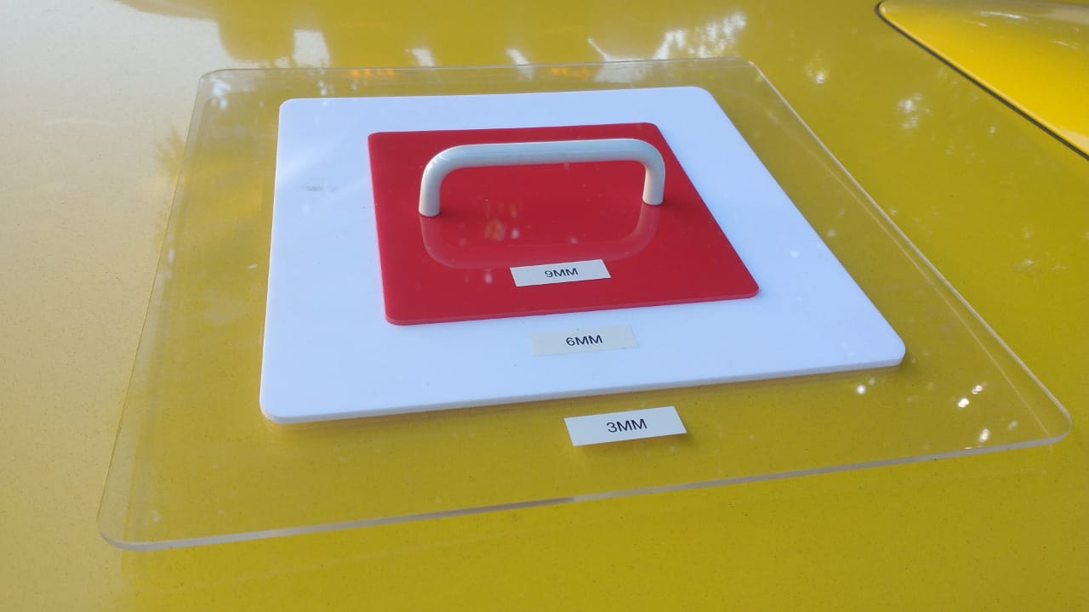
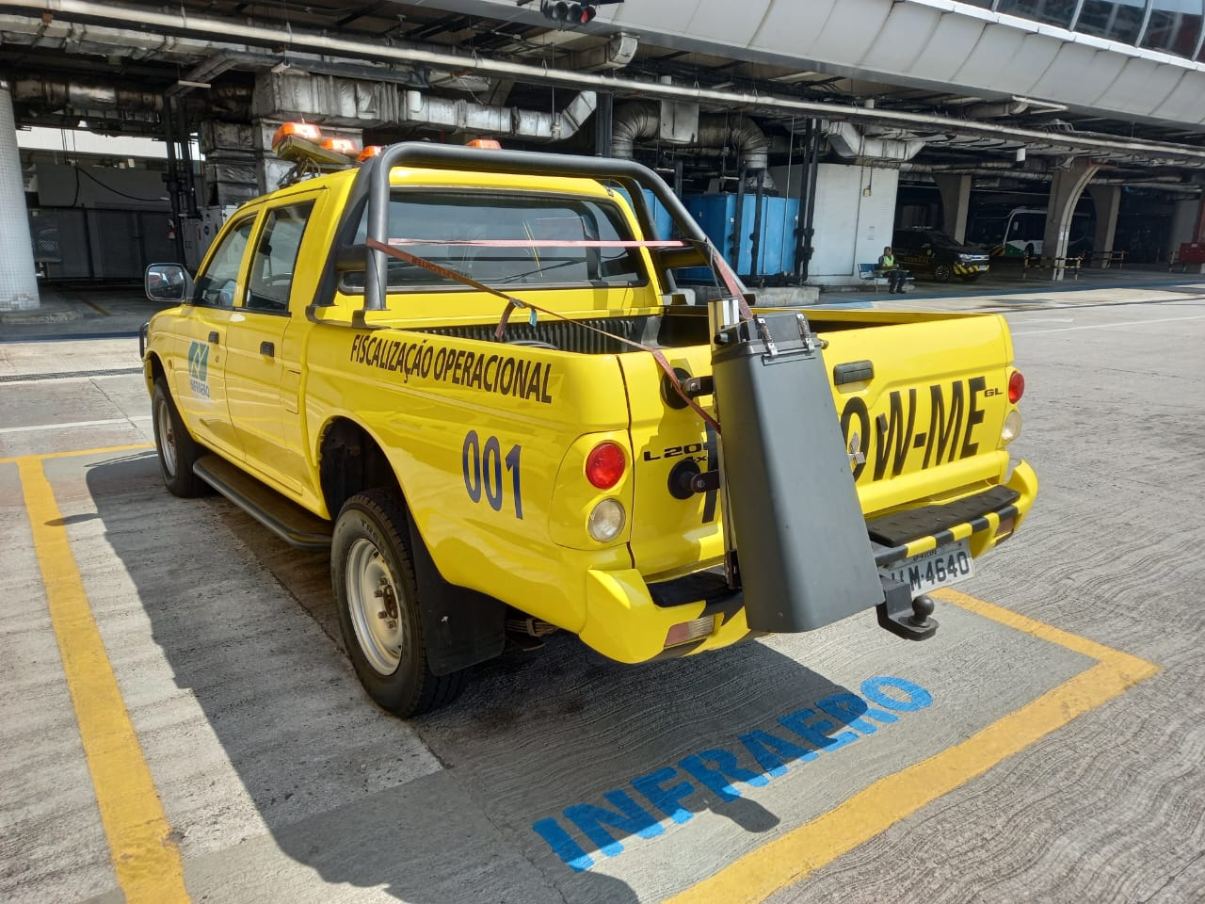
RUNWAY SAFETY
Runway Condition Report (RCR)
SDU Implementations - Based on ICAO’s GRF
Current Tools

Slide 5
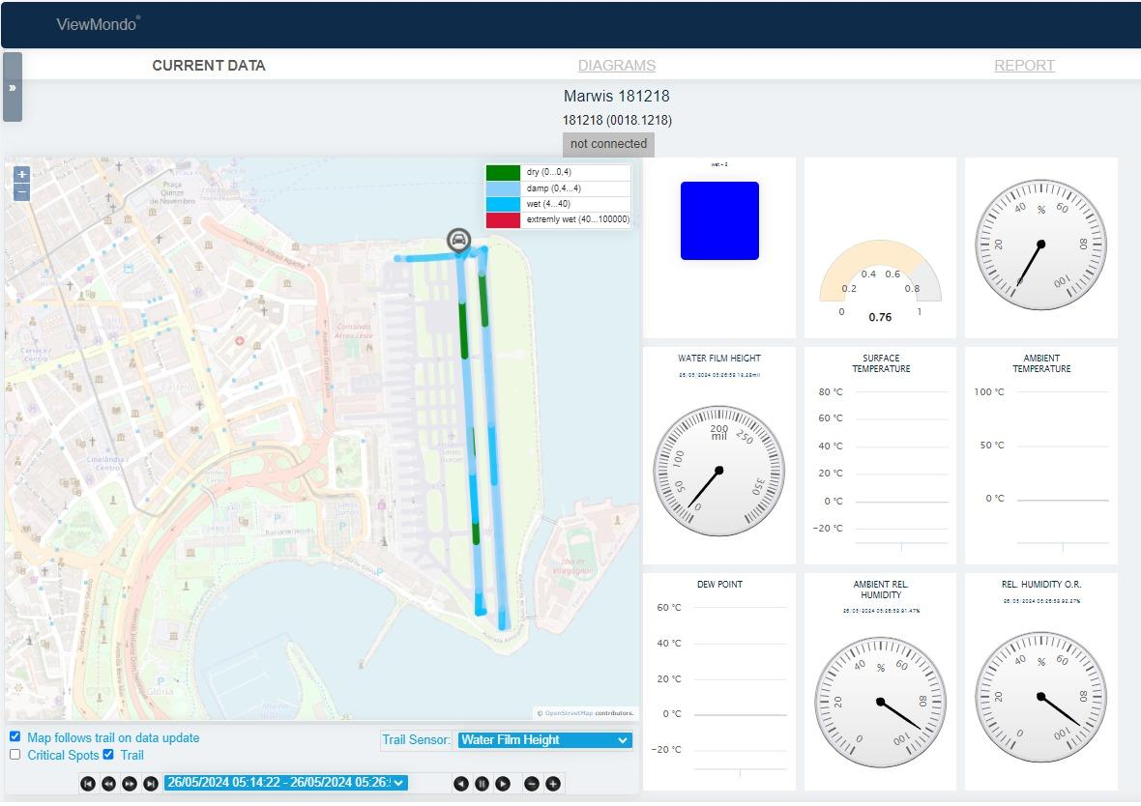
RUNWAY SAFETY
Runway Condition Report (RCR)
SDU Implementations - Based on ICAO’s GRF
Current Tools

Slide 6

Innovation under evaluation
RCR Tool©
Santos Dumont Airport (SDU)

Slide 7
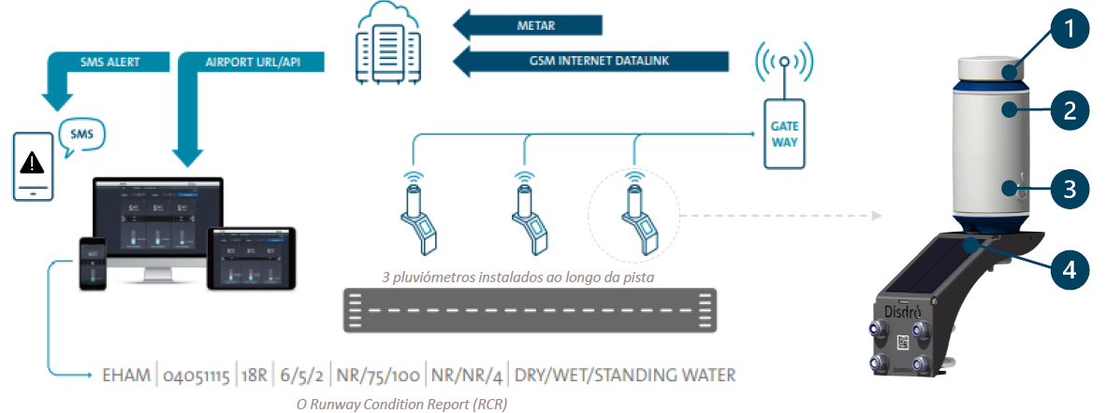

Innovation under evaluation
RCR Tool©
3 rain gauges installed along runway
1
Acoustic sensor - Continuous precipitation measurements, detects rain intensities as low as 0.05 mm/hr
4
Solar powered - more than 10 days of operation without
any sunlight
2
Wireless communication encrypted using LoRaWan
3
Weatherproof box

Slide 8
Innovation under evaluation
RCR Tool©
The wireless communication protocol used by the system is LoRaWan
Radio signal in the frequency range of 915-928 MHz
The 5G signals that cause interference with aircraft radio altimeters are located in the frequency range of 3.7 to 4 GHz, known as the 5G C band. The RCR-Tool© sensors do not operate in this frequency band.

Slide 9

Innovation under evaluation
RCR Tool©
Installed Airports
Rotterdam International Airport - The Hague Airport
Bonaire International Airport, Flamingo
FD Roosevelt Airport, Sint Eustatius
Munich International Airport, Germany
Istanbul International Airport, Turkey

Slide 10
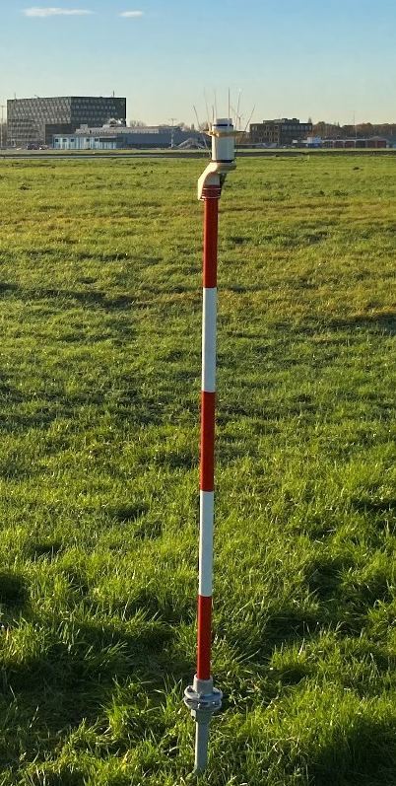
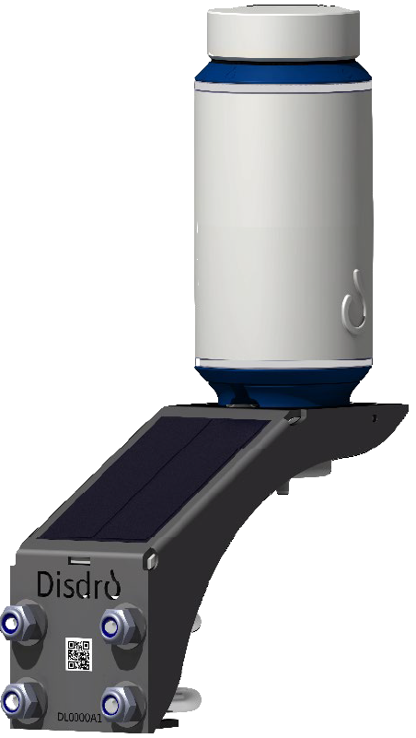
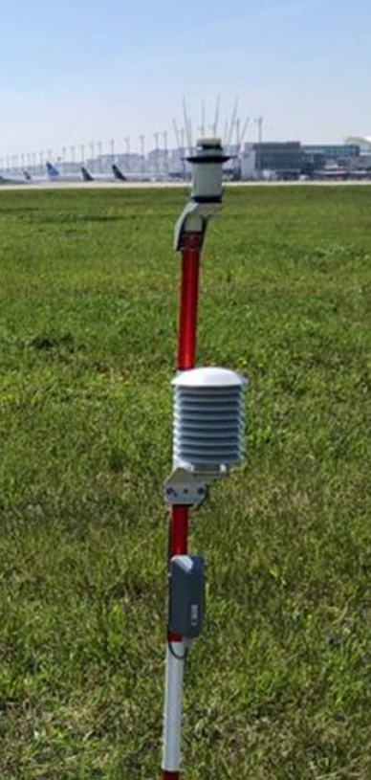
Innovation under evaluation
RCR Tool©
Santos Dumont Airport Deployment
Rain sensor installed along the runway
RCR-Tool© rain sensor
Temperature sensor installed below the rain sensor

Slide 11
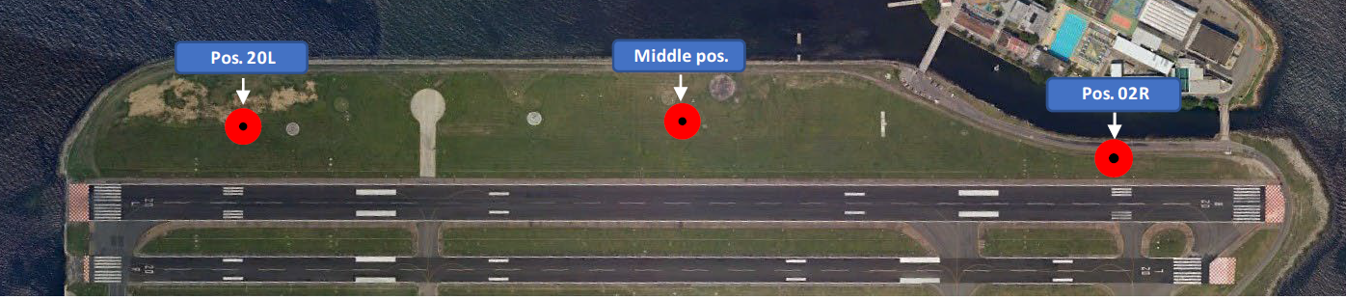
Innovation under evaluation
RCR Tool©
Santos Dumont Airport Deployment

Slide 12
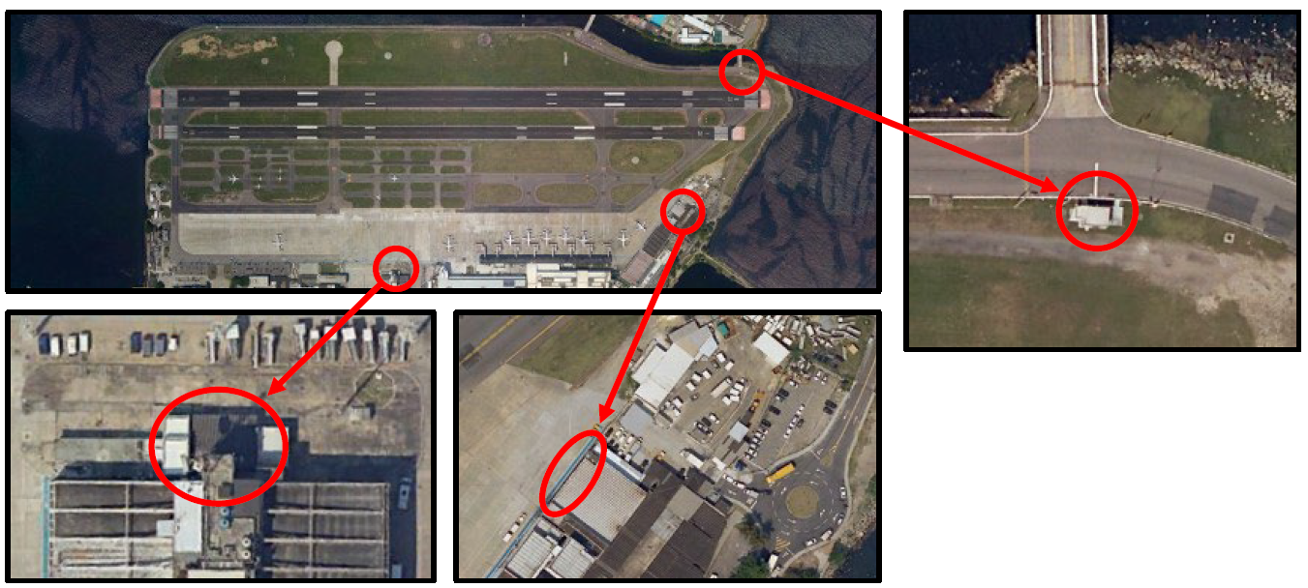
Innovation under evaluation
RCR Tool©
Santos Dumont Airport Deployment

Slide 13
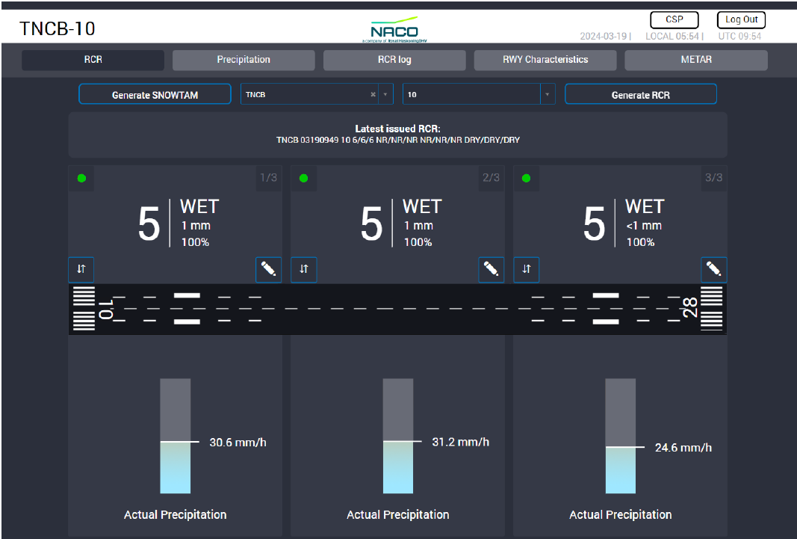
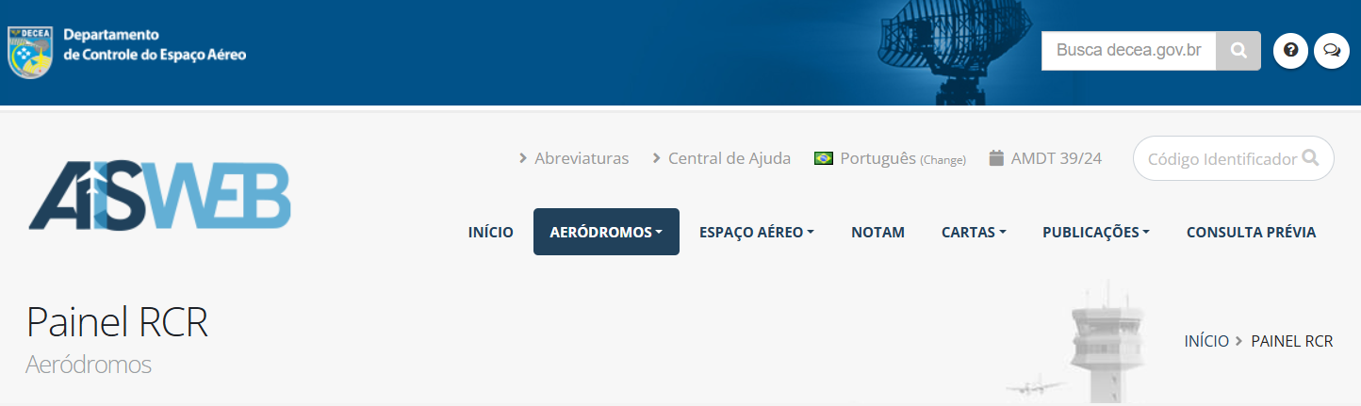

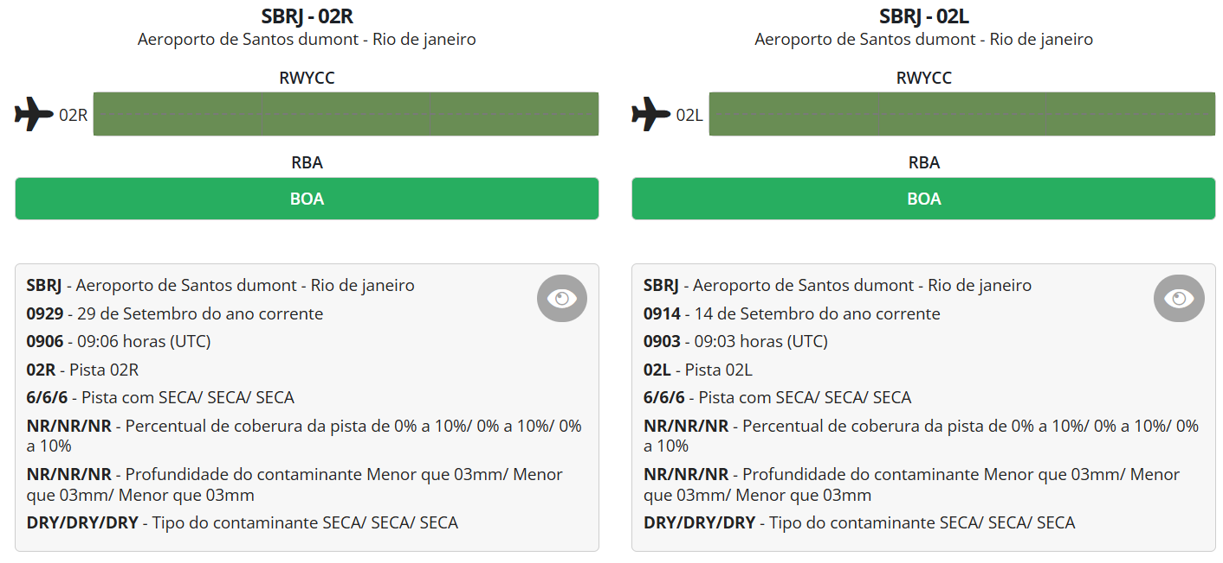
Innovation under evaluation
RCR Tool©
Santos Dumont Airport Deployment
L
20
R
02

Slide 14
Santos Dumont Airport Deployment
Project Schedule
 | 2024 |  |  |  |  |  |  |  |  |  |  |  | 2025
 | J | F | M | A | M | J | J | A | S | O | N | D | J | F | M | A | M | J | J | A | S | O | N | D
Preparation
Import of Equipments
3D Modeling of Runway
System Installation
Physical Installation (Oct, 14-15)
Workshop (ANAC, DECEA, Airlines Guests) (Oct, 16)
Calibration, Familiarization and Integration
System Calibration
SDU Team Familiarization
DECEA AISWEB RCR API Integration
Tests and Evaluations
System demonstration period (6 months)
Stakeholders feedbacks

Slide 15


