Slide 1
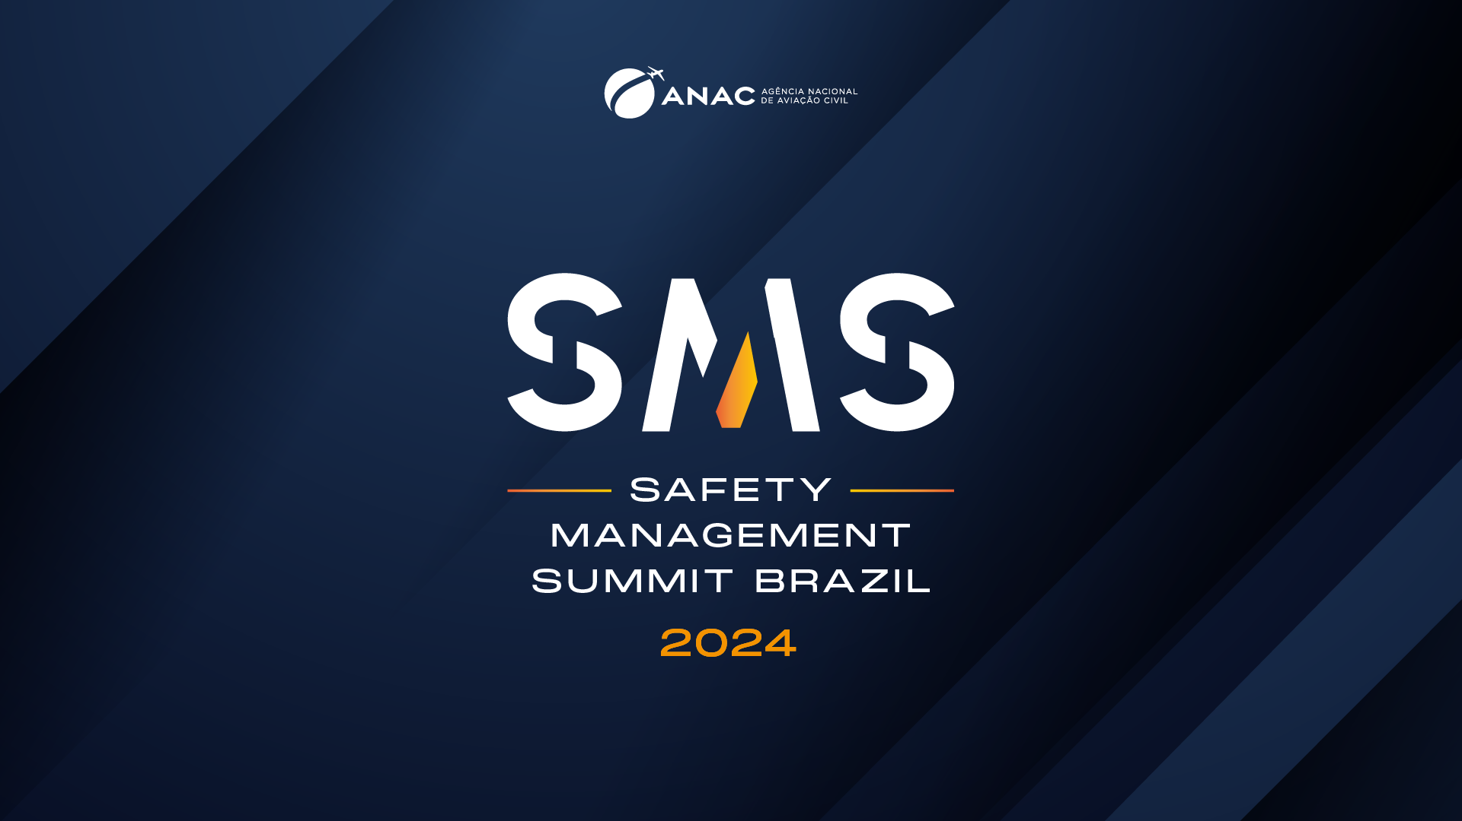

Slide 2

Safety Culture: more of the same?
TAM Aviação Executiva´s contribution

Slide 3

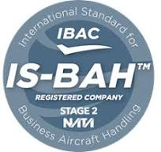

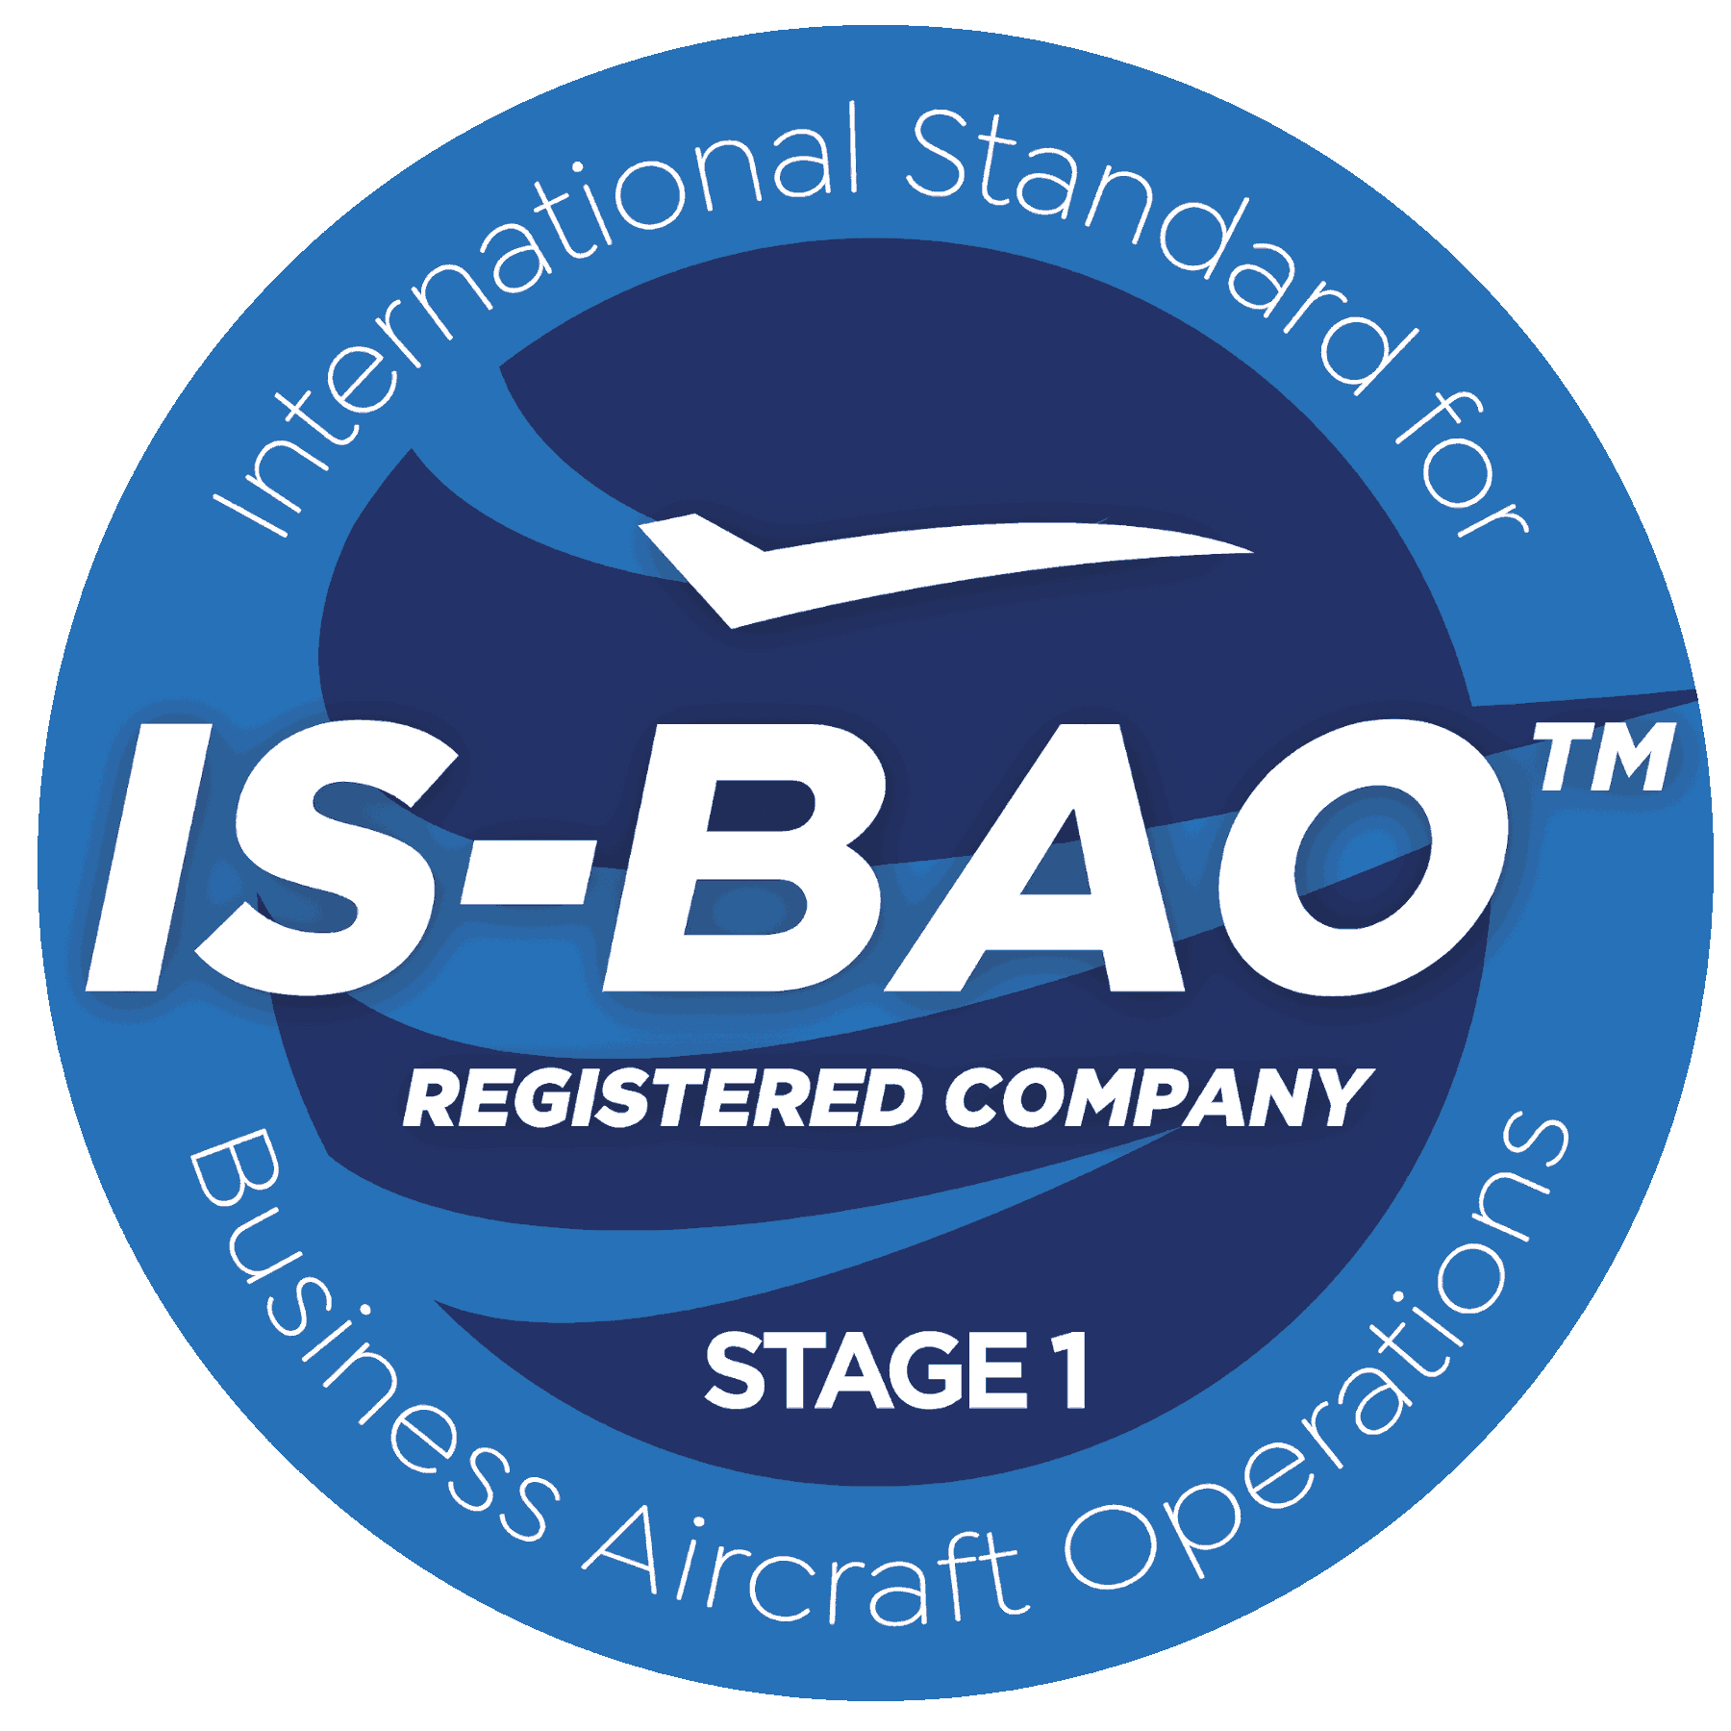

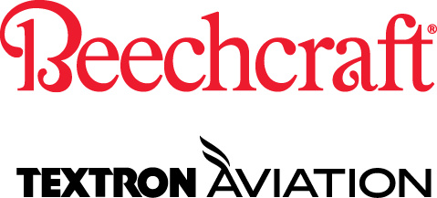



Service Scope: TAM AVIAÇÃO EXECUTIVA
Airport Ground Handling and Services for Executive Aviation (FBO) Congonhas (CGH), Guarulhos(GRU), Belo Horizonte(PLU) e Manaus(MAO) – IS-BAH Stage 2.
Comercial Flight Operations RBAC 135 – Charter and Aircraft Management -
IS-BAO Stage 2.
Approved Service Center Cessna & Beechcraft – RBAC 145, FAA, ANAC Argentina, DINAC (Paraguay), DGAC (Chile).
Sales and Commercial Representation – Aircrafts and Training: Cessna, Beechcraft, Bell Helicopters & Flight Safety.

Slide 4
Hazard Monitoring
Safety Culture: More of the Same?
Voluntary Report Incentive
Safety Culture Survey

Slide 5
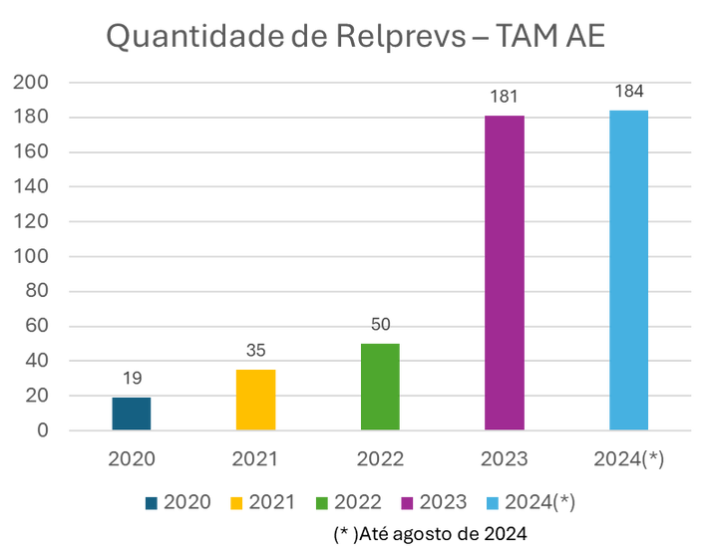


Titulo 1
Voluntary Report Incentive (“RELPREV”)
SAFETY KPIs by August 2024
“Relprev” record in one month: 36 reports
Exceeded the total number of 2023´s Relprevs
Reduction of anonymous Relprevs in 37%
Texto
Safety reporting culture: More of the same??
até AGO/2024
It depends where your safety culture or system maturity is placed
Things will be happening anyway
Humans adapt, cope, stop the work, but then report even if there was no undesirable outcome
Indicador | 2023 | Ago/2024
Qtde. Relprev | 181 | 184
% Relprev Anônimos | 69% | 43,5%

Slide 6
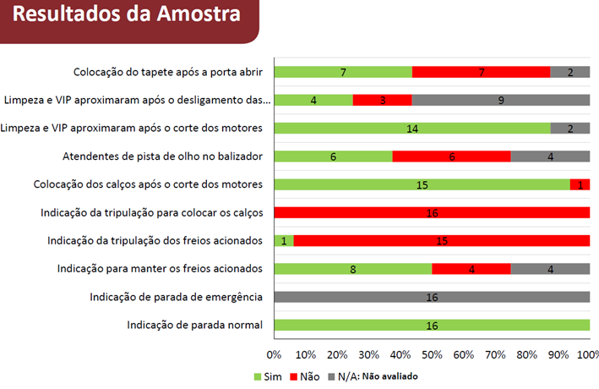
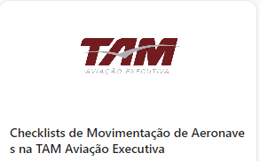
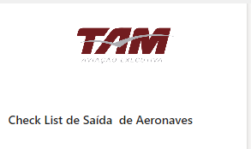
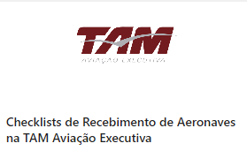
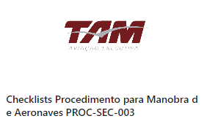
Hazard Monitoring by Activities Observation
More of the same? Not it is not. This is new and it is very good, requires engagement and understanding
Aircraft Towing in the ramp
Aircraft Towing inside the hangar (FBO)
Aircraft receiving in the ramp
Aircraft taxing in FBO´s ramp
Engine test at the Run-up
Aircraft Towing inside the hangar (CS)
Flight Planning process
Maintenance task completion/Task Registration
RUN-UP Monitoramento da Conformidade do Procedimento de Operação de Motores na Run Up

Slide 7


More of the same? Safety culture´s stage awareness always matters Gather valuable insight and guidance on where to focus your efforts Assessments track progress overtime Compare how employees perceive your SMS in different time periods; Gather valuable insight and guidance on where to focus your efforts
Safety Culture Survey
Examples of questions about person´s direct leader behavior
Acts quickly when a safety concern is raised in the work area.
After setbacks and adverse events (with damage and/or injuries), it identifies latent flaws in the system and creates
Regularly discusses with the team issues that impact safety, being aware of human and organizational factors that may put its operations at risk.

Slide 8
Hazard Monitoring
Safety Culture: More of the Same?
Voluntary Report Incentive
Safety Culture Survey

Slide 9
Thank you!
Ana Claudia Galvão
Safety Manager at TAM Executiva
Ana.galvao@tamexecutiva.com.br
Mob. +55 11 91717-7381

Slide 10
