Slide 1


Slide 2
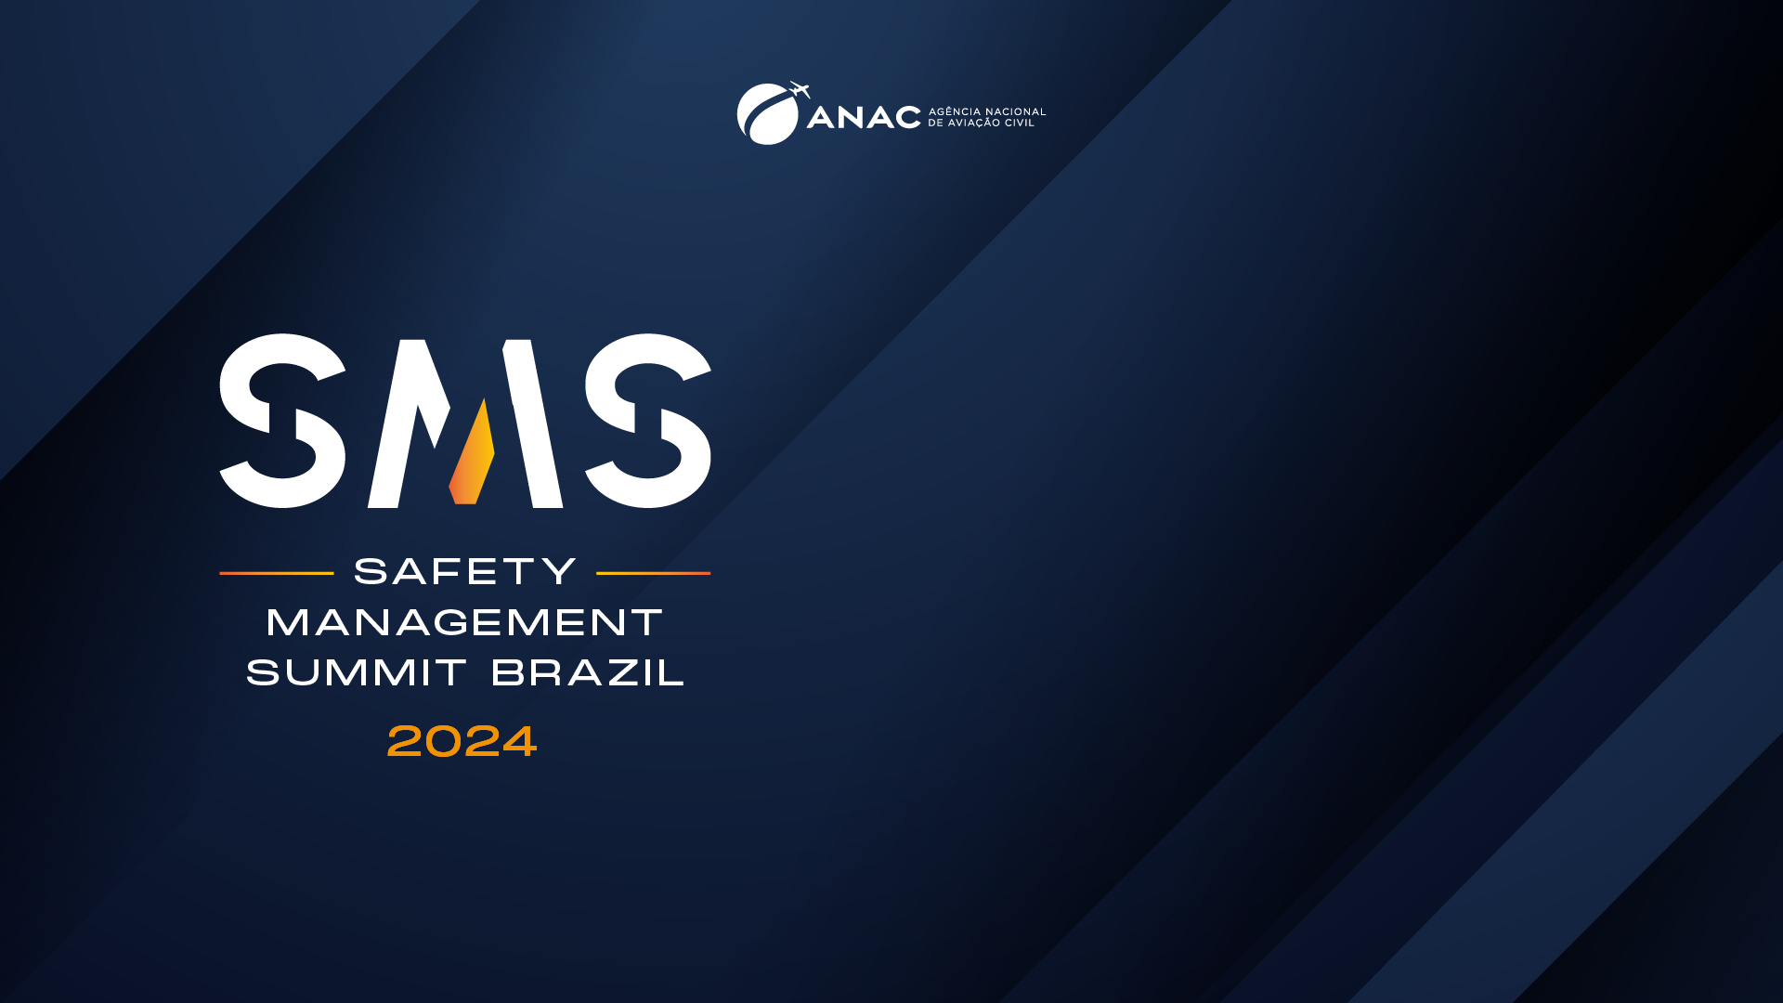
RESPONSABILIDADES NA FORMAÇÃO DE PILOTOS DE AERONAVES

Slide 3
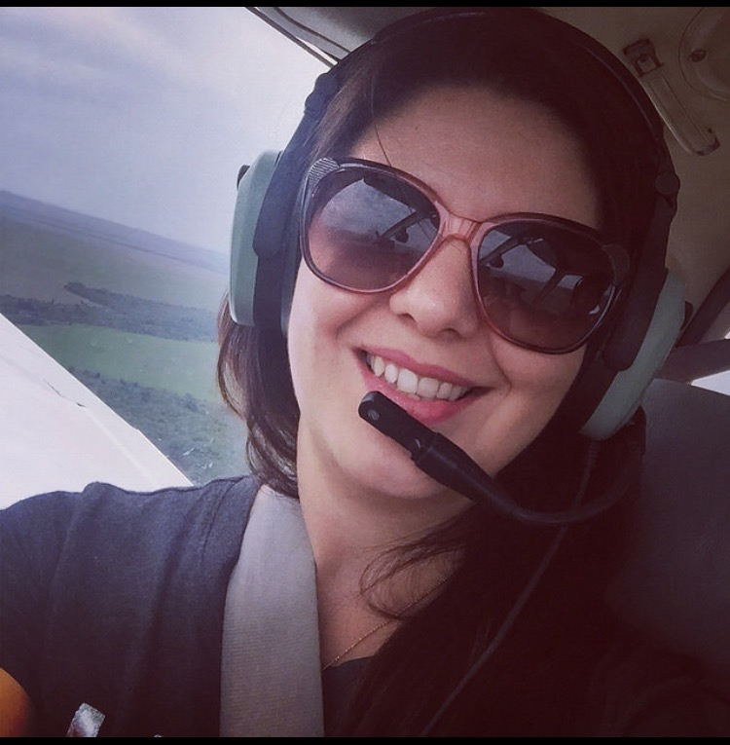
Curriculum
Lawyer, Postgraduate in Flight Safety; Degree in Literature; Aircraft Mechanic Student;
Trained at CBPAA – CENIPA;
SGSO by ANAC;
Active in the areas of Aeronautical, Regulatory, Administrative, Legislative and Civil Law;
Flight attendant - CCT ANAC;
Postgraduate Professor at Anhembi Morumbi University:
Undergraduate Teacher at Escola Superior do Ar;
Instructor in civil aviation schools and aviation mentoring;
Writer with three published books;
President of the OAB/SP Aeronautical Law Commission between 2013 and 2018 and the current three-year period 2022/2024 for the Tatuapé Subsection;
Financial Director of the Association of Women Aviators of Brazil, 2023/2025.

Slide 4
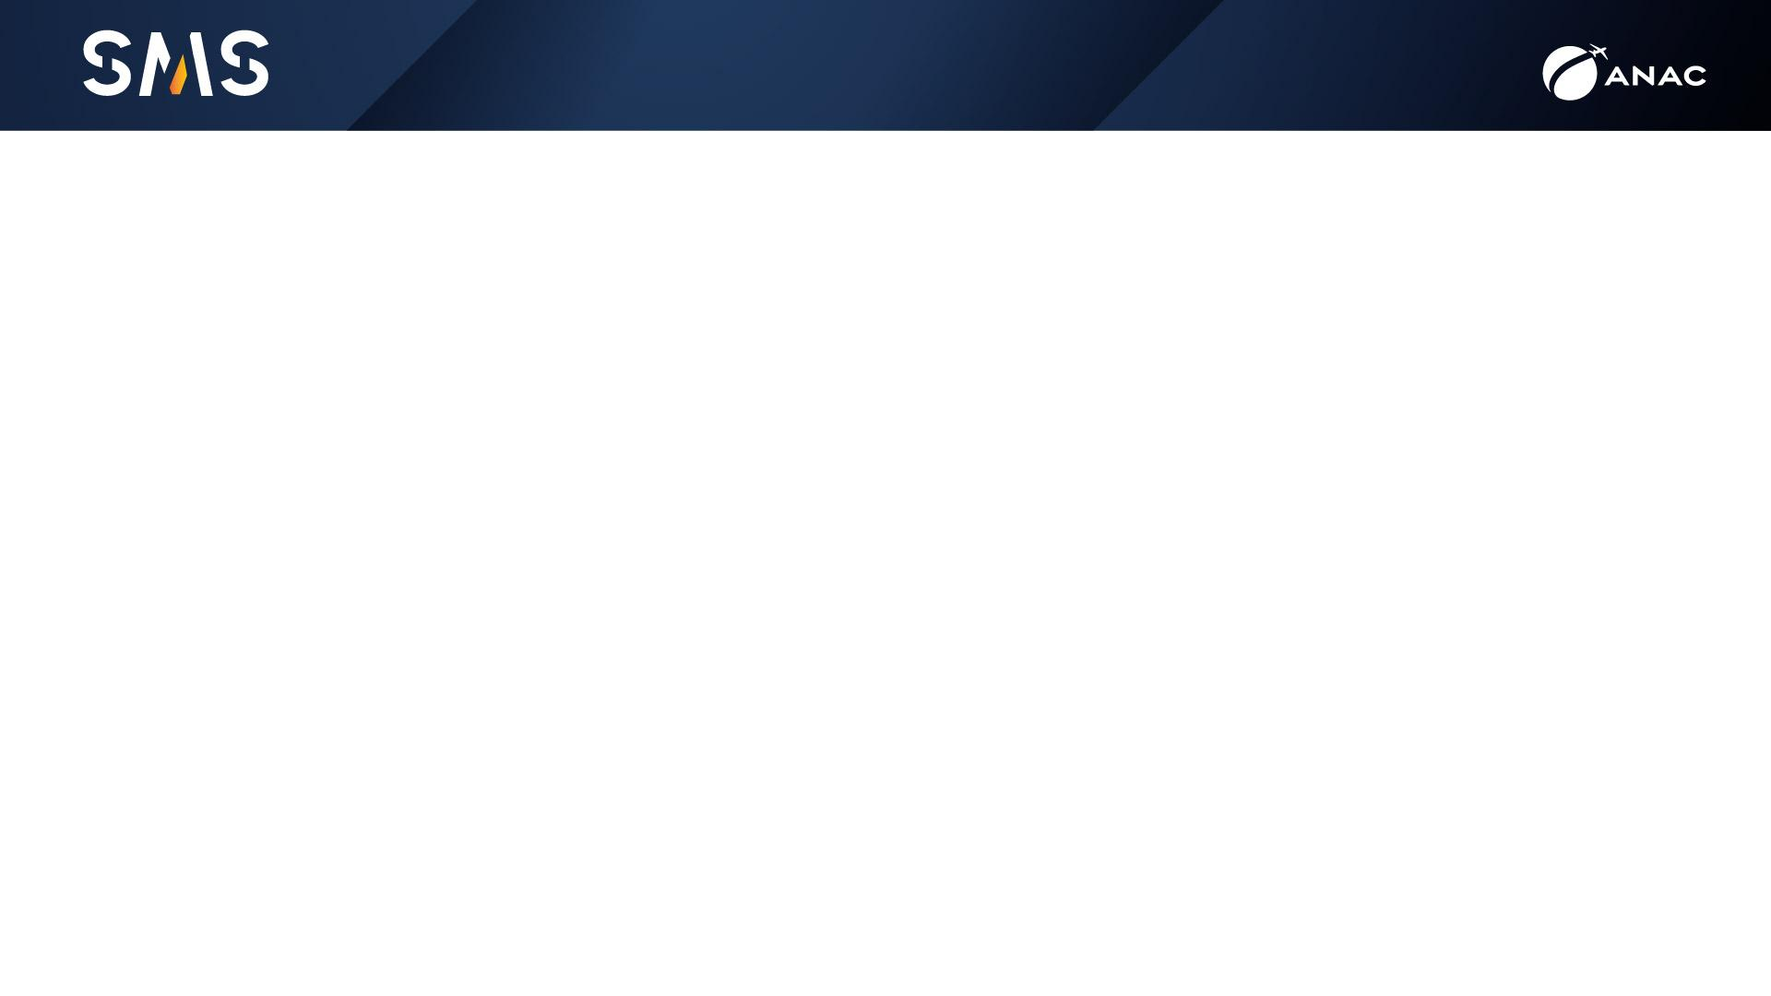
Summary
The purpose of this presentation is to demonstrate the responsibilities and considerations involved in the training of aircraft pilots, thereby enhancing aviation safety.
It provides a brief reflection on which behaviors directly influence operational safety, from instructors to the highest positions in civil aviation schools/CIAC.

Slide 5
Training courses – focus: instruction
Dos cursos de formação – foco: instrução
Curriculum – include legal responsibilities?
2) CIAC/School Responsibility
3) Flight Instructor Responsibility

Slide 6
Flight Instructor Responsibilities
Habits and vices (unpredictable extent of damage, different students)
The art of teaching
Deep knowledge
Patience x assertiveness / Respect, when to praise and when to criticize

Slide 7
Flight Instructor Responsabilities
Ability to inspire doing the right thing
Gaining the student’s trust
Demonstrate the need for perfect instruction, as it is highly desirable
Proper training sequence

Slide 8
Flight Instructor Responsabilities
Analysis of student reactions
High technical standard from the instructor and the same required from the student

Slide 9
Question to yourself
Are you aware that you will continue studying after your Flight Instructor training?
Do you know your limitations and will be able to apply the best teachings in practice?
Why be a flight instructor despite all the responsibilities that come with the profession? Are you only in it for the flying hours?
Their instructors had flaws. Are you repeating their mistakes and shortcomings?

Slide 10




“Lembre-se que da conduta de cada um depende o destino de todos”
Alexandre, O Grande.
Priscila Dower Mendizabal
advpriscilamendizabal
prisciladower@adv.oabsp.org.br
11 93730-4718

Slide 11
