Slide 1






- Airspace Planning Study Group -

Slide 2
OBJECTIVE
Present the Airspace Planning Study Group and the scheduled activities related with safety.

Slide 3
ROTEIRO
The Study Group; and
Products with focus on safety.

Slide 4
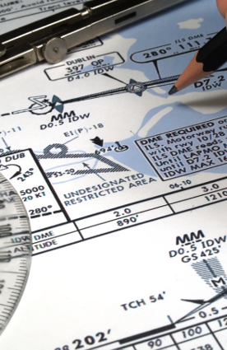
GEPEA
The Study Group

Slide 5
The Study Group
- Airspace Planning Study Group -
GEPEA
Civil Aviation Authority
Aeronautical Authority
Operators 121
Operators 129
Aerodrome Operators
Operators 135
Operators 91
“Permanent forum at the national level capable of bringing together the aeronautical community to discuss opportunities for improvement in the airspace organization and management, taking into account the particularities of the aircraft fleet operating in Brazil.”
(GEPEA Terms of Reference)

Slide 6

The Study Group
- New Needs -
Introduction of new airspace concepts to meet requirements of the aeronautical community, including aspects related with safety;
Introduction of new flight procedures to meet requirements of the aeronautical community, including aspects related with safety;
Optimization of existing flight procedures;
Improvement of national regulations affecting airspace within a collaborative decision-making process (CDM);
Definition of airspace concepts that should be prioritized, within a collaborative decision-making process (CDM); e
Definition of flight procedures that should be prioritized, within a collaborative decision-making process (CDM).

Slide 7

The Study Group
- Profile of Participants -
Airspace planners;
Airspace designers;
Procedures designers;
Civil aviation authority specialists;
Air traffic controllers;
Technical Pilots;
Flight Standards;
Safety; e
Engineers.

Slide 8
The Study Group
- Governance -
GEPEA
WG
SG1
Airspace
SG2
PANS-OPS
SG3
Environment
GADHOC 1
GADHOC 1
GADHOC 1
GADHOC 2
GADHOC 2
GADHOC 2
…
…
…
GADHOC N
GADHOC N
GADHOC N

Slide 9
The Study Group
- Governance -
GEPEA
Members
SG
Members Substitutes
Coordinators
GADHOC
Advisors
Advisors
Reporteur
Advisors

Slide 10
The Study Group
- Governance -
GEPEA
Member
DECEA
Member
ANAC
Member
OPR 129
Member
OPR 121
Member
OPR 135
Member
OPR 91
Mem Subs
DECEA
Mem Subs
ANAC
Mem Subs
OPR 129
Mem Subs
OPR 121
Mem Subs
OPR 135
Mem Subs
OPR 91
Advisor 1
DECEA
Advisor 1
ANAC
Advisor 1
OPR 129
Advisor 1
OPR 121
Advisor 1
OPR 135
Advisor 1
OPR 91
…
…
…
…
…
…
Advisor N
DECEA
Advisor N
ANAC
Advisor N
OPR 129
Advisor N
OPR 121
Advisor N
OPR 135
Advisor N
OPR 91

Slide 11
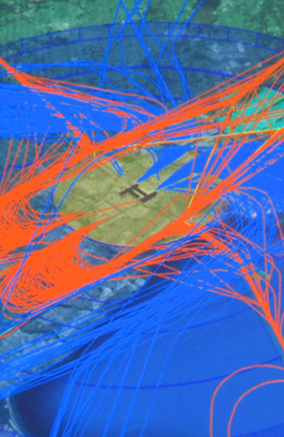
GEPEA
Products with focus on safety
SG1
- Airspace -

Slide 12

SG1/GADHOC CEA
- Airspace Concept-
Process;
Responsibilities; e
Criteria development.
Next Product Delivery: JAN/2019

Slide 13
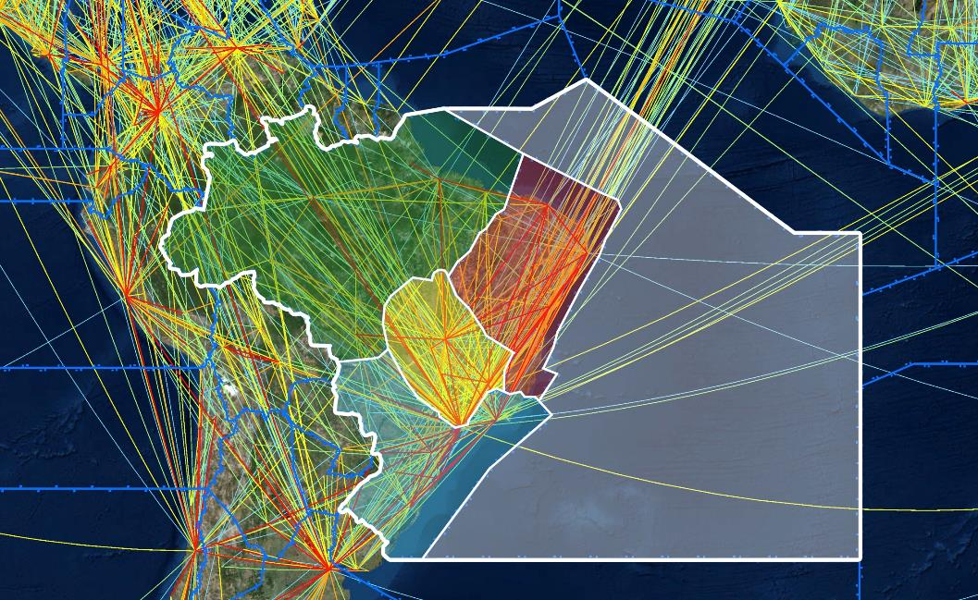
SG1/GADHOC CEA
- Airspace Concept-
An airspace concept provides the outline and intended framework of operations within an airspace. Airspace concepts are developed to satisfy explicit strategic objectives
SAFETY
CAPACITY
EFICIENCY
22.600.000 km²
ENVIRONMENT
ACCESS
Notes:
13

Slide 14
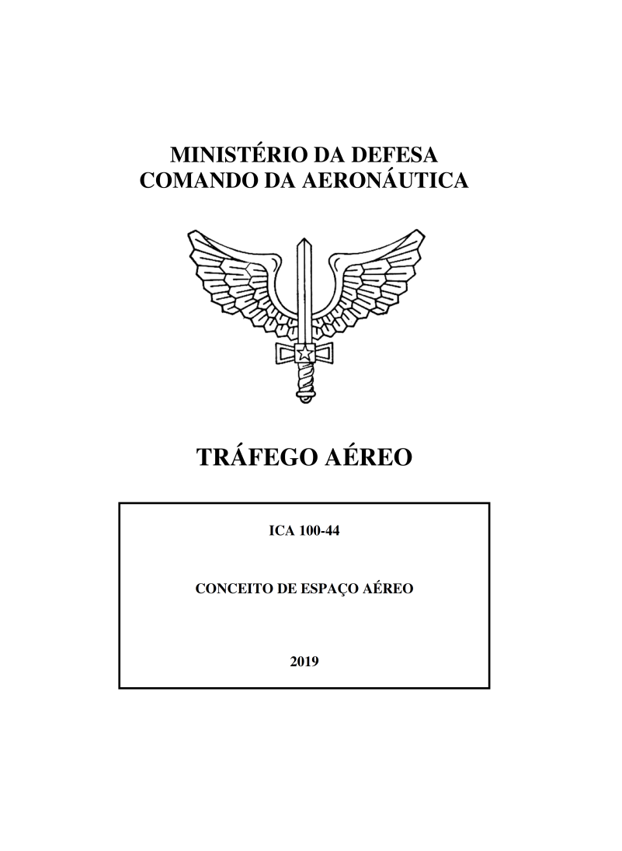
SG1/GADHOC CEA
- Airspace Concept-
Process
Responsibilities
Notes:
14
14

Slide 15
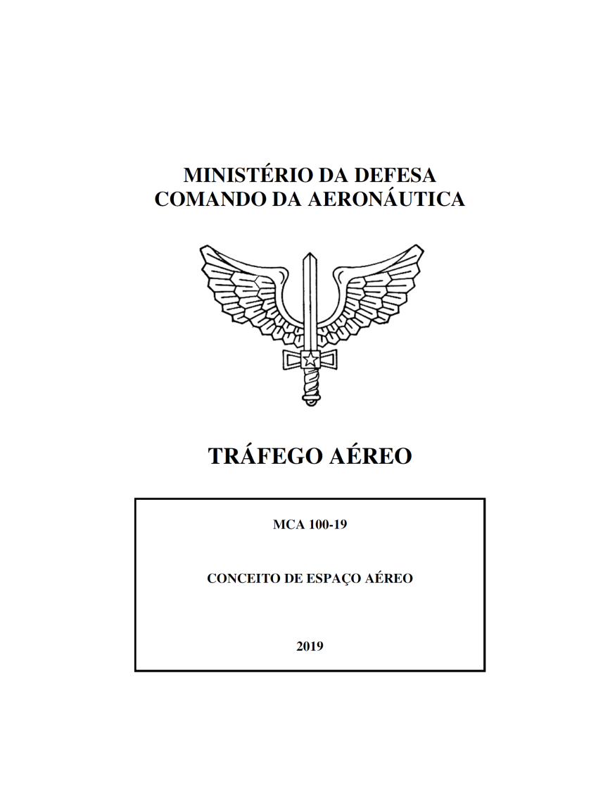
SG1/GADHOC CEA
- Airspace Concept-
Airspace Organization
Scenarios Development
Trajectories Development
Sectorization
Flexible Use of Airspace (FUA)
Key Performance Indicators
Notes:
15
15

Slide 16
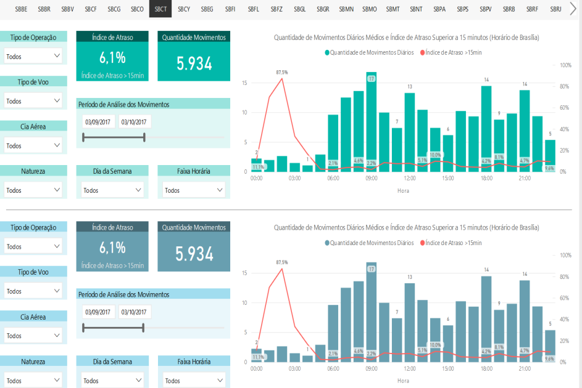
SG1/GADHOC PBN POS IMP
- Pós Implementation Performance -
Implementation of airspace changes;
Indicators; e
Methodology.
Deliverable Date: To be defined

Slide 17
SG1/GADHOC PBN POS IMP
- Pós Implementation Performance -
Safety KPIs
ASR
Incidents
TCAS/RA
Runway Incursion/excursion
Coordination GEPEA/BCAST
Deliverable Date: To be defined

Slide 18
GEPEA
Products with focus on safety
SG2
- PANS-OPS -

Slide 19
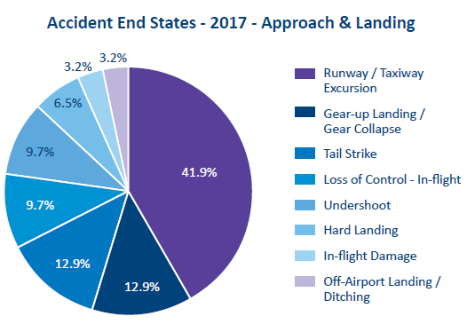
SG2/GADHOC RNAV VISUAL
- RNAV Visual Approach -
Unstable Approaches;
Runway Excursions
CFIT
Violated VSS
SBPS example
Deliverable Date: To be defined

Slide 20

SG2/GADHOC SID RNP-AR
- SID RNP-AR SBRJ -
One of the first in the world;
Increase of efficiency;
Use of available avionics; e
Radius to Fix Leg
* Specific Operational Approval by ANAC is required
Deliverable Date: To be established

Slide 21

GEPEA
Products with focus on safety
SG3
- Environment-

Slide 22
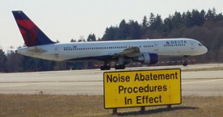
SG3 – Environoment
- Noisy Abatment Procedures-
Criteria Update;
Modern National Airlines Fleet (ICAO stages 3 and 4);
Keep the present level of noisy in the main airports.
Significative fuel savings.
Delivered in JUL 2018

Slide 23
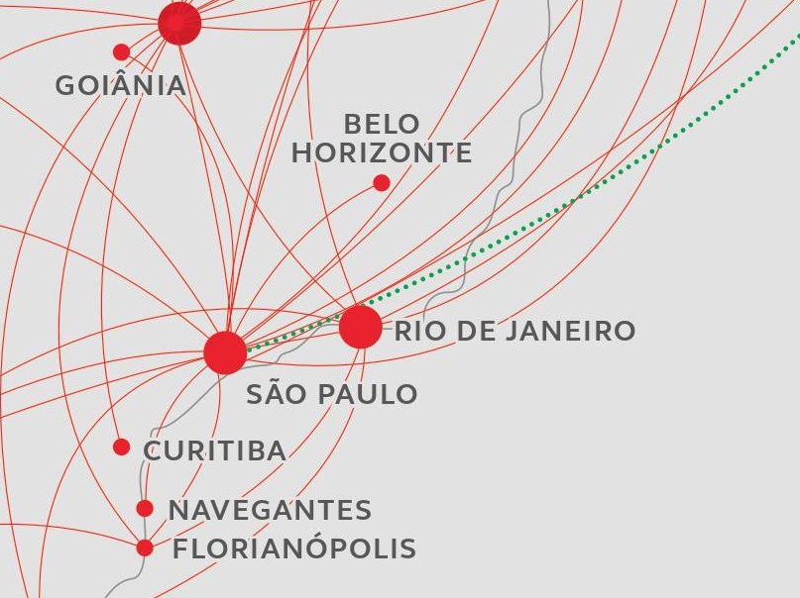
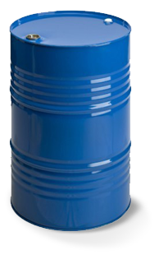
Resultados (Frota Nacional da Aviação Regular)
+ 2.379.690kg
One year fuel savings
1.190
RIO/SAO Flights

Slide 24
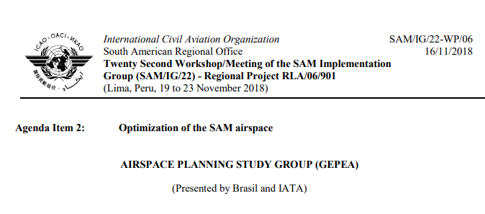
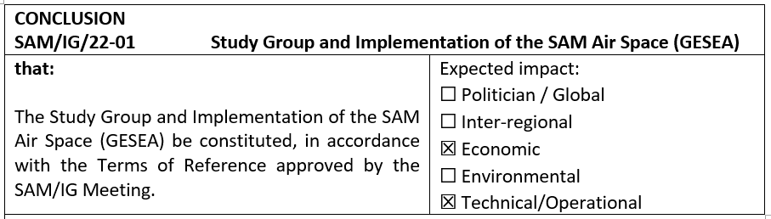
GESEA
- Study Group and Implementation of the SAM Air Space (GESEA)

Slide 25

QUESTIONS?

Slide 26
ROTEIRO
The Study Group; and
Products with focus on safety.

Slide 27
OBJECTIVE
Present the Airspace Planning Study Group and the scheduled activities related with safety.

Slide 28
Julio Pereira
Assistant Director Safety and Flight Operations
(11) 993800953
pereiraj@iata.org
Notes:
28

Slide 29
- Airspace Planning Study Group -

