Slide 1
Import and export procedures of fresh fruit and vegetables to/from the EU
Guy Lambrechts,
Department of Agriculture and Fisheries
Division Policy coordination
Senior expert Market and Agrifood Supply Chain

Slide 2
Outline presentation import export
Introduction
Marketing Standards
Other import and export requirements
Custom duties
Entry price
Additional import duties
Special safeguard clause
Import licences
Trade preferences - TRQ
SPS

Slide 3
Import export FFV EU
Source: EU Eurostat (Comext)

Slide 4
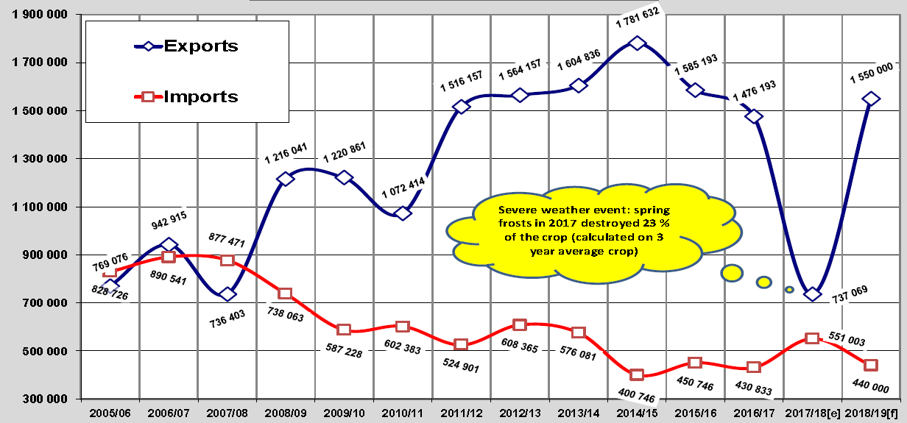
Import export apples

Slide 5
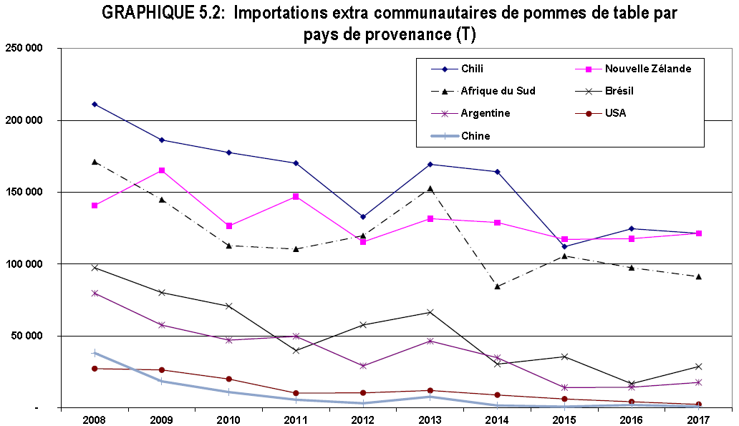
Import apples from 3rd countries

Slide 6
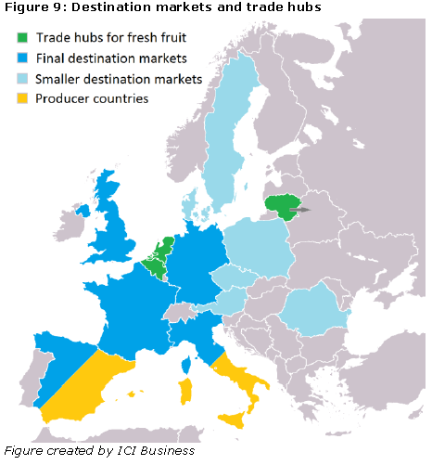

Slide 7
Is import the enemy of EU farmers?
yes | No/ or less
in same season | in counter season
in overlapping season
in large quantities | in low quantities
at low prices | at comparative price level
of dubious quality | of lesser quality
 | different varieties/colours
 | keeps consumer eating f&v
 | for exotic produce

Slide 8
Produce arriving in the EU:
Customs except declarations for free circulation if:
there is a conformity certificate
competent authority informs customs that
a conformity certificate had been issued
a conformity certificate is not needed (on basis of risk assessment)
EU may accept conformity check carried out by 3rd countries
List in annex of regulation 543/2011
Switzerland, Morocco, South Africa, Israel, India, New Zealand, Senegal, Kenya, Turkey

Slide 9
Quality inspection import
imports of f&v from third countries into the EU have to comply with the EU marketing standards

Slide 10
Document control at Import
Import shipments must be accompanied by official documents from the country of origin. The presence and accuracy of this will be checked.

Slide 11
Approved 3rd country
No new requests since 2013
Procedure
Written request of the country in question
Exchange of letters
Used standards: the Union marketing standards, or at least equivalent standards (UN/ECE), are met for products exported to the Union.
description of the inspection system in place
competent authorities
official bodies or bodies officially recognised by the authority
provide satisfactory guarantees and dispose of the necessary personnel, equipment and facilities to carry out checks
structure of inspection service, number of staff, equipment…
border controls
approval may only apply to products originating in the 3rd country concerned and may be limited to certain products.
Potentially a physical visit
Fulfilment of conditions of article 15.2 et 15.3 regulation (EU) 543/2013

Slide 12
Future?
European Commission does not intent to change policy
End of 2019 COM will make an evaluation on marketing standards
In current tabled proposals concerning the common agricultural policy after 2020 (CAP 2020) nothing is changed
EU can withdraw recognition
If significant number of lots or quantities do not corresponding to the information in the certificates of conformity

Slide 13
Goods exported
Approved coutry
Conformity certificate
Notification to inspection authority
Not approved country
Notification to inspection authority
Risk analysys
Physical inspection
+ conformity certificate
Confirmation that no inspection was necessary
Customs procedures will proceed
Eventual control by inspection service at import 5%

Slide 14
Quality F&V – Dynamic import Inspection percentages
The inspection percentages for the quality control for the import of fruit and vegetables are determined annually on the basis of the inspection results of the previous year according to a system of risk analysis as stated in Regulation EU No. 543/2011.
If the risk for a certain combination of product and country of origin is assessed as low or high, the inspection percentage is adjusted.
If products originate from recognized third countries and the shipment is accompanied by a certificate of inspection, an inspection rate of 5% applies.

Slide 15
Prior notification import & export
Sea transport: 24 u in advance
Air transport: day before or other agreed timeframe
for example 6 h before flight
If notified before 15h inspection on next day AM
If notified after 15h inspection next day PM
products that go from one specified consignor to the same destination and are available at the same time for inspection can be processed with one registration
1 standard inspection certificate is issued whereby a consignment is a quantity of goods that are transported with 1 vehicle and are accompanied by 1 transport document → more truck more certificates
There might be a charge for the issued certificates

Slide 16
When you apply for a certificate of conformity, the authority or electronic system assigns the consignment to a risk category, This risk assessment can take place in advance of the produce arriving.
The risk categories are:
high risk – where possible, all consignments in this category are physically inspected
medium risk – an inspector will decide whether a physical inspection is necessary
low risk – these consignments are automatically granted a certificate of conformity
Physical inspections usually take place at the point of entry of your consignment. However, if you apply for - and meet - the requirements of the local clearance procedure within Customs Freight Simplified Procedures, the inspections may be at the premises of the importer.

Slide 17
For a consignment that is not selected for inspection at import, proof of notification will be given in order to inform the customs
If the application is approved
If the consignment is assessed as low-risk or if it passes inspection, then:
its status is updated in the database
Release or conformity certificate issued
the shipment can be customs cleared

Slide 18
Disapproval: If product does not meet the standards
If the product does not meet the marketing standards, a rejection will follow.
If an inspector finds missing or incorrect labelling information or quality issues with your consignment.
The inspection will notify and will issue a refusal of entry certificate
The importer must decide what action he want to take to bring the goods into conformity with the marketing standards (eg by amending the labelling or designating the produce for a different use)
He must tell the inspector what action he will take and where it will take place and he should notify the inspector when the action has been taken
The inspector will re-inspect the consignment and issue a certificate of conformity if it passes
The produce won’t be allowed into free circulation until a re-inspection has taken place and a certificate of conformity issued.

Slide 19
Import inspection %
The inspection percentages for the quality control of fruit and vegetable exports are determined on the basis of risk analysis.
Example of percentages:
60% inspection for shipments with one or more of the 10 products with a specific marketing standard.
60% inspection for combination shipments of products with a specific and general marketing standard.
10% inspection for shipments containing only products with a general marketing standard.
5% inspection for export of fruit and vegetables from approved traders

Slide 20
Main problems with standards
Quality issues
some developed during transport
some should have been seen before shipping
Grading
Labelling
origin
name of varieties <> trade names <>mutants (apples)
identification of exporter, packer, producer

Slide 21
What is not harmonized within EU :
Cost recovery of inspections
Penalties

Slide 22
Custom duties

Slide 23
When declared to customs in the Community, goods must generally be classified according to the Combined Nomenclature or CN.
Imported and exported goods have to be declared stating under which subheading of the nomenclature they fall.
This determines which rate of customs duty applies and how the goods are treated for statistical purposes.

Slide 24
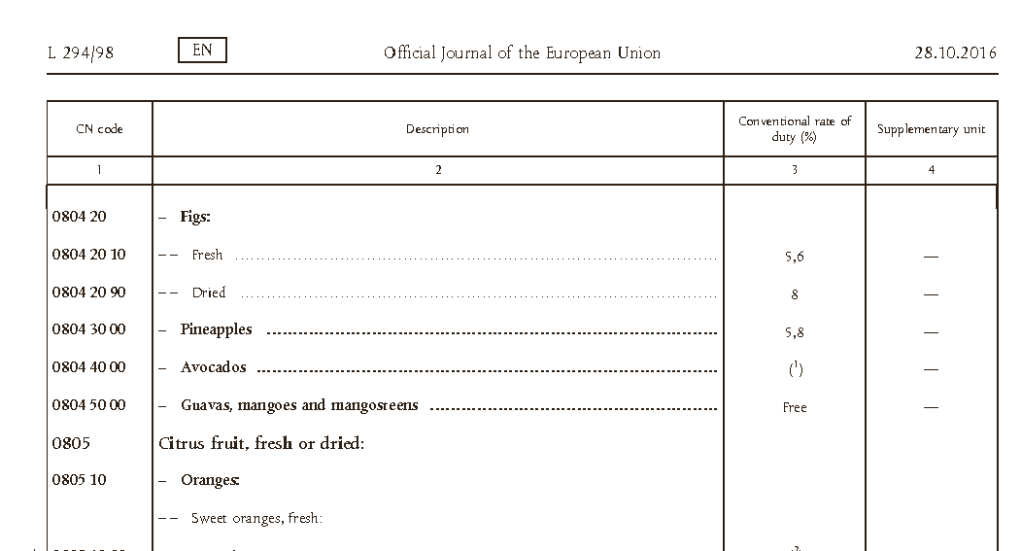

Slide 25
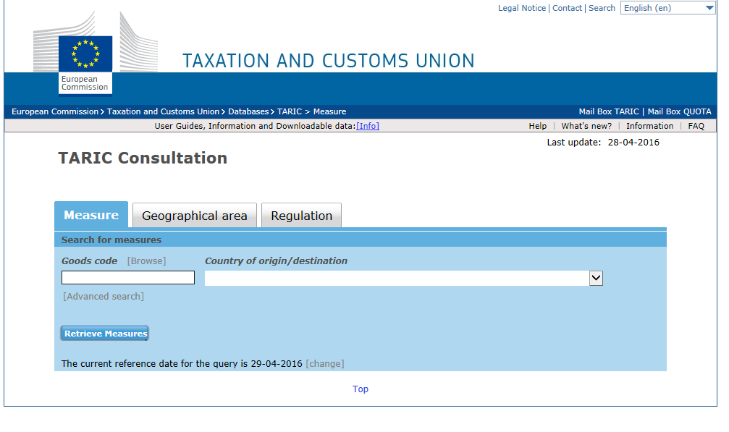
Ad-valorem duty
% based on custom value of the product
WTO consolidated
Preferential tariffs
Zero tariffs
Tariff rate quota
http://ec.europa.eu/taxation_customs/dds2/taric/taric_consultation.jsp

Slide 26
FTA Free trade agreements
FTA designed to create opportunities:
opening new markets for goods and services
increasing investment opportunities
making trade cheaper - by eliminating substantially all customs duties
making trade faster - by facilitating goods' transit through customs and setting common rules on technical and sanitary standards
making the policy environment more predictable - by taking joint commitments on areas that affect trade such as intellectual property rights, competition rules and the framework for public purchasing decisions
In return, partner countries can negotiate preferential tariffs for the export of fresh products to the EU.

Slide 27
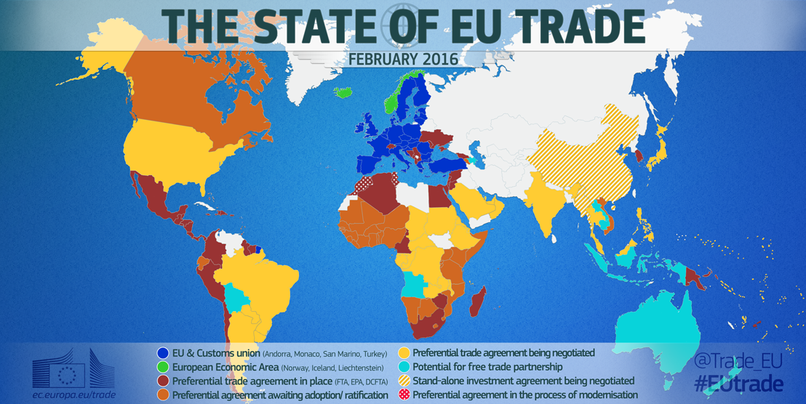

Slide 28
Preferential Tariff rate quota (TRQ)

Slide 29
TRQ (tariff rate quota)
Based on international agreements
TRQ permit:
a specific quantity of imported merchandise to be released into free circulation in the EU
at a reduced rate of customs duty (or even 0-tariff) or combination
during the quota period
quantities entered during quota period in excess of quota quantity of period subject to higher duty rates.
Notes:
Tariff-rate quotas, by definition, involve having imports of a good within a certain quota facing lower tariffs, relative to any imports above that quota threshold.

Slide 30
Tariff quotas administered
in a manner that avoids any discrimination between the operators based on a method:
simultaneous examination method
first come, first served
in proportion to the quantities requested
chronological order of applications
traditional/newcomers method
taking traditional trade patterns into account

Slide 31
Example strawberries form Israel:
normal duty (erga omnes) period 1/1- 30/4 11,20%
for Israel preferential tariff is 4,4%
But within a TRQ of 500.000 tons 0%

Slide 32
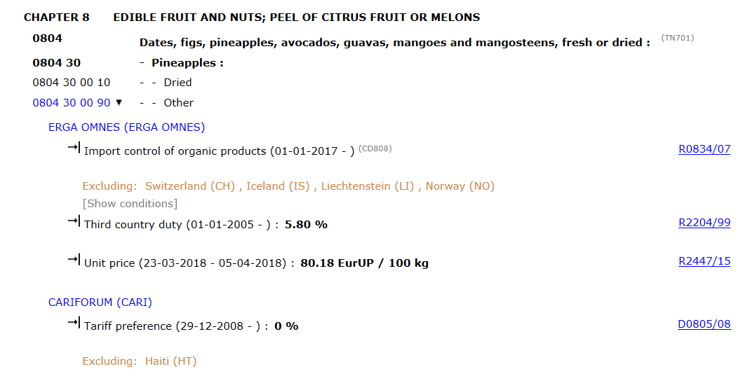

Slide 33
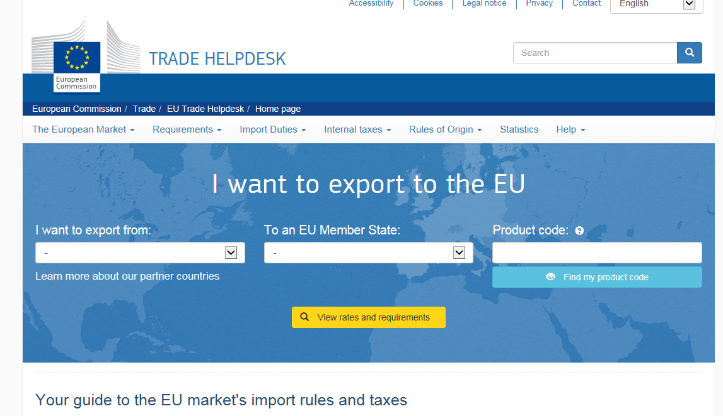
http://trade.ec.europa.eu/tradehelp/

Slide 34
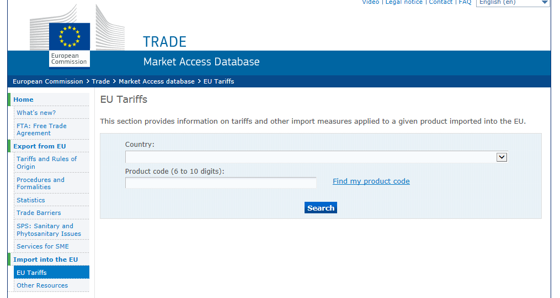
http://madb.europa.eu/madb/euTariffs.htm

Slide 35
Entry price
To avoid market disturbance by import at low prices
Functions as a kind of minimum import price
List of sensitive products

Slide 36
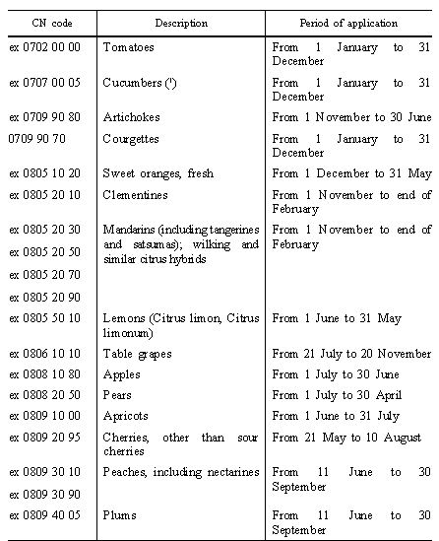

Slide 37
Import price is
Price on invoice
Or a standard import value calculated by the EU-Commission for each product and for each origin
IP
Entry Price
EP
Tariff Equivalent
will apply
IP

Slide 38
Goods must respect entry price
If not, a gradual tariff equivalent (TE) will be charged
* Only for apples in period 1/4 and 30/6
Import price lower than entry price | Amount in percentage of entry price
between 98 % and 100% | 2%
between 96 % and 98% | 4%
between 94 % and 96% | 6%
between 92 % and 94% | 8%
lower than 92 % | MTE
between 90 % and 92%* | 10%*
between 88 % and 90%* | 12%*
lower than 88%* | MTE*

Slide 39
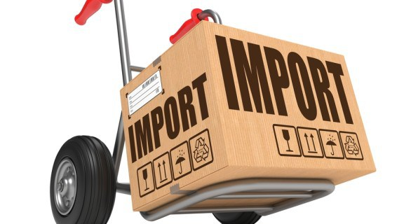
Additional import duties

Slide 40
Additional duties
Additional import duty may be applied to prevent or counteract adverse effects on the EU-market because of large volumes
List of products (annex regulation 543/2011)
Tomatoes, cucumbers, artichokes, courgettes, oranges, clementines, mandarins, lemons, table grapes, apples, pears, apricots, cherries, peaches and nectarines, plums
Trigger volumes
Based on domestic consumption (taking into account production, import export)
Additional duty shall be levied if the quantities put into free circulation exceeds the trigger volume
unless the imports are unlikely to disturb the union market
1/3 of customs duty

Slide 41
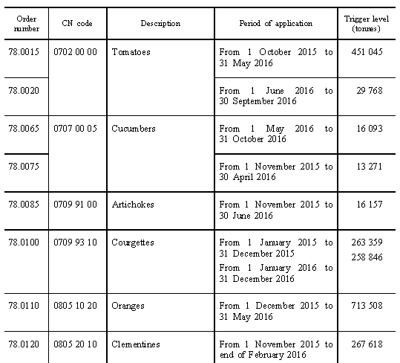

Slide 42
Saveguard measures

Slide 43
Safeguard measures
On request of MS
Or on initiative of Commission
Urgency procedure possible
Information and consultation period
Investigation procedures
Surveillance
for the purposes of monitoring the trend of these imports,
limited period of validity
Safeguard measure
Where a product is imported into the Community in such greatly increased quantities or on such terms or conditions as to cause, or threaten to cause, serious injury to Community producers
import authorisation

Slide 44
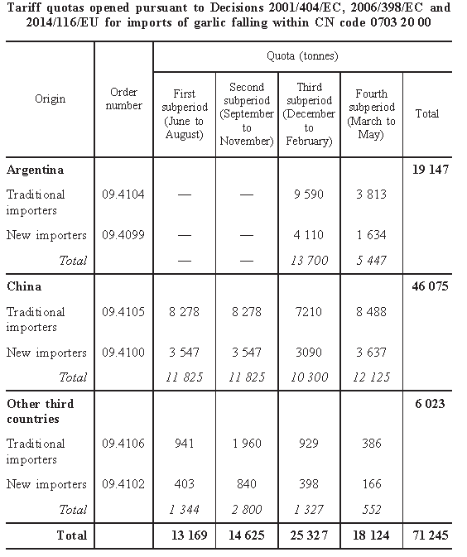
Import licenses garlic
(regulation EU 341/2007)
Licence security
Refunded if imported at
least 95%
→Certificate of origin needed

Slide 45
Import licenses of Preserved Mushrooms
Country of Origin | Quota application period is from 1 January to 31 December | Total Quota (tonnes)
China | Traditional Importers (95%) New Importers (5%) | 28,950 tonnes (drained net weight)
Other Third Countries | Traditional Importers: New Importers: | 5,030 tonnes (drained net weight)

Slide 46
Technical barriers to trade

Slide 47
phytosanitary measures – reciprocity?
EU operates with an open plant import system, which allows countries to import into EU member states as long they comply with plant health directive 2000/29.
EU exporters meanwhile will in many cases have to instruct their national plant protection authorities to negotiate bilateral protocols for each commodity with the respective national plant protection office of the destination concerned.

Slide 48
SPS Sanitary and Phyto-sanitary barriers to trade
country | product | MS concerned | SPS barrier resolving action
Canada | Apples and pears | BE, PL | Lift of barrier
 | apples | FR | Lift of barrier
USA | Apples and pears | PL , PT
Brazil | Pears | NL, BE | Import requirements published
 | Table grapes | PT | Import requirements published
 | Strawberry plants | ES | Import requirements published
Colombia | Pears | PT | Approval of imports

Slide 49
Questions?
Guy.lambrechts@lv.vlaanderen.be

